Slide 1
Week 10

Slide 2
Homework 9
Use D-segment algorithm to find CNVs.
Input: Number of read starts at each genomic position (1,2,>=3).
Use a Poisson model of read counts given copy number.

Slide 3
Poisson distribution
Probability of observing k counts given a mean of λ counts:
Probability of observing 3 or more counts:

Slide 4
Score
Emission probability of r reads:
Score associated with being in CNV given r observed reads:

Slide 5
D-segment algorithm
cumul = max = 0; start = 1
for (i = 1..N) {
cumul += score[i]
if cumul ≥ max: max = cumul; end = i
if (cumul ≤ 0) or (cumul ≤ max) or (i == N) {
if max ≥ S: output(start, end, max)
max = cumul = 0; start = end = i+1
}
}

Slide 6
How to organize a computational biology project

Slide 8
Principles
Someone unfamiliar with your project should be able to understand what you did and why.
Everything you do, you will have to do over again.

Slide 9
How not to organize a project
source/
<big, complicated program>
tests/

Slide 10
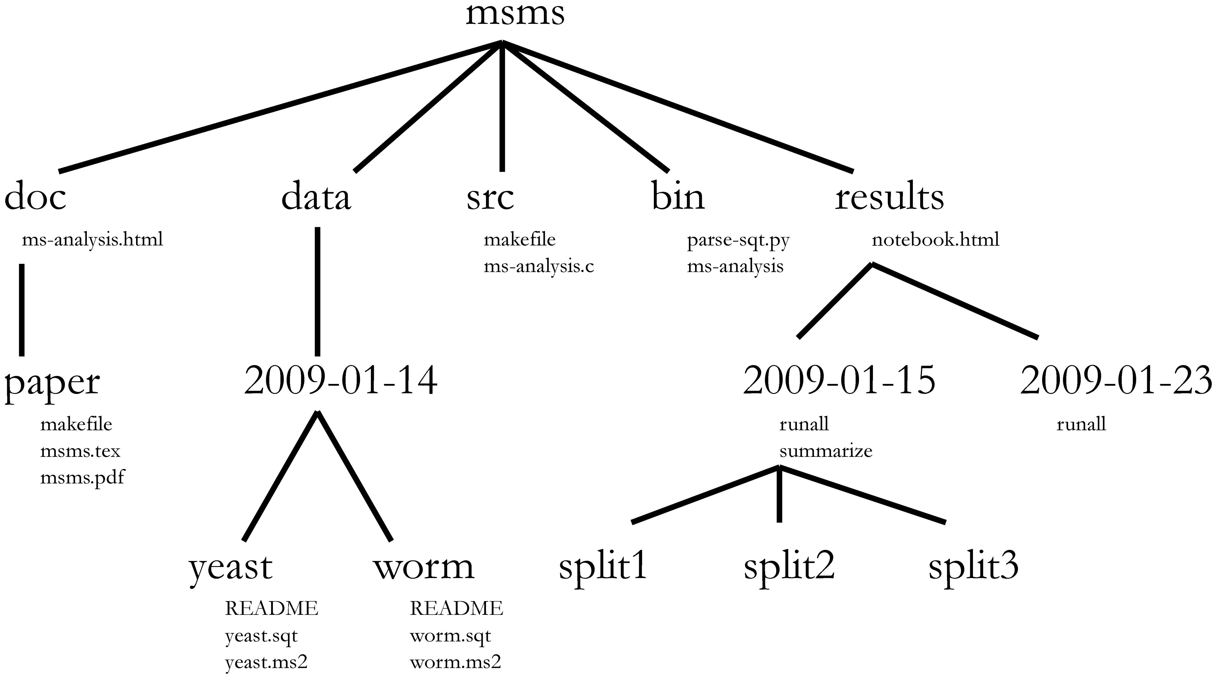
Files and directories

Slide 11
Carrying out a single experiment
A single driver script should carry out a full experiment.
The driver script should take no arguments.
Avoid editing intermediate files by hand.
Store all file and directory paths in the driver script.
Use relative paths.
Make the script restartable:
if (<output file does not exist>) then <perform operation>

Slide 12
Handling errors
Check for errors whenever possible.
When an error occurs, abort.
Create each output file using a temporary name, then rename the file when it is complete.

Slide 13
File and directory names
<id>_<date>_<brief description>
Example:
05_2015-03-12_logistic_regression

Slide 14
The information in a filename is contained in both the filename and its path
Bad:
predict_gene_expression/predict_gene_expression_using_logistic_regression/predict_gene_expression_using_logistic_regression_test_using_alpha=1
Good:
predict_gene_expression/logistic_regression/alpha=1

Slide 15
Source directories
Include only mature code with a defined specification.
Bad:
predict_gene_expression(histone mods)
Okay:
optimize_logisitic_regression_using_gradient_descent(features, labels)
Don't be afraid to copy/paste code between experiment directories.

Slide 16
Version control
Check in every hour or so, so you can roll back bad changes.
Check in any and only files that you have edited by hand.

