Slide 1
GS 540 Week 4

Slide 2
HW3
Multiple sequence alignment
Dynamic programming on an edit graph using a scoring matrix

Slide 3
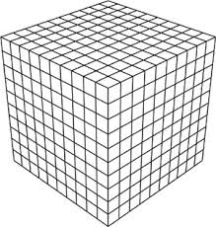
HW3: Dynamic programming matrix
MYPSIKETMRVQLSMEG
MYPWIKETMRSKVYMEG
MSVIATQMTYKVYMSGTV

Slide 4
HW3: Dynamic programming matrix
MYPSIKETMRVQLSMEG
MYPWIKETMRSKVYMEG
Algorithm: compute scores in dynamic programming matrix, then follow traceback
MSVIATQMTYKVYMSGTV

Slide 5
HW3: Updating a DP cell
A
0,0,1
1,0,1
C
Seven options:
- Match all three
characters
- Gap one character
- Gap two characters
0,0,0
1,0,0
B
1,1,1
0,1,1
0,1,0
1,1,0

Slide 6
HW3: Updating a DP cell
A
0,0,1
1,0,1
C
Option 1: Match all three.
s(A,B) + s(B,C) + s(A,C)
0,0,0
1,0,0
B
1,1,1
0,1,1
0,1,0
1,1,0

Slide 7
HW3: Updating a DP cell
A
0,0,1
1,0,1
C
Option 2: Gap 1 character
s(A,C) + s(C,-) + s(A,-)
0,0,0
1,0,0
B
1,1,1
0,1,1
0,1,0
1,1,0

Slide 8
HW3: Updating a DP cell
A
0,0,1
1,0,1
C
Option 3: Gap 2 bases
s(A,-) + s(A,-) + s(-,-)
0,0,0
1,0,0
B
1,1,1
0,1,1
0,1,0
1,1,0

Slide 9
HW3: Data structures
Score matrix:
map(character -> map(character -> score))
Sequences:
string, char[L]
DP matrix:
cell[L1][L2][L3]
cell: {score, traceback1, traceback2, traceback3}

Slide 10
HW3: Optimal subalignment
Full alignment:
Match:
KKK
DLK
YWY
G--
LFL
KVN
REH
IPI
QRQ
KPN
SNS
AVV
FFF
MVE
Score:
-5
-2
+1
-10
-7
+5
+4
+8
+2
+6
-3
+1
-7
-4
Find maximum-score subalignment.
- Use HW2 code.

Slide 11
HW3: Pseudocode
Read sequences
Read score matrix
Iterate over matrix, filling in score of each cell.
Follow traceback from final cell.
Find optimal subalignment.

Slide 12
HW4
Given this sequence of bases:
What’s the likelihood that
AGACAAGG
(M1) bases were selected from distributions corresponding to sites in a tss
(M2) bases were selected from distributions corresponding to sites not in a tss

Slide 13
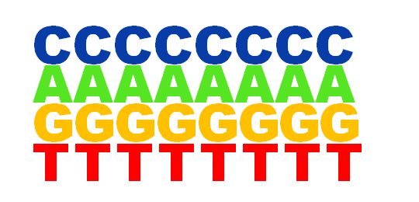
HW4
Create a position-specific weight matrix for transcription start sites
Use it to score true start sites
Use it to find potential unannotated start sites
M1
Log likelihood ratio:
p(sequence)|M1
p(sequence)|M2
Which model is more likely to have generated this sequence?
AGACAAGG
Log( )
Log( )
M2

Slide 14
Remember log arithmetic!
p(seq) = p(b1) * p(b2) * p(b3) * …p(bn)
log(p(seq)) = log(p(b1)) + log(p(b2)) + …log(p(bn))
log(p(seq)|M1)
log(p(seq)|M2)
log(p(seq)|M1)
log(p(seq)|M2)

Slide 15
Frequentist vs. Bayesian statistics

Slide 16
Frequentists
Bayesians

Slide 17
Frequentists and Bayesians agree on laws of probability
Probability
P(E) + P(¬E) = 1
P(A|B) = P(A,B) / P(B)
Frequentists
Bayesians

Slide 18
Frequentists and Bayesians disagree on how to apply probability to science
World
Bayesians apply probabilities to this
Frequentists apply probability to this
experiment,
process, etc.
Data

Slide 19
Frequentists and Bayesians disagree on how to apply probability to science
Do cigarettes cause cancer?
Bayesians apply probabilities to this
Frequentists apply probability to this
experiment,
process, etc.
Lifetimes of people who smoke and don't

Slide 20
Using Bayesian statistics, you refine your model of the world based on data
Do cigarettes cause cancer?
p(cause cancer | data) =
p(data | cause) p(cause) /
(p(data | cause) p(cause) +
p(data | don't cause) p(don't cause))
Lifetimes of people who smoke and don't
"prior"

Slide 21
Using frequentist statistics, you evaluate the probability that your model matches the truth
Do cigarettes cause cancer?
experiment,
process, etc.
Frequentists apply probability to this
Lifetimes of people who smoke and don't
maximum
likelihood model
Hypothesis

Slide 22
When to use frequentist vs. Bayesian statistics
Both methods are usually equivalent.
Frequentist statistics is the norm:
p-values, confidence intervals
Frequentist inference is usually more efficient.
We are usually actually interested in probabilities about the world (Bayesian), not probabilities about our model (frequentist).
For this reason, frequentist models can have perverse results.

