Slide 1
GS 540 week 5

Slide 2
What discussion topics would you like?
Past topics:
General programming tips
C/C++ tips and standard library
BLAST
Frequentist vs. Bayesian methods
Applications of HMMs

Slide 3
What discussion topics would you like?
Potential topics:
(Methods in comp-bio)
Practical programming topics
  Reading and writing binary files
  Managing packages in Unix
  How to organize a comp-bio project
Machine learning

Slide 4
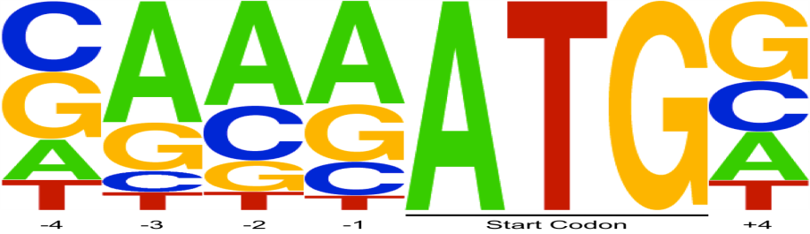
HW4
  Given this sequence of bases:
What’s the likelihood that
AGACAAGG
  (M1) bases were selected from distributions corresponding to sites in a tss
  (M2) bases were selected from distributions corresponding to sites not in a tss

Slide 5
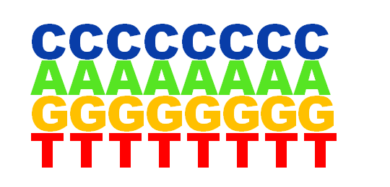
HW4
Create a position-specific weight matrix for transcription start sites
Use it to score true start sites
Use it to find potential unannotated start sites
M1
Log likelihood ratio:
p(sequence)|M1
p(sequence)|M2
Which model is more likely to have generated this sequence?
AGACAAGG
Log( )
Log( )
M2

Slide 6
File format
Genbank:
<gene entries> (use CDS)
<sequence> (compute complement)
Extract -10 bp through +10 bp (21 bp total)
join(10..16,20..30) :
0,1,2,3,4,5,6,7,8,9,10,11,12,13,14,15,16,20,21,22,23

Slide 7
HW4 Tips
Keep values in float form during calculations
Round (not truncate!) decimals to 3 places when printing
Add 1 pseudocount to count matrices
Exons in 'join' lists may be only one base long.
CDS entries may extend more than one line
Calculate background frequencies from forward and back strand
Do not include N’s when calculating frequency
  freq(‘A’) = count(‘A’)/count(‘A|C|G|T’)
CDS complement(join(132051..135534,135646..136126,
136241..138530,138820))

Slide 8
Remember log arithmetic!
p(seq) = p(b1) * p(b2) * p(b3) * …p(bn)
log(p(seq)) = log(p(b1)) + log(p(b2)) + …log(p(bn))
p(seq|M1)
p(seq|M2)
log(
)
= log(p(seq|M1)) - log(p(seq|M2))

Slide 9
HW5

Slide 10
HW5: Find C+G rich regions using an HMM
background
C+G rich

Slide 11
HMM basics
Given a sequence, and state parameters:
  Each possible path through the states has a certain probability of emitting the sequence
  P(O|M)
Probability of emitting this sequence from this state path given e-probs
Probability of taking this state path given t-probs
Joint Probability
sequence
(emissions)
A C G T A G C T T T
.04
.01
.0004
.10
.04
.0040
state paths
.02
.03
.0006
.06
.08
.0048

Slide 12
Viterbi Algorithm
.0004
.0040
.0006
Joint Probability
A C G T A G C T T T
.0048
sequence
.0004
.04
.01
…
.04
.0040
.10
states
.0006
.02
.03
.0048
Highest weight path
.06
.08

Slide 13
Applications of HMMs

Slide 14
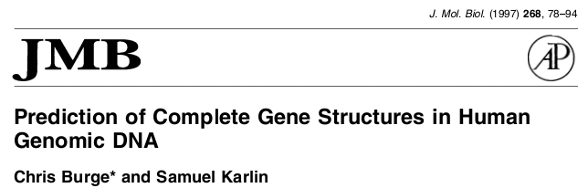
GENSCAN
Used to predict genes ab initio in the initial sequencing of the human genome

Slide 15
Gene detection: GENSCAN
Probabilistic model of gene structure
Identifies
  Transcription and splice sites
    Based on signal motifs
    Position weight matrix (extended)
  Exon/intron/intergenic regions
    Based on composition
    Hidden Markov Model
Today: PWM Emission Probabilities

Slide 16
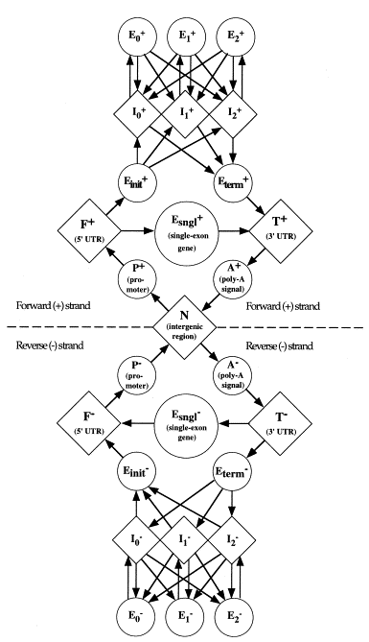
GENESCAN
HMM
Architecture

Slide 17
GENESCAN
HMM
Architecture

Slide 18
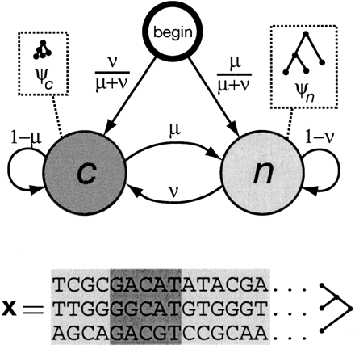
Evolutionary conservation: phylo-HMM
Siepel et al. Evolutionarily conserved elements in vertebrate, insect, worm, and yeast genomes. Genome Res. 15, 1034-1050 (2005).
Based on a two-state phylogenetic hidden Markov model (phylo-HMM)
  using genome-wide multiple alignments
  fits a phylo-HMM to the data by maximum likelihood
  Predicts conserved elements

Slide 19
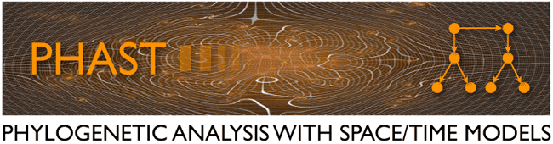
phastCONS
original engine behind the evolutionary conservation tracks in the UCSC Genome Browser
DESCRIPTION: Identify conserved elements or produce conservation scores, given a multiple alignment and a phylo-HMM. By default, a phylo-HMM consisting of two states is assumed: a "conserved" state and a "non-conserved" state. Separate phylogenetic models can be specified for these two states

Slide 20
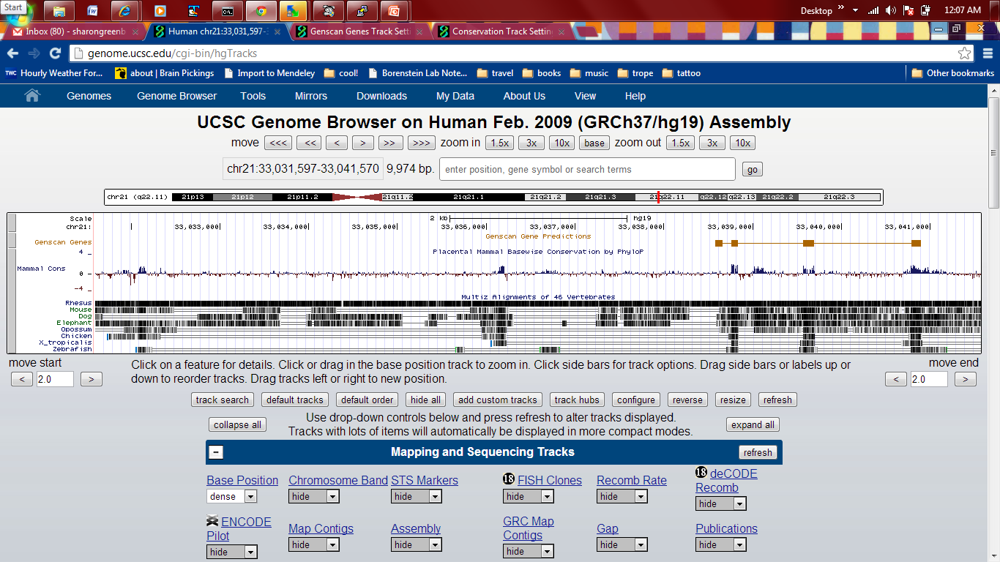
UCSC Genome Browser
http://genome.ucsc.edu/cgi-bin/hgTrackUi?hgsid=325902171&g=cons46way&hgTracksConfigPage=configure

Slide 21
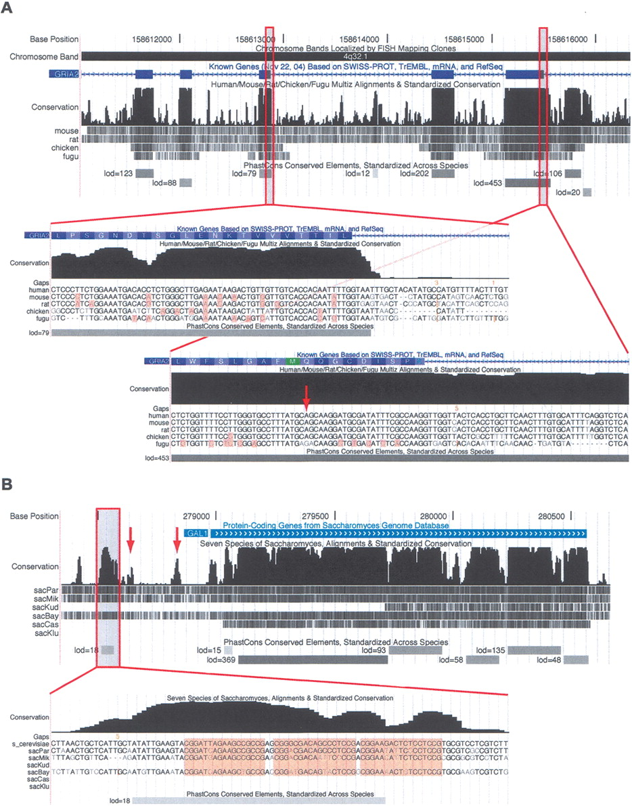
GRIA2, exons7-11, human
Notes:
exons 7–11 of the RNA-edited human gene GRIA2. A 158-bp conserved noncoding element can be seen near the 3′ end of exon 11. This conserved element includes the editing complementary sequence (ECS) of the RNA editing site in exon 11. Q->R [glutamine to arginine] by making CAG->CGG [really CIG – Inosines]. Requires base-pairing of RNA, which is encoded overlapping this region.

Slide 22
GAL1 promoter, S. cerevisiae
Notes:
The conserved element shown at bottom overlaps three GAL4-binding sites (highlighted in base-level view). A fourth GAL4-binding site also is reflected by a small bump in the conservation scores (left arrow), as is the promoter itself (right arrow).
Screen shots of the conservation tracks in the (A) human and (B) S. cerevisiae UCSC Genome Browsers. Each conservation track has two parts, a plot of conservation scores, and beneath it, a display showing where each of the other genomes aligns to the reference genome. (Darker shading indicates higher BLASTZ scores; white indicates no alignment.) A separate track labeled “PhastCons Conserved Elements” shows predicted conserved elements and log-odds scores.
In A, exons 7–11 of the RNA-edited human gene GRIA2 are shown. Peaks in the conservation plot generally correspond to exons and valleys to noncoding regions, but a 158-bp conserved noncoding element can be seen near the 3′ end of exon 11. This conserved element includes the editing complementary sequence (ECS) of the RNA editing site in exon 11. The displays seen when zooming in to the base level at a typical exon (left) and in the region of the RNA editing site (right; see arrow) are shown as insets. On the left, several synonymous substitutions are visible (highlighted bases) and the elevated conservation abruptly ends after the splice site, while on the right, there are fewer synonymous substitutions and the elevated conservation extends into the intron. In the base-level display, the vertical orange bars and numbers above them indicate “hidden” indels and their lengths—i.e., deletions in the human genome or insertions in other genomes.
In B, the S. cerevisiae GAL1 gene and 5′-flanking region are shown. Strong cross-species conservation can be seen in the regulatory region upstream of the promoter, as well as in the protein-coding portion of the gene. The conserved element shown at bottom overlaps three GAL4-binding sites (highlighted in base-level view). A fourth GAL4-binding site also is reflected by a small bump in the conservation scores (left arrow), as is the promoter itself (right arrow).

Slide 23
Semi-automated genome annotation: discover functional elements from functional genomics assays

Slide 24
Semi-automated genome annotation

