Slide 1
Week 8

Slide 2
Homework 7
2 state HMM
State 1: neutral
State 2: conserved
Emissions: alignment columns
Alignment of human, dog, mouse sequences
human
dog
mouse
A
A
T
A
-
A
C
C
C
1
1
1
0
2
2
2

Slide 3
Homework 7 tips
Do just one Viterbi parse (no training).
Ambiguous bases have been changed to "A".
Make sure you look up hg18 positions.
human
dog
mouse
A
A
T
A
-
A
C
C
C
1
1
1
0
2
2
2

Slide 4
Homework 8
Use logistic regression to predict gene expression using genomics assays in GM12878.
Train using gradient descent.
Label: CAGE gene expression -- "expressed"/"non-expressed"
Features: Histone modifications and DNA accessibility.

Slide 5
Homework 8 backstory

Slide 6
Homework 8 backstory

Slide 7
Homework 8 backstory

Slide 8
Model complexity: interpretation and generalization

Slide 9
Two goals for machine learning: prediction or interpretation

Slide 10
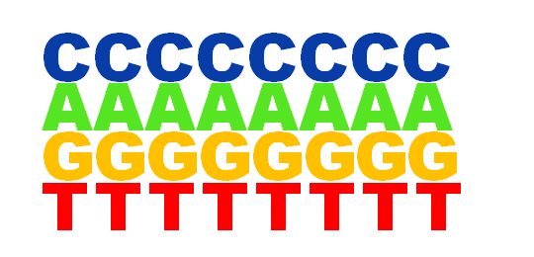
Generative methods model the joint distribution of features and labels
Translation
start sites:
AGACAAGG
Background:
Generative models are usually more interpretable.

Slide 11
Generative methods model the conditional distribution of the label given the features.

Slide 12
Discriminative models are more data-efficient

Slide 13
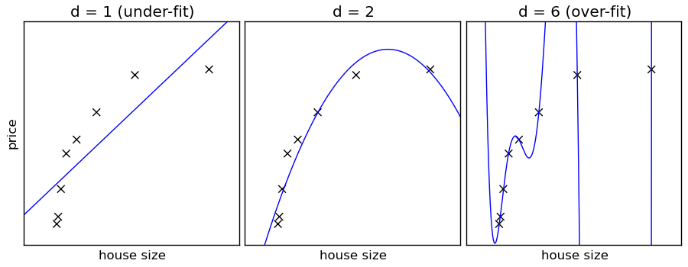
Simpler models generalize better and are more interpretable
Simple models have "strong inductive bias"

Slide 14
Regularization decreases the complexity of a model
L2 regression improves the generalizability of a model:
L1 regression improves the interpretability of a model:

Slide 15
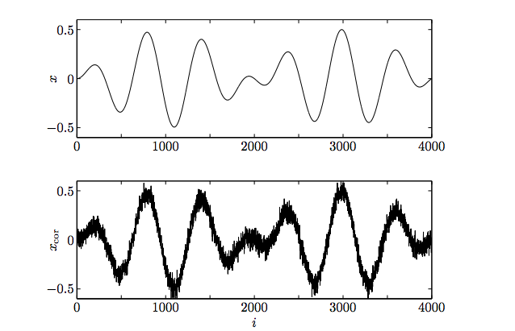
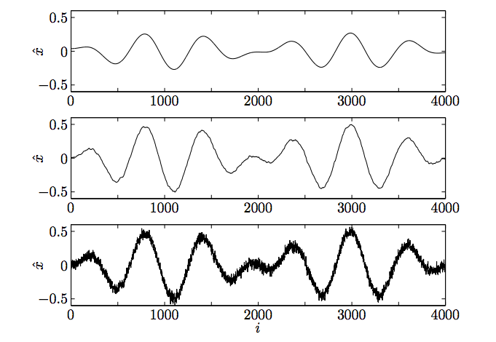
L2 regularization
True
True+noise
lambda=8
lambda=3
lambda=1

Slide 16
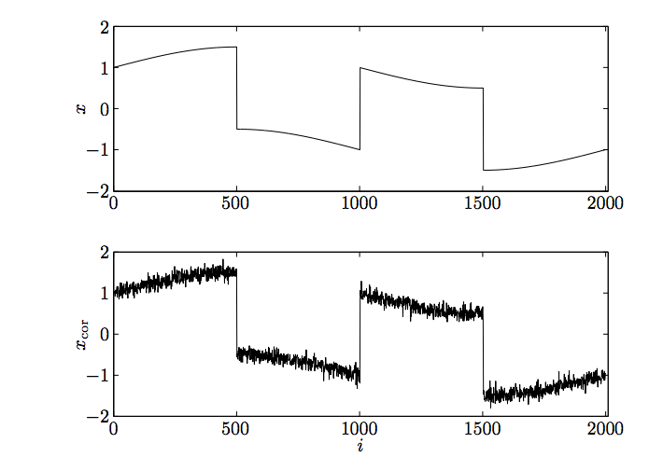
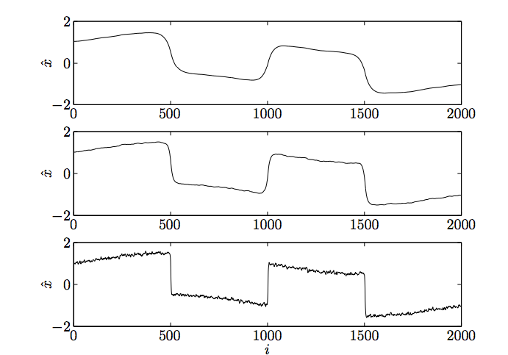
L2 regularization
True
True+noise
lambda=10
lambda=7
lambda=4

Slide 17
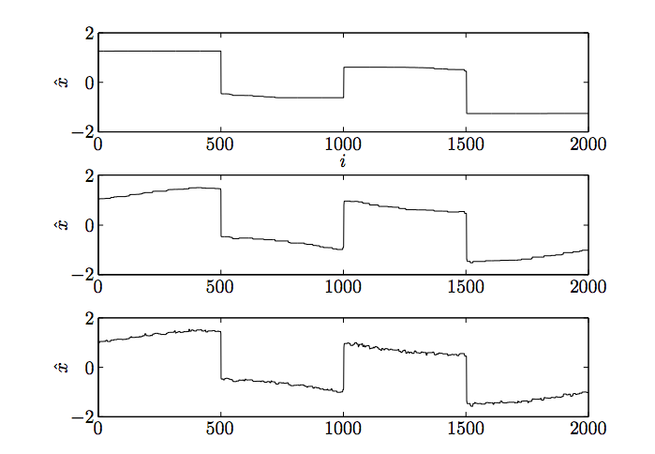
L1 regularization
True
True+noise
lambda=10
lambda=8
lambda=5

