Slide 1
Week 9

Slide 2
Homework 8
Use logistic regression to predict gene expression using genomics assays in GM12878.
Train using gradient descent.
Label: CAGE gene expression -- "expressed"/"non-expressed"
Features: Histone modifications and DNA accessibility.

Slide 3
Intercept feature
Has value 1 for all genes.
Allows the model to assign a probability to a gene with all 0-valued features.
Some treatments of logistic regression include an intercept feature into the model:

Slide 4
Homework 8 pseudocode
Initialize all theta_j's to zero
Until converged:
  For each training gene x:
    For each feature j, compute gradient WRT x and add it to theta_j
  Compute new log likelihood
Compute P(Y = 1|X) for testing gene.

Slide 5
Histone modifications
DNase: Open chromatin
FAIRE: Open chromatin
H3K4me1: Active enhancers
H3K4me2: Active regulatory elements
H3K4me3: Active promoters
H3K9ac: Active regulatory elements
H3K27ac: Active regulatory elements
H3K27me3: Repressed regions
H3K36me3: Active transcription
H4K20me1: Active transcription

Slide 6
Homework 9
Use D-segment algorithm to find CNVs.
Input: Number of read starts at each genomic position (1,2,>=3).
Use a Poisson model of read counts given copy number.

Slide 7
Performance measures for classification

Slide 8
Performance measures
True positives (TP)
False positives (FP)
True negatives (TN)
False negatives (FN)
Measures of performance:
  Recall: TP/(TP+FN)
  Precision: TP/(TP+FP)
  Specificity: TN/(TN+FP)
Accuracy: (TP+TN)/(TP+TN+FP+FN)

Slide 9
Sensitivity/specificity tradeoff
There is a tradeoff between false positives and false negatives.
Two strategies for plotting tradeoff:
  ROC curve
  Precision-recall curve

Slide 10
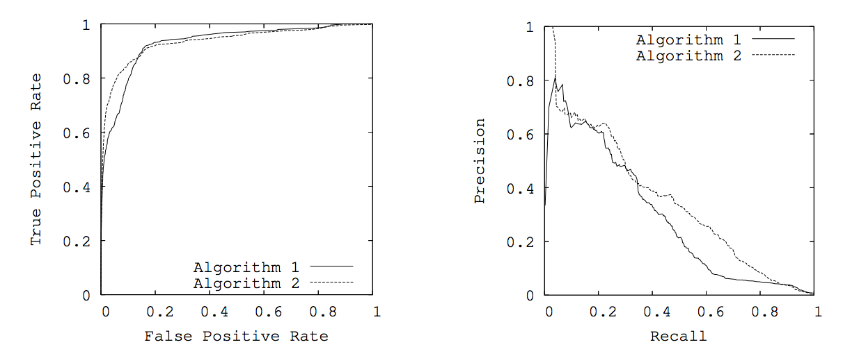
Receiver-operator characteristic (ROC) curve
Area under ROC curve (AUROC): Combined measure of performance based on ROC curve

Slide 11
Precision-recall curve
Area under ROC curve (AUPR): Combined measure of performance based on PR curve

Slide 12
ROC vs. PR

Slide 13
Use a performance measure based on your application
All predictions (positive and negative) are equally important: Use accuracy.
Some number of follow-up tests are planned: Use recall among a fixed number of predictions.
Positive predictions will be published: Use recall at a fixed precision (i.e. 95%)

Slide 14
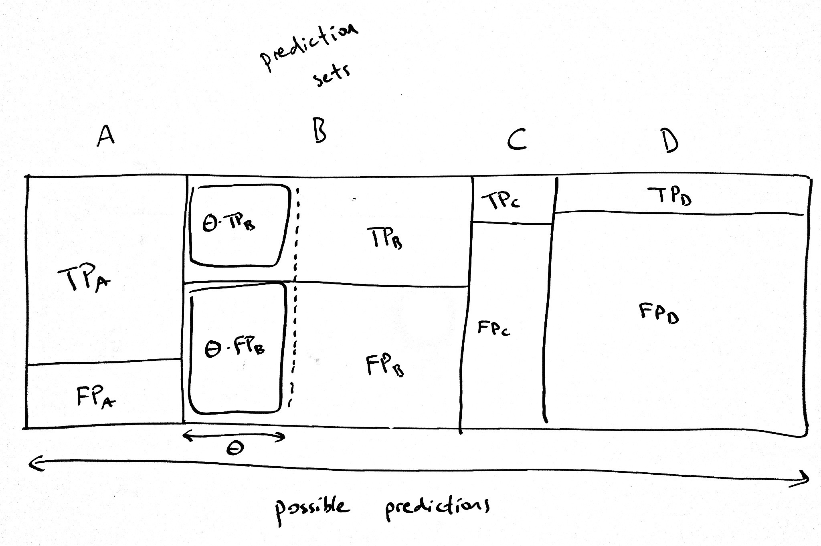
Measuring performance when multiple examples get the same score

Slide 15
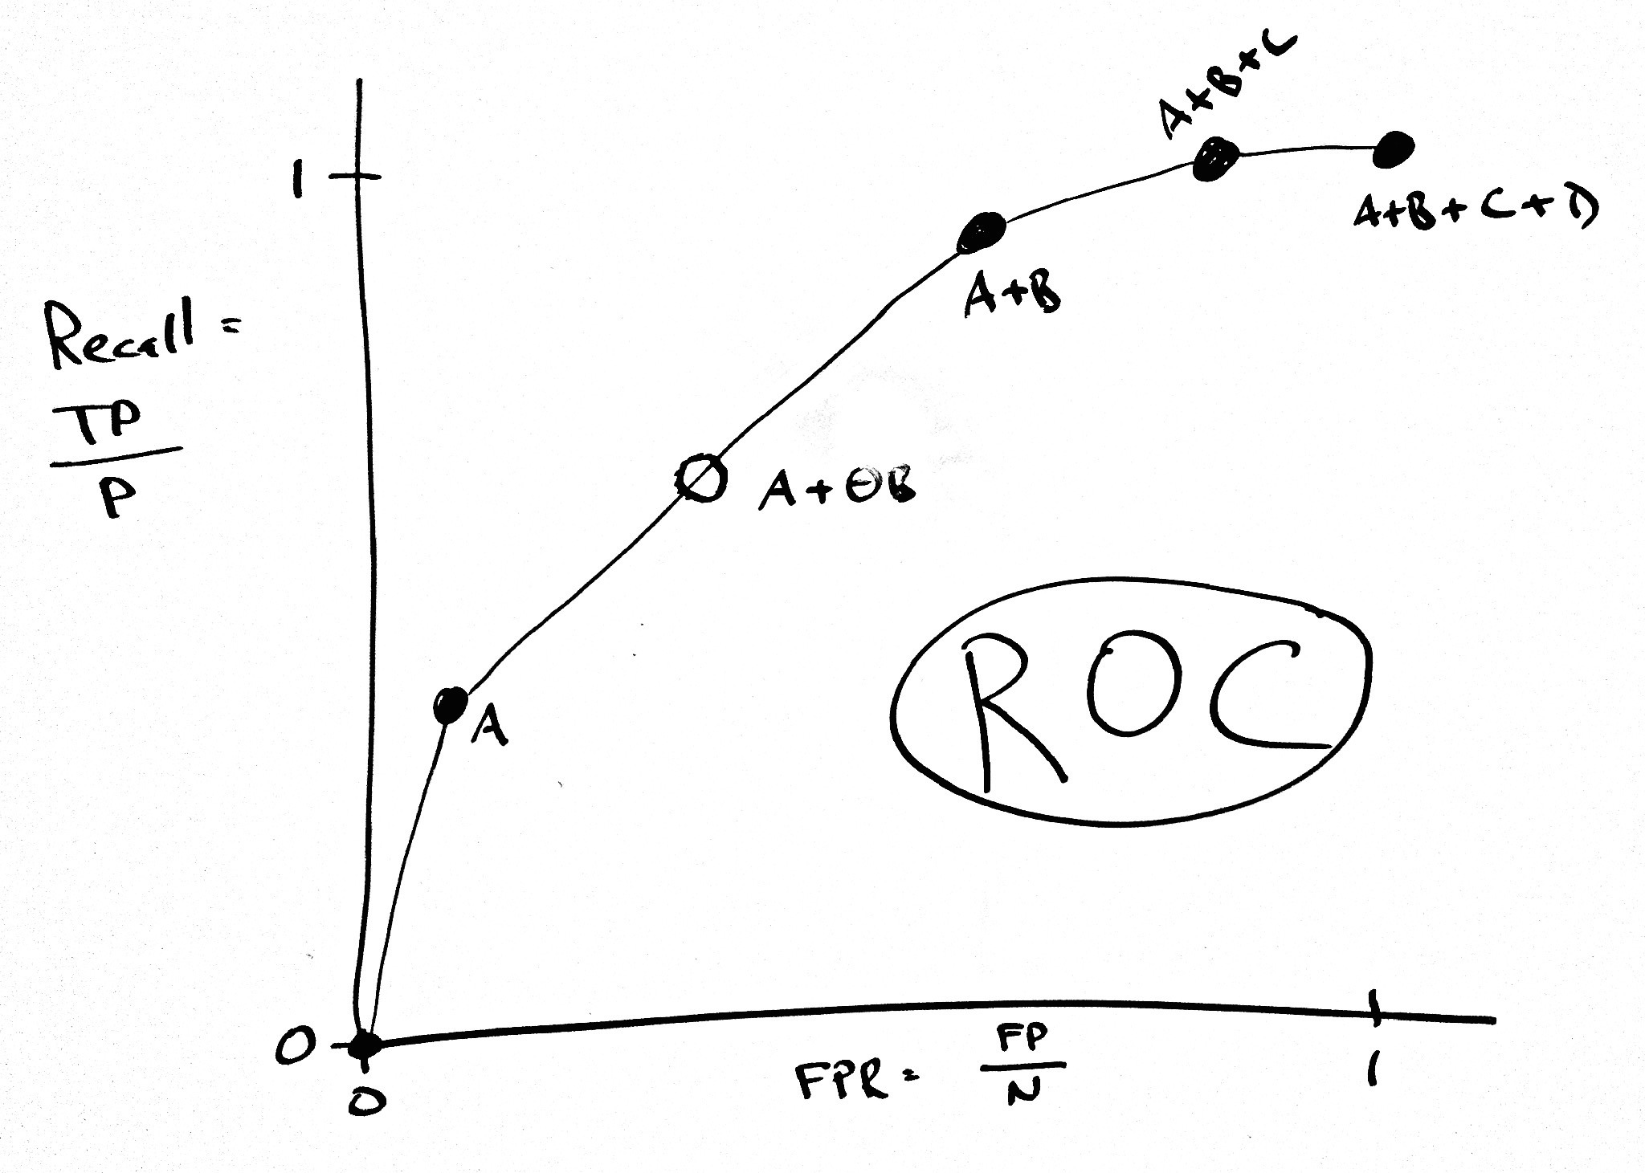
Interpolating in an ROC curve

Slide 16
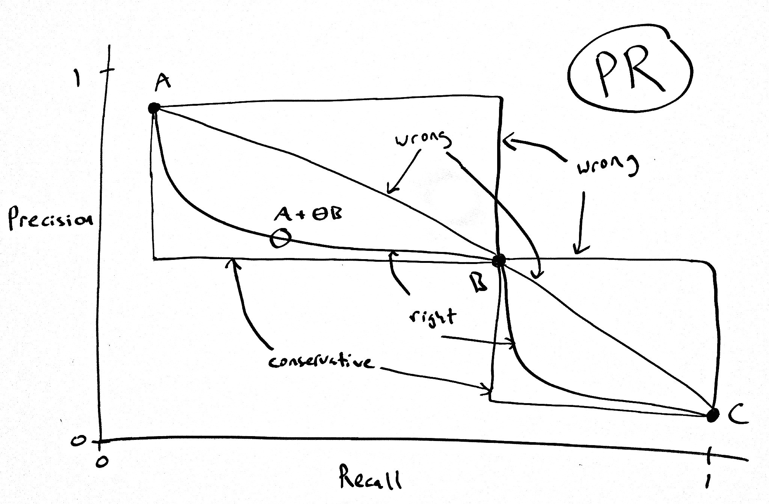
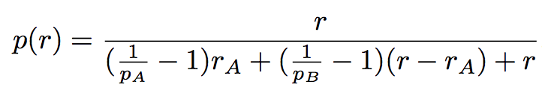
Interpolating in a PR curve

