Slide 1
Discussion Section: HW1 and Programming Tips
GS540

Slide 2
A bit about me…
Maxwell Libbrecht
4th year Computer Science graduate student
Bill Noble's lab
Functional element discovery from ENCODE data
Programming: Python, R, C/C++
Dev environment: Vim (Mac / Linux)

Slide 3
Discussion Section Topics?
Programming topics
Vector arithmetic in R, MATLAB, python+numpy
C++ standard library
Reading and writing binary files
Managing packages in Unix
How to organize a comp-bio project
Data structures
Machine learning
Methods in comp-bio
Identifying functional elements
Motifs
RNA-seq

Slide 4
Outline
General tips / Coding style advice
C Programming
Pointers
Sorting
Homework 1

Slide 5
Programming languages
Compiled: C, C++, C#, Java
Interpreted: Python, R, Perl, Ruby, MATLAB
Interpreted languages are usually slower.
Interpreted languages are fast when you can use premade packages written in C.
Please do not use packages that implement the meat of your algorithm.

Slide 6
Debugging tips
Validate using test cases with a small amount of data: HEY_YOU_UOY
Solve test cases by hand to verify program
Consider pathological / “edge” cases
Print intermediate output
Write test cases before you start coding
Write incrementally, test as you go
Use assertions to avoid bugs
Compare to a slow-but-correct version

Slide 7
Coding style advice
Your audience is people as well as the computer
Break large functions into small, simple functions
Functions for repeated code (initialize data, etc)
Use descriptive names for variables and files
"exons.txt" rather than "data", "position_index" rather than "i"

Slide 8
Performance
Avoid unnecessary optimization!
Simplicity over speed (at least at first)
Big performance gains from small changes (e.g. within loops)
Move unnecessary code out of loops
Avoid frequent memory allocation
Allocate memory in large blocks (e.g. array of structs, not one at a time)
Re-use the same piece of memory
Avoid slow comparison routines when sorting
Use a profiler (gprof for C; dprofpp for perl)

Slide 9
Numerical issues
Floating point numbers are stored in the format:
<coefficient> * 2^<exponent>
Do not compare floats with "x==y".
Use abs(x-y < 0.0001) instead
Beware subtracting large, similar numbers.
Beware integer casts:
1/2 == 0, but 1.0/2 == 0.5
Consider using log space to avoid overflow or underflow.

Slide 10
C++ help
http://www.cplusplus.com/doc/tutorial/
http://www.cprogramming.com/tutorial/c++-tutorial.html
C++ How to Program, Deitel and Deitel

Slide 11
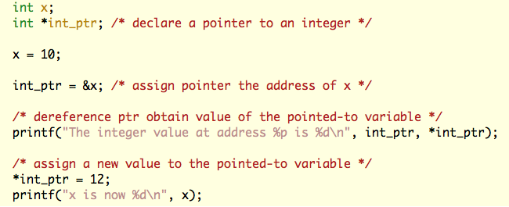
Pointers in C
Pointers are memory addresses (they point to other variables)
The address-of operator (&) obtains the memory address of a variable
The dereference operator (*) accesses the value stored at the pointed-to mem location

Slide 12
Pointers in C
x:
10
int_ptr:

Slide 13
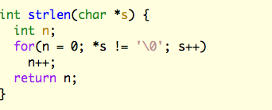
Pointers in C
Arrays are pointers to blocks of memory
Pointers “know” the data size they point to
Array indices are just pointer arithmetic and dereferencing combined:
a[12] is the same as *(a+12)
&a[3] is the same as a+3
From The C Programming Language
by B. Kernighan & D. Ritchie

Slide 14
Pointers in C
Large arrays should be dynamically allocated (on the heap)
C
C++
From The C Programming Language
by B. Kernighan & D. Ritchie

Slide 15
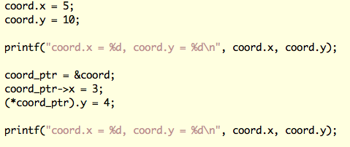
Pointers in C (cont’d)
Attributes of pointed-to structures can be derefenced with “arrow notation”:
a->elem is equivalent to (*a).elem

Slide 16
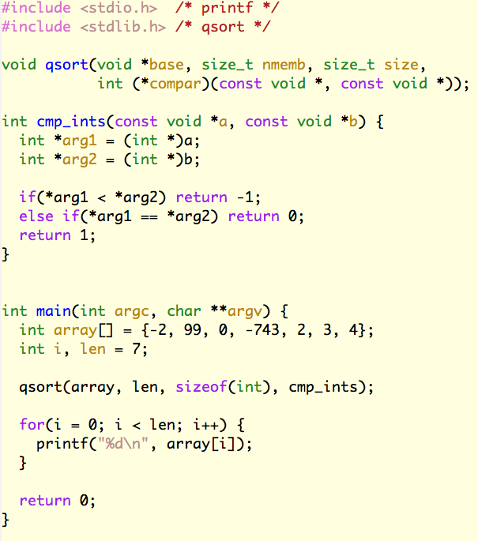
Sorting (in C)
http://en.wikipedia.org/wiki/Quicksort

Slide 17
HW1 Tips
Start with pseudocode / [python]
Get comfortable with pointers
Saves memory without copying strings
Pointer arithmetic
Think about how to store inputs
Declare large arrays on heap not stack
Think about how to store results
Output in template format directly
Avoid copy-pasting results into a template

Slide 18
HW1 pseudocode
Read in a sequence
What form?
How do I store it?
Find its reverse complement
Concatenate
Make suffix array
Sort suffix array
Find ALL longest common substrings
Adjacent in list?
From different genomes?
How do I store it?

