Slide 1
HW
Suffix arrays
Highest-weight path in a DAG
Edit distance
BLAST

Slide 2
HW1: Suffix arrays
Testing
Working together
Formatting

Slide 3
Highest-weight path in a DAG
V i END
V ii
V iii
V iv
V v
V vi
V vii START
E A ii i -1
E B iii i 5
E C iv i -2
E D iv ii 4
E E iv iii -3
E F v ii 2
E G vi iii -3
E H v iv -5
E I vi iv 4
E J vii iv -3
E K vii v 1
E L vii vi -3

Slide 4
Highest-weight path in a DAG
V i END
V ii
V iii
V iv
V v
V vi
V vii START
E A ii i -1
E B iii i 5
E C iv i -2
E D iv ii 4
E E iv iii -3
E F v ii 2
E G vi iii -3
E H v iv -5
E I vi iv 4
E J vii iv -3
E K vii v 1
E L vii vi -3
Decide how to store graph
Decide what order to visit nodes in (depth order or any other order in which parents come before children)
If START node given, start there instead of at a root
Keep track of highest-weight path found so far to every node
After traversal, look through all nodes to see which has highest weight
If END node given, only look at that one
struct node
{
int num_parents;
int num_children;
string label;
edge** in_edges;
edge** out_edges;
int depth;
double score;
edge* prev_path_edge;
bool visited;
};
Properties that won’t change
Properties that will change
struct edge
{
char label;
double weight;
node* node_from;
node* node_to;
};

Slide 5
Highest-weight path in a DAG
V i END
V ii
V iii
V iv
V v
V vi
V vii START
E A ii i -1
E B iii i 5
E C iv i -2
E D iv ii 4
E E iv iii -3
E F v ii 2
E G vi iii -3
E H v iv -5
E I vi iv 4
E J vii iv -3
E K vii v 1
E L vii vi -3
Decide how to store graph
Decide what order to visit nodes in (depth order or any other order in which parents come before children)
If START node given, start there instead of at a root (and don’t allow other nodes to be the start of new paths)
Keep track of highest-weight path found so far to every node
After traversal, look through all nodes to see which has highest weight
If END node given, only look at that one

Slide 6
Highest-weight path in a DAG
V i END
V ii
V iii
V iv
V v
V vi
V vii START
E A ii i -1
E B iii i 5
E C iv i -2
E D iv ii 4
E E iv iii -3
E F v ii 2
E G vi iii -3
E H v iv -5
E I vi iv 4
E J vii iv -3
E K vii v 1
E L vii vi -3
Decide how to store graph
Decide what order to visit nodes in (depth order or any other order in which parents come before children)
If START node given, start there instead of at a root (and don’t allow other nodes to be the start of new paths)
Keep track of highest-weight path found so far to every node
After traversal, look through all nodes to see which has highest weight
If END node given, only look at that one

Slide 7
Highest-weight path in a DAG
V i END
V ii
V iii
V iv
V v
V vi
V vii START
E A ii i -1
E B iii i 5
E C iv i -2
E D iv ii 4
E E iv iii -3
E F v ii 2
E G vi iii -3
E H v iv -5
E I vi iv 4
E J vii iv -3
E K vii v 1
E L vii vi -3
Decide how to store graph
Decide what order to visit nodes in (depth order or any other order in which parents come before children)
If START node given, start there instead of at a root (and don’t allow other nodes to be the start of new paths)
Keep track of highest-weight path found so far to every node
After traversal, look through all nodes to see which has highest weight
If END node given, only look at that one

Slide 8
Highest-weight path in a DAG
-1.49
0.74
0.74
0.74
0.74
-1.49
-1.49
0.74
-1.49
0.74
-1.49
0.74
Convert sequence to graph
Find highest-weight path with given weights (using program from other part)
Most GC-rich region
Notes:
Will never start/end with A/T

Slide 9
HW 3: Edit graph
Create edit graph for 3 sequences using BLOSUM62 score matrix
Output in format for HW2 program
Run HW2 program on it to find highest scoring path (local alignment)

Slide 10
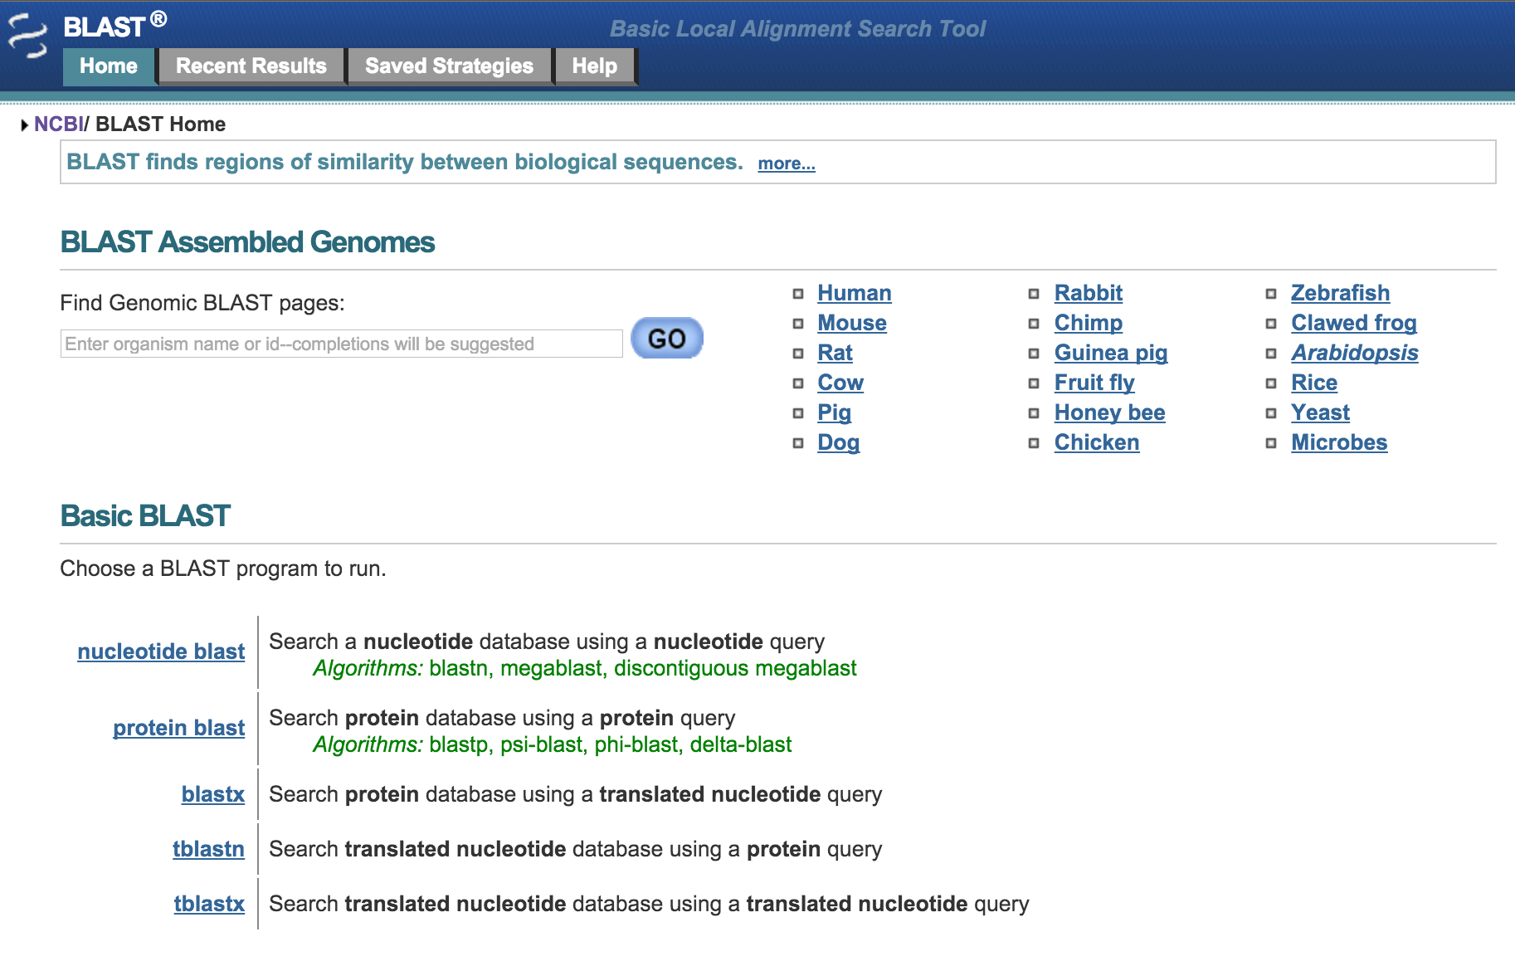
Basic Local Alignment Search Tool (BLAST)
Original paper cited 57,356 times on Google Scholar

Slide 11
1988 bioinformatics conference questions
Can suffix trees be built in a way that is independent of alphabet size s?
Suffix arrays
Computation of Burroughs-Wheeler Transform in O(n) time
Can a precomputed index such as a suffix tree of a large text be used to speed up searches for approximate matches to a string?
Eventually led to BLAST

Slide 12
1988 bioinformatics conference questions
Can suffix trees be built in a way that is independent of alphabet size s?
Suffix arrays
Computation of Burroughs-Wheeler Transform in O(n) time
Can a precomputed index such as a suffix tree of a large text be used to speed up searches for approximate matches to a string?
Eventually led to BLAST

Slide 13
1988 bioinformatics conference questions
Can suffix trees be built in a way that is independent of alphabet size s?
Suffix arrays
Computation of Burroughs-Wheeler Transform in O(n) time
Can a precomputed index such as a suffix tree of a large text be used to speed up searches for approximate matches to a string?
Eventually led to BLAST

Slide 14
The general problem BLAST was made to solve
Given a text of length n and a query of length p, find matches of query within text with up to e differences allowed (or where ε = e/p is the relative length difference allowed)

Slide 15
The general problem BLAST was made to solve
Given a text of length n and a query of length p, find matches of query within text with up to e differences allowed (or where ε = e/p is the relative length difference allowed)
number of insertions, deletions, and substitutions

Slide 16
The general problem BLAST was made to solve
Given a text of length n and a query of length p, find matches of query within text with up to e differences allowed (or where ε = e/p is the relative length difference allowed)
Query: abba
Text: ababbbbabababbababababbbbabaaabababbababababbaba
number of insertions, deletions, and substitutions

Slide 17
The general problem BLAST was made to solve
Given a text of length n and a query of length p, find matches of query within text with up to e differences allowed (or where ε = e/p is the relative length difference allowed)
Query: abba
Text: ababbbbabababbababababbbbabaaabababbababababbaba
2 matches for for e=1
number of insertions, deletions, and substitutions

Slide 18
Categories of approximate match algorithms
Deterministic
Find exactly the set of locations in the text where a query matches within a specified threshold
Filter
False positives but no false negatives
Heuristic
Miss some of the matches (false negatives)
Find some incorrect matches (false positives)

Slide 19
Categories of approximate match algorithms
Deterministic
Find exactly the set of locations in the text where a query matches within a specified threshold
Filter
False positives but no false negatives
Heuristic
Miss some of the matches (false negatives)
Find some incorrect matches (false positives)

Slide 20
Categories of approximate match algorithms
Deterministic
Find exactly the set of locations in the text where a query matches within a specified threshold
Filter
False positives but no false negatives
Heuristic
Miss some of the matches (false negatives)
Find some incorrect matches (false positives)

Slide 21
Neighborhoods are sets of all the approximate matches
Query: abba
Text: ababbbbabababbababababbbbabaaabababbababababbaba
N₁(abba) = {aaba, aabba, abaa, aba, abaa, ababa, abba, abbaa, abbab, abb, abbb, abbba, babba, bba, bbba}
But whenever we find abaa, we also find aba
Condensed neighboorhood eliminates this redundancy:
N^{c}₁(abba) = {aaba, aabba, aba, abb, babba, bba, bbba}
[only members of neighborhood that don’t have prefixes in the neighborhood]

Slide 22
Neighborhoods are sets of all the approximate matches
Query: abba
Text: ababbbbabababbababababbbbabaaabababbababababbaba
N₁(abba) = {aaba, aabba, abaa, aba, abaa, ababa, abba, abbaa, abbab, abb, abbb, abbba, babba, bba, bbba}
But whenever we find abaa, we also find aba
Condensed neighboorhood eliminates this redundancy:
N^{c}₁(abba) = {aaba, aabba, aba, abb, babba, bba, bbba}
[only members of neighborhood that don’t have prefixes in the neighborhood]

Slide 23
Neighborhoods are sets of all the approximate matches
Query: abba
Text: ababbbbabababbababababbbbabaaabababbababababbaba
N₁(abba) = {aaba, aabba, abaa, aba, abaa, ababa, abba, abbaa, abbab, abb, abbb, abbba, babba, bba, bbba}
But whenever we find abaa, we also find aba
Condensed neighboorhood eliminates this redundancy:
N^{c}₁(abba) = {aaba, aabba, aba, abb, babba, bba, bbba}
[only members of neighborhood that don’t have prefixes in the neighborhood]

Slide 24
Advantage of using (condensed) neighborhoods
Say we have:
Query of length 100
9 allowed differences
Partition query into 10 strings of length 10
Then one of the 10 query parts must have an exact match in text
Or, partition query into 5 strings of length 20
→Then one of the 5 query parts must have a 1-neighborhood match in tex
Which partition is better?
FPR = 10/s¹⁰ = 28,600
The size of condensed neighborhood is about (k choose e) (2s)^{e} = 800
FPR = 800/s²⁰ = 2.18

Slide 25
Advantage of using (condensed) neighborhoods
Say we have:
Query of length 100
9 allowed differences
Partition query into 10 strings of length 10
Then one of the 10 query parts must have an exact match in text
Or, partition query into 5 strings of length 20
→Then one of the 5 query parts must have a 1-neighborhood match in tex
Which partition is better?
FPR = 10/s¹⁰ = 28,600
The size of condensed neighborhood is about (k choose e) (2s)^{e} = 800
FPR = 800/s²⁰ = 2.18

Slide 26
Advantage of using (condensed) neighborhoods
Say we have:
Query of length 100
9 allowed differences
Partition query into 10 strings of length 10
Then one of the 10 query parts must have an exact match in text
Or, partition query into 5 strings of length 20
→Then one of the 5 query parts must have a 1-neighborhood match in tex
Which partition is better?
FPR = 10/s¹⁰ = 28,600
The size of condensed neighborhood is about (k choose e) (2s)^{e} = 800
FPR = 800/s²⁰ = 2.18

Slide 27
Advantage of using (condensed) neighborhoods
Say we have:
Query of length 100
9 allowed differences
Partition query into 10 strings of length 10
Then one of the 10 query parts must have an exact match in text
Or, partition query into 5 strings of length 20
→Then one of the 5 query parts must have a 1-neighborhood match in tex
Which partition is better?
FPR = 10/s¹⁰ = 28,600
The size of condensed neighborhood is about (k choose e) (2s)^{e} = 800
FPR = 800/s²⁰ = 2.18

Slide 28
Advantage of using (condensed) neighborhoods
Say we have:
Query of length 100
9 allowed differences
Partition query into 10 strings of length 10
Then one of the 10 query parts must have an exact match in text
Or, partition query into 5 strings of length 20
→Then one of the 5 query parts must have a 1-neighborhood match in tex
Which partition is better?
FPR = 10/s¹⁰ = 28,600
The size of condensed neighborhood is about (k choose e) (2s)^{e} = 800
FPR = 800/s²⁰ = 2.18

Slide 29
Advantage of using (condensed) neighborhoods
Say we have:
Query of length 100
9 allowed differences
Partition query into 10 strings of length 10
Then one of the 10 query parts must have an exact match in text
Or, partition query into 5 strings of length 20
→Then one of the 5 query parts must have a 1-neighborhood match in tex
Which partition is better?
FPR = 10/s¹⁰ = 28,600
The size of condensed neighborhood is about (k choose e) (2s)^{e} = 800
FPR = 800/s²⁰ = 2.18

Slide 30
Advantage of using (condensed) neighborhoods
Say we have:
Query of length 100
9 allowed differences
Partition query into 10 strings of length 10
Then one of the 10 query parts must have an exact match in text
Or, partition query into 5 strings of length 20
→Then one of the 5 query parts must have a 1-neighborhood match in tex
Which partition is better?
FPR = 10/s¹⁰ = 28,600
The size of condensed neighborhood is about (k choose e) (2s)^{e} = 800
FPR = 800/s²⁰ = 2.18

Slide 31
Determine which positives are true efficiently
h true hits, O(hep) time to confirm and report all matches and their alignments
Goal of the filter is to return fewer false positives
Optimize time a filter would take on a random text with no expected hits to the query

Slide 32
Initial idea for BLAST
Partition the query into p/k k-mers
Generate every string in the e-neighborhood of the query k-mers and find all the exact matches to these strings
Check each location reported above with an O(ep) algorithm.
What k-mer size is best?
It turns out through math that something around log_{s}n is best (though there’s no exact analytic formula…yet)

Slide 33
More concrete idea of BLAST (for proteins)
Consider the p−k+1 overlapping k-mers of the query (to increase the chance of not missing a true hit)
Generate every string in the e-neighborhood of the query k-mers under a similarity-based protein metric and find all the exact matches to these strings by some means
Mealy machine (finite automaton)
Extend each seed match into a local alignment of significance by some means, and report it if its score is sufficiently high
Stop when score drops too far below best score seen
Indels?
Notes:
heuristic

Slide 34
Getting a provably efficient deterministic algorithm
What k-mer size is best?
It turns out through math that something around log_{s}n is best (though there’s no exact analytic formula…yet)
Extension strategy
“double and check”
k-mer of query s₀ e-matches substring t₀ of text
Then look at 2k-mer of query s₁ that spans s₀ and determine whether there is t₁ that spans t₀ that e-matches s₁
If not, then stop (which is provably okay)
Otherwise, continue doubling
With this strategy, extension and reporting time is O(en^{1-logs(α)}log(n) + hep)
If α > 1, then O(n^{c}) for c < 1 → sublinear!

Slide 35
Getting a provably efficient deterministic algorithm
What k-mer size is best?
It turns out through math that something around log_{s}n is best (though there’s no exact analytic formula…yet)
Extension strategy
“double and check”
k-mer of query s₀ e-matches substring t₀ of text
Then look at 2k-mer of query s₁ that spans s₀ and determine whether there is t₁ that spans t₀ that e-matches s₁
If not, then stop (which is provably okay)
Otherwise, continue doubling
With this strategy, extension and reporting time is O(en^{1-logs(α)}log(n) + hep)
If α > 1, then O(n^{c}) for c < 1 → sublinear!

Slide 36
Generating condensed neighborhoods efficiently
Don’t have exact formula for the size
Minimize time visiting words not in the condensed neighborhood
O(eN_{e}(k))

Slide 37
Complexity of entire BLAST algorithm
Add up the times for generating condensed neighborhoods and extending potential matches
Sublinear! (using a O(n) precomputed index)

Slide 38
Actual implementation of BLAST
Remove low-complexity and highly repetitive regions
Find each 11-letter subsequence of the query sequence
For each of these subsequences:
Find neighborhood for a given threshold
Organize in efficient search tree
Scan database sequences for exact matches in neighborhoods
Extend the exact matches in both directions, continuing until score begins to decrease
List all matches with high enough scores (above empirically determined threshold)
Evaluate significance of scores (E-values) [Gumbel extreme value distribution
Combine matches into longer alignments
Show the gapped Smith-Waterman alignments for matches

Slide 39
If you’d rather have Gene Myers explain BLAST
https://www.youtube.com/watch?v=pVFX3V0Q2Rg
http://myerslab.mpi-cbg.de/wp-content/uploads/2014/06/behind.blast_.pdf

Slide 41
Identity, similarity, homology
What we calculate, what we actually want to know

Slide 42
“Homology is the central concept for all of biology. Whenever we say that a mammalian hormone is the ‘same’ hormone as a fish hormone, that a human gene sequence is the ‘same’ as a sequence in a chimp or a mouse, that a HOX gene is the ‘same’ in a mouse, a fruit fly, a frog, and a human - even when we argue that discoveries about a worm, a fruit fly, a frog, a mouse, or a chimp have relevance to the human condition - we have made a bold and direct statement about homology. The aggressive confidence of modern biomedical science implies that we know what we are talking about. But a deeper reflection shows that this confidence is based more on hope than on certainty.”
- David Wake

