Slide 1
HW7: Evolutionarily conserved segments
ENCODE region 009 (beta-globin locus)
Multiple alignment of human, dog, and mouse
2 states: neutral (fast-evolving), conserved (slow-evolving)
Emitted symbols are multiple alignment columns (e.g. ‘AAT’)
Viterbi parse (no iteration)

Slide 2
Input
Original maf format
  Sequences broken into alignment blocks based on which species included
  http://genome.ucsc.edu/FAQ/FAQformat.html#format5
Your file format
  Only 3 species
  Gaps filled in with As in human sequence

Slide 3
Setting parameters
Emission probabilities
  Neutral state: observed frequencies in neutral data set
  Conserved state: observed frequencies in functional data set
Transition probabilities
  Given
  More likely to go from conserved to neutral
Initial probabilites
  Given
  More likely to start in neutral state

Slide 4
Output
Parameter values
  Including emission probabilities you calculated from neutral and conserved data sets
State and segment histograms (like HW5)
Coordinates of 10 longest conserved segments (relative to the start position)
Brief annotations for the 5 longest conserved segments (just look at UCSC genome browser)

Slide 5
ENCODE project
Pilot study of 30 Mb (1% of human genome) in 44 regions
  50% chosen, 50% random
Some findings:
  Pervasive transcription
  Novel transcription start sites
  Regulatory sequences around TSS are symmetrically distributed
  Chromatin accessibility and histone modification patterns are highly predictive of transcriptional activity
  DNA replication timing correlated with chromatin structure
  5% of genome under evolutionary constraint in mammals, 60% of this show biochemical function
  Many functional elements unconstrained across mammalian evolution

Slide 6
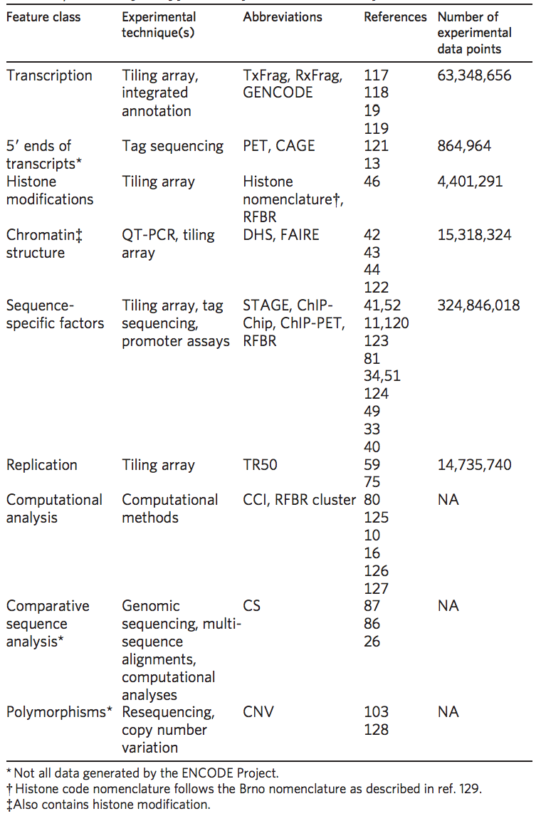
ENCODE assays

Slide 7
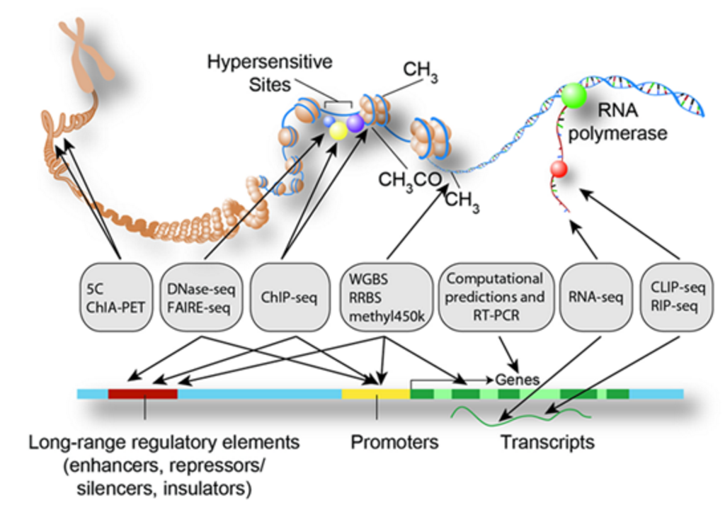
ENCODE assays

Slide 8
ENm009 – beta globin
https://genome.ucsc.edu/cgi-bin/hgTracks?db=hg18&lastVirtModeType=default&lastVirtModeExtraState=&virtModeType=default&virtMode=0&nonVirtPosition=&position=chr11%3A4730996-5732587&hgsid=477415705_hsOHD2dsAOK6lFv6g65rqlbpgzyP

Slide 9
Expectation-maximization (EM) algorithm
General algorithm for ML estimation with “missing data”
Clustering
Machine learning
Computer vision
Natural language processing
Notes:
X is observations
Y is state sequences
Theta is parameters
So we want to maximize observing x given parameters (by changing parameters)
And this involves summing over all state sequences

Slide 10
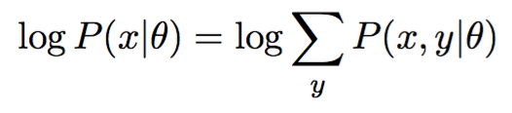

Expectation-maximization (EM) algorithm
Goal is to find parameters that maximize the log likelihood
Given one set of parameters, want to pick a better set
Notes:
X is observations
Y is state sequences
Theta is parameters
So we want to maximize observing x given parameters (by changing parameters)
And this involves summing over all state sequences

Slide 11


Expectation-maximization (EM) algorithm
Goal is to find parameters that maximize the log likelihood
With + algebra, can rewrite log likelihood as
Then multplying by and summing over

Slide 12
Expectation-maximization (EM) algorithm
Goal is to find parameters that maximize the log likelihood
With + algebra, can rewrite log likelihood as
Then multplying by and summing over

Slide 13
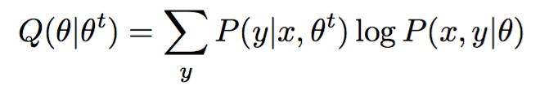
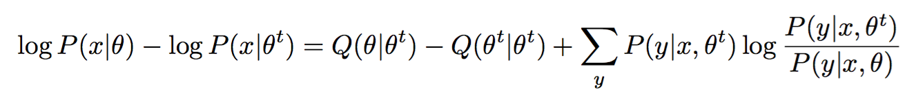
Expectation-maximization (EM) algorithm
Want this difference to be positive:

Slide 14

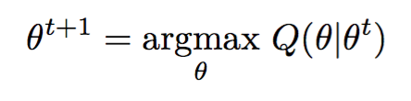
Expectation-maximization (EM) algorithm
Want this difference to be positive:
Average of the log likelihood of x and y given θ, over the distribution of y given the current set of parameters θ^{t}

Slide 15
Expectation-maximization (EM) algorithm
Want this difference to be positive:
Average of the log likelihood of x and y given θ, over the distribution of y given the current set of parameters θ^{t}

Slide 16
Expectation-maximization (EM) algorithm
Want this difference to be positive:

Slide 17
Expectation-maximization (EM) algorithm
Expectation step: Calculate Q function
Maximization step: Choose new parameters to maximize Q

Slide 18
Baum-Welch algorithm
Special case of EM
  Missing data are the unknown states
Overall likelihood increases, will converge to local maximum

Slide 19
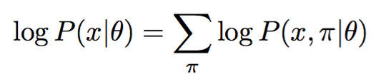
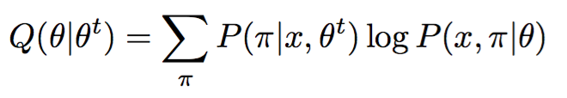
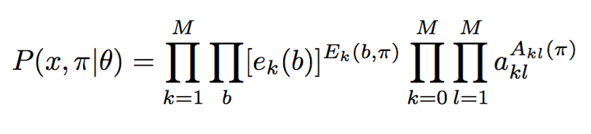
Baum-Welch algorithm
Each parameter occurs some number of times in the joint probability:

Slide 20
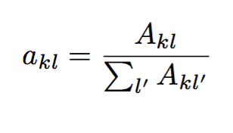
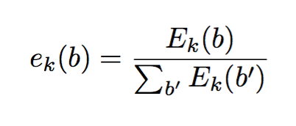
Baum-Welch algorithm
E step: calculate expectations for emission and transition probabilites
M step: reestimate emission and transition probabilities
Notes:
M is number of states

Slide 21
Markov Chain Monte Carlo (MCMC) methods
Markov Chains + Monte Carlo methods

Slide 22
Markov chain
Like a Hidden Markov Model except the whole thing is observed
Markov property – current state only depends on previous state
Andrey Markov

Slide 23
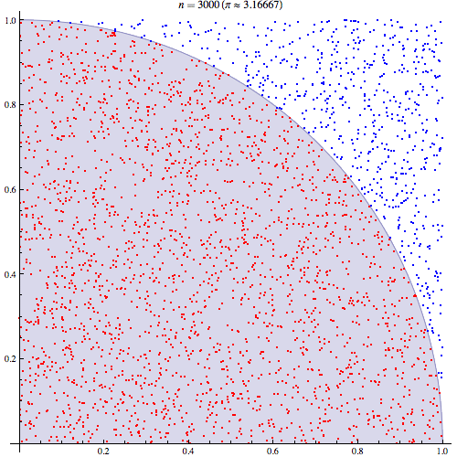
Monte Carlo methods
Random sampling to obtain numerical results

Slide 24
Markov Chain Monte Carlo (MCMC)
Markov Chains + Monte Carlo methods
  Random sampling of a probability distribution using a Markov chain
Way of computing an integral, expected value
First application was in statistical physics

Slide 25
Metropolis-Hastings algorithm
At each step, pick a candidate for next sample value based on the current sample value
With some probability, accept the candidate and use it in the next iteration
How to determine probability of acceptance?
  Need function that is proportional to sampled distribution

Slide 26
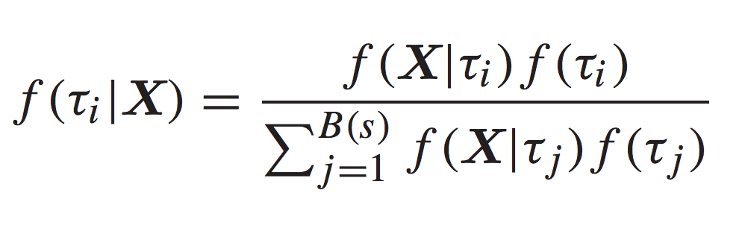
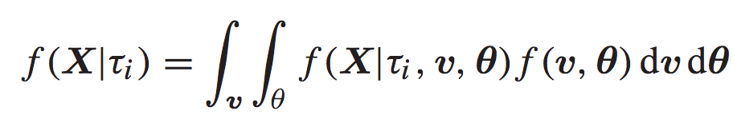
Bayesian inference of phylogenetic trees
Want to calculate the probability of a particular phylogeny given a sequence alignment
Notes:
B(s) is number of trees possible for s species
integrating over all combinations of branch lengths (v) and substitution parameters (theta)
f(ti) is prior for trees, typically set to 1/B(s)
f(v, theta) is prior on branch lengths and substitution parameters, assume poisson process or something

Slide 27
Bayesian inference of phylogenetic trees
Propose new tree topology or parameter value
Determine acceptance ratio
Choose a random number
Move to new tree if random number is less than acceptance ratio; otherwise remain at old tree
Return to step 1 if equilibrium hasn’t been reached

Slide 28
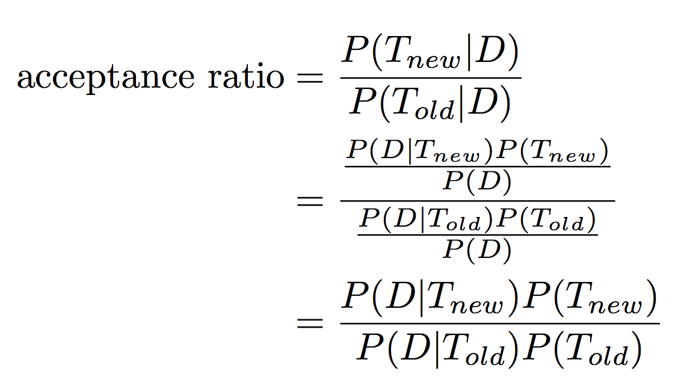
Bayesian inference of phylogenetic trees

Slide 29
Bayesian inference of phylogenetic trees
Propose new tree topology or parameter value
Determine acceptance ratio
Choose a random number
Move to new tree if random number is less than acceptance ratio; otherwise remain at old tree
Return to step 1 if equilibrium hasn’t been reached

Slide 30
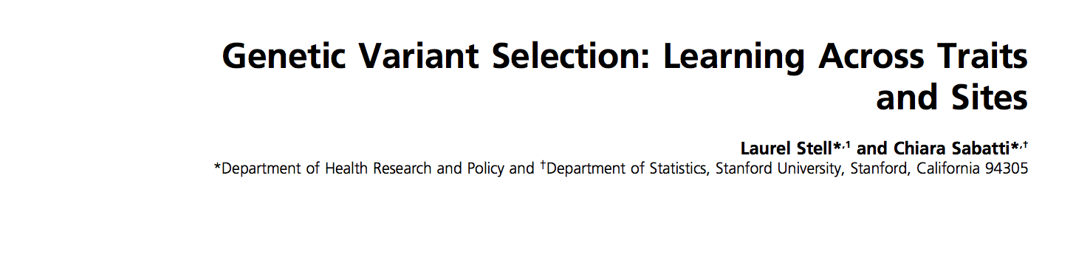
Another recent MCMC example
Sampling posterior probabilities of variant being interesting, given experimental results

