Slide 1
Maximal D-segments
Maximal-scoring
  No subsegment has higher score
  No segment properly containing the segment satisfies the above
  No supersegment has higher score ← NOT TRUE (see next slide for example)
Maximum allowed dropoff D < 0
  No subsegment has score < D
Score >= S
  Where S >= -D

Slide 3
D
cumulative score
S
0
sequence position
Notes:
find the maximal d segments

Slide 4
D
cumulative score
S
0
sequence position

Slide 5
D
cumulative score
S
0
sequence position

Slide 6
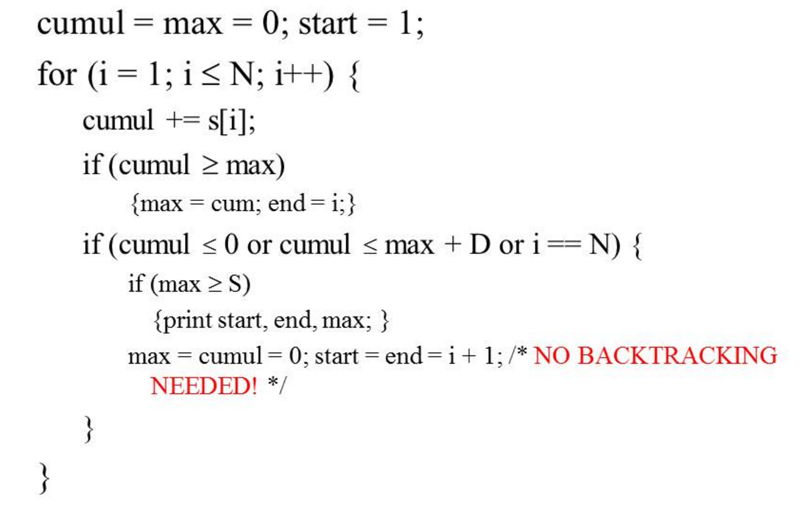

Slide 7
position 1 2 3 4 5 6 7 8 9 10 11 12 13 14
# read starts 0 0 0 0 1 2 0 4 1 2 0 0 0 0
score -.05 -.05 -.05 -.05 .52 1.1 -.05 1.7 .52 1.1 -.05 -.05 -.05 -.05
D = 3
max = 0
start = 2
end = 2
cumul = -.05

Slide 8
position 1 2 3 4 5 6 7 8 9 10 11 12 13 14
# read starts 0 0 0 0 1 2 0 4 1 2 0 0 0 0
score -.05 -.05 -.05 -.05 .52 1.1 -.05 1.7 .52 1.1 -.05 -.05 -.05 -.05
D = 3
max = 0
start = 3
end = 3
cumul = -.05

Slide 9
position 1 2 3 4 5 6 7 8 9 10 11 12 13 14
# read starts 0 0 0 0 1 2 0 4 1 2 0 0 0 0
score -.05 -.05 -.05 -.05 .52 1.1 -.05 1.7 .52 1.1 -.05 -.05 -.05 -.05
D = 3
max = 0
start = 4
end = 4
cumul = -.05

Slide 10
position 1 2 3 4 5 6 7 8 9 10 11 12 13 14
# read starts 0 0 0 0 1 2 0 4 1 2 0 0 0 0
score -.05 -.05 -.05 -.05 .52 1.1 -.05 1.7 .52 1.1 -.05 -.05 -.05 -.05
D = 3
max = 0
start = 5
end = 5
cumul = -.05

Slide 11
position 1 2 3 4 5 6 7 8 9 10 11 12 13 14
# read starts 0 0 0 0 1 2 0 4 1 2 0 0 0 0
score -.05 -.05 -.05 -.05 .52 1.1 -.05 1.7 .52 1.1 -.05 -.05 -.05 -.05
D = 3
max = .52
start = 5
end = 5
cumul = .52

Slide 12
position 1 2 3 4 5 6 7 8 9 10 11 12 13 14
# read starts 0 0 0 0 1 2 0 4 1 2 0 0 0 0
score -.05 -.05 -.05 -.05 .52 1.1 -.05 1.7 .52 1.1 -.05 -.05 -.05 -.05
D = 3
max = 1.62
start = 5
end = 6
cumul = 1.62

Slide 13
position 1 2 3 4 5 6 7 8 9 10 11 12 13 14
# read starts 0 0 0 0 1 2 0 4 1 2 0 0 0 0
score -.05 -.05 -.05 -.05 .52 1.1 -.05 1.7 .52 1.1 -.05 -.05 -.05 -.05
D = 3
max = 1.62
start = 5
end = 6
cumul = 1.57

Slide 14
position 1 2 3 4 5 6 7 8 9 10 11 12 13 14
# read starts 0 0 0 0 1 2 0 4 1 2 0 0 0 0
score -.05 -.05 -.05 -.05 .52 1.1 -.05 1.7 .52 1.1 -.05 -.05 -.05 -.05
D = 3
max = 3.27
start = 5
end = 8
cumul = 3.27

Slide 15
position 1 2 3 4 5 6 7 8 9 10 11 12 13 14
# read starts 0 0 0 0 1 2 0 4 1 2 0 0 0 0
score -.05 -.05 -.05 -.05 .52 1.1 -.05 1.7 .52 1.1 -.05 -.05 -.05 -.05
D = 3
max = 3.79
start = 5
end = 9
cumul = 3.79

Slide 16
position 1 2 3 4 5 6 7 8 9 10 11 12 13 14
# read starts 0 0 0 0 1 2 0 4 1 2 0 0 0 0
score -.05 -.05 -.05 -.05 .52 1.1 -.05 1.7 .52 1.1 -.05 -.05 -.05 -.05
D = 3
max = 4.89
start = 5
end = 10
cumul = 4.89

Slide 17
position 1 2 3 4 5 6 7 8 9 10 11 12 13 14
# read starts 0 0 0 0 1 2 0 4 1 2 0 0 0 0
score -.05 -.05 -.05 -.05 .52 1.1 -.05 1.7 .52 1.1 -.05 -.05 -.05 -.05
D = 3
max = 4.89
start = 5
end = 10
cumul = 4.84

Slide 18
position 1 2 3 4 5 6 7 8 9 10 11 12 13 14
# read starts 0 0 0 0 1 2 0 4 1 2 0 0 0 0
score -.05 -.05 -.05 -.05 .52 1.1 -.05 1.7 .52 1.1 -.05 -.05 -.05 -.05
D = 3
max = 4.89
start = 5
end = 10
cumul = 4.79

Slide 19
position 1 2 3 4 5 6 7 8 9 10 11 12 13 14
# read starts 0 0 0 0 1 2 0 4 1 2 0 0 0 0
score -.05 -.05 -.05 -.05 .52 1.1 -.05 1.7 .52 1.1 -.05 -.05 -.05 -.05
D = 3
max = 4.89
start = 5
end = 10
cumul = 4.74

Slide 20
position 1 2 3 4 5 6 7 8 9 10 11 12 13 14
# read starts 0 0 0 0 1 2 0 4 1 2 0 0 0 0
score -.05 -.05 -.05 -.05 .52 1.1 -.05 1.7 .52 1.1 -.05 -.05 -.05 -.05
D = 3
max = 4.89
start = 5
end = 10
cumul = 4.69

Slide 21
position 1 2 3 4 5 6 7 8 9 10 11 12 13 14
# read starts 0 0 0 0 1 2 0 4 1 2 0 0 0 0
score -.05 -.05 -.05 -.05 .52 1.1 -.05 1.7 .52 1.1 -.05 -.05 -.05 -.05
D = 3
max = 4.89
start = 5
end = 10

Slide 22
Parameters
N = expected length of normal copy number region (state 1)
E = expected length of elevated copy number region (state 2)
Transition probabilities:
  a₁₂ = 1/N, a₁₁ = 1 – 1/N
  a₂₁ = 1/E, a₂₂ = 1 – 1/E
Emission probabilities:
  Symbols: 0, 1, 2, >=3 (number of read starts)
  Poisson-distributed with given means
    m₁ = average number of read starts per site across chromsome
    m₂ = 1.5m₁

Slide 23
Poisson-distributed emission probabilities
p = m^{r}e^{-m}/r!

Slide 24
Poisson-distributed emission probabilities
p = m^{r}e^{-m}/r!
How do you calculate this?

Slide 25
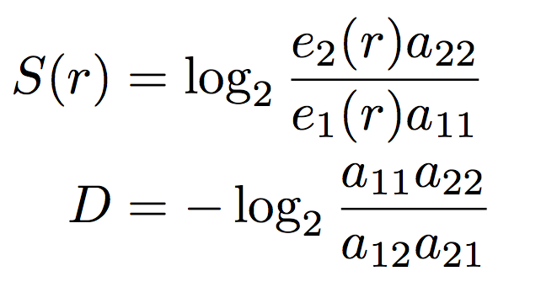
Scoring function
Maximum dropoff:
Minimum segment score:
Notes:
S can be larger than this, but no less

Slide 26
Why does S need to be >= -D?
D
cumulative score
S
0
sequence position

Slide 27
Why does S need to be >= -D?
D
cumulative score
S
0
sequence position

Slide 28
Why does S need to be >= -D?
D
cumulative score
S
0
sequence position

Slide 29
What happens when we…
increase N (expected length of normal copy number region)?
  decrease a₁₂ and increase a₁₁
  decrease scores
  decrease D (allow larger dropoff)
  increase S (require higher score)
increase E (expected length of elevated copy number region)?
  decrease a₂₁ and increase a₂₂
  increase scores
  decrease D (allow larger dropoff)
  increase S (require higher score)
  a₁₂ = 1/N, a₁₁ = 1 – 1/N
  a₂₁ = 1/E, a₂₂ = 1 – 1/E
  e₁(r) = Poisson(m₁, r)
  e₂(r) = Poisson(1.5m₁, r)

Slide 30
What happens when we…
increase N (expected length of normal copy number region)?
  decrease a₁₂ and increase a₁₁
  decrease scores
  decrease D (allow larger dropoff)
  increase S (require higher score)
increase E (expected length of elevated copy number region)?
  decrease a₂₁ and increase a₂₂
  increase scores
  decrease D (allow larger dropoff)
  increase S (require higher score)
  a₁₂ = 1/N, a₁₁ = 1 – 1/N
  a₂₁ = 1/E, a₂₂ = 1 – 1/E
  e₁(r) = Poisson(m₁, r)
  e₂(r) = Poisson(1.5m₁, r)

Slide 31
What happens when we…
increase N (expected length of normal copy number region)?
  decrease a₁₂ and increase a₁₁
  decrease scores
  decrease D (allow larger dropoff)
  increase S (require higher score)
increase E (expected length of elevated copy number region)?
  decrease a₂₁ and increase a₂₂
  increase scores
  decrease D (allow larger dropoff)
  increase S (require higher score)
  a₁₂ = 1/N, a₁₁ = 1 – 1/N
  a₂₁ = 1/E, a₂₂ = 1 – 1/E
  e₁(r) = Poisson(m₁, r)
  e₂(r) = Poisson(1.5m₁, r)

Slide 32
What happens when we…
increase N (expected length of normal copy number region)?
  decrease a₁₂ and increase a₁₁
  decrease scores
  decrease D (allow larger dropoff)
  increase S (require higher score)
increase E (expected length of elevated copy number region)?
  decrease a₂₁ and increase a₂₂
  increase scores
  decrease D (allow larger dropoff)
  increase S (require higher score)
  a₁₂ = 1/N, a₁₁ = 1 – 1/N
  a₂₁ = 1/E, a₂₂ = 1 – 1/E
  e₁(r) = Poisson(m₁, r)
  e₂(r) = Poisson(1.5m₁, r)

Slide 33
http://bozeman.genome.washington.edu/compbio/mbt599/hw8_template.txt

Slide 34
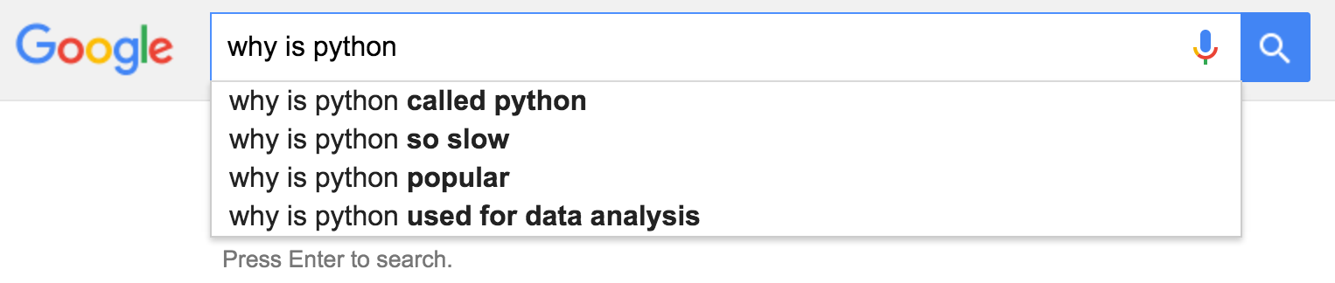
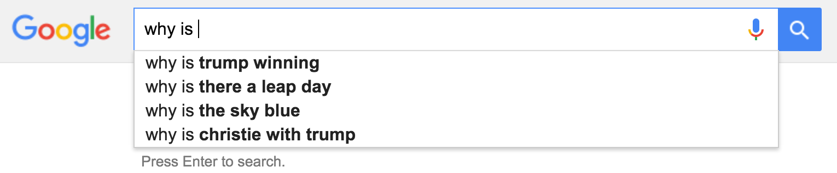

Slide 36
https://www3.ntu.edu.sg/home/ehchua/programming/cpp/gcc_make.html
Notes:
GCC compiles a C/C++ program into executable in 4 steps as shown in the above diagram. For example, a "gcc -o hello.exe hello.c" is carried out as follows:
Pre-processing: via the GNU C Preprocessor (cpp.exe), which includes the headers (#include) and expands the macros (#define).> cpp hello.c > hello.i
The resultant intermediate file "hello.i" contains the expanded source code.
Compilation: The compiler compiles the pre-processed source code into assembly code for a specific processor.> gcc -S hello.iThe -S option specifies to produce assembly code, instead of object code. The resultant assembly file is "hello.s".
Assembly: The assembler (as.exe) converts the assembly code into machine code in the object file "hello.o".> as -o hello.o hello.s
Linker: Finally, the linker (ld.exe) links the object code with the library code to produce an executable file "hello.exe".> ld -o hello.exe hello.o ...libraries…

Slide 37
https://github.com/bitfragment/digstud/blob/master/11-file-3-program-slides.md

Slide 38
https://www3.ntu.edu.sg/home/ehchua/programming/cpp/gcc_make.html
Notes:
GCC compiles a C/C++ program into executable in 4 steps as shown in the above diagram. For example, a "gcc -o hello.exe hello.c" is carried out as follows:
Pre-processing: via the GNU C Preprocessor (cpp.exe), which includes the headers (#include) and expands the macros (#define).> cpp hello.c > hello.i
The resultant intermediate file "hello.i" contains the expanded source code.
Compilation: The compiler compiles the pre-processed source code into assembly code for a specific processor.> gcc -S hello.iThe -S option specifies to produce assembly code, instead of object code. The resultant assembly file is "hello.s".
Assembly: The assembler (as.exe) converts the assembly code into machine code in the object file "hello.o".> as -o hello.o hello.s
Linker: Finally, the linker (ld.exe) links the object code with the library code to produce an executable file "hello.exe".> ld -o hello.exe hello.o ...libraries…

Slide 39
Programmers waste enormous amounts of time thinking about, or worrying about, the speed of noncritical parts of their programs, and these attempts at efficiency actually have a strong negative impact when debugging and maintenance are considered. We should forget about small efficiencies, say about 97% of the time: premature optimization is the root of all evil. Yet we should not pass up our opportunities in that critical 3%.”
- Donald Knuth, 1974
Notes:
analysis of algorithms, complexity theory, big O notation, tex

Slide 40
What to do when Python is too slow
profile
use Cython
use a different programming language

Slide 41
Cython
Superset of Python
Static type declarations
Source code translated into optimized C code, then compiled as Python extension modules
examples
Notes:
run through example code

Slide 42
Profiling
Which parts of the code are taking the most time?
python line_profiler
example
Notes:
example code

Slide 43
Unix tools
Regular expressions
grep
sed
AWK

Slide 44
Regular expressions
Sequence of characters that define a search pattern
banana matches the text banana
\b[A-Z0-9._%+-]+@[A-Z0-9 .-]+\.[A-Z]{2,}\b matches email addresses
Easier to write than read...
Notes:
Brackets [] indicate ‘or’
Curly braces {} indicate
\b is word boundary
A-Z indicates alphabetic characters
0-9 indicates numeric characters
+ indicates 1 or more times (for the thing before it)
{2,} indicates 2 or more times
\ is escape character

Slide 45
grep (globally search a regular expression and print)
grep ‘>’ sequence.fasta
  prints all lines containing ‘>’ in sequence.fasta
grep -c ‘\b[A-Z0-9._%+-]+@[A-Z0-9 .-]+\.[A-Z]{2,}\b‘ things.txt
  prints number of lines containing email addresses in things.txt
examples

Slide 46
sed (stream editor)
makes changes in a file
s for substitution
  sed ‘s/day/night/’ old > new → changes first occurrence of day on each line in old to night in new
examples
http://www.grymoire.com/Unix/Sed.html#uh-64

Slide 47
AWK
data extraction and reporting
pattern { action }
  pattern specifies a test that is performed with each line read as input
useful for processing tables of data
examples
http://www.grymoire.com/Unix/Awk.html#uh-0

Slide 48
If you were a soon-to-graduate college senior or Ph.D. and you didn't have any "baggage", what kind of research would you want to do? Or would you even choose research again?
I think the most exciting computer research now is partly in robotics, and partly in applications to biochemistry…It is hard for me to say confidently that, after fifty more years of explosive growth of computer science, there will still be a lot of fascinating unsolved problems at peoples' fingertips, that it won't be pretty much working on refinements of well-explored things. Maybe all of the simple stuff and the really great stuff has been discovered. It may not be true, but I can't predict an unending growth. I can't be as confident about computer science as I can about biology. Biology easily has 500 years of exciting problems to work on, it's at that level.
- Donald Knuth, 2006

