Slide 1
First discussion section agenda
Introductions
HW1 context/advice/questions
General programming tips
Suggestions for future topics

Slide 2
Introductions
Who am I?
  4th year Genome Sciences student
  Trapnell Lab
  Macrophage polarization
    Single cell genomics
    Changes in gene expression/accessibility over time
  Python/R/Java
Who are you?
  Department
  Programming experience
    Language of choice?

Slide 3
Suffix trees
Mapping between all suffixes of a text and their position in the text
Applications:
  Finding longest-repeated substring
  Finding all repetitions in a string
  Compression
  Genetic sequence analysis
  and more…

Slide 4
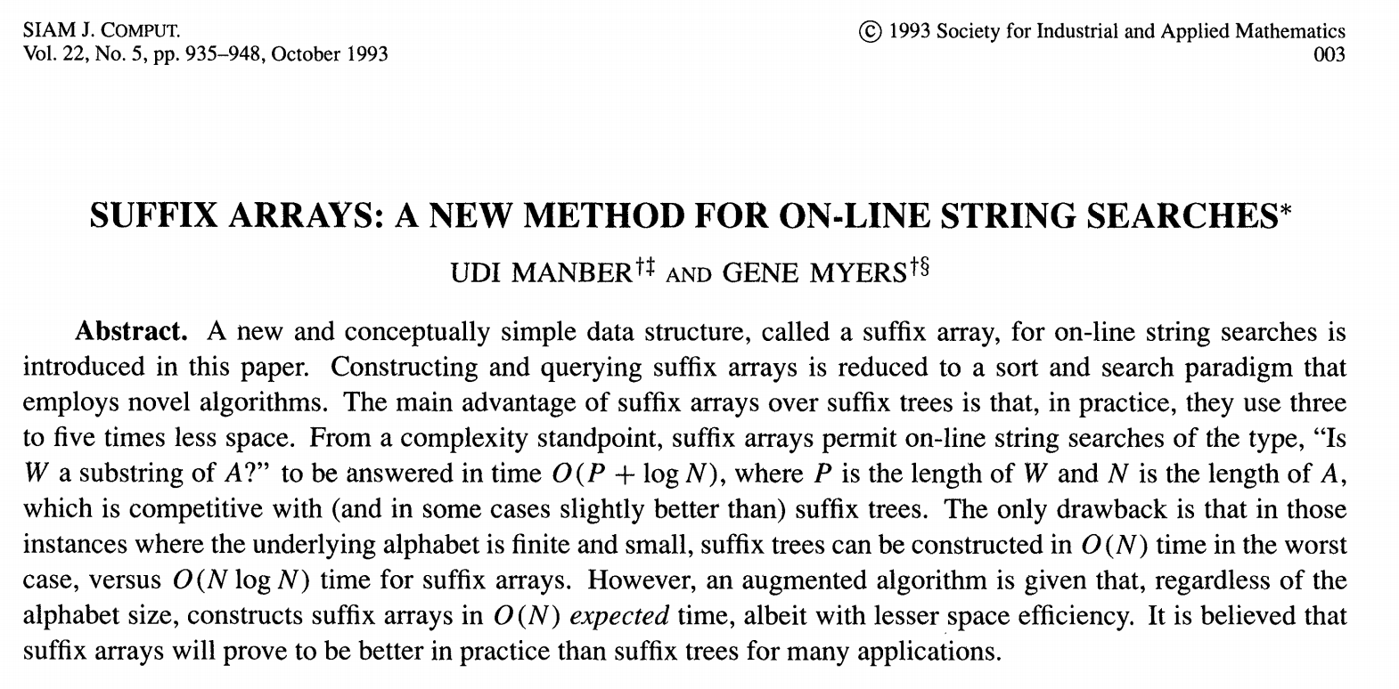
Udi Manber: Yahoo!, Amazon, Google, YouTube, currently at the NIH
Gene Myers: one of the creators of BLAST, currently at the Max Planck Institute

Slide 5
Why suffix arrays?
Compared to suffix trees:
  5 times as space efficient
  Similar search times
  Takes longer to construct
  (but same asymptotic time complexity)
“A primary motivation for this paper was to be able to efficiently answer on-line string queries for very long genetic sequences (on the order of one million or more symbols long). In practice, it is the space overhead of the query data structure that limits the largest text that may be handled.”

Slide 6
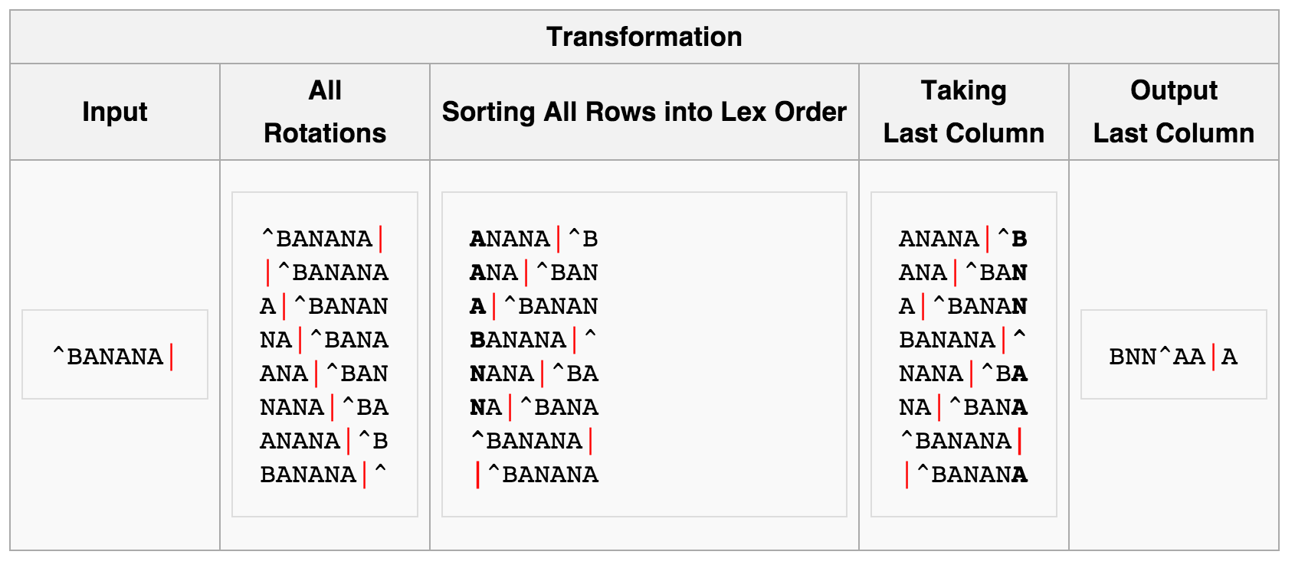
Burrows-Wheeler transform
Used in Bowtie (short read aligner by Cole Trapnell) to reduce memory usage, in combination with suffix arrays
Useful for compression (since compressing repeated sequences is easier)

Slide 7
HW1
Assignment: find the longest exactly matching subsequence between two bacterial genome sequences using suffix arrays
Due: 11:59pm on Sunday, January 14th

Slide 8
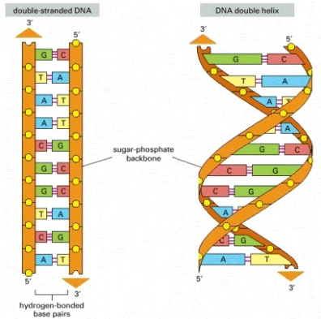
HW1
Genome A (N bases)
Genome B (M bases)
AATGC… …GGA
CTTAT… …ACC
Notes:
- Reverse complementation explained in slide 37 of the biological review

Slide 9
HW1
Genome A (N bases)
Genome B (M bases)
AATGC… …GGA
CTTAT… …ACC
Rev. complement A (N bases)
Rev. complement B (M bases)
TCC… …GCATT
GGT… …ATAAG
Goal: find longest subsequence in A (or reverse complement of A) with an exact match in B (or reverse complement of B)
Notes:
- Reverse complementation explained in slide 37 of the biological review

Slide 10
HW1
One approach: create a single combined sequence with both genome sequences and their reverse complements
AATGC…GGA
\0
TCC…GCATT
\0
CTTAT…ACC
\0
GGT…ATAAG
\0
Genome A (N bases)
Rev. comp. A (N bases)
Genome B (M bases)
Rev. comp. B (M bases)
null character
NOTE: sequences and their reverse complements should only be stored in memory ONCE. Do NOT store separate copies of each substring sequence (or you will run out of memory).

Slide 11
HW1
1. Create a list of pointers to the suffixes for the genome sequences and their reverse complements
p₁ p₂ p₃ …
p_{N+1} p_{N+2} p_{N+3} …
AATGC…GGA
\0
TCC…GCATT
\0
CTTAT…ACC
\0
GGT…ATAAG
\0
p₁ p₂ p₃
.
.
.
p_{N+1} p_{N+2} p_{N+3}
.
.
.
Each pointer refers to the location in the sequence where a suffix starts.

Slide 12
HW1
2. When looking at two pointers, compare them based on the sequence of the substring that they point to.
p₁ p₂ p₃ …
p_{N+1} p_{N+2} p_{N+3} …
AATGC…GGA
\0
TCC…GCATT
\0
CTTAT…ACC
\0
GGT…ATAAG
\0
p₁ p₂ p₃
.
.
.
p_{N+1} p_{N+2} p_{N+3}
.
.
.

Slide 13
HW1
3. Sort the suffixes lexicographically.
p₁ p₂ p₃ …
p_{N+1} p_{N+2} p_{N+3} …
AATGC…GGA
\0
TCC…GCATT
\0
CTTAT…ACC
\0
GGT…ATAAG
\0
p₁ p₂
REMEMBER: pointers are just references to locations in a string. They are NOT substrings, but we sort them based on the substrings they point to.
p_{N+3}
p_{N+2}
p_{N+1}
p₃

Slide 14
HW1
4. Find matching subsequences using the list of sorted suffixes.
p₁ p₂ p₃ …
p_{N+1} p_{N+2} p_{N+3} …
AATGC…GGA
\0
TCC…GCATT
\0
CTTAT…ACC
\0
GGT…ATAAG
\0
p₁ p₂
4a. Compare the subsequences associated with the first two pointers and find the matching subsequence.
p_{N+3}
AAG
\0
p_{N+2}
Match sequence is “AA”
p₁
AATGC… …GGA
\0
p_{N+1}
p₃

Slide 15
HW1
4. Find matching subsequences using the list of sorted suffixes.
p₁ p₂ p₃ …
p_{N+1} p_{N+2} p_{N+3} …
AATGC…GGA
\0
TCC…GCATT
\0
CTTAT…ACC
\0
GGT…ATAAG
\0
p₁ p₂
4b. Continue comparing pairs of pointers, keeping track of those with the longest match sequences.
p_{N+3}
AAG
\0
p_{N+2}
Match sequence is “A”
p₂
ATGC… …GGA
\0
p_{N+1}
p₃

Slide 16
HW1
4. Find matching subsequences using the list of sorted suffixes.
p₁ p₂ p₃ …
p_{N+1} p_{N+2} p_{N+3} …
AATGC…GGA
\0
TCC…GCATT
\0
CTTAT…ACC
\0
GGT…ATAAG
\0
p₁ p₂
4c. If there are multiple match sequences that have the maximum length, report all of them. If a match sequence appears in more than one location, report all occurrences of the match sequence.
p_{N+3}
p_{N+2}
p_{N+1}
p₃

Slide 17
HW1
4. Find matching subsequences using the list of sorted suffixes.
p₁ p₂ p₃ …
p_{N+1} p_{N+2} p_{N+3} …
AATGC…GGA
\0
TCC…GCATT
\0
CTTAT…ACC
\0
GGT…ATAAG
\0
p₁ p₂
NOTE: we want the longest matching subsequence that appears at least once in both organisms.
p_{N+3}
p_{N+2}
p_{N+1}
p₃
NO
YES
YES

Slide 18
HW1 tips
Plan out your algorithm with pseudocode
Think about what comparisons you need (and don’t need) to make
Get comfortable with pointers
Think about how to store inputs
Think about how to store results (and intermediate results)
Try to format your output to match the template
Start early (especially if using Python)
  If submitting an incomplete assignment, demonstrate the parts that do work (e.g. can read in file, works on test data but not on full dataset, etc.)

Slide 19
Programming tips: style
The more readable your code is
  The easier it will be for me to help
  The more useful it will be to you later (especially if you TA this class)
Tips for readability
  Intuitive and meaningful variable/function names
  Comments
    Outlining general structure of program/key points of implemented algorithm
    Clarifying any tricky/unintuitive lines of code
  Simplicity over performance optimization (until it becomes necessary)
Please make an effort to match the output template!

Slide 20
Programming tips: testing
Create small, easily-verified test cases
  Try to cover any edge cases you can think of
Print intermediate output
  Is the processed data as expected?
Write incrementally, test as you go
  Assertion statements can be helpful
Check against expectations
  Do your results make sense?

Slide 21
Programming tips: efficiency
Remove unnecessary operations from loops
Slow comparisons mean slow sorting
Profiling tools
  line_profiler (python)
  gprof, valgrind (C/C++) [valgrind also identifies memory leaks]
  Jprofiler (Java)

Slide 22
Pointers in C++
xptr
x
char x = ‘h’;
char *xptr = &x;
0xFE
‘h’
0x80
0xFE
Pointers are memory addresses; they tell you where the actual things are
The address-of operator (&) obtains the memory address of a variable
The dereference operator (*) accesses the value stored at the pointed-to memory location
Passing arguments by reference saves memory and time
Attributes of pointed-to structures can be accessed with the -> operator
  a->element is the same as (*a).element (particularly useful for iterators)

Slide 23
Arrays are pointers to blocks of memory
Pointers “know” the size of the thing they point to
Array indices are just pointer arithmetic and dereferencing combined
  a[12] is the same as *(a + 12)
  &a[3] is the same as a + 3
Large arrays should be dynamically allocated (on the heap)
  Make sure you delete them
word[0]
word[1]
word[2]
‘h’
‘i’
‘\0’
const char *word = “hi”;
0x80
0x88
0x90
word
word+1
word+2

Slide 24
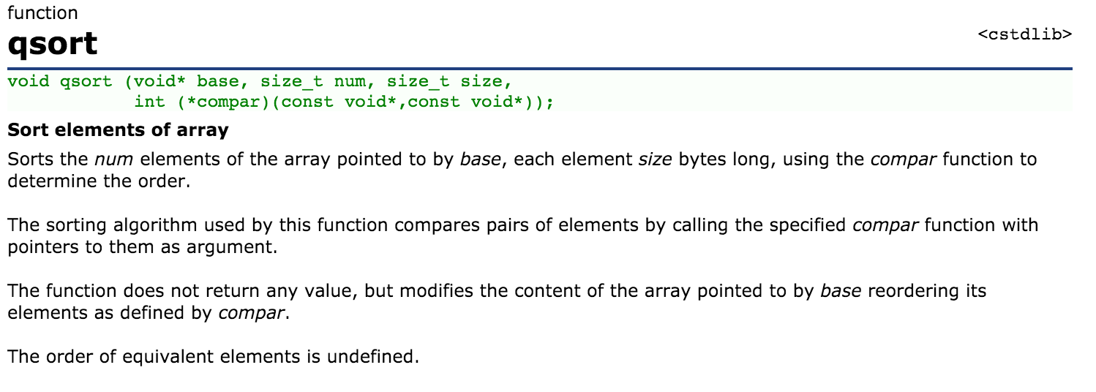
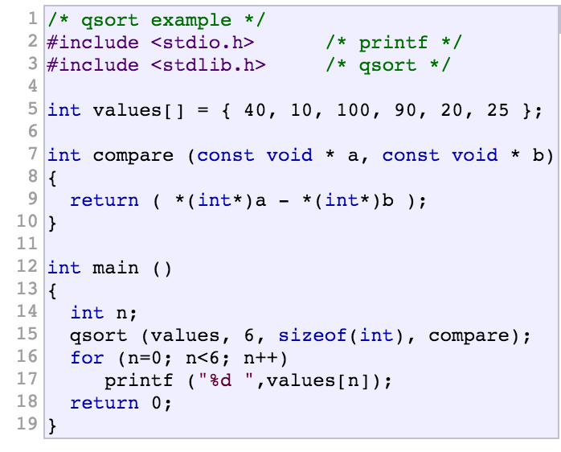
Sorting in C++
http://www.cplusplus.com/reference/

Slide 25
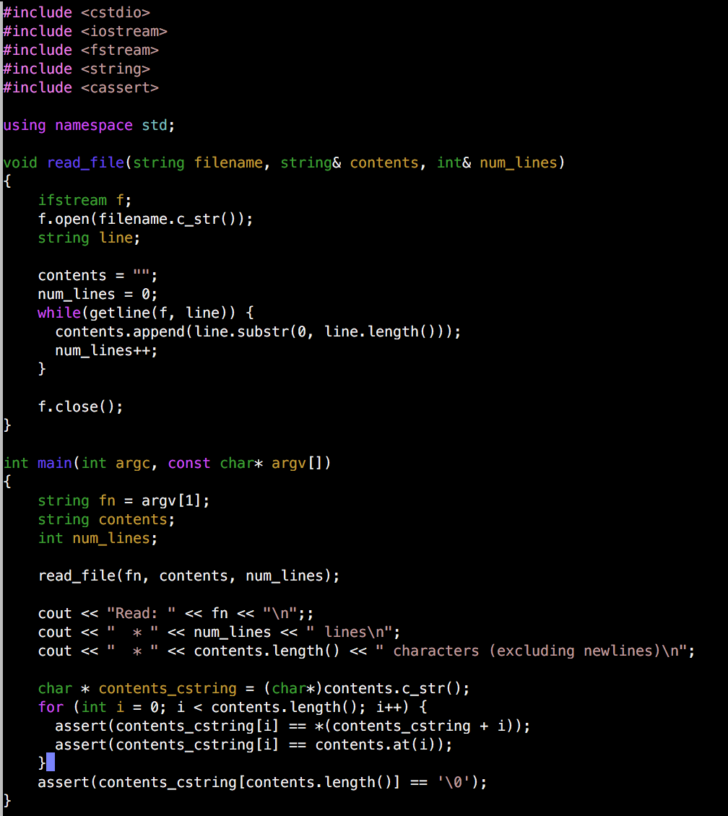
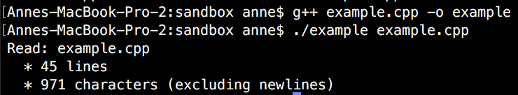
Example of reading in a file in C++
(and a few other things)
Output:

Slide 26
Suggestions for future discussion topics?
BLAST/multiple alignment
Additional applications of HMMs (GENSCAN)
Dynamic Bayesian Networks
Frequentist vs. Bayesian statistics, probabilities vs. likelihoods
Dynamic programming
More programming tips
Plotting with ggplot (R)
Machine learning
Other suggestions?

