Slide 1
Jumpstart to Becoming an Independent Researcher in Computational Biology
Genome 540
March 12, 2019
Eliah Overbey

Slide 2
Lecture Overview
Once you have a scientific question that you want to answer, how can you find the data and tools that you need in order to answer your question?
Types of Genomic Data
[Sequencing Methods/Platforms]
Topic 1
Location of Data
[Databases]
Topic 2
Approaches to analyzing data
[Crash Course in Machine Learning]
Topic 3

Slide 3
An Incomplete List of Genomic Data Types
In Genome 540, you have mostly analyzed long sequences of DNA
What else is there?
Legend
Feature of Interest
= DNA
DNA Sequences
1
ACGT

Slide 4
An Incomplete List of Genomic Data Types
In Genome 540, you have mostly analyzed long sequences of DNA
What else is there?
Legend
Feature of Interest
= DNA
DNA Sequences
RNA Sequences
= RNA
1
ACGT
ACGU
2

Slide 5
An Incomplete List of Genomic Data Types
In Genome 540, you have mostly analyzed long sequences of DNA
What else is there?
Legend
7
Feature of Interest
9
= DNA
DNA Sequences
RNA Sequences
Protein Sequences
DNA Methylation
RNA Methylation
RNA Structure
Histone Modifications
DNA-DNA Interactions
DNA-RNA Interactions
DNA-Protein Interactions
RNA-RNA Interactions
RNA-Protein Interactions
Protein-Protein Interactions
10
= RNA
4
6
8
= protein
5
1
11
ACGT
= histone (protein-complex)
ACGU
12
2
= chemical modification
13
3

Slide 6
Can your question be answered with a single data type?

Slide 7
Can your question be answered with a single data type?
How large is the jellyfish genome?
How many chromosomes does it have?
What is its evolutionary relationship to other oceanic genomes?

Slide 8
Can your question be answered with a single data type?
How large is the jellyfish genome?
How many chromosomes does it have?
What is its evolutionary relationship to other oceanic genomes?
DNA Sequencing!

Slide 9
Can your question be answered with a single data type?
How large is the jellyfish genome?
How many chromosomes does it have?
What is its evolutionary relationship to other oceanic genomes?
DNA Sequencing!
How does gene expression in the retina differ when mice are exposed to spaceflight?
What genes are expressed in the mouse retina on Earth? On the International Space Station?
How does gene expression in the retina alter in certain retinal diseases and in old age?

Slide 10
Can your question be answered with a single data type?
How large is the jellyfish genome?
How many chromosomes does it have?
What is its evolutionary relationship to other oceanic genomes?
DNA Sequencing!
How does gene expression in the retina differ when mice are exposed to spaceflight?
What genes are expressed in the mouse retina on Earth? On the International Space Station?
How does gene expression in the retina alter in certain retinal diseases and in old age?
RNA Sequencing!

Slide 11
Integrating Data Types: An Example
Can we find novel enhancers in our cell type of interest?

Slide 12
Integrating Data Types: An Example
Can we find novel enhancers in our cell type of interest?
Quick Refresh: Enhancers are distal regulatory elements that increase gene expression. They are an important mechanism for fine-tuning gene expression and enhancer variations can cause disease.
Increase Gene Expression
Enhancer
Enhancer
Gene
Gene

Slide 13
Integrating Data Types: An Example
What information do we need to find candidate enhancers?
Enhancer
Gene

Slide 14
Integrating Data Types: An Example
What information do we need to find candidate enhancers?
Gene Expression Levels (RNA-seq)
Enhancer
Gene

Slide 15
Integrating Data Types: An Example
What information do we need to find candidate enhancers?
Gene Expression Levels (RNA-seq)
Proximity Information/DNA-DNA Interactions (Hi-C)
Enhancer
Gene

Slide 16
Integrating Data Types: An Example
What information do we need to find candidate enhancers?
Gene Expression Levels (RNA-seq)
Proximity Information/DNA-DNA Interactions (Hi-C)
Enhancer Locations (ChIP-seq)
Enhancer
Gene

Slide 17
Integrating Data Types: An Example
What information do we need to find candidate enhancers?
Gene Expression Levels (RNA-seq)
Proximity Information/DNA-DNA Interactions (Hi-C)
Enhancer Locations (ChIP-seq)
Open chromatin information (ATAC-seq, DNase-seq)
Enhancer
Gene

Slide 18
Integrating Data Types: An Example
What information do we need to find candidate enhancers?
Gene Expression Levels (RNA-seq)
Proximity Information/DNA-DNA Interactions (Hi-C)
Enhancer Locations (ChIP-seq)
Open chromatin information (ATAC-seq, DNase-seq)
Important: These are only “candidate” enhancers. Functional validation, such as a reporter assay, will need to be done to prove the existence of the enhancer.
Enhancer
Gene
Notes:
As your formulating scientific questions, its important to think about: What kind of data will I need? Does my approach validate my conclusions? Or is it correlative?

Slide 19
Integrating Data Types: An Example
What information do we need to find candidate enhancers?
Gene Expression Levels (RNA-seq)
Proximity Information/DNA-DNA Interactions (Hi-C)
Enhancer Locations (ChIP-seq)
Open chromatin information (ATAC-seq, DNase-seq)
Important: These are only “candidate” enhancers. Functional validation, such as a reporter assay, will need to be done to prove the existence of the enhancer.
Enhancer
Want more info?
Research Reports 4/5/2019
Friday, 3:15pm
Foege Auditorium
Gene

Slide 20
Project Considerations
Once you have a scientific question that you want to answer, how can you find the data and tools that you need in order to answer your question?
What piece of the genome do I need to look at?
DNA? RNA? Interactions?
Will my solution provide an answer based on correlation? If so, is there a way to functionally validate my findings?

Slide 21
Project Considerations
Once you have a scientific question that you want to answer, how can you find the data and tools that you need in order to answer your question?
What piece of the genome do I need to look at?
DNA? RNA? Interactions?
Will my solution provide an answer based on correlation? If so, is there a way to functionally validate my findings?
Next:
Does sequencing platform matter?
How does sequencing information differ based on the platform used?

Slide 22
Popular Sequencing Platforms
Oxford Nanopore Technologies
Illumina
Pacific Biosciences
(recently acquired by Illumina)
Illumina NextSeq
PacBio Sequel
Oxford Nanopore MinION
Notes:
Upfront cost of sequencing machine, cost per experimental run, whether you get data back in real-time, or after the run is complete.
But if your purely a computational biologist, you probably don’t care about those things.
What you are about it…

Slide 23
Trade-off: Read Length vs Accuracy
Company | Read Length (bases) | Basecalling Accuracy
Illumina | 50 - 300 | 99.9%
Pacific Biosciences | Average ~45,000 | ~90%
Oxford Nanopore Technologies | Full length RNA (~2000) Variable: 200,000+ DNA | ~90-95%

Slide 24
Trade-off: Read Length vs Accuracy
Company | Read Length (bases) | Basecalling Accuracy
Illumina | 50 - 300 | 99.9%
Pacific Biosciences | Average ~45,000 | ~90%
Oxford Nanopore Technologies | Full length RNA (~2000) Variable: 200,000+ DNA | ~90-95%
Pacific Biosciences:
Long read sequences yields variable read lengths

Slide 25
Trade-off: Read Length vs Accuracy
Company | Read Length (bases) | Basecalling Accuracy
Illumina | 50 - 300 | 99.9%
Pacific Biosciences | Average ~45,000 | ~90%
Oxford Nanopore Technologies | Full length RNA (~2000) Variable: 200,000+ DNA | ~90-95%
Do you want small, accurate reads or long, noisy reads?

Slide 26
Example: Gene Expression (RNA-sequencing) Considerations
Advantages: Short, Accurate Reads
Person 1: ATCGCTGTATCTGTATGGTTTA
Person 2: ATCCCTGTATCTGTATTGTTTA
Person 3: ATCGCTGTAACTGTATTGTTTA
Identification of SNPs
(single nucleotide polymorphisms)

Slide 27
Example: Gene Expression (RNA-sequencing) Considerations
Advantages: Short, Accurate Reads
Advantages: Long, Noisy Reads
Blue = Introns
Green, Orange, Yellow, Grey = Exons
Person 1: ATCGCTGTATCTGTATGGTTTA
Person 2: ATCCCTGTATCTGTATTGTTTA
Person 3: ATCGCTGTAACTGTATTGTTTA
Identification of SNPs
(single nucleotide polymorphisms)
Isoform Detection

Slide 28
Example: Genome Assembly (DNA-sequencing)
Advantages: Short, Accurate Reads
Advantages: Long, Noisy Reads
High resolution assemblies. You can rely on the SNP information being detected.
Long repeat regions

Slide 29
Example: Genome Assembly (DNA-sequencing)
Advantages: Short, Accurate Reads
Advantages: Long, Noisy Reads
High resolution assemblies. You can rely on the SNP information being detected.
Long repeat regions
Can we have the best of both worlds?

Slide 30
Example: Genome Assembly (DNA-sequencing)
Advantages: Short, Accurate Reads
Advantages: Long, Noisy Reads
High resolution assemblies. You can rely on the SNP information being detected.
Long repeat regions
Can we have the best of both worlds?

Slide 31
Example: Genome Assembly (DNA-sequencing)
Advantages: Short, Accurate Reads
Advantages: Long, Noisy Reads
High resolution assemblies. You can rely on the SNP information being detected.
Long repeat regions
Can we have the best of both worlds?

Slide 32
Project Considerations
Once you have a scientific question that you want to answer, how can you find the data and tools that you need in order to answer your question?
What piece of the genome do I need to look at?
DNA? RNA? Interactions?
Will my solution provide an answer based on correlation? If so, is there a way to functionally validate my findings?
Next:
Does sequencing platform matter?
How does sequencing information differ based on the platform used?

Slide 33
Project Considerations
Once you have a scientific question that you want to answer, how can you find the data and tools that you need in order to answer your question?
What piece of the genome do I need to look at?
DNA? RNA? Interactions?
Will my solution provide an answer based on correlation? If so, is there a way to functionally validate my findings?
Next:
Does sequencing platform matter? – YES!
How does sequencing information differ based on the platform used?
Do I want long/noisy reads? Short/accurate reads? Combination of the two?

Slide 34
Lecture Overview
Once you have a scientific question that you want to answer, how can you find the data and tools that you need in order to answer your question?
Types of Genomic Data
[Sequencing Methods/Platforms]
Topic 1
Location of Data
[Databases]
Topic 2
Approaches to analyzing data
[Crash Course in Machine Learning]
Topic 3

Slide 35
Know What You’re Looking For
Raw sequencing data
Processed data
Topical data

Slide 36
SRA – Sequence Read Archive

Slide 37
GenBank

Slide 38
GEO – Gene Expression Omnibus

Slide 39
1000 Genomes Project

Slide 40
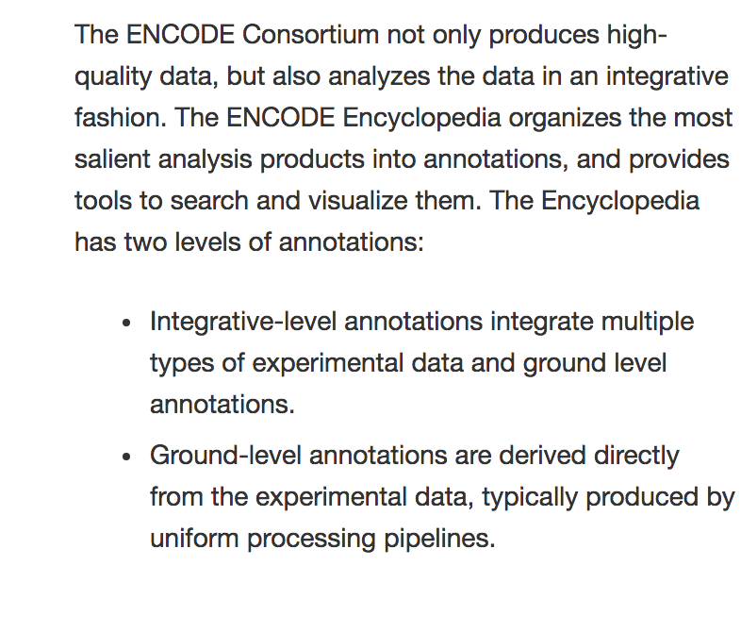
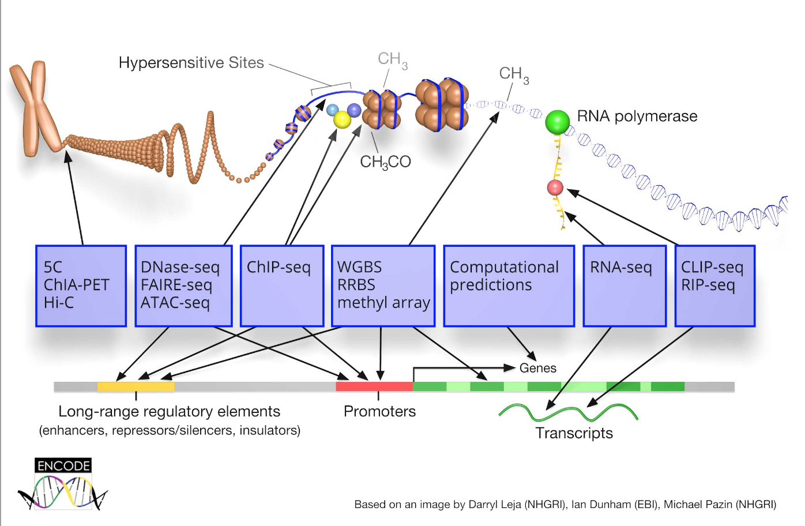
ENCODE: Encylopedia of DNA Elements

Slide 41
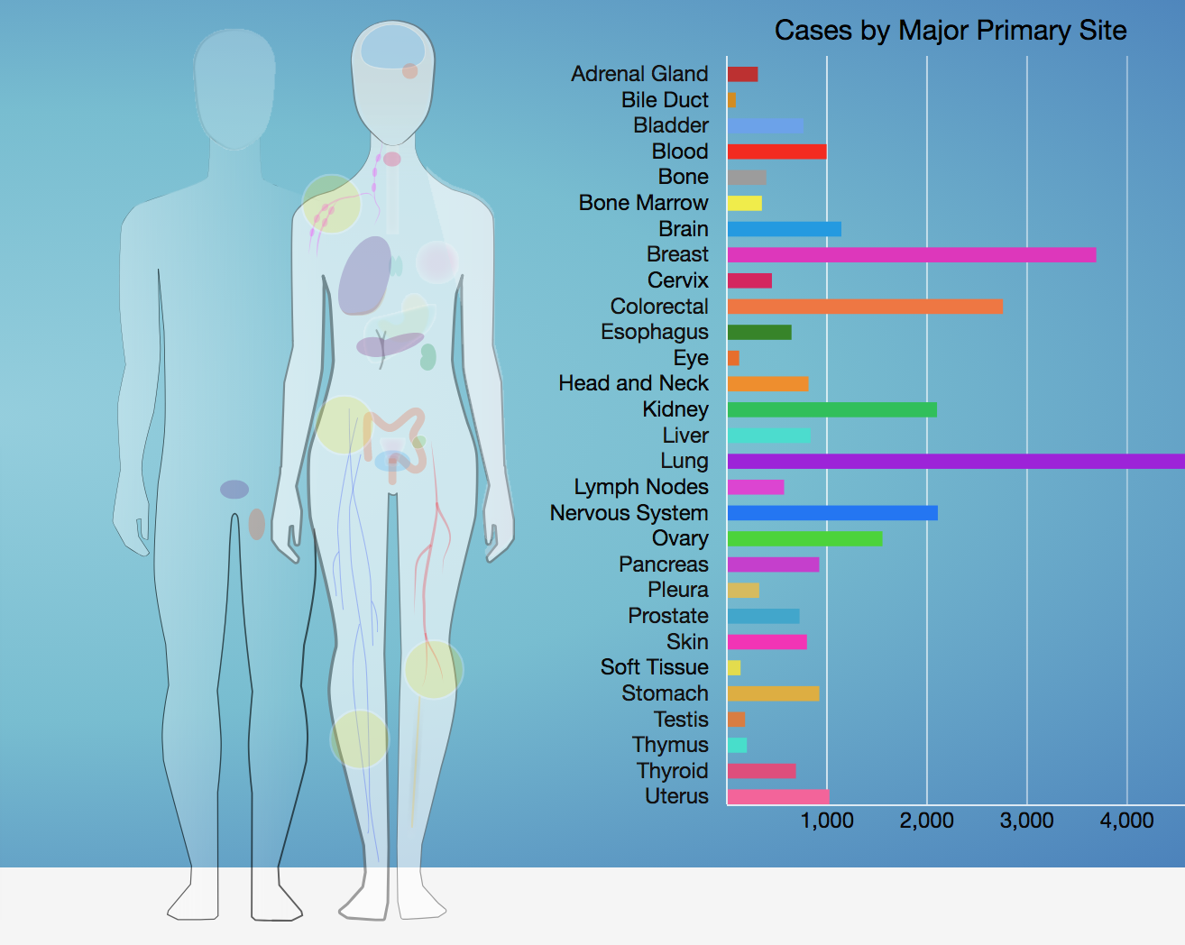
The Cancer Genome Atlas (TCGA)

Slide 42
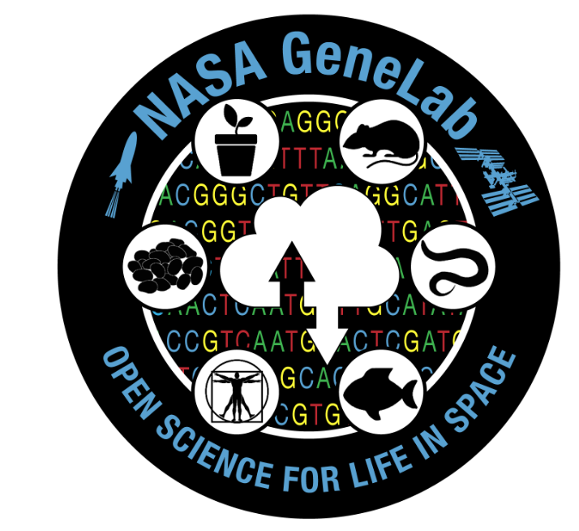
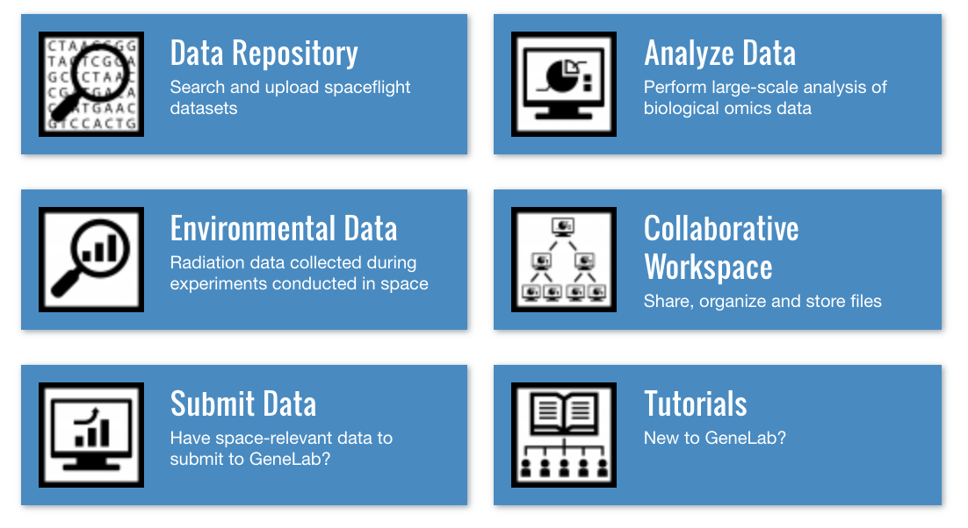
NASA GeneLab

Slide 43
Lecture Overview
Once you have a scientific question that you want to answer, how can you find the data and tools that you need in order to answer your question?
Types of Genomic Data
[Sequencing Methods/Platforms]
Topic 1
Location of Data
[Databases]
Topic 2
Approaches to analyzing data
[Crash Course in Machine Learning]
Topic 3

Slide 44
What is Machine Learning?
Geron, (2017)

Slide 45
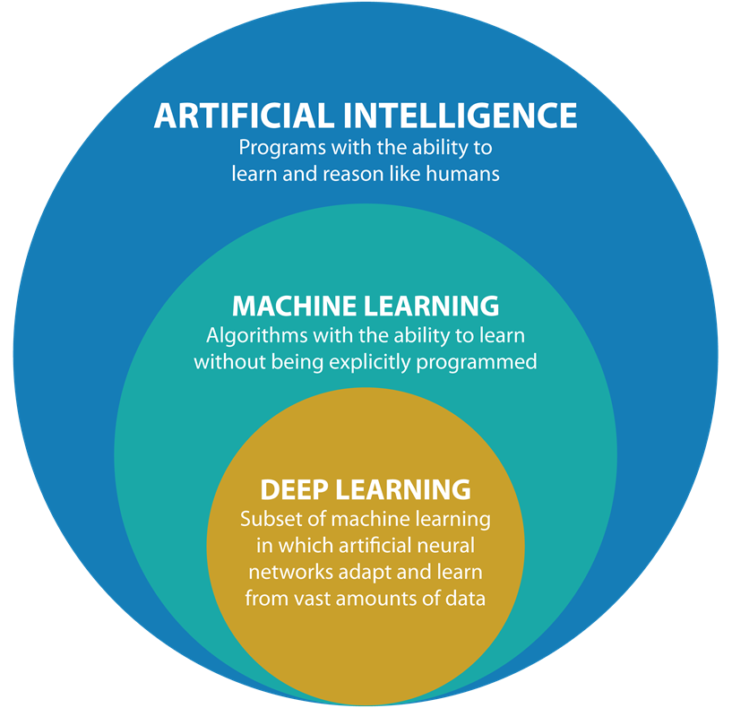
AI VS Machine Learning VS Deep Learning

Slide 46
What Problems Can Machine Learning Solve?
Geron, (2017)

Slide 47
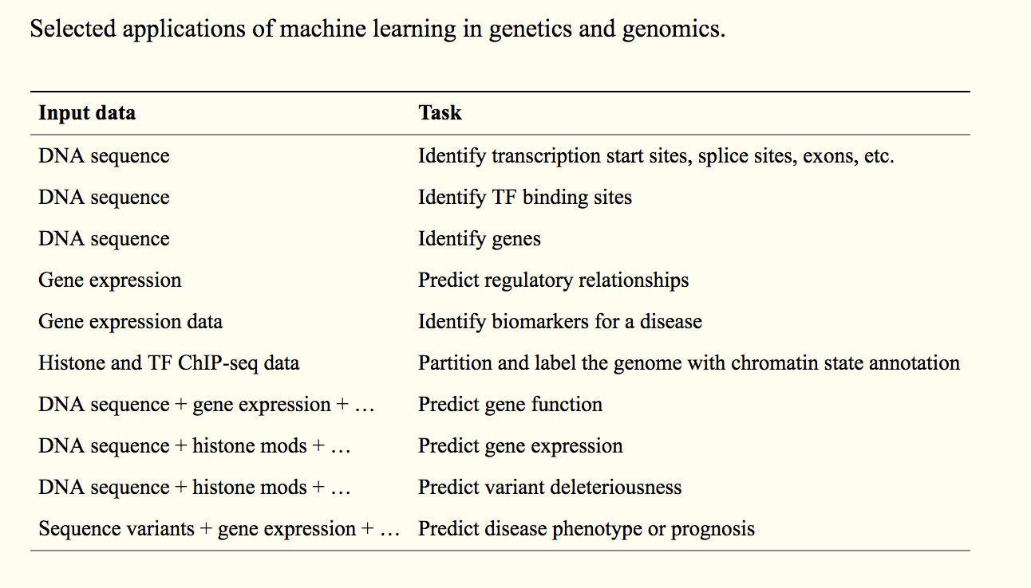
Applications of Machine Learning in Genomics
Libbrecht, Noble (2015)

Slide 48
Types of Machine Learning
Type of training
Supervised
Semi-Supervised
Unsupervised
Reinforcement Learning
Pace of Learning
Incrementally (batch learning)
On-the-fly (online learning)
Instance-based or model-based learning

Slide 49
Supervised Learning
The data that you feed to the algorithm includes the desired solutions, called labels.
Example 1: Classify an email as ‘spam’ or ‘not-spam’.
Classification task.

Slide 50
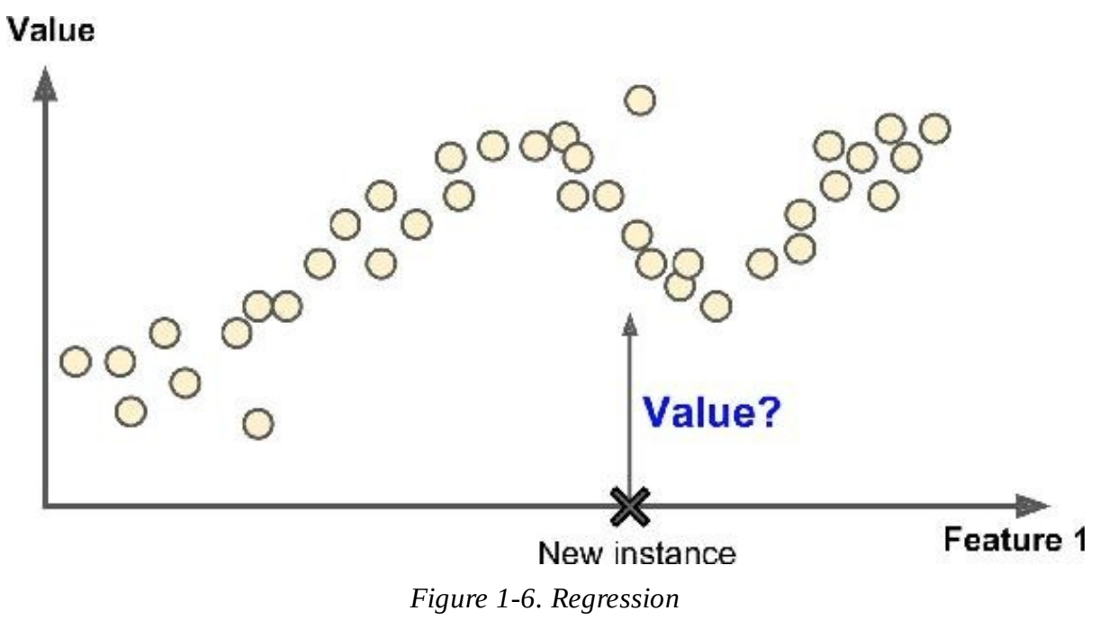
Supervised Learning
The data that you feed to the algorithm includes the desired solutions, called labels.
Example 1: Classify an email as ‘spam’ or ‘not-spam’.
Classification task.
Example 2: Predict a target numerical value, such as the price of a car based on a set of predictors (age, mileage, brand, etc.) called features.
Regression Task.

Slide 51
Supervised Learning Algorithms
K-nearest neighbors
Linear Regression
Logistic Regression
Support Vector Machines
Decision Trees and Random Forests
Neural Networks
Notes:
What is the difference between Linear Regression and Logistic Regression?
Find an astrobiology example of each of these.
Talk about neural networks separately at the end.

Slide 52
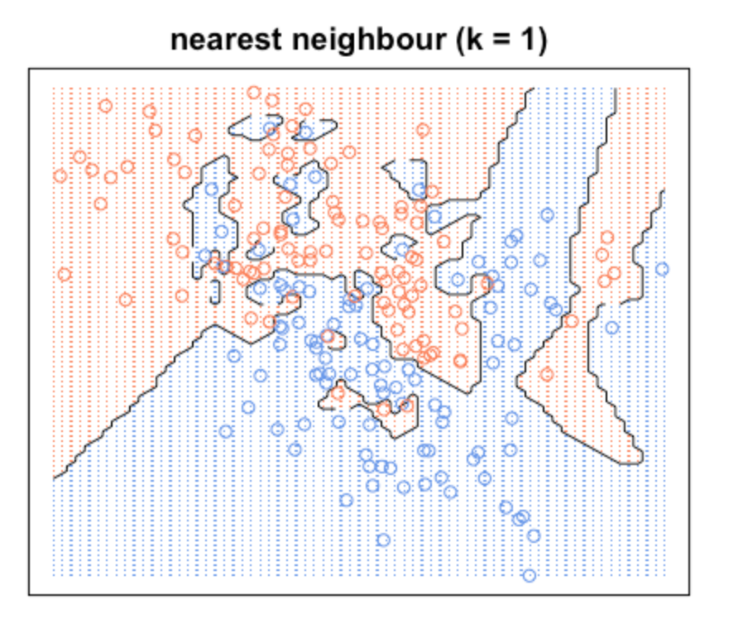
K-nearest Neighbors (KNN): Concept
Online Tutorial

Slide 53
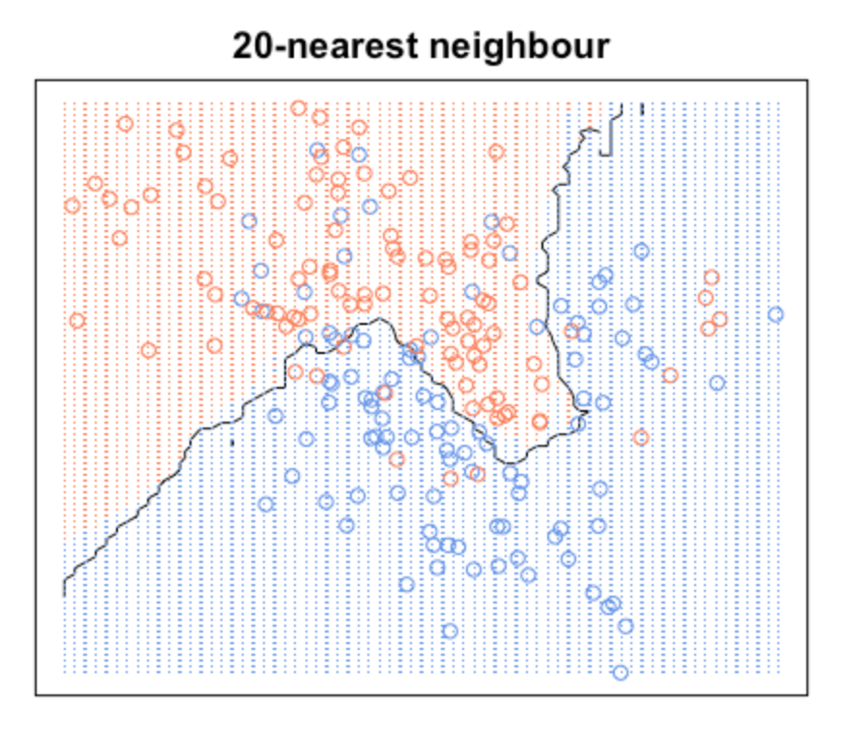
K-nearest Neighbors (KNN): Concept
Online Tutorial

Slide 54
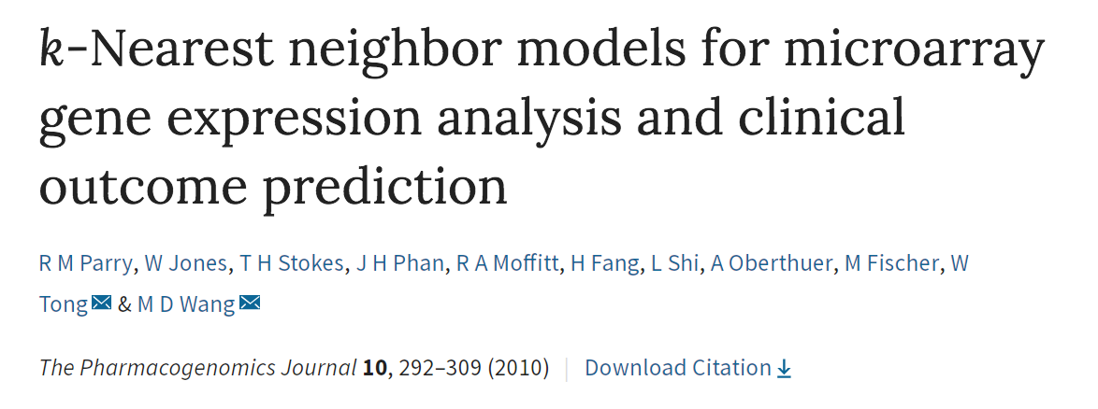
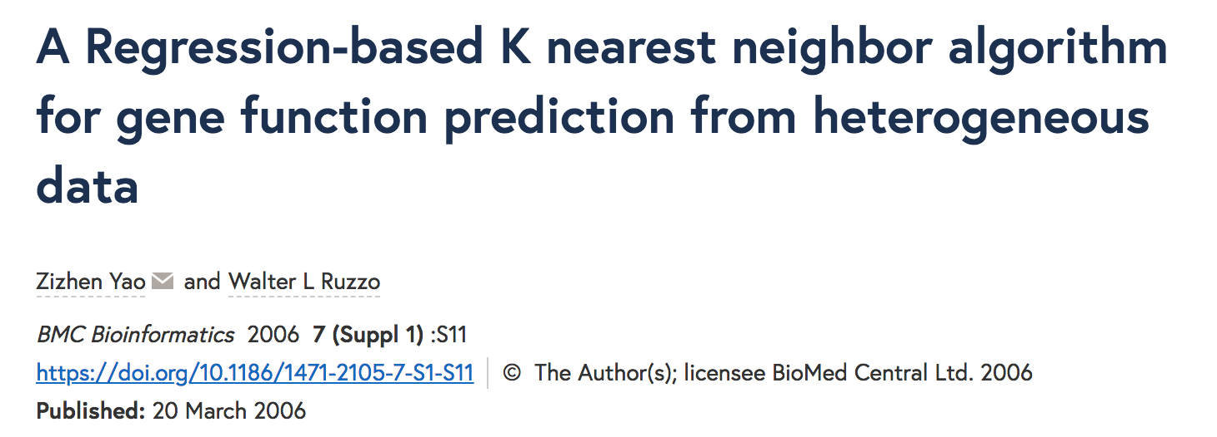
Applications in Genomics

Slide 55
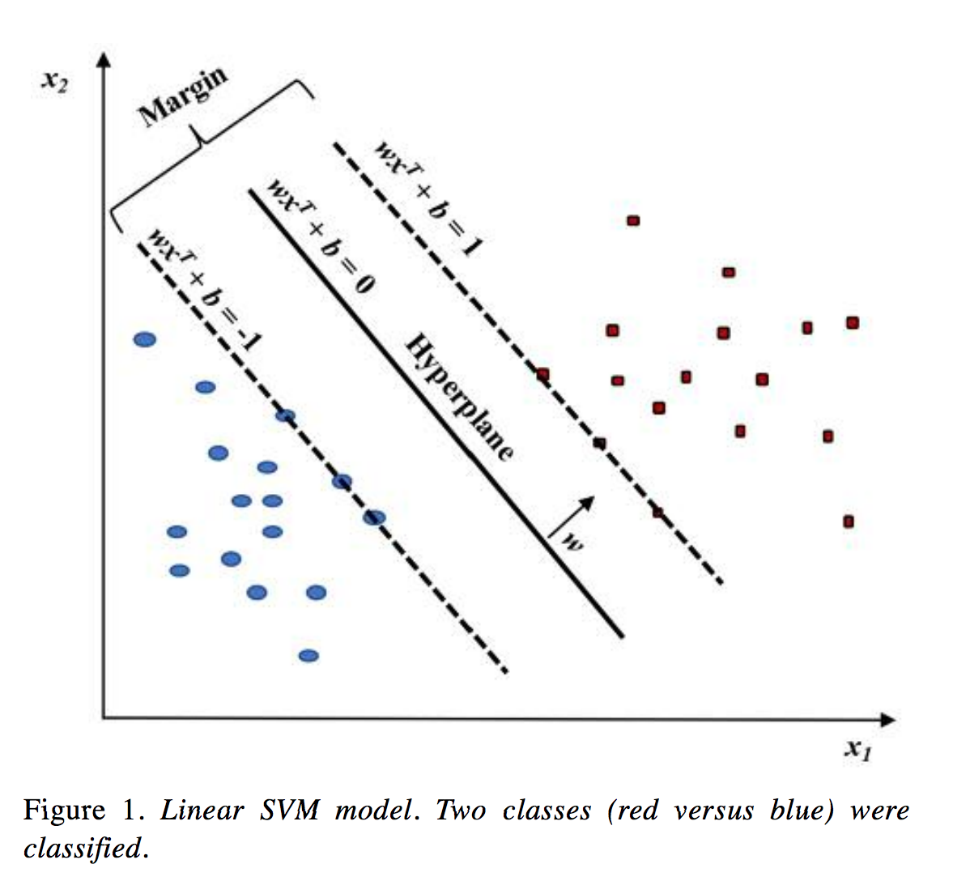
Support Vector Machines (SVM): Concept
Huang et al. (2018)
Notes:
Support vectors define the hyperplane

Slide 56
Support Vector Machines (SVM): Example
Using DNA methylation to distinguish between acute lymphoblastic leukemia (ALL) and acute myeloid leukiema (AML)
Model et al. (2015)
Notes:
Support vectors define the hyperplane

Slide 57
Support Vector Machines (SVM): Example
Using DNA methylation to distinguish between acute lymphoblastic leukemia (ALL) and acute myeloid leukiema (AML)
Input Data
List of genomic regions with DNA methylation across many patient samples.
Samples are labeled with which type of cancer the patient has.
Model et al. (2015)
Notes:
Support vectors define the hyperplane

Slide 58
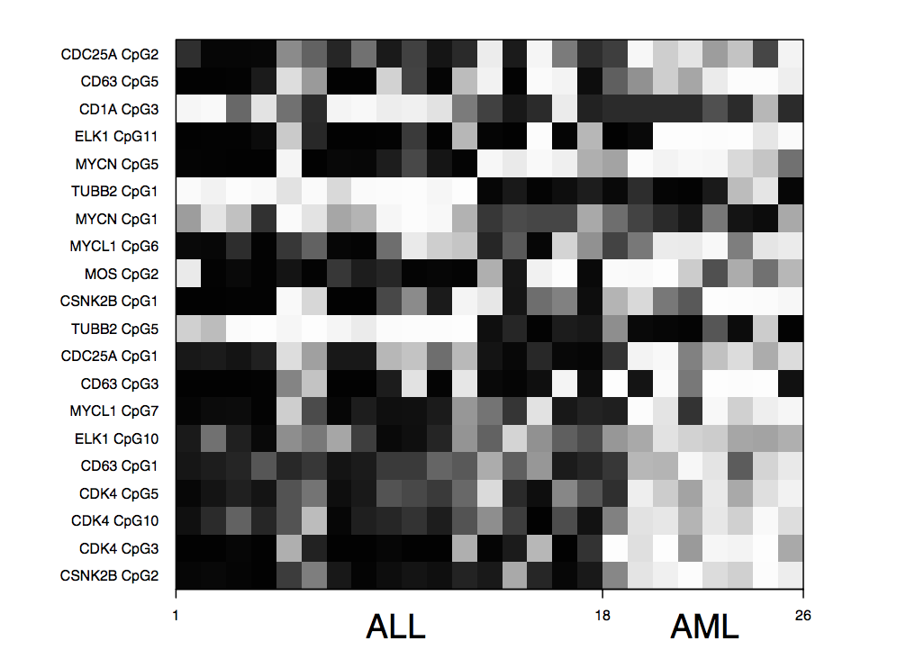
Support Vector Machines (SVM): Example
Using DNA methylation to distinguish between acute lymphoblastic leukemia (ALL) and acute myeloid leukiema (AML)
Input Data
List of genomic regions with DNA methylation across many patient samples.
Samples are labeled with which type of cancer the patient has.
Feature Selection with the Fisher Criterion
Model et al. (2015)
Notes:
Support vectors define the hyperplane

Slide 59
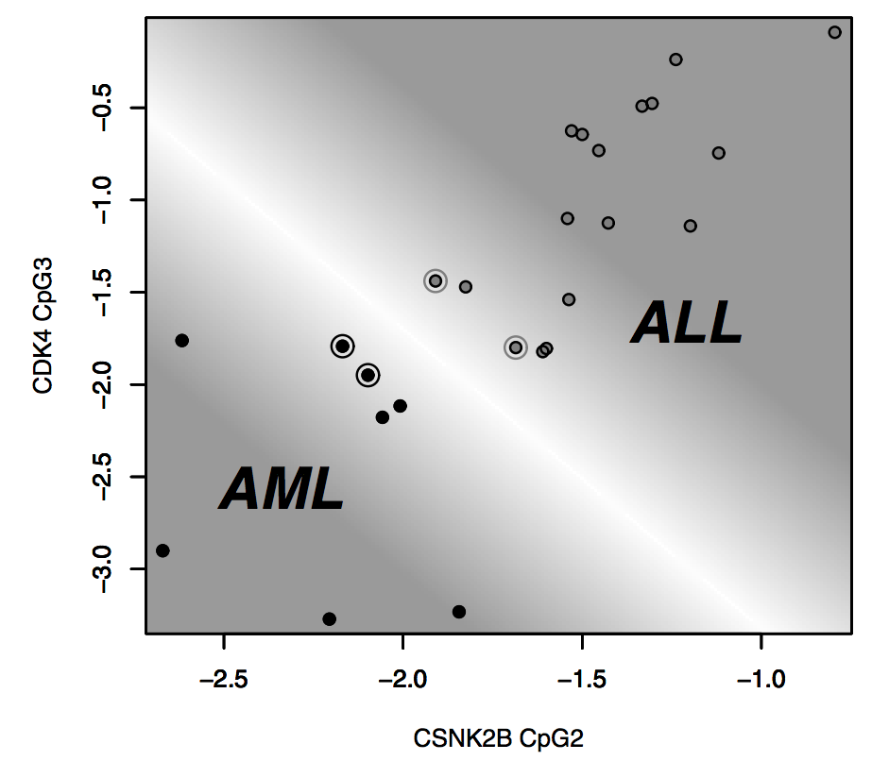
Support Vector Machines (SVM): Example
Using DNA methylation to distinguish between acute lymphoblastic leukemia (ALL) and acute myeloid leukiema (AML)
Input Data
List of genomic regions with DNA methylation across many patient samples.
Samples are labeled with which type of cancer the patient has.
Feature Selection with the Fisher Criterion
Model et al. (2015)
Notes:
Support vectors define the hyperplane

Slide 60
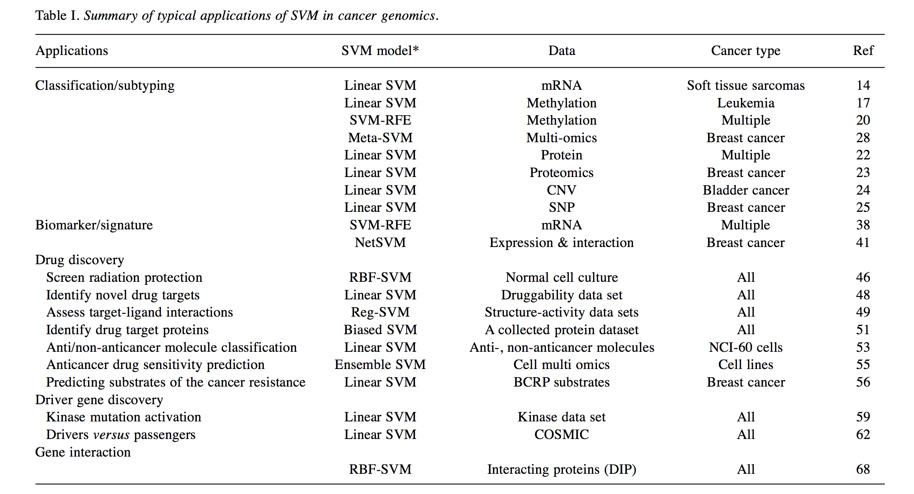
Support Vector Machines Broadly Applied in Cancer Genomics
Huang et al. (2018)

Slide 61
Semi-Supervised Learning
Training data is partially labeled.
Typically, there is a bit of labeled data and a lot of unlabeled data.

Slide 62
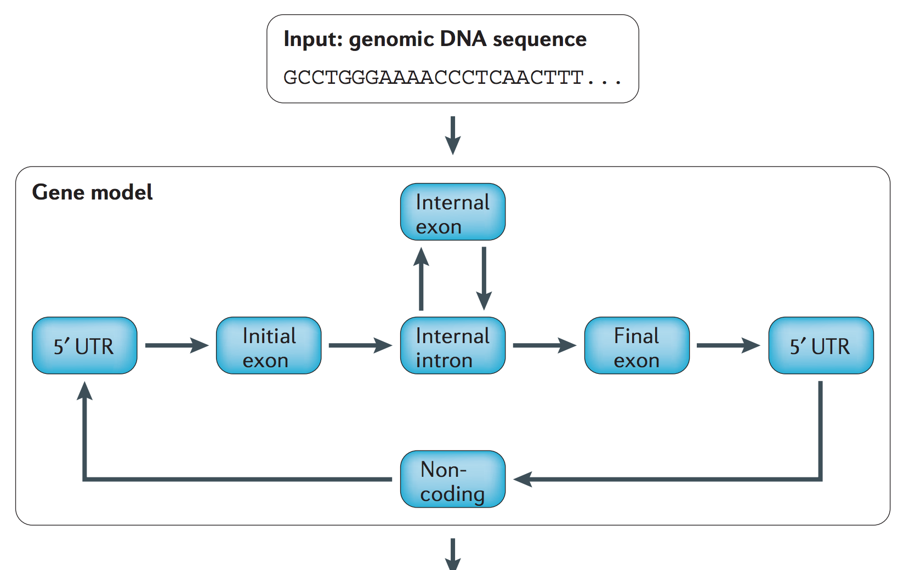
Semi-Supervised Learning
Training data is partially labeled.
Typically, there is a bit of labeled data and a lot of unlabeled data.
Example: Gene-finding systems
1) Use a collection of annotated genes to train your model.
2) Then scan the whole genome and assign tentative labels for additional genes.
3) Update the model based on the tentative genes that were found.
This increases the amount of training data for your model and can results in better predictions.
Libbrecht, Noble (2015)

Slide 63
Reinforcement Learning
Very different!
Learning system is called an “agent”
The agent can:
Observe the environment
Select and perform actions
Receive rewards/penalties
The agent must learn the best strategy, which is the one that maximizes rewards and minimizes penalties
Fewer genomics examples

Slide 64
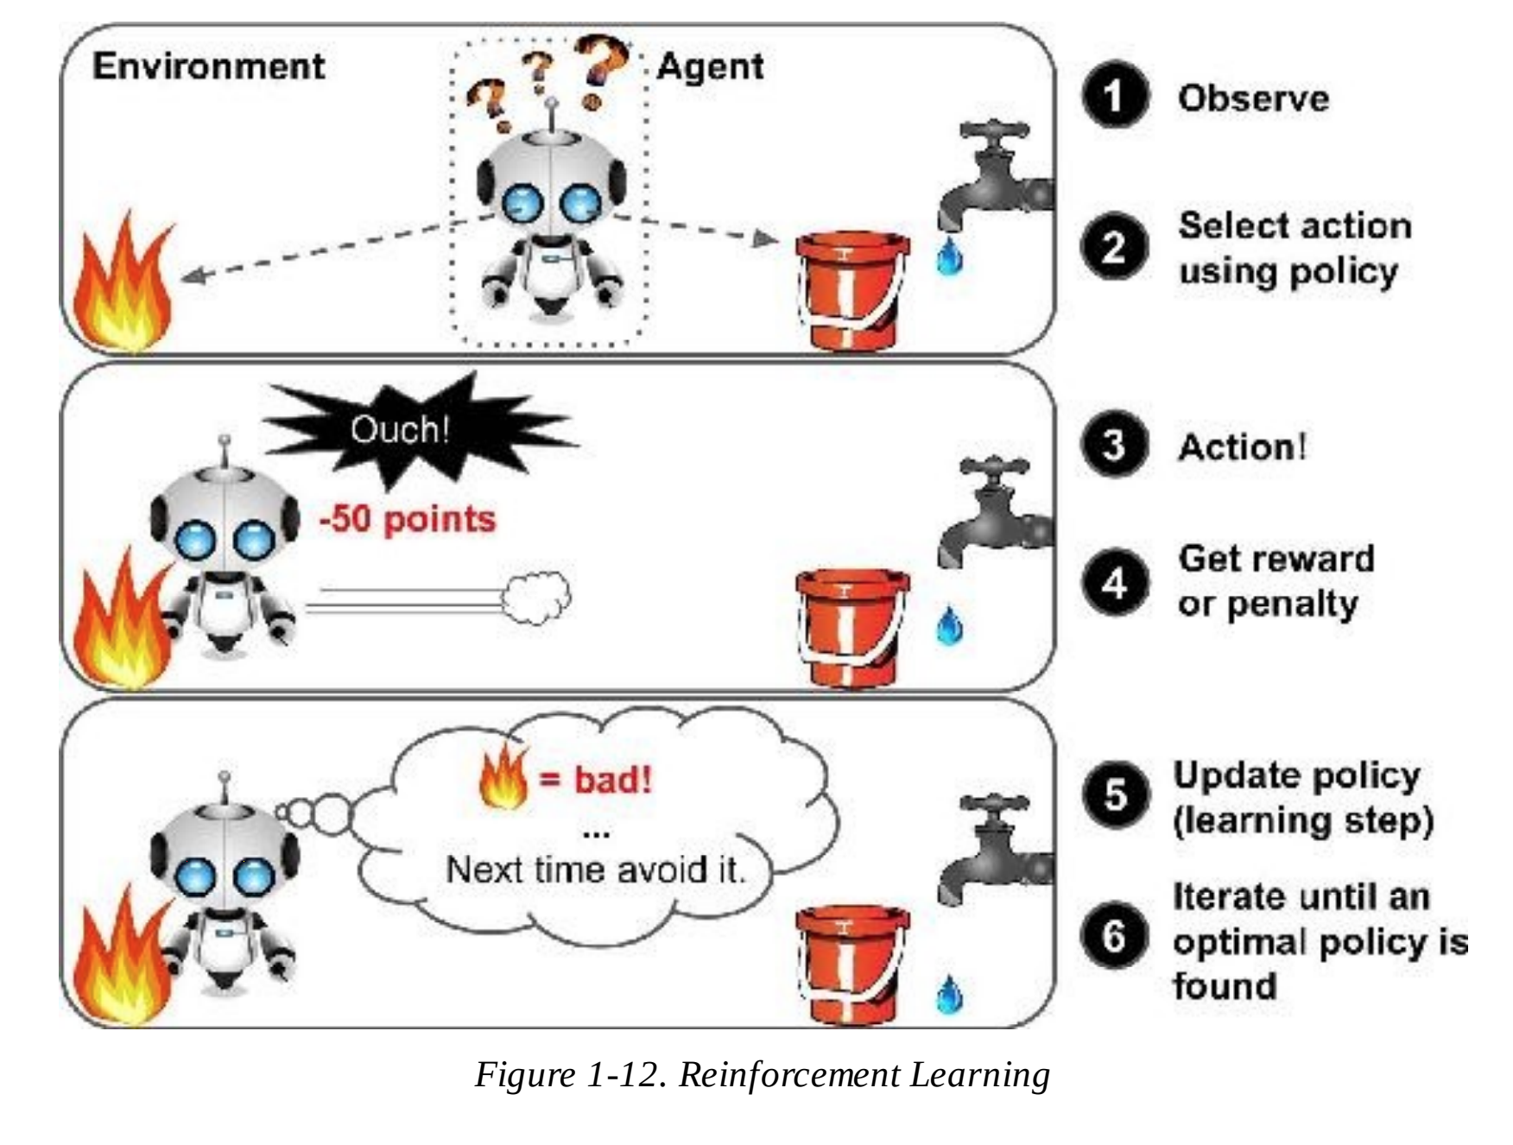
Reinforcement Learning
Geron (2017)

Slide 65
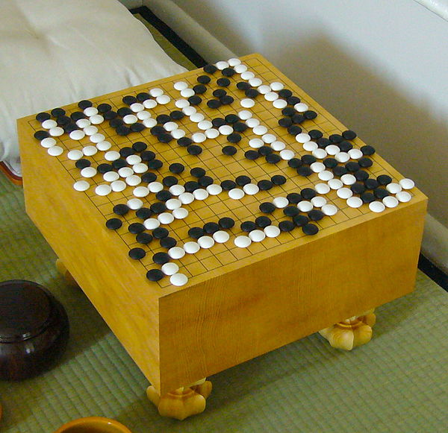
Reinforcement Learning: AlphaGo
AlphaGo is a computer program created by Google’s DeepMind team
Invented in China over 2500 years ago
In 2016, it beat Go champion Lee Sedol (AlphaGo won 4 out of 5 games).
2 * 10¹⁷⁰ = lower bound on number of legal board positions (more atoms than in the known universe)
It used “highly inventive winning moves” that went against hundreds of years of wisdom

Slide 66
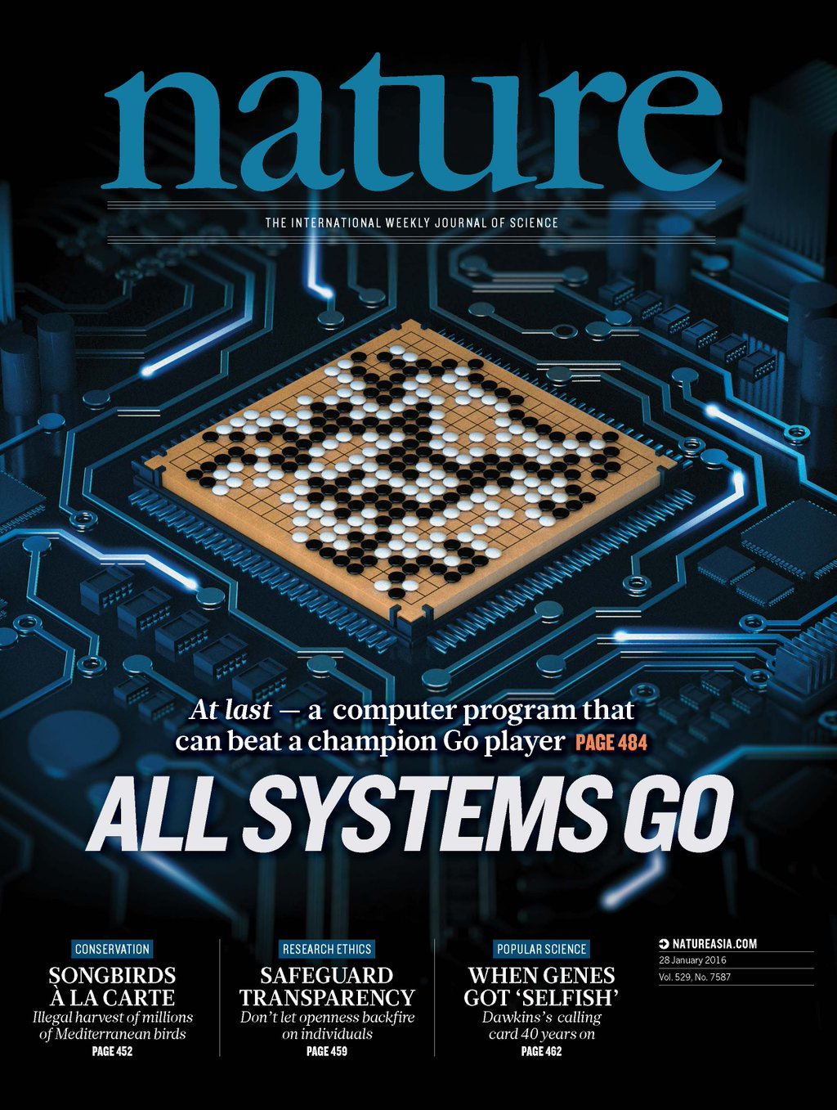
Reinforcement Learning: AlphaGo
Learning was turned off during the games against Lee Sedol.
AlphaGo was just applying the policy it had learned.
Silver (2016)

Slide 67
Unsupervised Learning Algorithms
Dimensionality Reduction, Clustering, and Visualization
Principal Component Analysis (PCA)
Kernal PCA
Independent Component Analysis
Locally-Linear Embedding (LLE)
T-distributed Stochastic Neighbor Embedding (t-SNE)
Notes:
Find an astrobiology example of some of these.

Slide 68
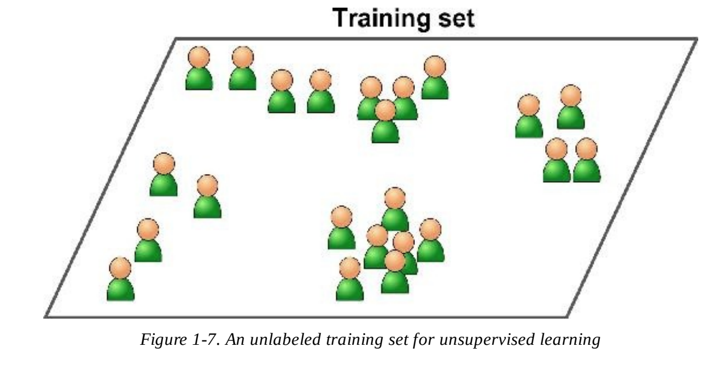
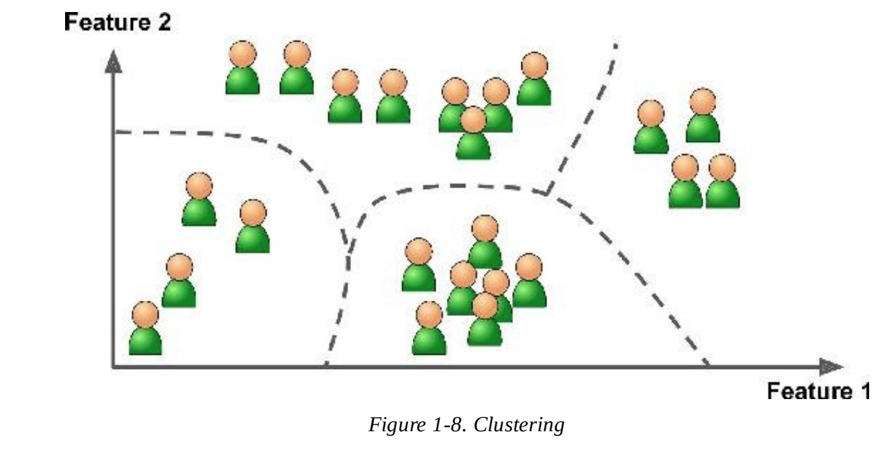
Unsupervised Learning
The training data is unlabeled.
Geron (2017)

Slide 69
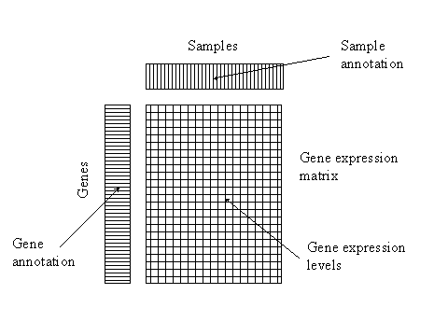
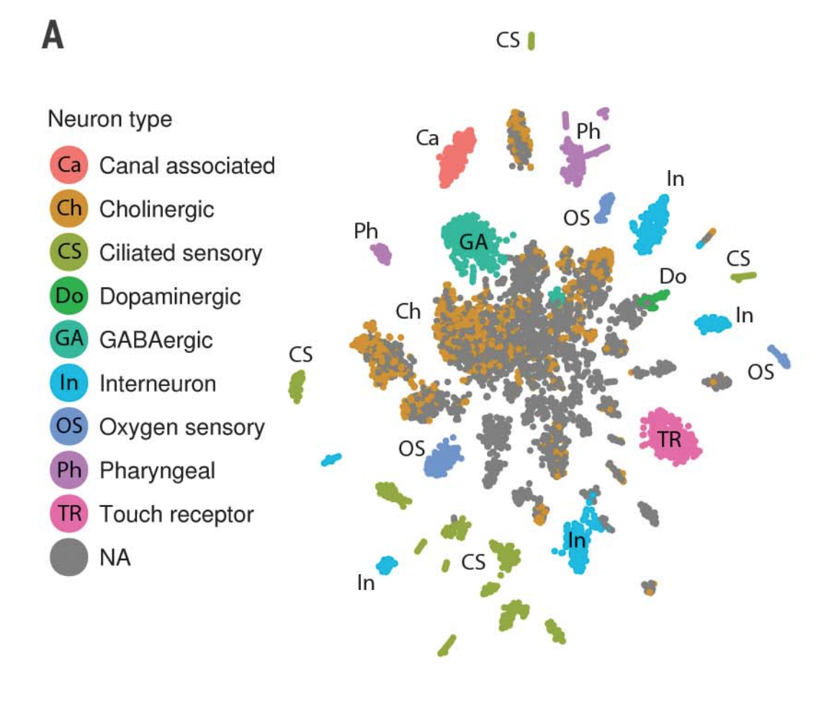
T-SNE Example: Clustering cell types from single cell RNA-seq data
Neuron Cells in C. elegans
Cao et al. 2017

Slide 70
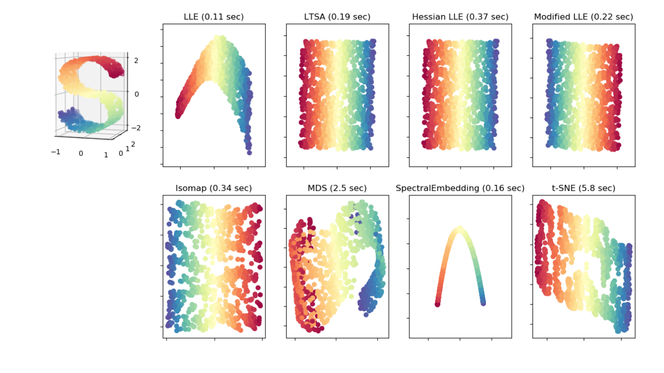
Variations in Dimensionaltiy Reduction Methods
SciKit Learn Tutorial

Slide 71
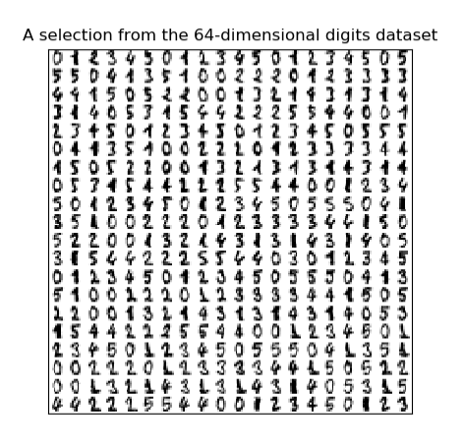
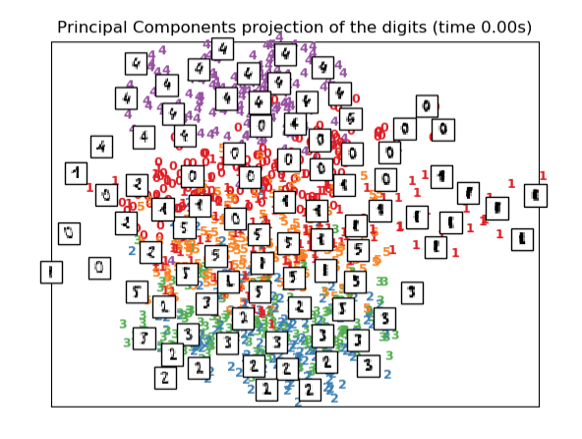
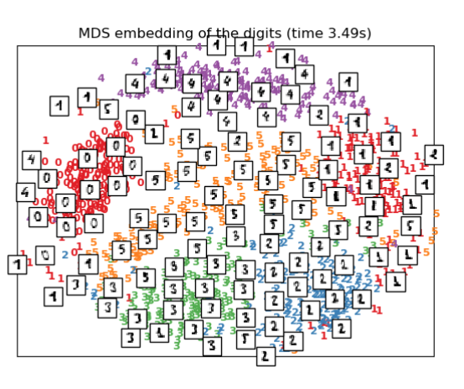
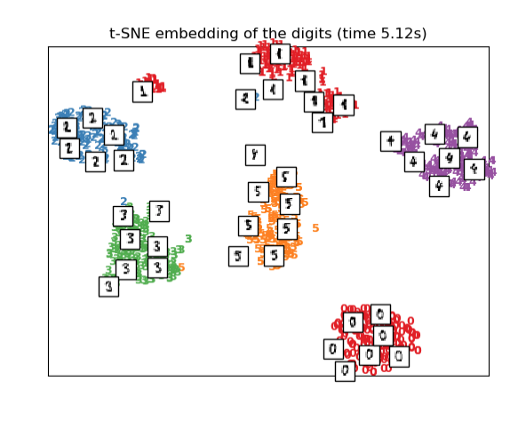
t-SNE is optimal for separating clusters
SciKit Learn Tutorial

Slide 72
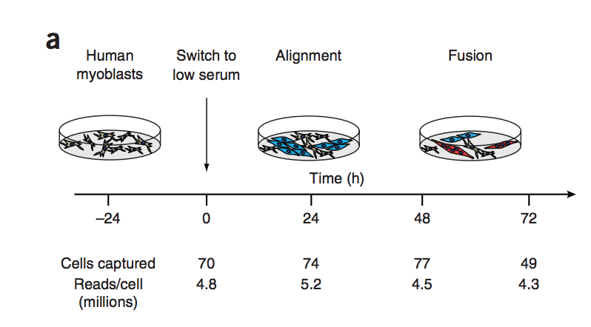
Example: Independent Component Analysis
Ordering single cell RNA-seq measurements in pseudotime
Trapnell et al. 2014

Slide 73
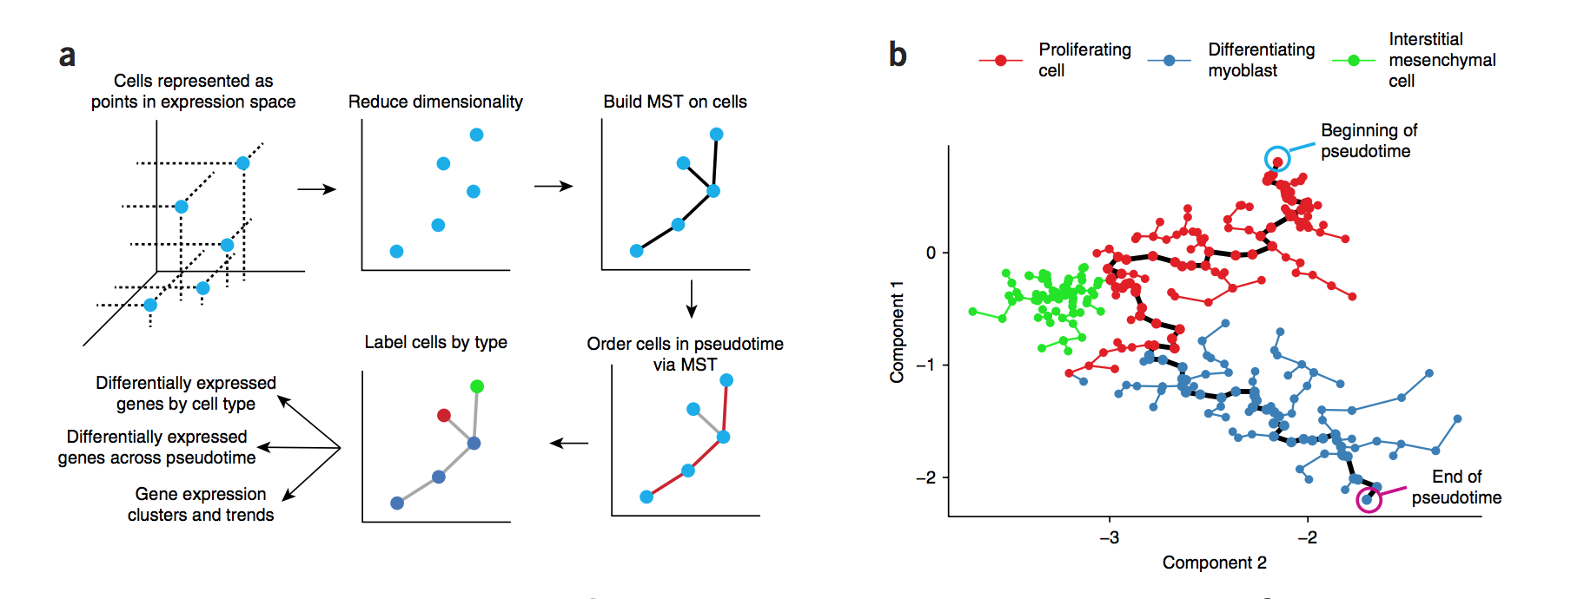
Example: Independent Component Analysis
Ordering single cell RNA-seq measurements in pseudotime
Trapnell et al. 2014

Slide 74
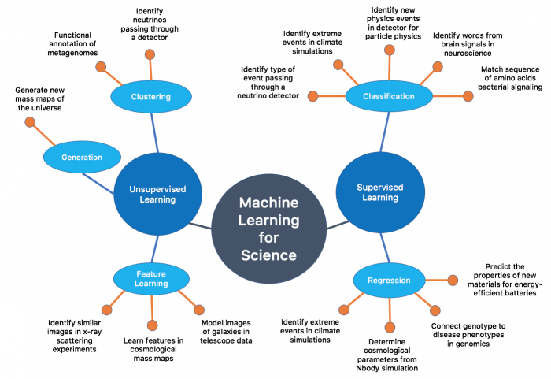

Slide 75
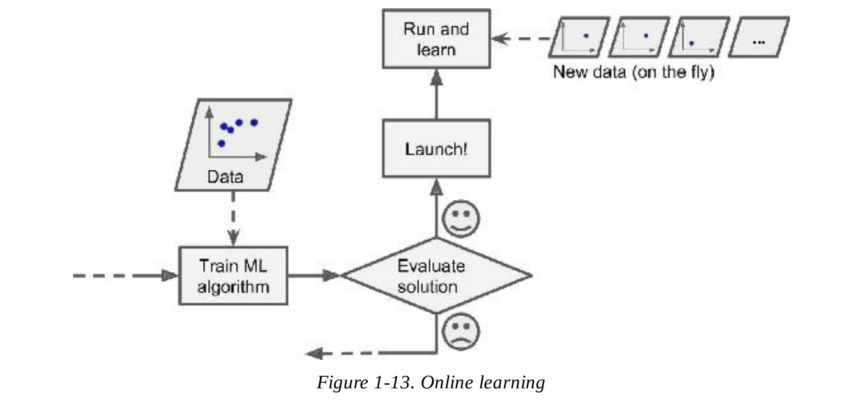
Batch Learning vs Online Learning
Batch Learning
System is incapable of learning incrementally and must be trained all at once.
Online Learning
System can learn from batches
of data.
A ‘Learning Rate’ setting can
determine how to weight new
data compared to the older data.
Geron (2017)

Slide 76
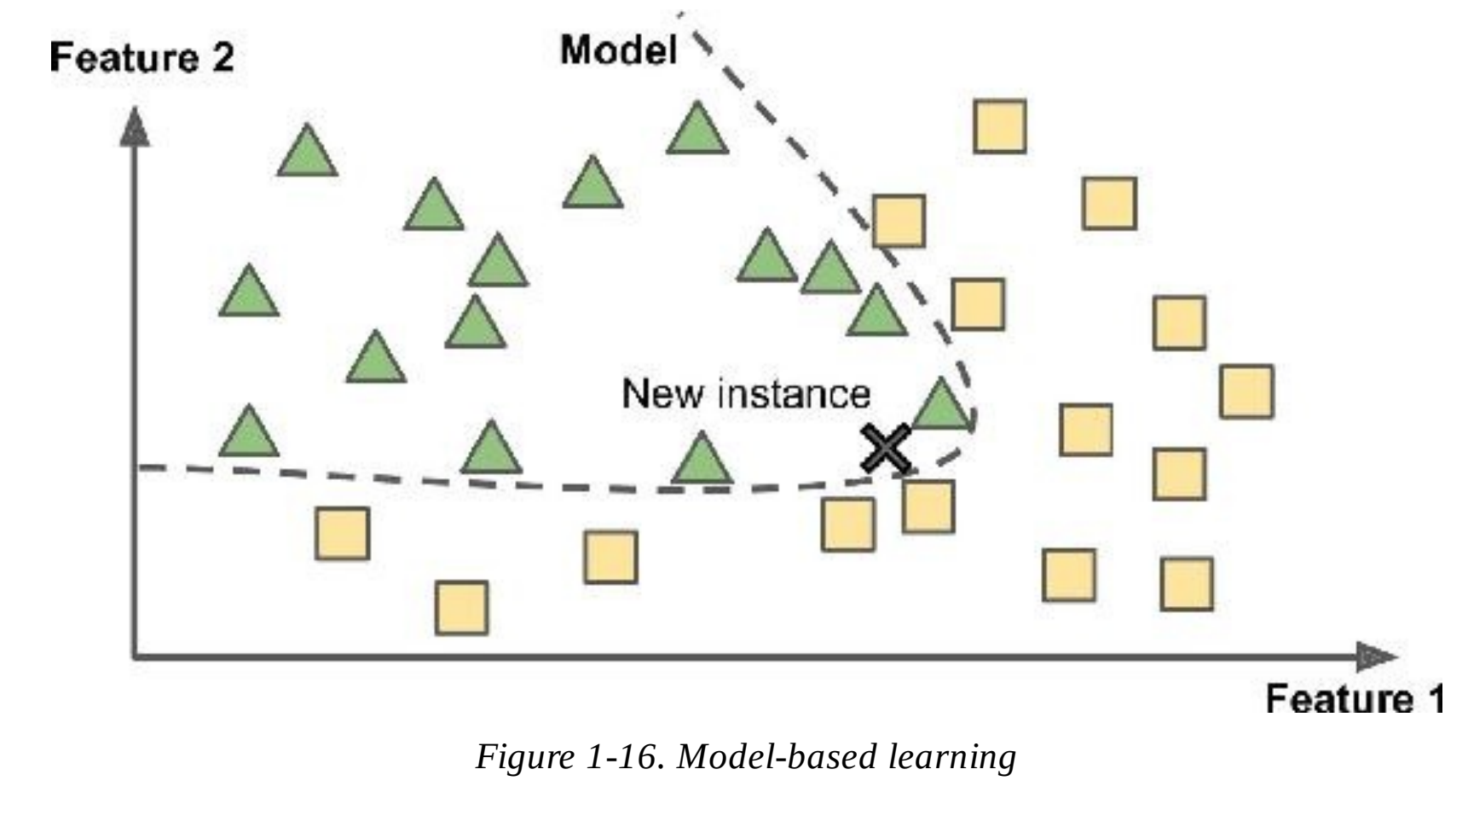
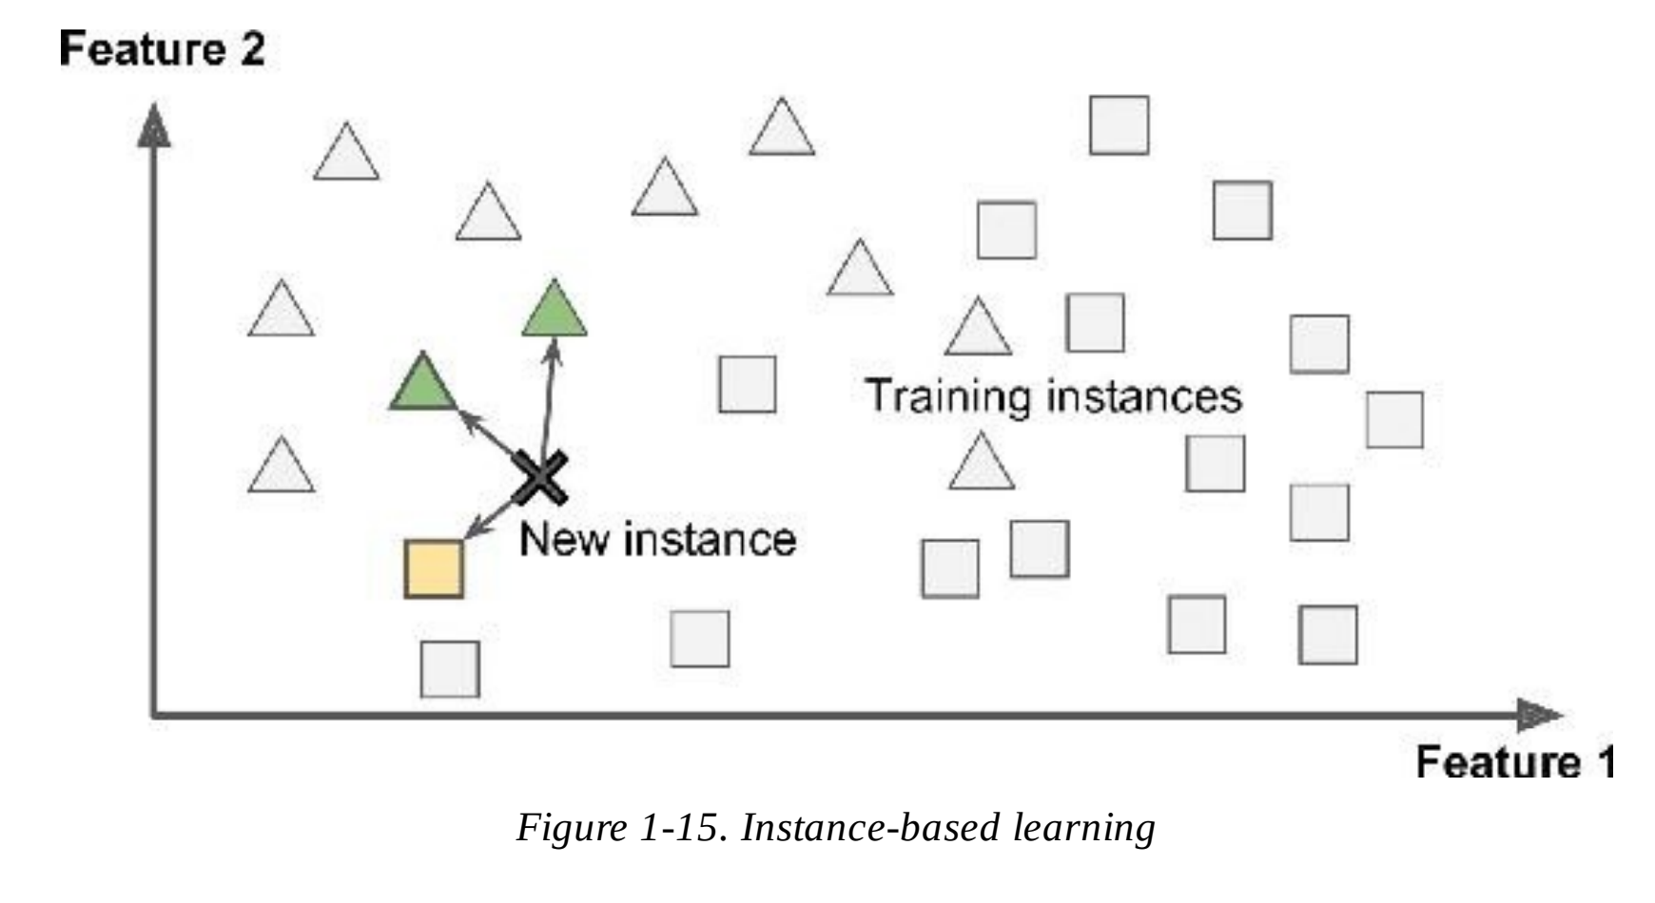
Instance-Based vs Model Based Learning
Learn labels of test data from measures of similarity between training instances and test instances.
Build a model to make predictions and learn labels of test data from those predictions.
Geron (2017)

Slide 77
Main Challenges in Machine Learning
Insufficient quality of training data
Non-representative training set
Poor quality data
Irrelevant features
Overfitting
Underfitting

Slide 78
Main Challenges in Machine Learning
Insufficient quality of training data
Non-representative training set
Poor quality data
Irrelevant features
Overfitting
Underfitting
Underfitting
Good Fit
Overfitting

Slide 79
Neural Nets (Deep Learning)
Convolutional Neural Net (CNN):
CNN take a fixed size input and generate fixed-size outputs.
CNN is a type of feed-forward artificial neural network - are variations of multilayer perceptrons which are designed to use minimal amounts of preprocessing.
CNNs use connectivity pattern between its neurons is inspired by the organization of the animal visual cortex, whose individual neurons are arranged in such a way that they respond to overlapping regions tiling the visual field.
CNNs are ideal for images and videos processing.
Recurrent Neural Net (RNN):
RNN can handle arbitrary input/output lengths.
RNN, unlike feedforward neural networks, can use their internal memory to process arbitrary sequences of inputs.
Recurrent neural networks use time-series information (i.e. what I spoke last will impact what I will speak next.)
RNNs are ideal for text and speech analysis.

Slide 80
Convolutional Neural Nets

Slide 81
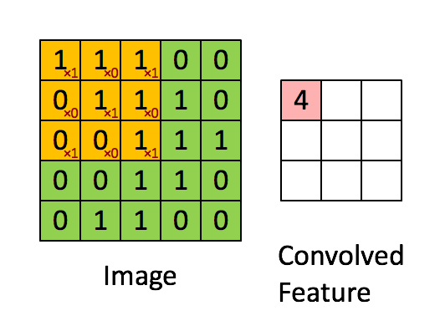
Convolutional Neural Nets

Slide 82
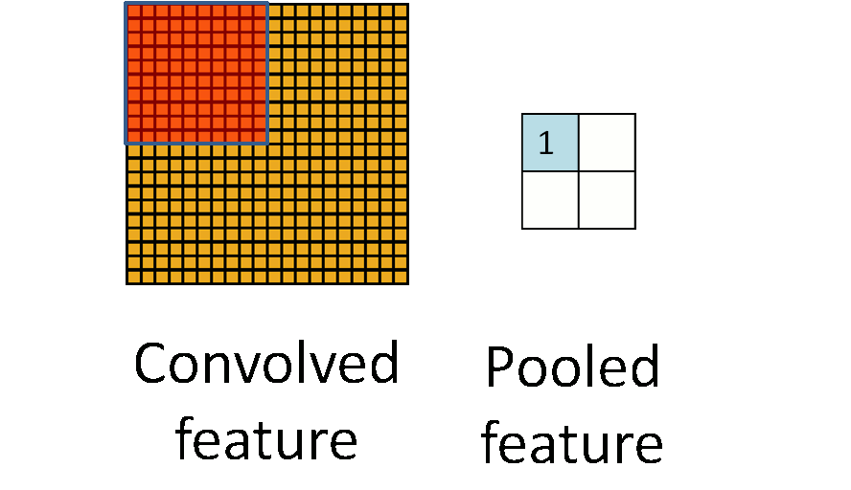
Convolutional Neural Nets

Slide 83
Convolutional Neural Nets: Promoter Prediction
A is encoded as (1 0 0 0), T is encoded as (0 1 0 0),
G is encoded as (0 0 1 0) and C is encoded as (0 0 0 1).

Slide 84
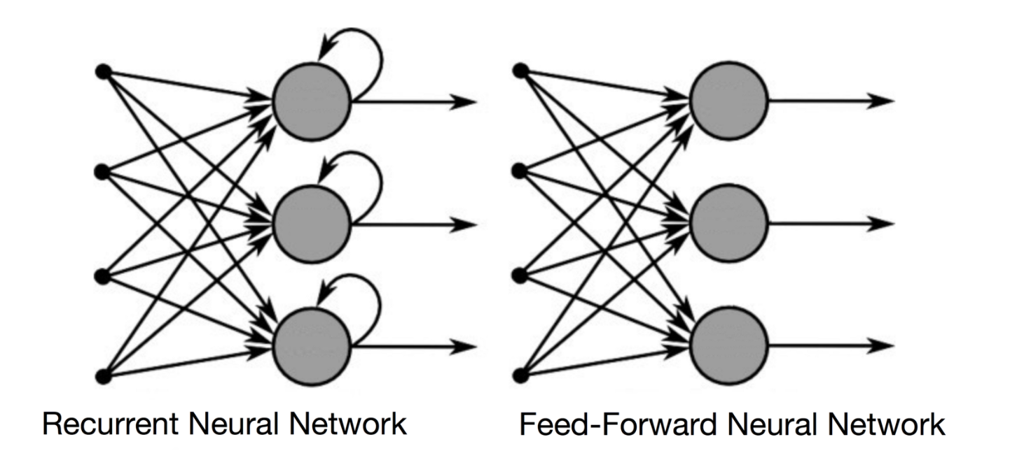
Recurrent Neural Networks
RNNs allow for passing through the same layer multiple times

Slide 85
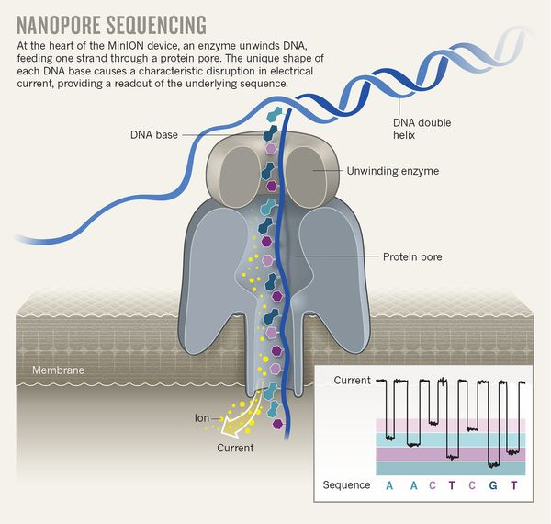
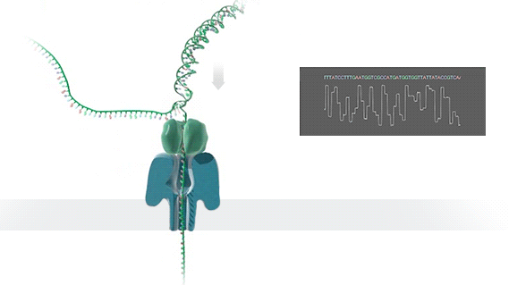
Interpreting current signal from nanopore sequencing
Example: Recurrent Neural Networks
Eisenstein. 2017
Oxford Nanopore Technologies

Slide 86
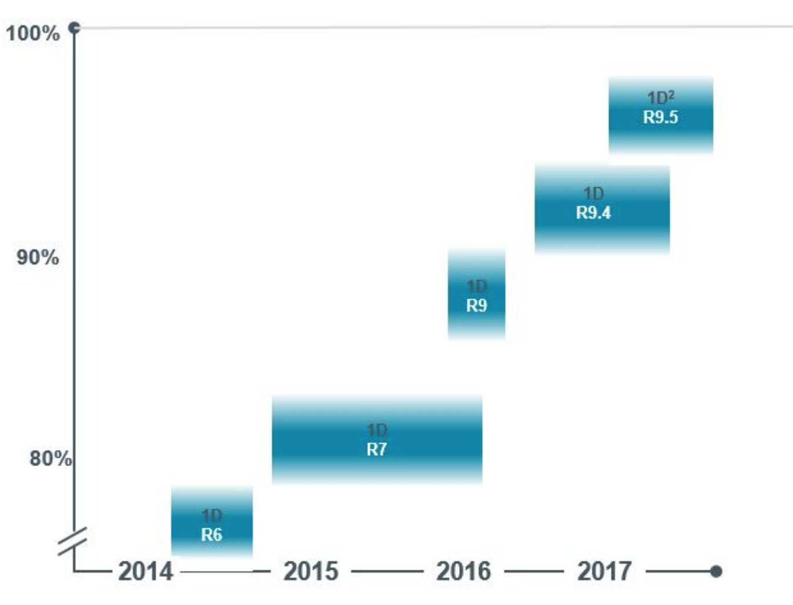
Basecalling accuracy increases significantly after RNNs introduced
RNNs Necessary for Sequencing Accuracy
Basecalling accuracy
Introduction of RNN
Release of the sequencer
Oxford Nanopore Technologies

Slide 87
Get Started Using Deep Learning: Tensorflow
“Open source library… with strong support for machine learning and deep learning. ”
Developed by Google’s AI research team
https://www.tensorflow.org
https://github.com/tensorflow/tensorflow
You can pip install it!
pip install tensorflow
Also has APIs for Java, C, and GO

Slide 88
Get Started Using Deep Learning: Tensorflow
Provides a framework and tools in which to build ML models
Allows varying levels of abstraction
High level APIs let you use pre-defined models
Low level API allows you to define your own mathematical operations
Optimized for CPUs, GPUs, and TPUs (Tensor Processing Units)

Slide 89
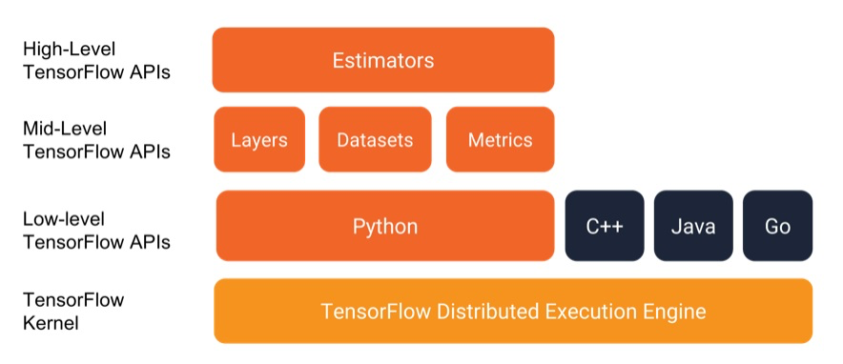
Get Started Using Deep Learning: Tensorflow

Slide 90
Get Started Using Deep Learning: Tensorflow
Prerequisites:
python
pandas toolkit (for data manipulation and analysis)
pip install pandas
Install Tensorflow:
pip install tensorflow
Take a look at their tutorials or google’s machine learning crash course:
https://www.tensorflow.org/tutorials
https://developers.google.com/machine-learning/crash-course/ml-intro

Slide 91
Visualzing a Neural Network with Tensorflow
https://playground.tensorflow.org
Concepts:
Learning rate: Like a step size - how much you adjust weights each iteration.
Activation function: How the node determines its output for a given input.
Regularization: A penalty term on the objective related to the number of weights in the model.
Loss: A measurement of the goodness of the fit.

Slide 92
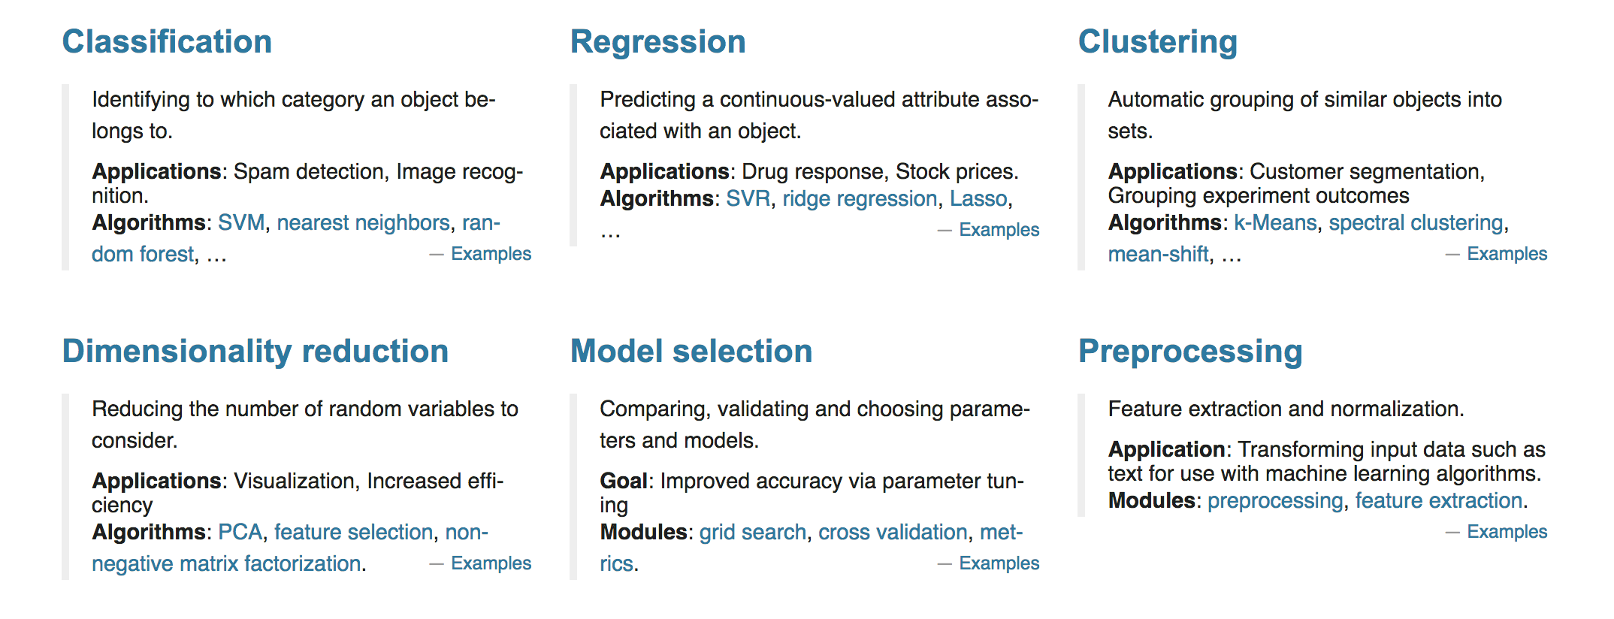
Other Machine Learning Packages: scikit-learn
Machine learning library for python

Slide 93
Lecture Overview
Once you have a scientific question that you want to answer, how can you find the data and tools that you need in order to answer your question?
Types of Genomic Data
[Sequencing Methods/Platforms]
Topic 1
Location of Data
[Databases]
Topic 2
Approaches to analyzing data
[Crash Course in Machine Learning]
Topic 3

Slide 94
Thanks for a great quarter!

