Slide 1
Genome 540
Week 1: Discussion
Jan 10, 2018
Eliah Overbey
Modified From Anne Clark (2016)

Slide 2
Agenda
Introductions
HW1
C++ and programming tips
Future topic suggestions

Slide 3
Introductions
TA: Eliah Overbey
4th year Genome Sciences student
Hawkins Lab
Current Research:
  Nanopore sequencing for RNA modifications
  Promoter-Enhancer Interactions via Capture Hi-C
Other Involvement:
  Advanced Data Science Option
  Women in Genome Sciences
  Astrobiology Program
Class: Tell me about you!
Department
Programming Experience
A hobby (if you have any)

Slide 4
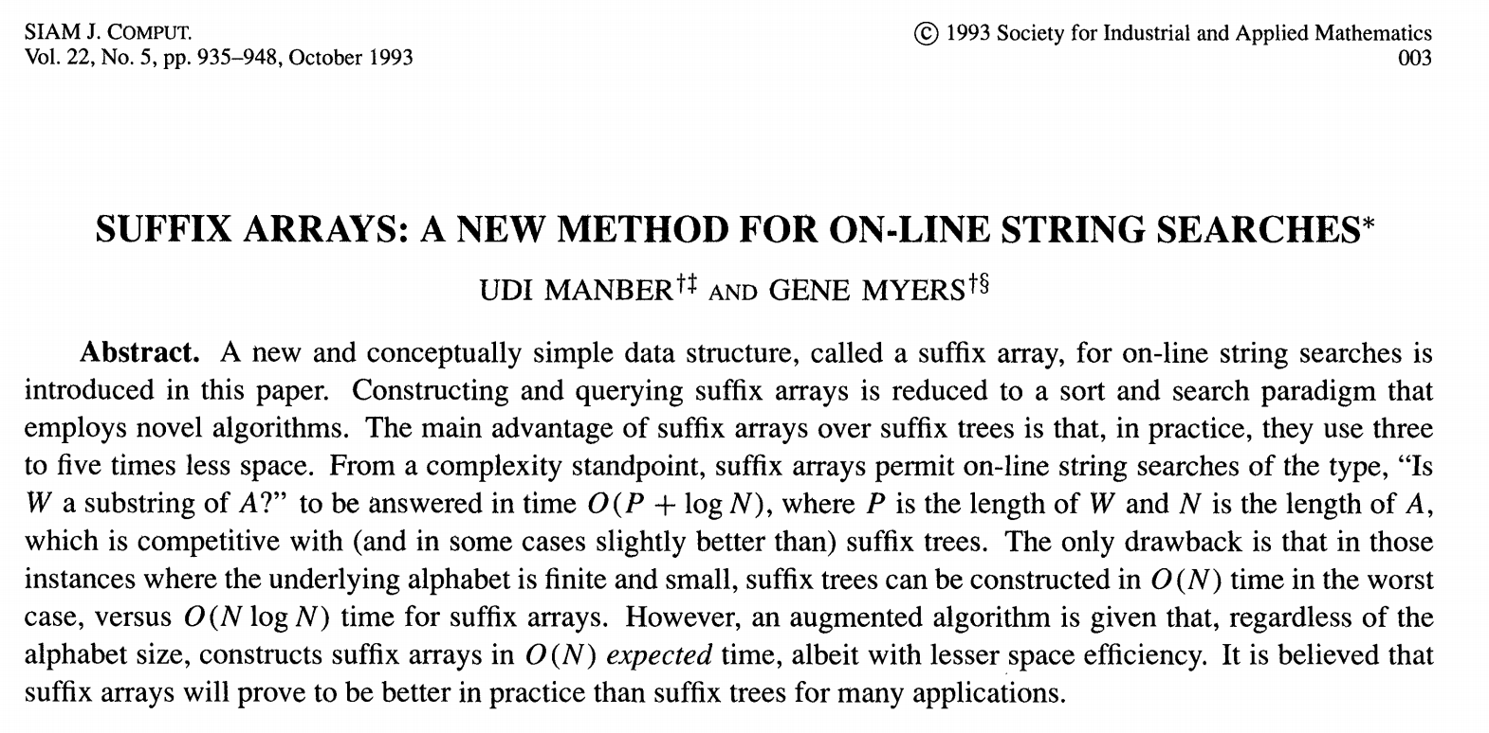

Slide 5
Yahoo!, Amazon, Google, Youtube, NIH, UC San Francisco, Anthem

Slide 6
Yahoo!, Amazon, Google, Youtube, NIH, UC San Francisco, Anthem
One of the creators of BLAST (1990)

Slide 7
Yahoo!, Amazon, Google, Youtube, NIH, UC San Francisco, Anthem
One of the creators of BLAST (1990)
Notes:
(G)oo – dee man-brr
Anthem = health insurance company

Slide 8
Suffix trees
Applications:
  Finding longest-repeated substring
  Finding all repetitions in a string
  Computing substring statistics
  Approximate string matching
  Compression
  Genetic sequence analysis

Slide 9
Suffix arrays
Substantially more space-efficient
Search times comparable
Greater upfront build time
“A primary motivation for this paper was to be able to efficiently answer on-line string queries for very long genetic sequences (on the order of one million or more symbols long). In practice, it is the space overhead of the query data structure that limits the largest text that may be handled.”
Fancier implementations than yours take advantage of the fact that you’re not sorting arbitrary strings, and that suffix trees can be built more quickly

Slide 10
Homework 1
Program a suffix array
Test it on the files provided and compare with the test output that we give you
Run your program on the Pyrococcus yayanosii and the Methanopyrus kandleri genome
Use the annotation files to find the gene associated with the longest common subsequences between the two species
Submit your program output and your code

Slide 11
Assignment Genomes: Extremophile Archaea from Hydrothermal Vents
Black smoker vents:
Methanopyrus kandleri
Pyrococcus yayanosii
Piezophilic (pressure)
Hyperthermophilic (temperature)
Isolated at 95 Celsius under a hydrostatic pressure of 42 Mpa (megapascal)
From the Atlantic deep sea ridge, 4100m below sea level
Atmospheric pressure at sea level is 0.03 Mpa
Halophilic (salt)
Hyperthermophilic (temperature)
From the Gulf of California, 2000m below sea level
Can continue to grow in autoclave temperature (121 C)
Notes:
Isolated at Ashadze

Slide 12
HW1 tips
Start with pseudocode/python
Get comfortable with pointers
Think about how to store inputs
Think about how to store results
Output to template directly

Slide 13
Programming style
The more readable your code is
  The more I’ll be able to help you if something’s wrong
  The more useful it will be to you later (especially if you TA this class…)
Tips for readability
  Intuitive variable/function names
  Comments
    Outlining general structure of program/key points of implemented algorithm
    Clarifying any tricky/unintuitive lines of code
  Simplicity over performance optimization (until it becomes necessary)
Please match the template!

Slide 14
Programming tips: testing
Create small, easily-verified test cases
Edge cases
Print intermediate output
Write incrementally, test as you go
  Assertion statements
Check against expectations

Slide 15
Programming tips: efficiency
Remove unnecessary stuff from loops
Avoid slow comparison routines when sorting
Profiling tools
  line_profiler (python)
  gprof, valgrind (C/C++) [valgrind also identifies memory leaks]
  Run your code and stop it a bunch of times

Slide 16
Pointers in C++
xptr
x
char x = ‘h’;
char *xptr = &x;
0xFE
‘h’
0x80
0xFE
Pointers are memory addresses, which point to other variables
The address-of operator (&) obtains the memory address of a variable
The dereference operator (*) accesses the value stored at the pointed-to memory location
Passing arguments by reference
Attributes of pointed-to structures can be accessed with -> operator
  a->element is the same as (*a).element (particularly useful for iterators)

Slide 17
Arrays point to blocks of memory
Pointers “know” the data size they point to
Array indices are just pointer arithmetic and dereferencing combined
  a[12] is the same as *(a + 12)
  &a[3] is the same as a + 3
Large arrays should be dynamically allocated (on the heap)
  Make sure you delete them
word[0]
word[1]
word[2]
const char *word = “hi”;
‘h’
‘i’
‘\0’
0x80
0x88
0x90
word
word+1
word+2

Slide 18
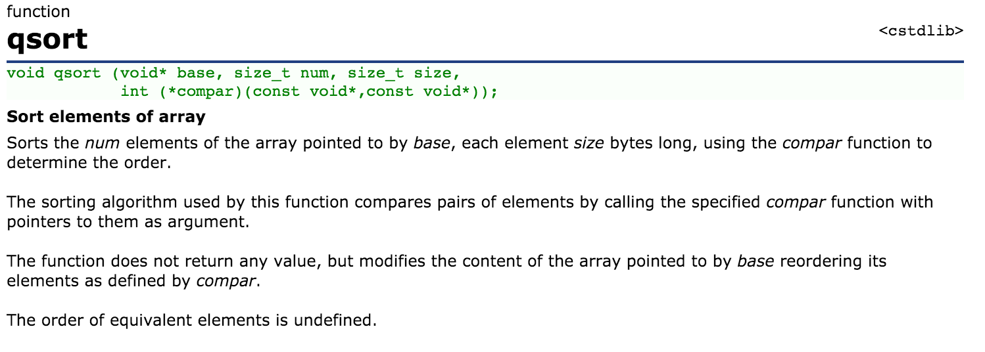
Sorting in C++

Slide 19
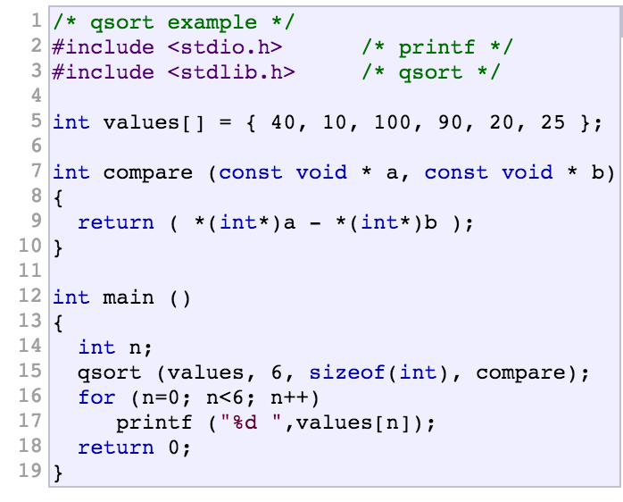
Sorting in C++
http://www.cplusplus.com/reference/

Slide 20
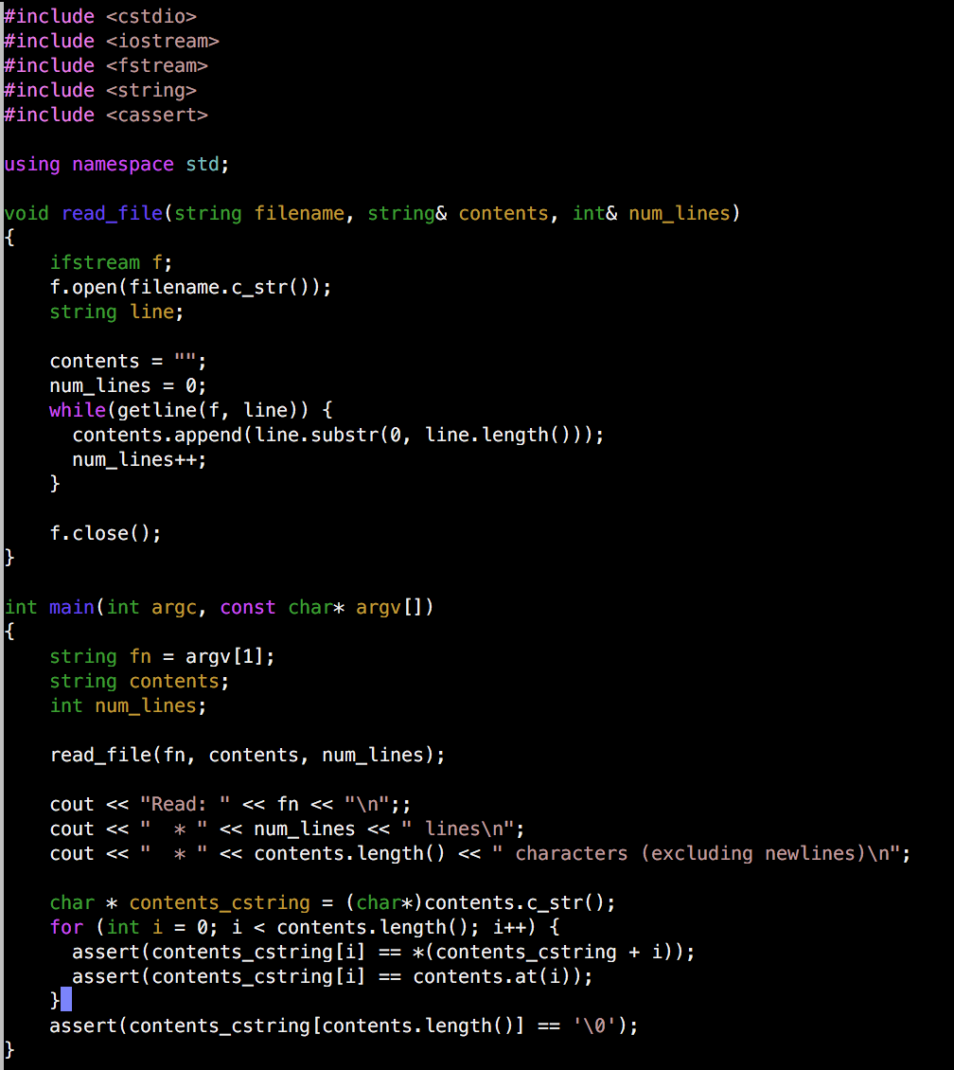
Example of reading in a file in C++
(and a few other things)

Slide 21
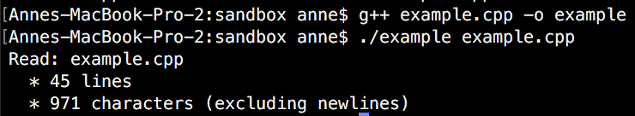
Example of reading in a file in C++
(and a few other things)

Slide 22

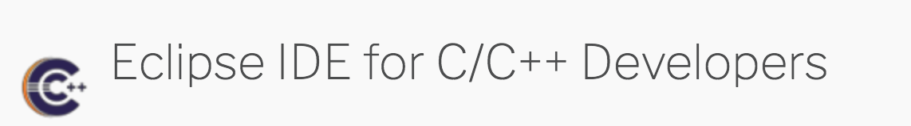

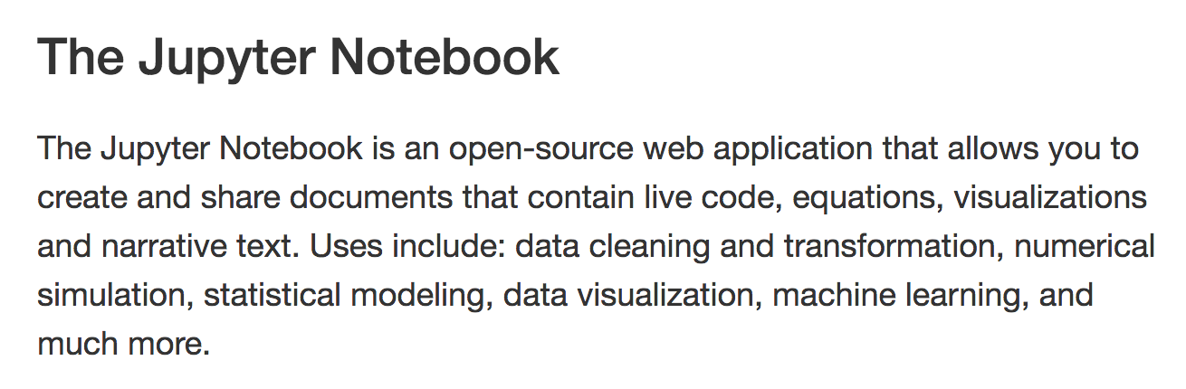
Othesr Coding Environments
Python

Slide 23
Potential topics for future discussion sections
BLAST/multiple alignment
Sequencing Methods
Additional applications of HMMs (GENSCAN)
Dynamic programming
General programming tips
Specific languages: C++, R, Python, Unix/Command line tools
Plotting with ggplot (R) or other data visualization topics
Version Control/Github
Jupyter Notebooks/Reproducibility
Machine learning
Notes:
Developing Shiny apps
dynamic programming
more about c++, tips for optimization and parallelization
General c++ tips
BLAST and multiple alignment
sequencing methods
version control
Some applied machine learning
feature transformations on sequence data

Slide 24
See you next week!

