Slide 1
Week 2 Discussion Section
Genome 540
Eliah Overbey
1/17/2019

Slide 2
Agenda
Q’s about HW1?
Overview of HW2
Other DAG Algorithms
C++ Tips

Slide 3
HW2: Highest Weighted Path for Directed Acyclic Graphs (DAGs)
Write 2 programs
Test your code on our examples and compare your results
Run your code on the submission DAG and genome and submit these results
Due Jan 27, 11:59pm

Slide 4
HW2: Highest Weighted Path for Directed Acyclic Graphs (DAGs)

Slide 5
HW2: Write two programs
Program 1: Find a highest-weight path in a weighted directed acyclic graph
Program 2: Convert a fasta file to written graph format

Slide 6
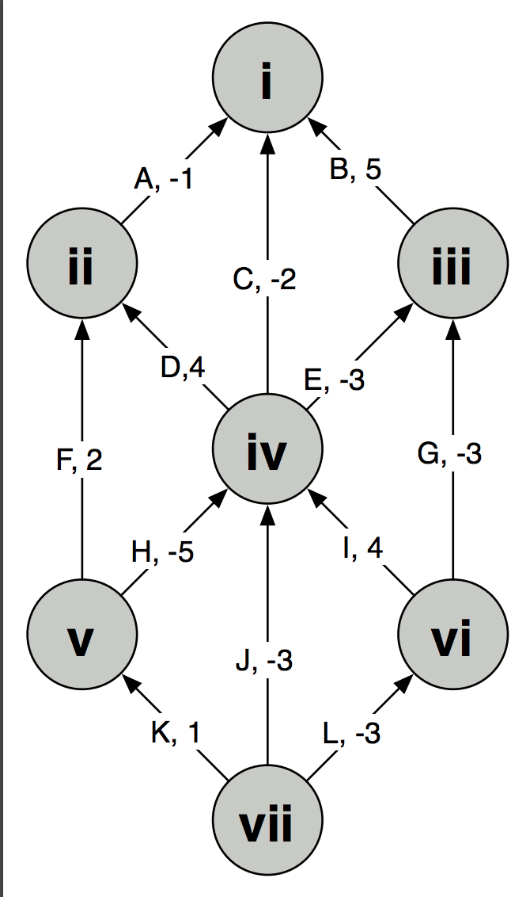
HW2: Program 1
Program 1: Find a highest-weight path in a weighted directed acyclic graph
Convert graph by hand into a list of vertices and edges, which you will input into your program
Write a program to output the
    Path Score
    2. The label of the beginning vertex on the path
    3. the label of the ending vertex on the path
    4. (in order) the labels for all the edges that occur on this path.
Test Example:

Slide 7
HW2: Program 1
Program 1: Find a highest-weight path in a weighted directed acyclic graph
Convert graph by hand into a list of vertices and edges, which you will input into your program
Write a program to output the
    Path Score
    2. The label of the beginning vertex on the path
    3. the label of the ending vertex on the path
    4. (in order) the labels for all the edges that occur on this path.
Run this program “unconstrained” and with the start and end contraints of “vii” and “i” respectively
Test Example:

Slide 8
HW2: Program 1
Program 1: Find a highest-weight path in a weighted directed acyclic graph
Convert graph by hand into a list of vertices and edges, which you will input into your program
Write a program to output the
    Path Score
    2. The label of the beginning vertex on the path
    3. the label of the ending vertex on the path
    4. (in order) the labels for all the edges that occur on this path.
Run this program “unconstrained” and with the start and end contraints of “vii” and “i” respectively
Test Example:
Example Input:
V vii START
V vi
V v
…
E A ii i -1
E B iii i 5

Slide 9
HW2: Program 1
Program 1: Find a highest-weight path in a weighted directed acyclic graph
Convert graph by hand into a list of vertices and edges, which you will input into your program
Write a program to output the
    Path Score
    2. The label of the beginning vertex on the path
    3. the label of the ending vertex on the path
    4. (in order) the labels for all the edges that occur on this path.
Run this program “unconstrained” and with the start and end contraints of “vii” and “i” respectively
Example output:
Test Example:
Part 1
Score: 8.0
Begin: vi
End: ii
Path: ID
Part 2
Score: 4.0 Begin: vii
End: i
Path: LIDA

Slide 10
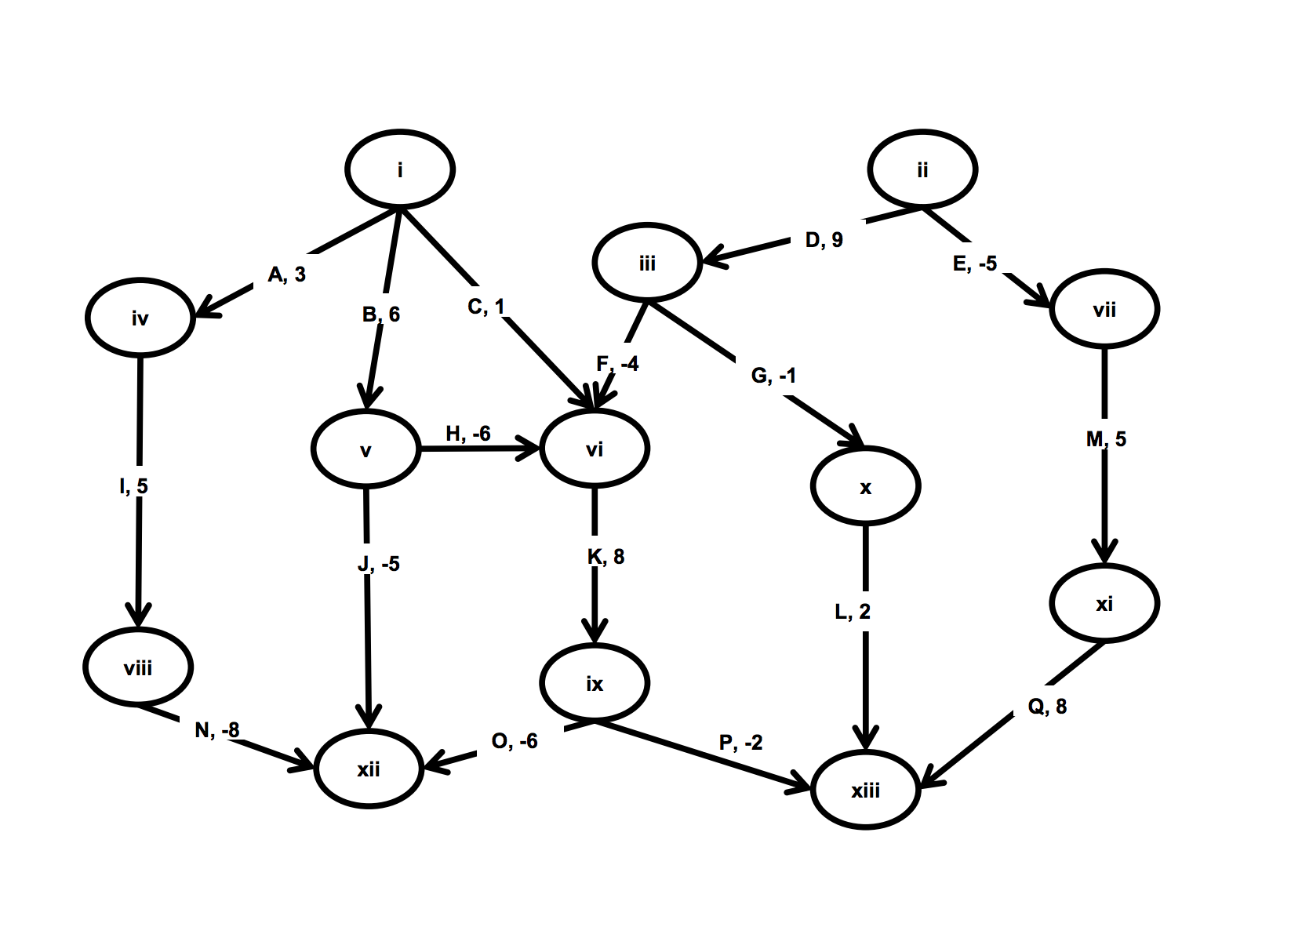
HW2: Program 1
Program 1: Find a highest-weight path in a weighted directed acyclic graph
Convert graph by hand into a list of vertices and edges, which you will input into your program
Write a program to output the
    Path Score
    2. The label of the beginning vertex on the path
    3. the label of the ending vertex on the path
    4. (in order) the labels for all the edges that occur on this path.
Run this program “unconstrained” and with the start and end contraints of “i” and “xii” respectively
Output: Turn this in
For Grading:

Slide 11
Program 1 Algorithm

Slide 12
HW2: Program 2
0
Program 2: Convert FASTA to written graph format
A, -1.49
Read 2 input files:
  1) a FASTA file containing a DNA sequence, and
  2) a 'scoring scheme' file that indicates a score to be attached to each possible base (A, C, G, T, or other)
Output a written graph to run through program 1
1
C, 0.74
2
G, 0.74
3
T, -1.49
…

Slide 13
HW2: Program 2
0
Program 2: Convert FASTA to written graph format
A, -1.49
Example of written graph output:
V 0
V 1
V 2
…
E G 0 1 0.74
E T 1 2 -1.49
E G 2 3 0.74
1
C, 0.74
2
G, 0.74
3
Run this output through program 1
T, -1.49
…

Slide 14
HW2: Program 2
0
Program 2: Find a highest-weight path in a linked list
A, -1.49
Test example: Mycoplasma gallisepticum
Part 3
>gi|400273702|gb|CP003508.1| Mycoplasma gallisepticum NC96_1596-4-2P, complete genome
*=986257
A=337443
C=156212
T=336693
G=155909
N=0
Score: 11.069998
Begin: 344420
End: 344444
Path: GGCGGCGGCCCCTGGCGATGGCCG
Description: This sequence lies within the HFMG96NCA_2038 gene (encodes a hypothetical protein).
1
C, 0.74
2
G, 0.74
3
T, -1.49
…

Slide 15
HW2: Program 2
Refer to online hw for more thorough details
0
Program 2: Find a highest-weight path in a linked list
A, -1.49
Test example: Mycoplasma gallisepticum
Part 3
>gi|400273702|gb|CP003508.1| Mycoplasma gallisepticum NC96_1596-4-2P, complete genome
*=986257
A=337443
C=156212
T=336693
G=155909
N=0
Score: 11.069998
Begin: 344420
End: 344444
Path: GGCGGCGGCCCCTGGCGATGGCCG
Description: This sequence lies within the HFMG96NCA_2038 gene (encodes a hypothetical protein).
1
C, 0.74
2
G, 0.74
3
T, -1.49
…

Slide 16
HW2: Program 2
For Grading: Oleispira antarctica
psycrophilic bacteria (cold-loving, optimal growth at 2-4 Celsius)
can degrade oil and is being explored as a bioremediation tool
Bioremediation: the use of either naturally occurring or deliberately introduced microorganisms or other forms of life to consume and break down environmental pollutants, in order to clean up a polluted site.
Scanning Electron Micrograph of Oleispira antarctica

Slide 17
Any Questions on HW2?

Slide 18
Other DAG Algorithms
Minimum-weight path on a DAG
Similar to the homework
  Looking for the minimum instead of the maximum
  If there are no negative weights, then the shortest path is technically weight 0 (single node)
  Otherwise, update vertex weights in depth order as normal

Slide 19
What if graph has cycles?
More difficult (can’t order nodes by depth)
Bellman-Ford algorithm (for given start vertex)
  Choose source node and set distance to 0
  Set distance to all other nodes to infinity
  For each edge (u,v), if v’s distance can be reduced by taking that edge, update v’s distance
  Cycle through all edges in this way |V|-1 times
  Repeat for all vertices as source node
  (can also check for negative-weight cycle with one extra iteration)
Tutorial and dynamic programming implementation here.

Slide 20
What if graph has no negative edges?
Less difficult (we can visit some nodes fewer times)
Dijkstra’s algorithm (for given start vertex)
  Choose source node and set distance to 0
  Set distance to all other nodes to infinity
  Set source node to current
  Make distance offers to all unvisited neighbors, which are accepted if they’re less than the previous best offer
  Mark current as visited (it will never be updated again)
  Select unvisited neighbor with smallest distance, set it to current, and repeat
  (When destination node has been marked visited, stop)

Slide 21
More C++ Tips

Slide 22
C++: heap vs. stack memory
Stack
Objects created inside a function stored here by default
Automatically deleted once the function runs to completion
Fixed size – stack overflow if you run out of space
Much faster to allocate
Local data, parameter passing, etc.
Heap
Must use the “new” operator when creating objects to store them here
Must be manually deleted
More memory can be added to the heap as needed
  Use heap memory for large objects, or if you don’t know how much space you need
Slower to allocate
Global/shared data, large objects
For more info, see Stack Overflow thread here.

Slide 23
C++: arrays & vectors
Arrays
Built-in language construct for a contiguous, indexable sequence of elements
Fixed size, determined upon declaration
More efficient
For arrays of objects, the object class must have a default constructor
Vectors
Template class implemented as a dynamic array
Grows and shrinks dynamically, and memory is managed automatically
Less efficient
Objects do not require a default constructor
For more info, see Stack Overflow threads here and here, as well as this tutorial.
Notes:
For those uncomfortable with pointers, vectors offer a level of abstraction; they can be passed to other functions/referred to by value, so you don’t strictly need to use pointers to interact with them, unlike arrays. However, do note that passing by value means you are copying the contents of the vector to pass them on to the function, so be careful where you use this.

Slide 24
C++: sorting & comparators
std::sort() – standard C++ sorting function (docs)
  Usage: std::sort(first, last) [default sorting]
  std::sort(first, last, comp) [custom sorting]
  `first` and `last` are random-access iterators indicating the range of elements to be sorted, [first, last)
  `comp` is a comparator object that describes how items should be compared for sorting
    E.g. a comparator for two Suffix objects might look like
    struct compSuffix {
    bool operator() (const Suffix& a, const Suffix& b) {
    return <true when a comes before b>
    }
    }
For more info on custom comparators, see the Stack Overflow thread here.

Slide 25
C++: iterators
Iterator: something that allows you to
  Iterate over a sequence
  Represent a sequence or subsequence
  Access elements of a sequence
Introductory tutorial here, and C++ documentation on random-access iterators here
  Iterator functions include `begin()` (returns beginning position of container) and `end()` (returns end position of container)
Pointers are a type of iterator
For more info on pointers, see tutorial here, GameDev post here, and Stack Overflow thread here.

Slide 26
See you next week!
Reminder: HW1 due THIS Sunday, 11:59pm

