Slide 1
Week 4 Genome 540: Discussion
Eliah Overbey
1/31/2019

Slide 2
Agenda
HW3 questions
HW4: Multiple sequence alignment & edit graphs
BLAST

Slide 3
HWs 2 & 3
HW2
Grades have been emailed out. Let me know if you didn’t get yours.
HW3:
Any questions?
FORMATTING
Lots of reported segments – will be using a “diff” to help check them, so submitted files must match the template format exactly
Run “diff” between the your code on the test example data and the template to check that your formatting is correct
If you have formatting questions, let me know
I will be return misformatted submissions to you to fix. Late turnin points will be applied based on when it is submitted in the correct format.
Notes:
diff can ignore blank spaces
-b

Slide 4
HW 4: find multiple alignment for three sequences
Create an edit graph for 3 sequences using the BLOSUM62 score matrix
Run HW2 WDAG program on the edit graph to find the highest scoring path (local alignment)
Report in the specified format:
Maximum path score for the multiple alignment
List of all edge weights (alphabetically sorted)
List of all edge counts (alphabetically sorted)
Highest scoring alignment

Slide 5
HW4: Multiple sequence alignment
B
C
A
A = M C D R ...
B = M S D E ...
C = M V D R ...

Slide 6
HW4: Multiple sequence alignment
B
C
A
0 1 2 3 4
A = •M•C•D•R•...
B = •M•S•D•E•...
C = •M•V•D•R•...

Slide 7
HW4: Multiple sequence alignment
B
C
A
(1,2,1)
(2,2,1)
0 1 2 3 4
A = •M•C•D•R•...
B = •M•S•D•E•...
C = •M•V•D•R•...
(1,1,1)
(2,1,1)
(1,2,2)
(2,2,2)
(1,1,2)
(2,1,2)

Slide 8
HW4: Multiple sequence alignment
B
C
A
(1,2,1)
(2,2,1)
0 1 2 3 4
A = •M•C•D•R•...
B = •M•S•D•E•...
C = •M•V•D•R•...
(1,1,1)
(2,1,1)
CSV
(1,2,2)
(2,2,2)
(1,1,2)
(2,1,2)

Slide 9
HW4: Multiple sequence alignment
B
C
A
(1,2,1)
(2,2,1)
0 1 2 3 4
A = •M•C•D•R•...
B = •M•S•D•E•...
C = •M•V•D•R•...
weight(CSV) = score(CS) + score(CV) + score(SV)
(1,1,1)
(2,1,1)
CSV
(1,2,2)
(2,2,2)
(1,1,2)
(2,1,2)

Slide 10
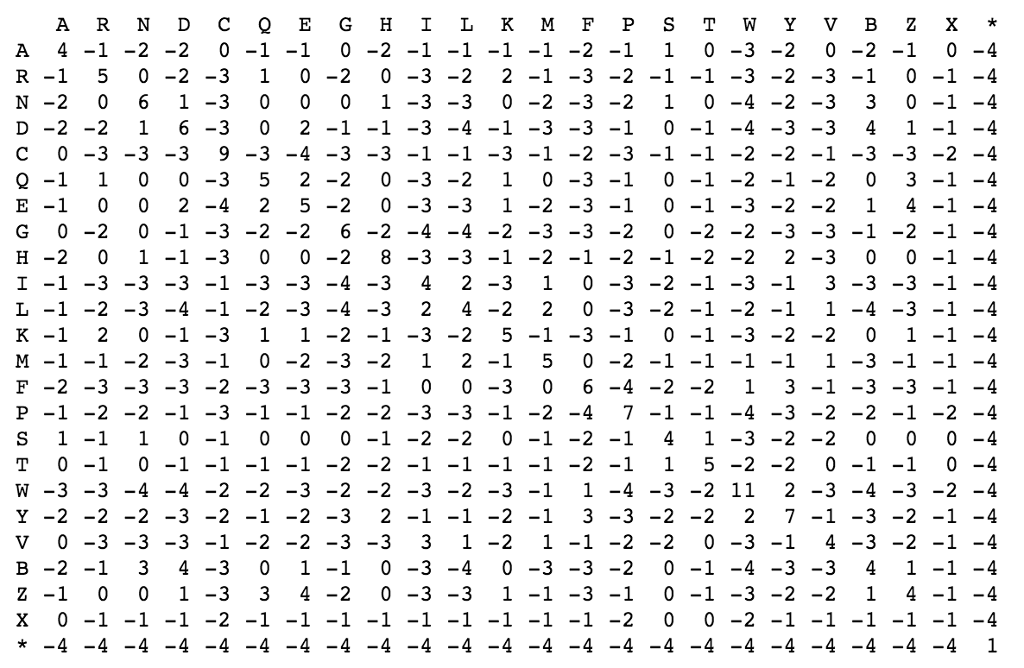
HW4: Multiple sequence alignment
B
C
A
(1,2,1)
(2,2,1)
0 1 2 3 4
A = •M•C•D•R•...
B = •M•S•D•E•...
C = •M•V•D•R•...
weight(CSV) = score(CS) + score(CV) + score(SV)
(1,1,1)
(2,1,1)
CSV
(1,2,2)
(2,2,2)
(1,1,2)
(2,1,2)

Slide 11
HW4: Multiple sequence alignment
B
C
A
(1,2,1)
(2,2,1)
0 1 2 3 4
A = •M•C•D•R•...
B = •M•S•D•E•...
C = •M•V•D•R•...
weight(CSV) = score(CS) + score(CV) + score(SV)
CS–
(1,1,1)
(2,1,1)
CSV
(1,2,2)
(2,2,2)
(1,1,2)
(2,1,2)

Slide 12
HW4: Multiple sequence alignment
B
C
A
(1,2,1)
(2,2,1)
0 1 2 3 4
A = •M•C•D•R•...
B = •M•S•D•E•...
C = •M•V•D•R•...
weight(CSV) = score(CS) + score(CV) + score(SV)
weight(CS-) = score(CS) + score(C–) + score(S–)
CS–
(1,1,1)
(2,1,1)
CSV
(1,2,2)
(2,2,2)
(1,1,2)
(2,1,2)

Slide 13
HW4: Multiple sequence alignment
B
C
A
(1,2,1)
(2,2,1)
0 1 2 3 4
A = •M•C•D•R•...
B = •M•S•D•E•...
C = •M•V•D•R•...
weight(CSV) = score(CS) + score(CV) + score(SV)
weight(CS-) = score(CS) + gap_penalty + gap_penalty
CS–
(1,1,1)
(2,1,1)
CSV
(1,2,2)
(2,2,2)
(1,1,2)
(2,1,2)

Slide 14
HW4: Multiple sequence alignment
B
C
A
(1,2,1)
(2,2,1)
0 1 2 3 4
A = •M•C•D•R•...
B = •M•S•D•E•...
C = •M•V•D•R•...
weight(CSV) = score(CS) + score(CV) + score(SV)
weight(CS-) = score(CS) + gap_penalty + gap_penalty
–S–
CS–
(1,1,1)
(2,1,1)
C––
CSV
––V
–SV
(1,2,2)
(2,2,2)
C–V
(1,1,2)
(2,1,2)

Slide 15
https://blast.ncbi.nlm.nih.gov/Blast.cgi

Slide 16
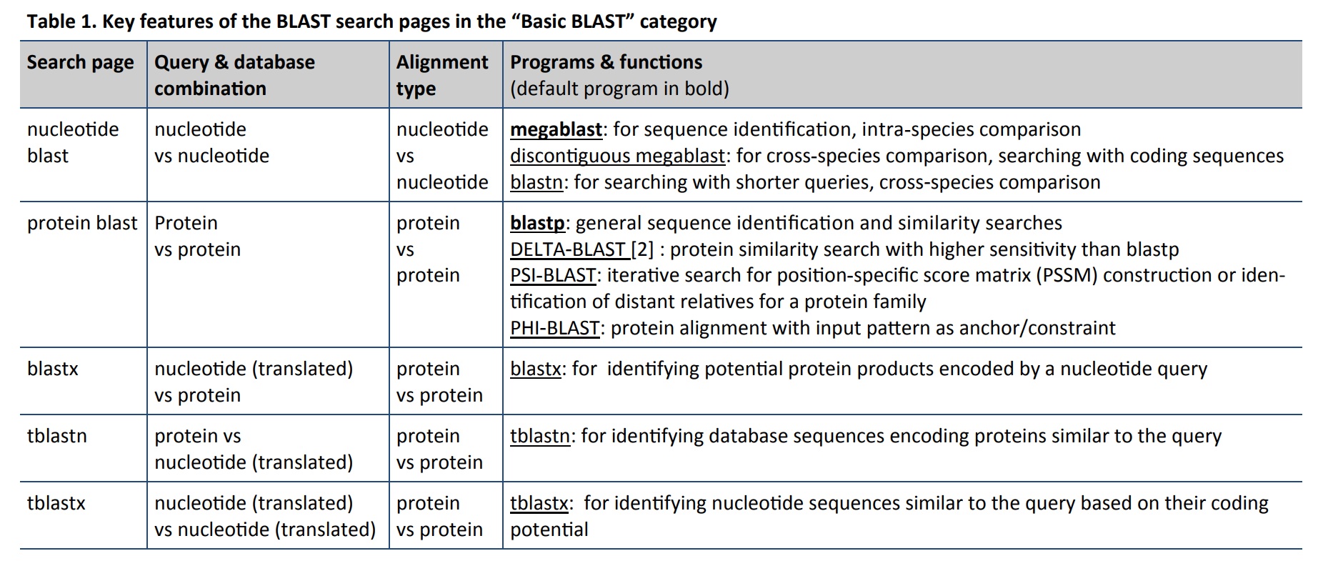

Slide 17
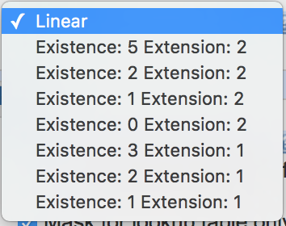
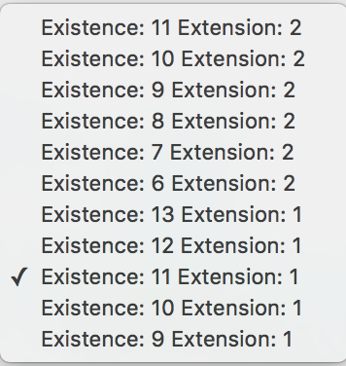
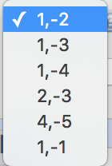
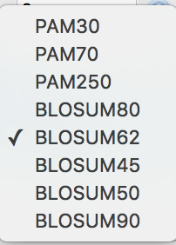

Slide 18
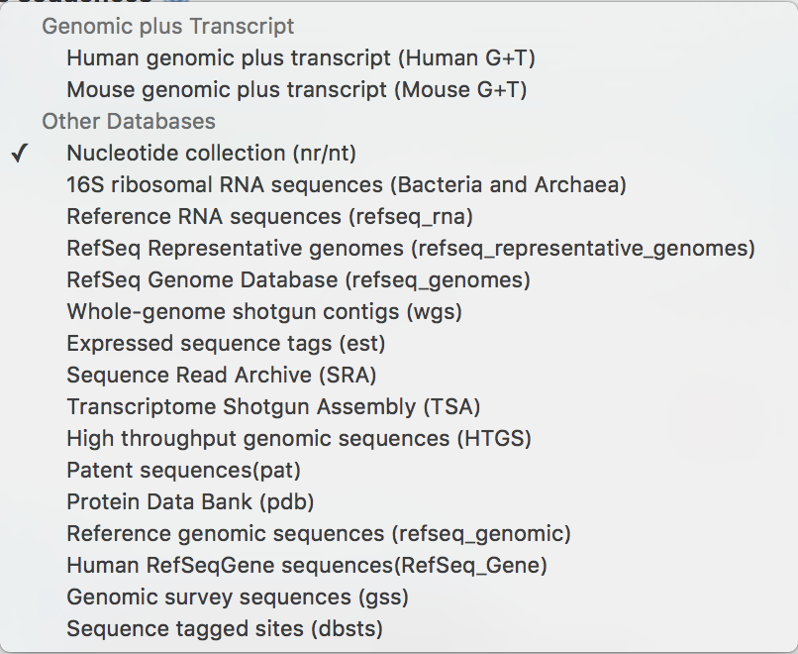
What can I search against?
Nucleotide databases

Slide 19
What can I search against?
Nucleotide databases

Slide 20
What can I search against?
Nucleotide databases

Slide 21
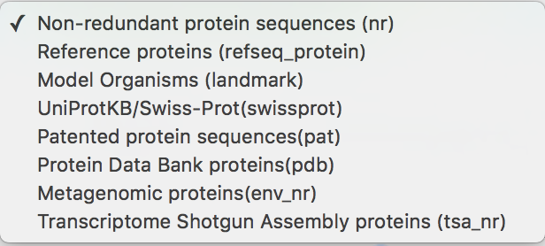
What can I search against?
Protein databases

Slide 22
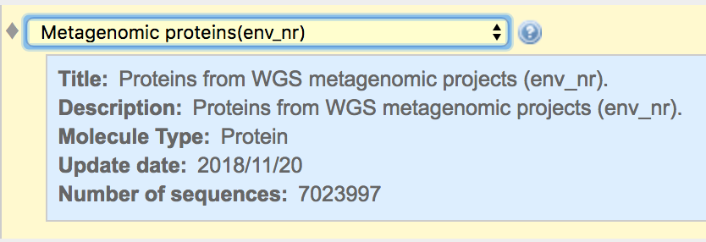
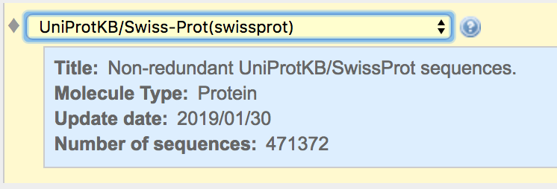
What can I search against?
Protein databases

Slide 23
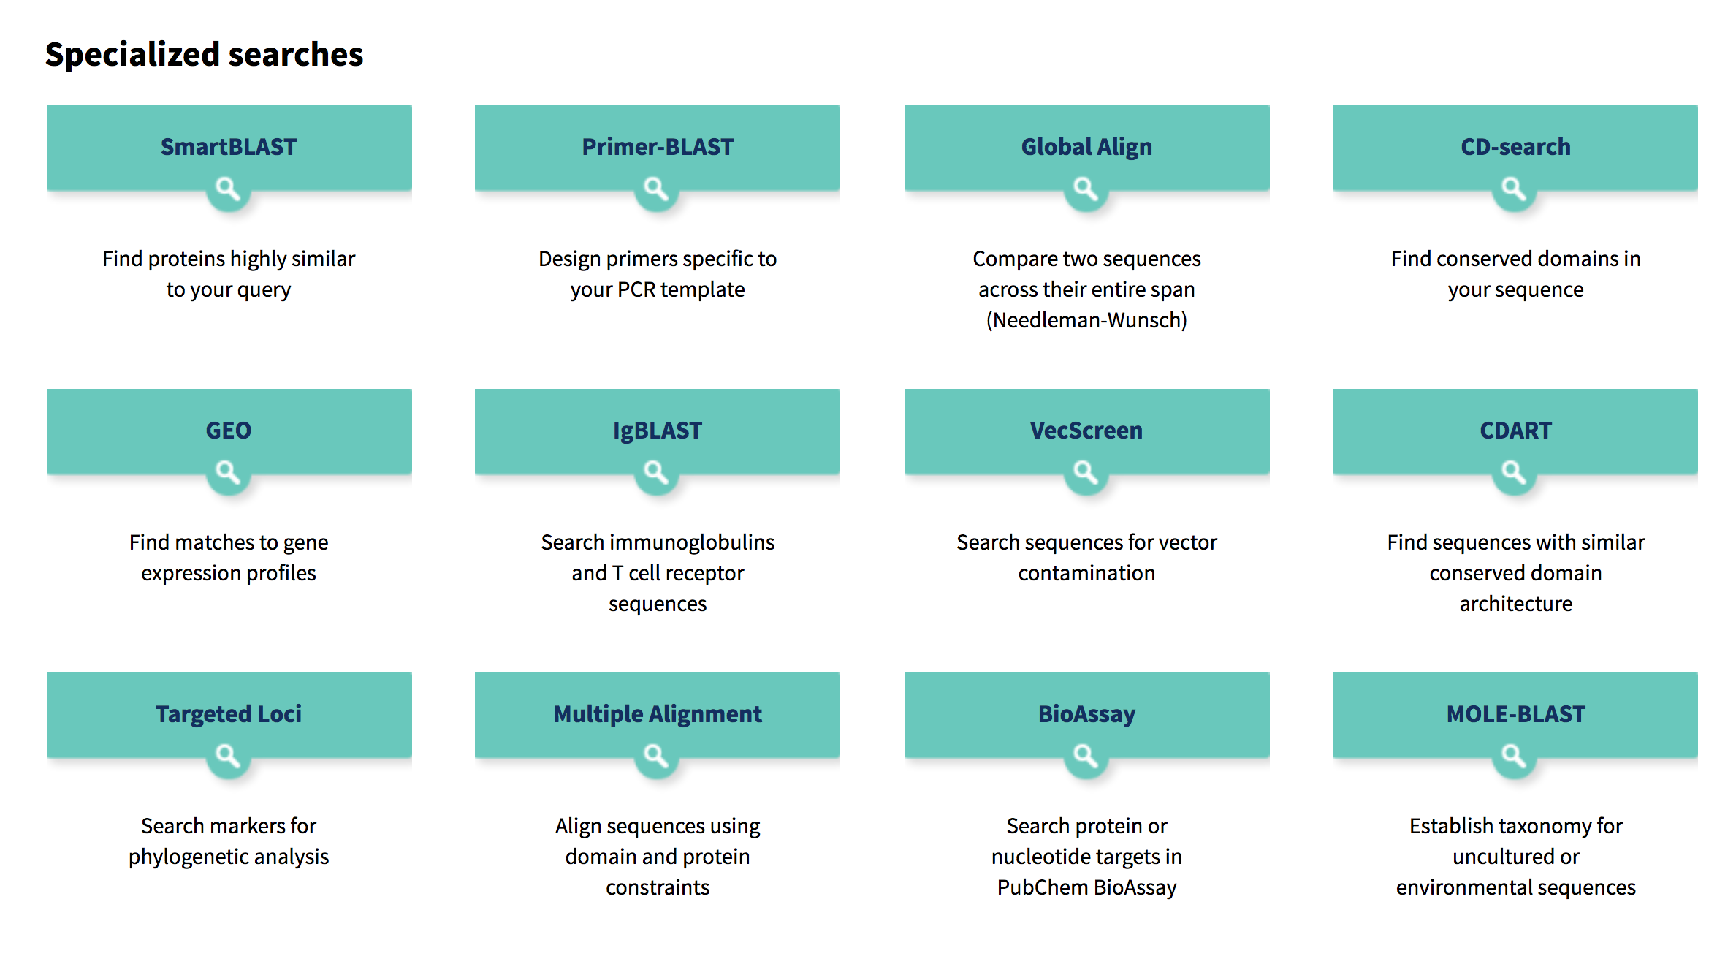
What can I search against?

Slide 24
Using BLAST: Input
Seq Length: 755

Slide 25
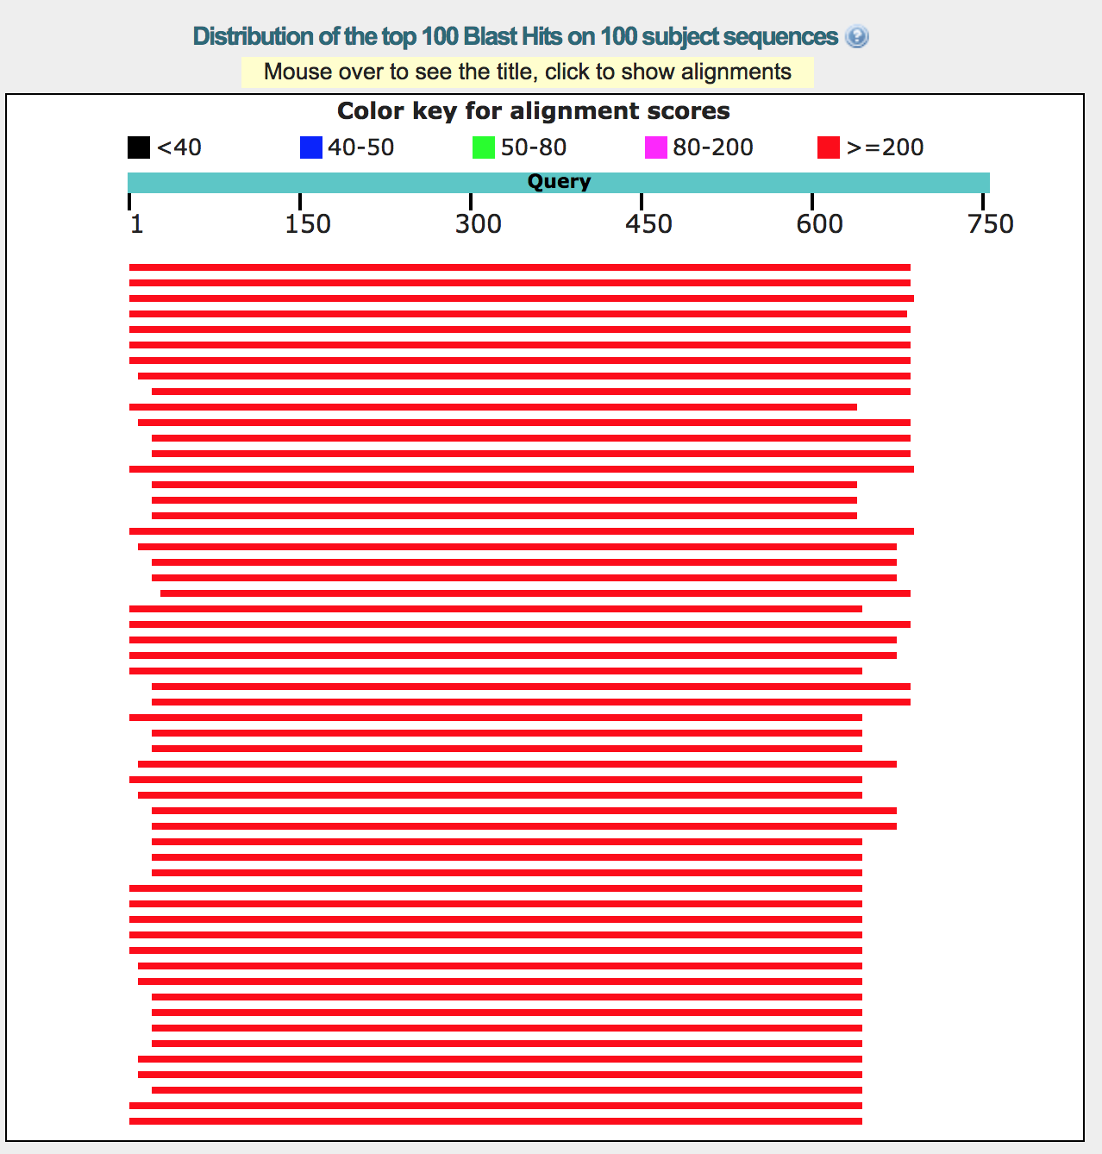
Using BLAST: Output
Seq Length: 755

Slide 26
Using BLAST: Output

Slide 27
Using BLAST: Output

Slide 28
Using BLAST: Output

Slide 29
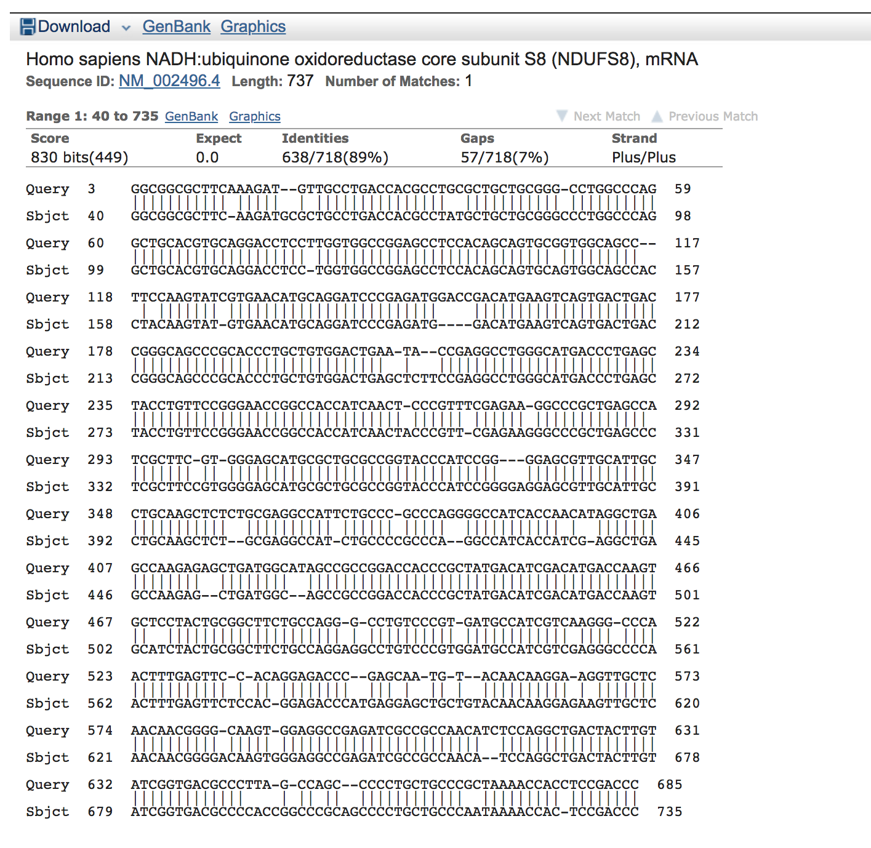
Using BLAST: Output

Slide 30
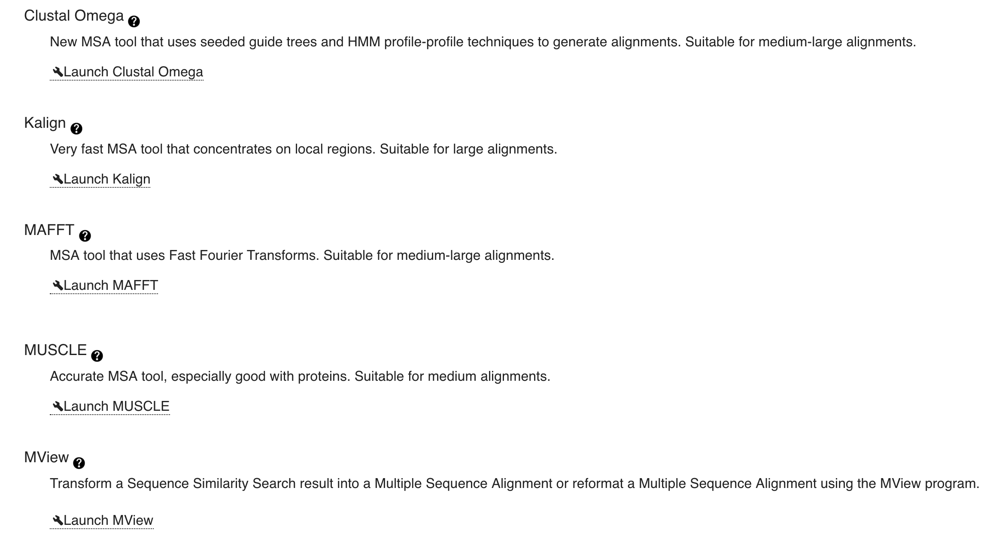
What if I want to do a multiple alignment?
https://www.ebi.ac.uk/Tools/msa/

Slide 31
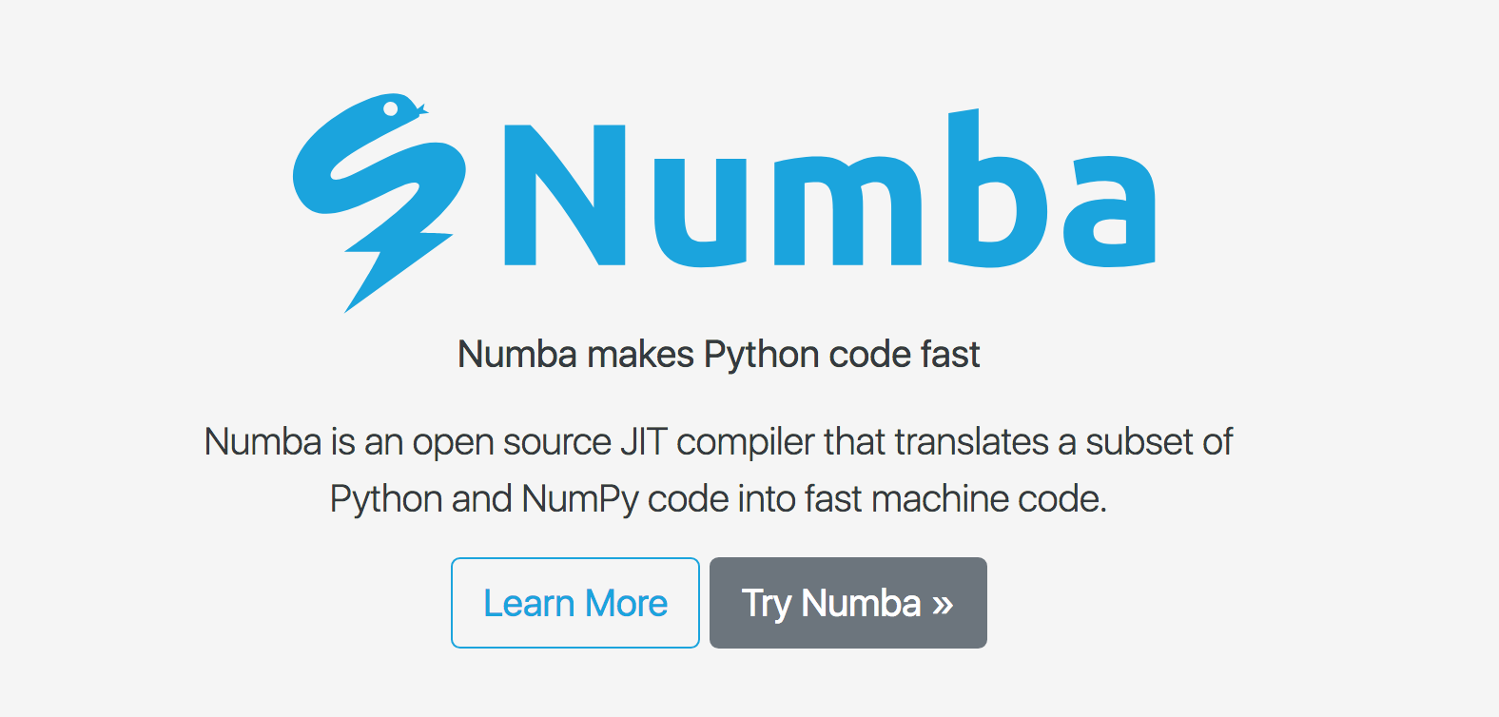
http://numba.pydata.org/

Slide 32
