Slide 1
Discussion Section Week 6
Eliah Overbey
Feb 14, 2019

Slide 2
Agenda
HW5 questions?
Unix tools
Regular expressions
grep
sed
AWK
uniq
sort
Version control (Git)

Slide 3
Regular expressions
Notes:
Brackets [] indicate ‘or’
Curly braces {} indicate
\b is word boundary
A-Z indicates alphabetic characters
0-9 indicates numeric characters
+ indicates 1 or more times (for the thing before it)
{2,} indicates 2 or more times
\ is escape character

Slide 4
Regular expressions
Strings that define a pattern, often used for searching and matching
Many special operators to define patterns
E.g. ‘^’, ‘$’, ‘.’, ‘*’, ‘+’, ‘?’ to name a few (table here)
Examples:
‘a’: anything with the letter ‘a’
‘a.b’: anything with the letters ‘a’ and ‘b’ separated by any character
‘^a.*z$’: anything that starts with the letter ‘a’ and ends with the letter ‘z’
‘\b[A-Z0-9._%+-]+@[A-Z0-9.-]+\.[A-Z]{2,}\b’: email addresses (more detailed explanation here)
Notes:
Brackets [] indicate ‘or’
Curly braces {} indicate
\b is word boundary
A-Z indicates alphabetic characters
0-9 indicates numeric characters
+ indicates 1 or more times (for the thing before it)
{2,} indicates 2 or more times
\ is escape character

Slide 6
grep (globally search a regular expression and print)
grep ‘>’ sequence.fasta
prints all lines containing ‘>’ in sequence.fasta
grep -c ‘\b[A-Z0-9._%+-]+@[A-Z0-9 .-]+\.[A-Z]{2,}\b‘ things.txt
prints number of lines containing email addresses in things.txt

Slide 7
sed (stream editor)
Changes text (in file or piped directly to sed)
Most often used for substitution with the ‘s’ command (though there are other commands
sed ‘s/day/night/’ old > new → changes first occurrence of day on each line in old to night in new
If you want to know more, here’s an in-depth tutorial

Slide 8
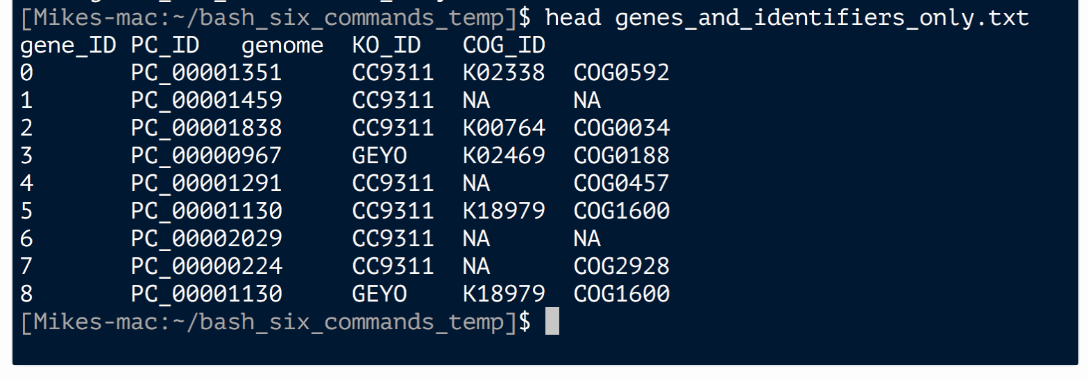
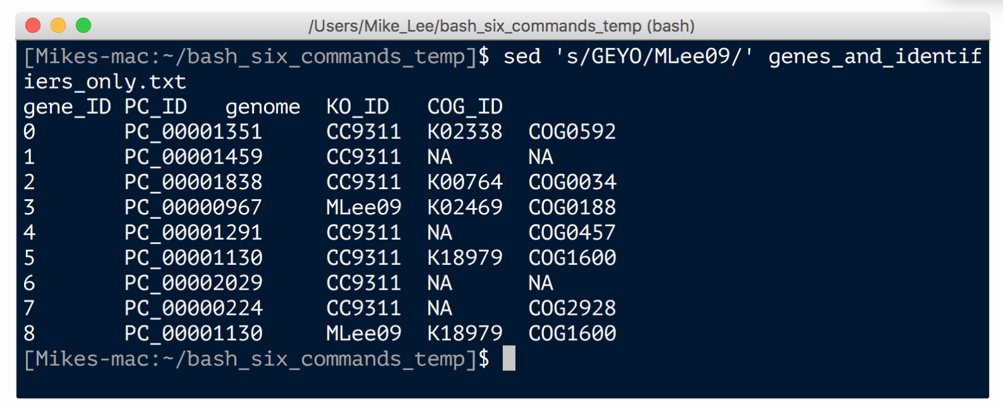
sed (stream editor): Example

Slide 9
Tutorial link here

Slide 10
Awk for genomics

Slide 12
Sort/uniq examples

Slide 15
Other Resources
Bioinformatics One-Liners (sed, awk, cut, uniq, sort)
https://github.com/stephenturner/oneliners
Misc Bioinformatics Unix Commands:
https://github.com/crazyhottommy/bioinformatics-one-liners
“Just Enough Unix for Bioinformatics”
http://jnmaloof.github.io/BIS180L_web/2018/04/03/2Just_Enough_Unix/

Slide 16
Version Control

Slide 17
The value of version control
Backups
You might not backup things on your local machine regularly
Easier to retrieve previous versions than through system administrator
Historical record
Programs evolve over the course of the project
Simpler than dealing with a bunch of different copies of the file
Reproduce an experiment with code from some specific date
Collaboration
Edit same file simultaneously
Merge later

Slide 18
The value of version control
Requires discipline
Check in at least once a day
If your code is currently broken, can check into a “branch” and then merge into main project (“trunk”) later
Should only be used for files you edit by hand
No data, compiled programs, results
Can tell version control system to ignore certain types of files

Slide 19
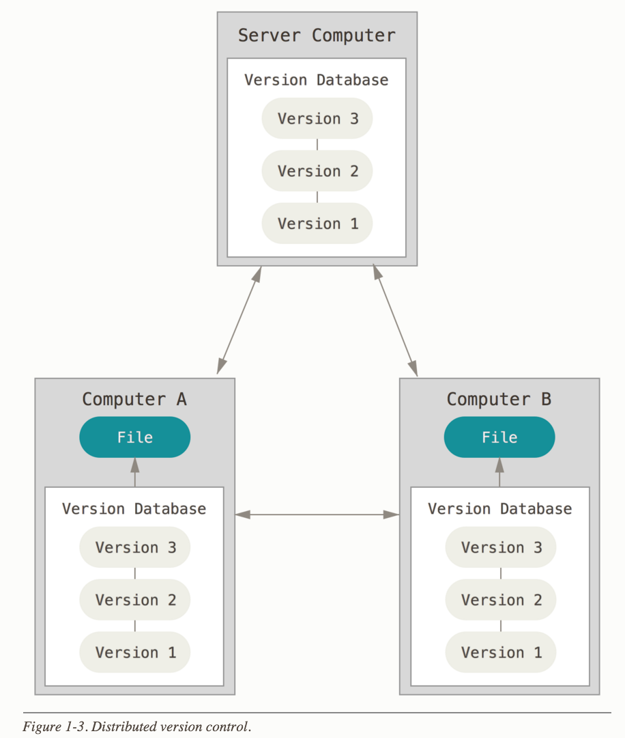
Distributed version control with Git
Git is a commonly used version control tool
Useful for tracking files both for your own use and in collaborative projects
Notes:
alternative to just making folders yourself locally

Slide 20
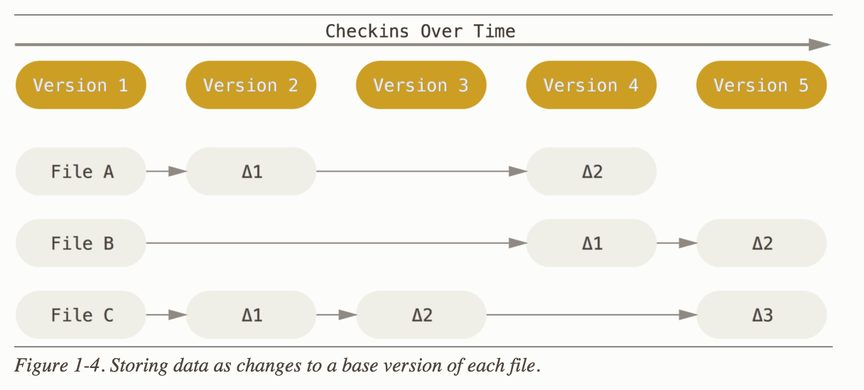
How many other version control tools work:

Slide 21
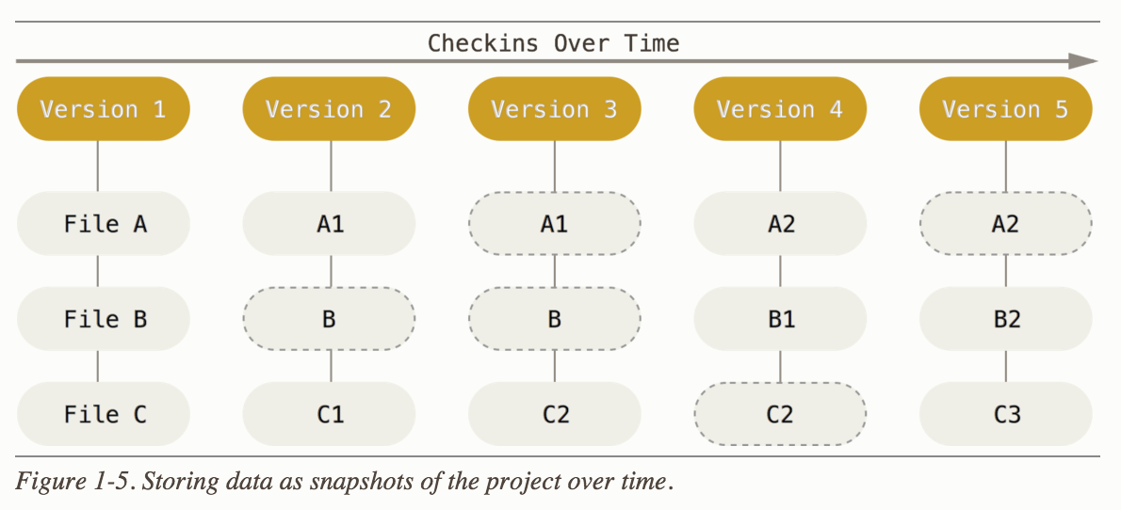
How Git works:

Slide 22
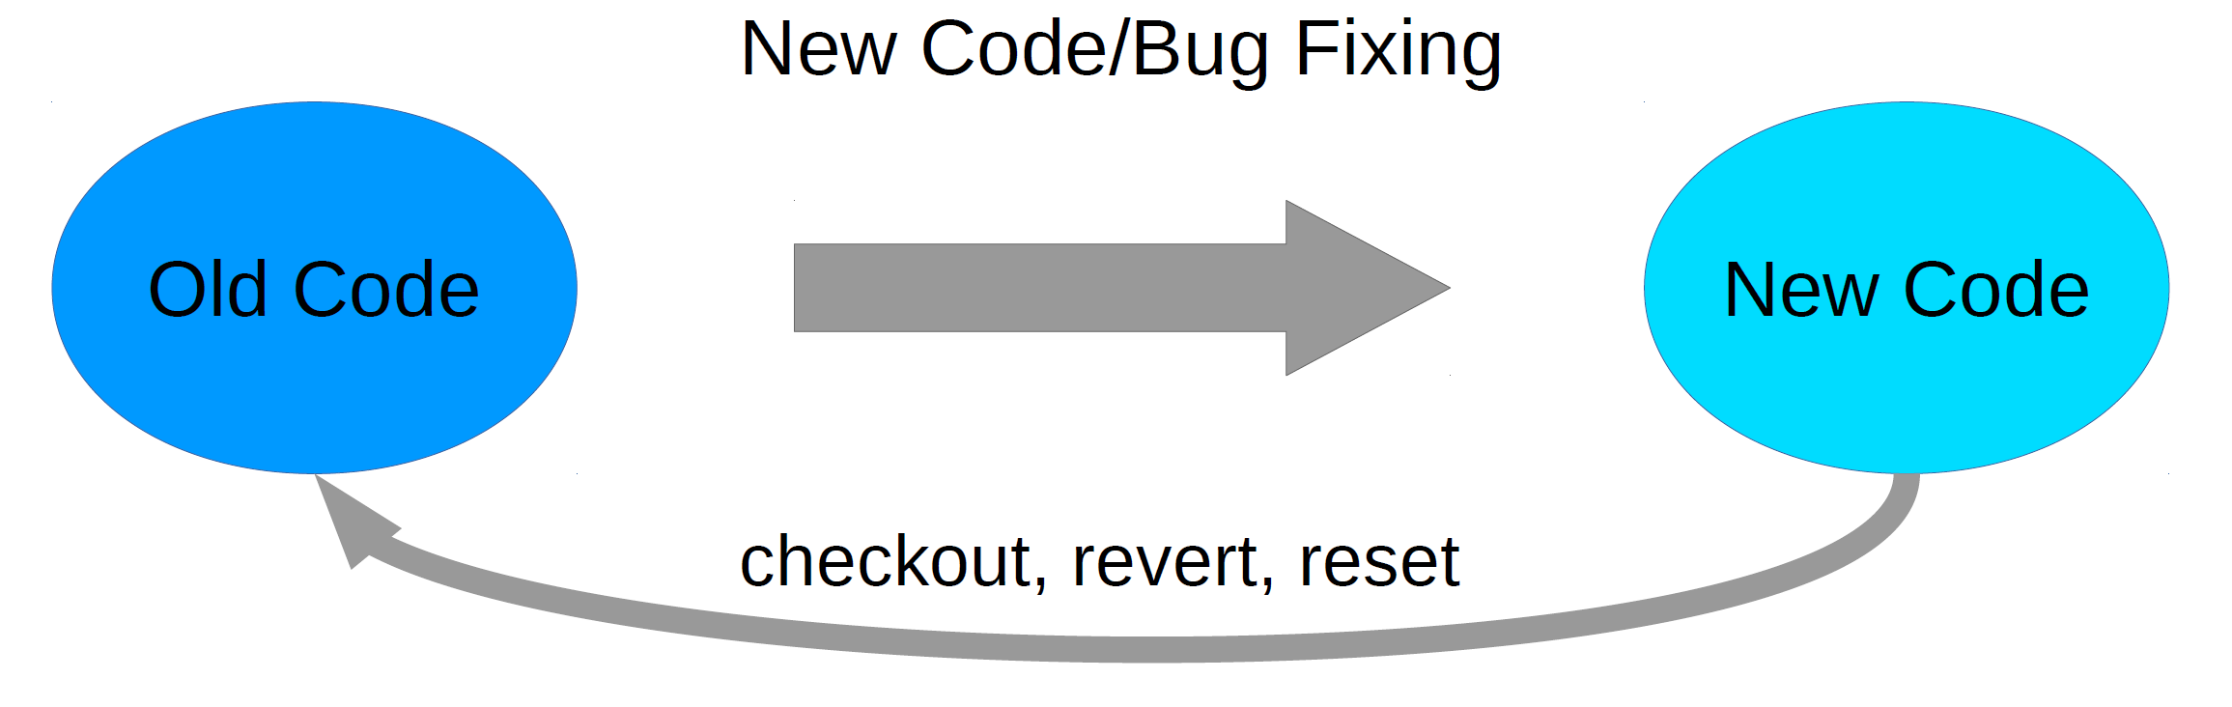
Keeping track of previous code
Reasons to revert:
New bug, better to restart from old code
Need to regenerate results with a previous version of code

Slide 23
Branches allow testing and parallel collaboration

Slide 24
Branches allow testing and parallel collaboration

Slide 25
Basic Git commands
Working solo:
Creating a repo (git init)
Adding, deleting (git add, git rm)
Committing (git commit [-m])
Undoing changes (git reset [file])
Checking what files you’ve changed (git status)
Looking at the change log (git log [--stat] [-p])
Ignoring files (.gitignore)
Notes:
init: This creates a new subdirectory named .git that contains all of your necessary repository files – a Git repository skeleton. At this point, nothing in your project is tracked yet.

Slide 26
Basic Git commands
Working with collaborators:
Cloning a repo (git clone [address])
Pushing/pulling changes (git push/pull [branch])
Safely undoing changes for everyone (git revert [commit])
Making a new branch (git branch [name])
Switching branches (git checkout [name]
Merging branches (git merge [name])
Notes:
init: This creates a new subdirectory named .git that contains all of your necessary repository files – a Git repository skeleton. At this point, nothing in your project is tracked yet.

Slide 27
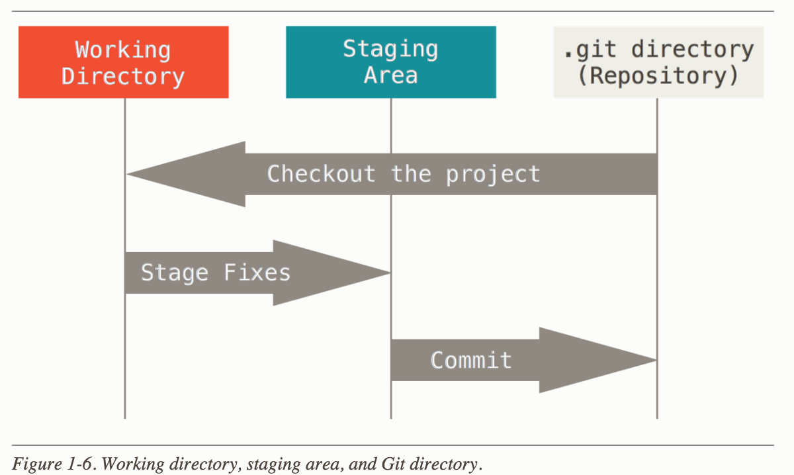
Git schematic

Slide 28
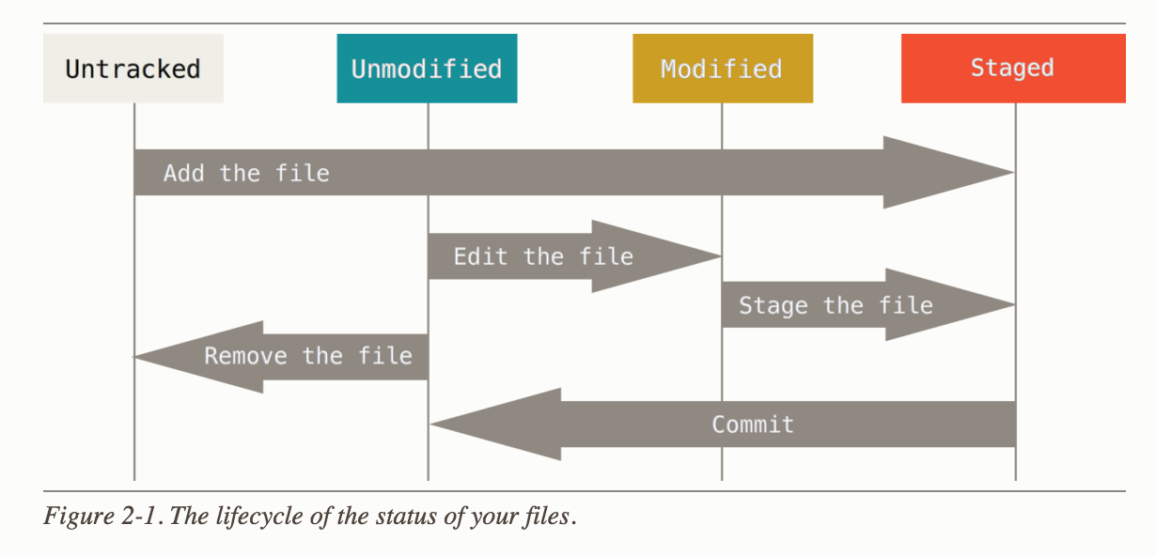
Git schematic

Slide 29
Good luck on HW5! Start HW6 early

