Slide 1
Discussion Section Week 8
Eliah Overbey
Feb 28 2019

Slide 2
Agenda
HW6 questions
Baum-Welch (forward-backward) algorithm
HW7

Slide 3
Baum-Welch Algorithm
Baum–Welch is an expectation-maximization algorithm that uses the forward–backward algorithm.
1. Use the forward algorithm to calculate the forward probabilities for the HMM.
2. Use the backward algorithm calculate the backward probabilities for the HMM.
3. Re-estimate transition, emission, and initial probabilities by calculating the expected number of each edge type
4. Calculate the new log likelihood of the model (the likelihood of our observations given our re-tuned model)
5. Repeat until the change in log likelihood is smaller than a given threshold or when a maximum number of iterations is passed.

Slide 4
Forward-backward algorithm
A
G
C

Slide 5
Forward-backward algorithm
A
G
C
For each node:
Forward: store the sum of probabilities of paths ending at position i state k
Backward: store the sum of probabilities of paths starting at position i state k

Slide 6
Forward-backward algorithm
A
G
C
For each node:
Forward: store the sum of probabilities of paths ending at position i state k
Backward: store the sum of probabilities of paths starting at position i state k

Slide 7
Mathematical Terminology
Some terminology for the following slides:
α_{k}(i): The forward probability of being in state k at position i
β_{k}(i): The backward probability of being in state k at position i
e_{k}(S_{i}): The emission probability of the character at position i in state k
a_{kl}: The transition probability from state k to state l
$π$_{k}: The initiation probablility to state k
N = Number of states/number of incoming edges to a node

Slide 8
Forward Algorithm
α_{k}(1) = $π$_{k *} e_{k}(S_{i})
α_{k}(i+1) = e_{k}(S_{i+1}) * $\sum_{j=1}^{N}{\text{α}\text{j}\left(i\right) ajk}$
Build a dynamic programming table for these calculations
(or store these calculations in node/vertex objects; or in a list)
A
G
C
 | A | G | C
State 1 | $$Eq. 1$$ | $$Eq. 2$$ | $$Eq. 2$$
State 2 | $$Eq. 1$$ | $$Eq. 2$$ | $$Eq. 2$$
Notes:
Look up how to do the addition in this statement. Will it create an underflow issue.

Slide 9
Backward Algorithm
Build a dynamic programming table for these calculations
(or store these calculations in node/vertex objects; or in a list)
A
G
C
 | A | G | C
State 1 | $$Eq. 2$$ | $$Eq. 2$$ | $$Eq. 1$$
State 2 | $$Eq. 2$$ | $$Eq. 2$$ | $$Eq. 1$$

Slide 10
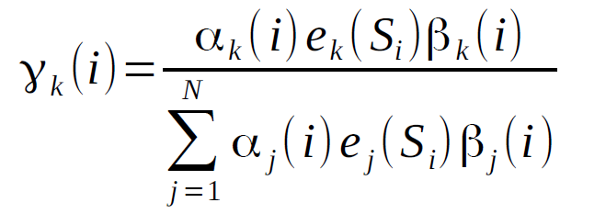
An alternative way to think about updating
A
G
C
Consider the probabilities at each node:
Figure out the probability of being in state k at position i

Slide 11
An alternative way to think about updating
A
G
C
Consider the probabilities at each edge:
Figure out the probability of going from state k to state l from position i to position i+1
Note: The emission probability e_{k}(S_{i}) has been factored out of the forward probability below. If you already calculated it in to the forward probability, you don’t have to do it twice.

Slide 12
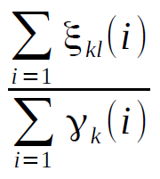
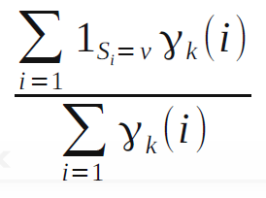
An alternative way to think about updating
The initial probabilities for each state k can be updated to
The transition probability from state k to state l can be updated to
The emission probability for symbol v from state k can be updated to
Remember to ignore the last position

Slide 13
Notes for debugging
Try calculating some simple forward and backward probabilities by hand to check your algorithm
Make sure the sum of the numerators for a single state or transition from a given state equals the associated denominator
The likelihood at each iteration should increase; if it decreases, then you have a bug
Your program should take less than 250 iterations. Have a print statement in your program to keep track of iterations as your program is running.

Slide 14
Underflow
This happens when numbers are too small to be stored in a variable
Solutions:
Scale weights to be close to 1 (affects all paths by same constant factor – which can be multiplied back later)
Use log weights, so can add instead of multiplying
Ex: Instead of 0.0001 * 0.0002, you can do:
log(0.0001) + log(0.0002)
What about when you need to sum probabilities in logspace? See this blogpost for a solution:
https://gasstationwithoutpumps.wordpress.com/2014/05/06/sum-of-probabilities-in-log-prob-space/

Slide 15
HW7: detecting G+C-rich regions round II (Baum-Welch)
Due 11:59pm Wednesday, March 6
Assignment: use Baum-Welch algorithm to identify G+C-rich regions in a genome sequence
Input: same as last time!
Run Baum-Welch until the increase in sequence log-likelihood is less than 0.1

Slide 16
HW7: detecting G+C-rich regions round II (Baum-Welch)
Due 11:59pm Wednesday, March 6
Assignment: use Baum-Welch algorithm to identify G+C-rich regions in a genome sequence
Input: same as last time!
Run Baum-Welch until the increase in sequence log-likelihood is less than 0.1
Output:
Name and first line of the FASTA file
Number of iterations until convergence
Final sequence log-likelihood
Final probabilities (initial, transition, emission)
Scientific notation, four significant digits (see template)
Notes:
http://www.cs.rochester.edu/u/james/CSC248/Lec11.pdf
Extentions of HMM models
How to combine HMMs with other modeling strategies
Tuesday of week 10

