Slide 1
Discussion Section Week 9
Eliah Overbey
March 7, 2019

Slide 2
Agenda
HW6: Questions?
HW7 was due last night
HW8: Due Wednesday, March 13, 11:59pm
HW9: Due Wednesday, March 20, 11:59pm

Slide 3
HW8: Evolutionarily conserved segments
ENCODE region 010 (chromosome 7)
Multiple alignment of human, dog, and mouse
2 states: neutral (fast-evolving), conserved (slow-evolving)
Emitted symbols are multiple alignment columns (e.g. ‘AAT’)
Viterbi parse (no iteration)
Notes:
- Don’t need to worry about updating transition probabilities and performing multiple iterations; just do a single pass to determine the Viterbi path

Slide 4
Input
Original maf format
Sequences broken into alignment blocks based on the species included
Official file format specs
Homework file format
Only 3 species
Gaps in human sequence and ambiguous bases replaced with ‘A’ for simplicity

Slide 5
HMM Diagram
start
0.95
0.05
Neutral
Conserved
0.05
0.95
0.90
0.10
A--
TTT
… all tuple possibilities …

Slide 6
Setting parameters
Emission probabilities
Neutral state: observed frequencies in neutral data set
Conserved state: observed frequencies in functional data set
Transition probabilities
Given in the assignment; more likely to go from conserved to neutral
Initiation probabilities
Given in the assignment; more likely to start in the neutral state

Slide 7
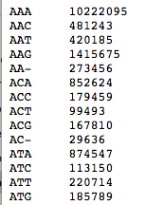
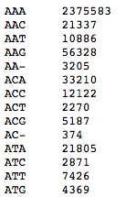
Calculating Emission Probabilities
Neutral State: Ancient Repeat Sequences
Conserved State: Putative Functional Sites
etc …
1st base: human
2nd base: dog
3rd base: mouse
etc …

Slide 8
Output
Parameter values
Emission probabilities you calculated from neutral and conserved data sets
Initiation/transition probabilities you were given in the assignment
State and segment histograms
Coordinates of 10 longest conserved segments (report positions relative to the start of the chromosome)
Brief annotations for the 5 longest conserved segments (look at UCSC genome browser, like in HW3)
Notes:
- When looking up annotations in the UCSC genome browser, make sure you’ve selected the correct reference genome (hg18)

Slide 9
HW8: Questions?

Slide 10
HW9: D-segments Revisited
Same input data as for HW3 (file of read-start counts for chromosome 18)
New scoring scheme for the read-start bins (0, 1, 2, and >=3)
Same format, different numbers
AND different values for S and D cutoffs

Slide 11
HW9: D-segments Revisited
Assignment:
Create randomized data sets with the same average read-start distribution as the original data
N = number of sites in original sequence
counts[r] = number of sites with r read starts in original sequence
for each site 1..N
x = random number between 0 and 1 (uniform distribution)
if x < counts[0] / N
randomized_counts[site] = 0
else if x < (counts[0] + counts[1]) / N
randomized_counts[site] = 1
else if x < (counts[0] + counts[1] + counts[2]) / N
randomized_counts[site] = 2
else
randomized_counts[site] = 3

Slide 12
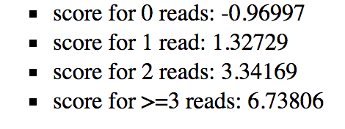
HW9: D-segments Revisited
Assignment:
Create randomized data sets with the same average read-start distribution as the original data
Run maximal D-segment algorithm (from HW3) on 10 different randomizations of the read start sequence
Scoring scheme different from HW3 for the read-start bins
D = -5
S = {5, 10, 15, 20, 25} → 5 different S, D combinations

Slide 13
HW9: D-segments Revisited
Assignment:
Create randomized data sets with the same average read-start distribution as the original data
Run maximal D-segment algorithm (from HW3) on 10 different randomizations of the read start sequence
Scoring scheme different from HW3 for the read-start bins
D = -5
S = {5, 10, 15, 20, 25} → 5 different S, D combinations
Run maximal D-segment algorithm on the original data, using the same parameters

Slide 14
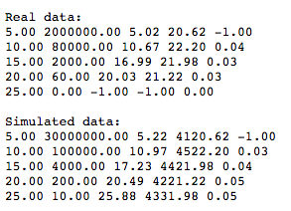
HW9: D-segments Revisited
Output:
Two tables, one for the original ‘real’ data, and another for the combined results across the 10 sets of simulated data. Each table row should report:
S-value
Number of D-segments found (mean for simulated data)
Minimum D-segment score found
Maximum D-segment score found
Ratio of #D-seg(S_{i})/#D-seg(S_{i-1})
Brief written answers to the questions posed in the assignment text (to be posted)

Slide 15
HW9: Questions?

Slide 16
Next Week: HW Office Hours

