Slide 1
First discussion section
Introductions
HW1 context/advice/questions
C++/general programming tips
Input on future topics

Slide 2
Introductions
Who am I?
  4th year Genome Sciences student
  Eichler Lab
  Human structural variation
    Long read sequencing
    De novo assembly
    Segmental duplications
  Python/Snakemake/C++
Who are you?
  Department
  Programming experience

Slide 4
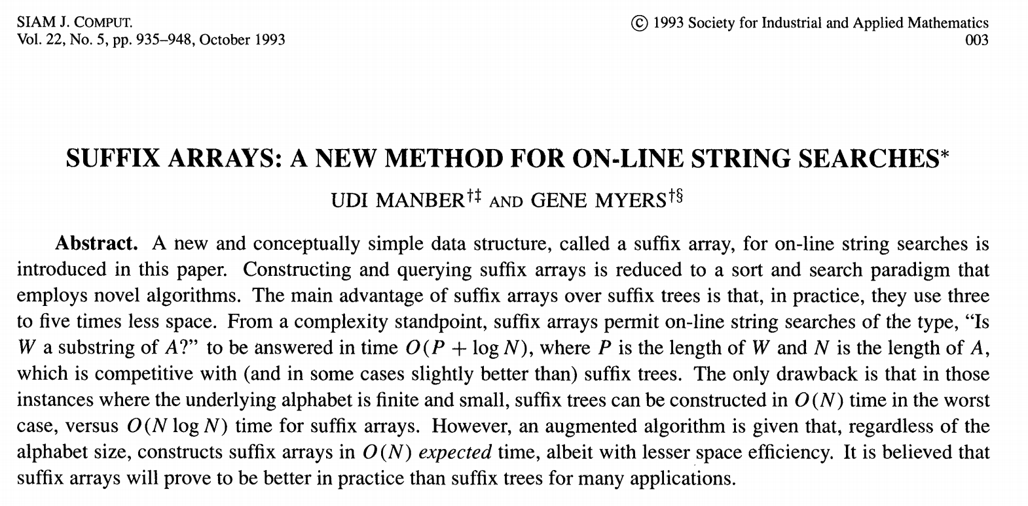

Slide 5
Yahoo!, Amazon, Google, Youtube, NIH

Slide 6
Yahoo!, Amazon, Google, Youtube, NIH
One of the creators of BLAST (1990),
Shotgun sequence assembly

Slide 7
Suffix trees
Applications:
  Finding longest-repeated substring
  Finding all repetitions in a string
  Computing substring statistics
  Approximate string matching
  Compression
  Genetic sequence analysis
  https://www.youtube.com/watch?v=hLsrPsFHPcQ&t=1s

Slide 8
Suffix arrays
Substantially more space-efficient
Search times comparable
Greater upfront build time
“A primary motivation for this paper was to be able to efficiently answer on-line string queries for very long genetic sequences (on the order of one million or more symbols long). In practice, it is the space overhead of the query data structure that limits the largest text that may be handled.”
Fancier implementations than yours take advantage of the fact that you’re not sorting arbitrary strings, and that suffix trees can be built more quickly

Slide 9
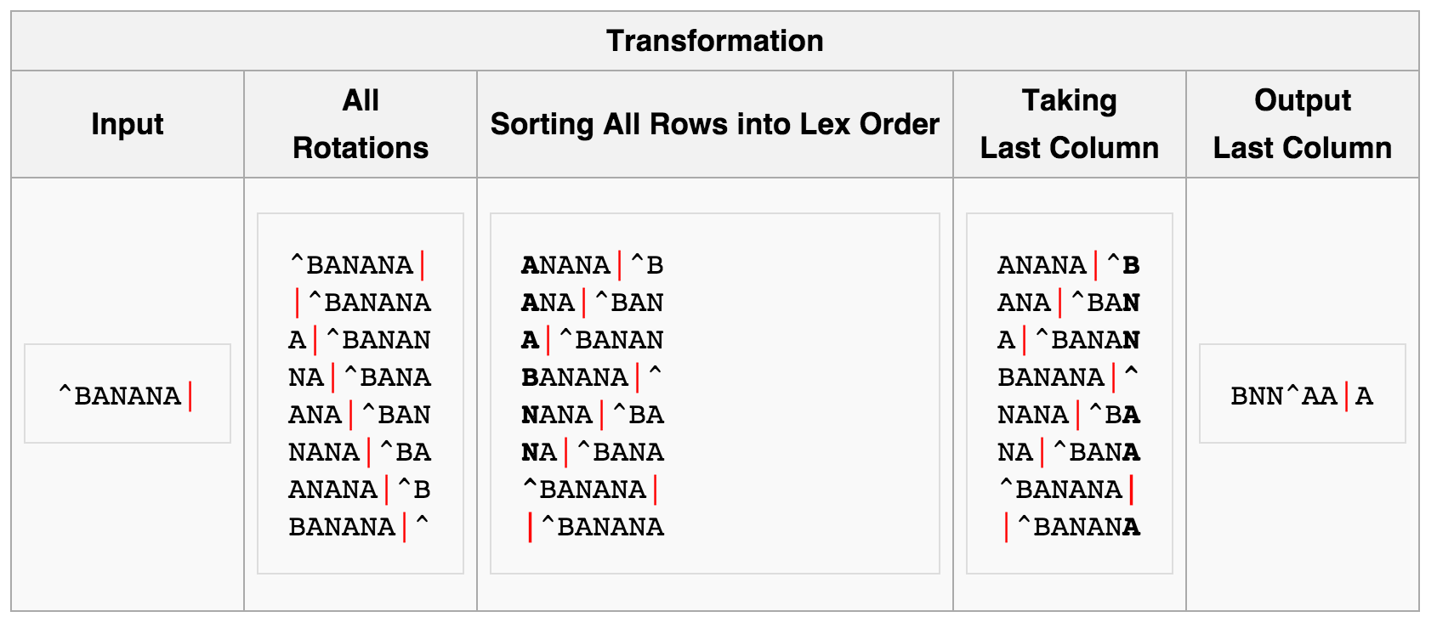
Burrows-Wheeler transform
Useful for compression (since compressing repeated sequences is easier)

Slide 10
Burrows-Wheeler transform
Used in Bowtie (short read aligner by Cole Trapnell) to reduce memory usage, in combination with suffix arrays
Useful for compression (since compressing repeated sequences is easier)

Slide 11
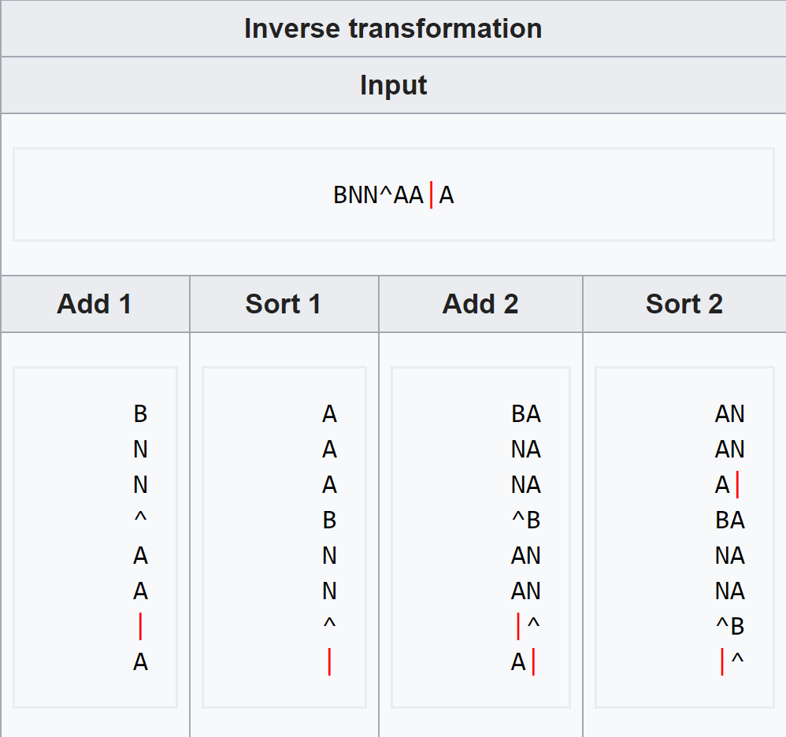
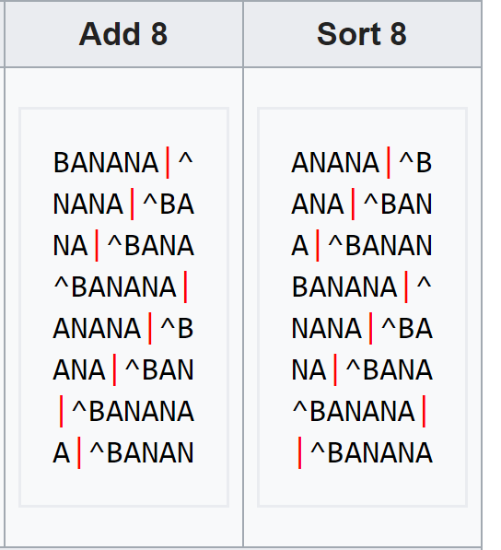
Burrows-Wheeler inverse transform
…
Useful for compression (since compressing repeated sequences is easier)

Slide 12
HW1 tips
Start with pseudocode/python
Get comfortable with pointers
Think about how to store inputs
Think about how to store results
Output to template directly

Slide 13
Programming style
The more readable your code is
  The more I’ll be able to help you if something’s wrong
  The more useful it will be to you later (especially if you TA this class…)
Tips for readability
  Intuitive variable/function names
  Comments
    Outlining general structure of program/key points of implemented algorithm
    Clarifying any tricky/unintuitive lines of code
  Simplicity over performance optimization (until it becomes necessary)
Please make an effort to match the template!

Slide 14
Programming tips: testing
Create small, easily-verified test cases
Edge cases
Print intermediate output (cerr)
Write incrementally, test as you go
  Assertion statements
Check against expectations

Slide 15
Programming tips: efficiency
Remove unnecessary stuff from loops
Avoid slow comparison routines when sorting
Profiling tools
  line_profiler (python)
  gprof, valgrind (C/C++) [valgrind also identifies memory leaks]
  dprofpp (Perl) [Does anyone use Perl anymore??]

Slide 16
Pointers in C++
Pointers are memory addresses, which point to variables
There are two operators essential for handling pointers and memory addresses in C/C++: `*` and `&`
Unfortunately, both operators can be used in two ways which often leads to confusion.

Slide 17
* as a suffix to a type is a “pointer”
char * p; // p is a memory location that stores a “char”

Slide 18
& as a unary prefix is the address-of operator and obtains the memory address of a variable
char x = ‘h’;
char * p = &x;

Slide 19
* as a unary prefix means content of that memory location
char y = ‘a’;
char* p = &y; // p points to the memory location of y
char x = *p ; // *p is the object that p points to (i.e. ‘a’)

Slide 20
& as a suffix to a type means “pass by reference”
// pass by reference
void my_func(int &a){
a = 5;
}
int main(int argc, char* argv[] ){
int a = 0;
my_func(a);
cout << a << endl;
}

Slide 21
Arrays point to blocks of memory
Arrays are just pointers to continuous blocks of memory
Array indices are just pointer arithmetic and dereferencing combined
  a[12] is the same as *(a + 12)
  &a[3] is the same as a + 3
Large arrays should be dynamically allocated (on the heap)
  Make sure you delete them
char word[6]; // an array of 6 characters called word
word[0] = ‘a’;
word[0]
word[1]
word[2]
‘h’
‘i’
‘\0’
const char *word = “hi”;
0x80
0x88
0x90
word
word+1
word+2
int n = some_large_number;
Double * d = new double[N];

Slide 22
Dynamic arrays in C++ (Vectors)
#include <iostream>
#include <fstream>
#include <sstream>
#include <vector> // must have this in order to use vector
#include <algorithm>
using namespace std;
int main(int argc, char* argv[] ){
vector<string> vec; // make an empty vector that will be made up of strings
vec.push_back("ZABC"); // adds “ZABC” to the vector, can be accesses with strings[0]
vec.push_back("DEF"); // adds ”DEF”
for(auto x : vec){
cout << x << endl;
}
vec.clear(); // empty the vec of all elements
// documentation http://www.cplusplus.com/reference/vector/vector/
}

Slide 23
Custom data types in C++ (Structs)
struct complex{
int real;
int img;
};
int main(int argc, char* argv[] ){
complex a = { 10 , 1} ;
cout << “Real: ” << a.real << “ Img: ” << a.img << endl;
complex * p = &a;
cout << “Real: ” << p->real << “ Img: ” << p->img << endl;
}

Slide 24
Sorting in C++ with sort
#include <iostream>
#include <fstream>
#include <sstream>
#include <vector>
#include <algorithm> // must have this in order to use sort
using namespace std;
bool my_cmp(const string & a, const string & b ){
return( a < b );
}
int main(int argc, char* argv[] ){
vector<string> vec;
vec.push_back("ZABC");
vec.push_back("DEF");
sort(vec.begin(), vec.end(), my_cmp );
for(auto x : vec){
cout << x << endl;
}
}

Slide 25
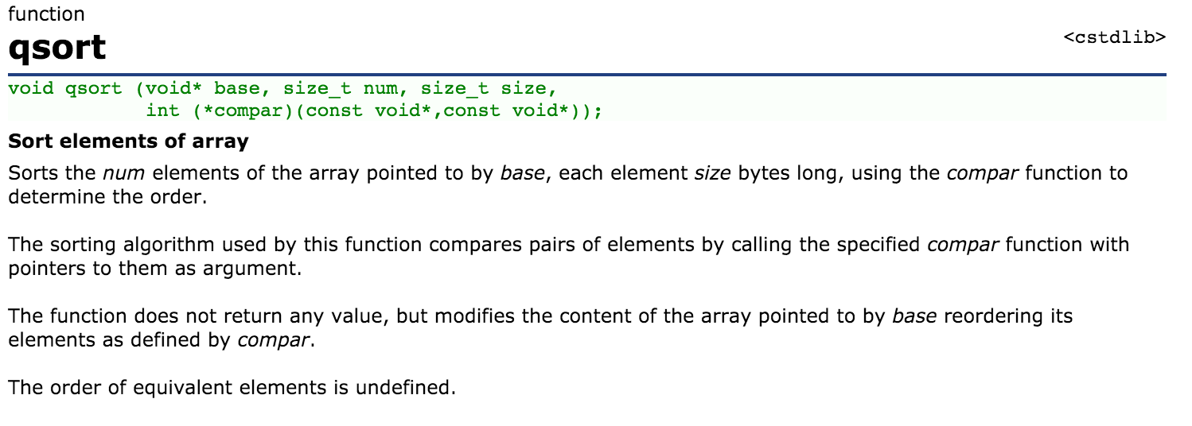
Other sorting options in C++

Slide 26
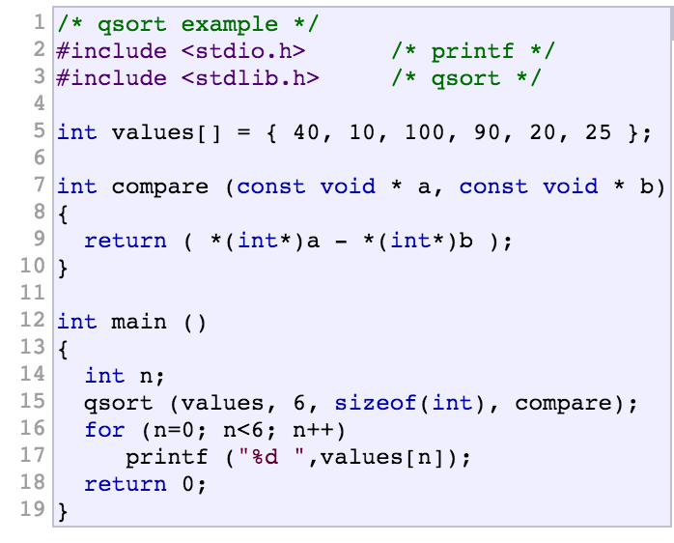
Other sorting options in C++
http://www.cplusplus.com/reference/

Slide 27
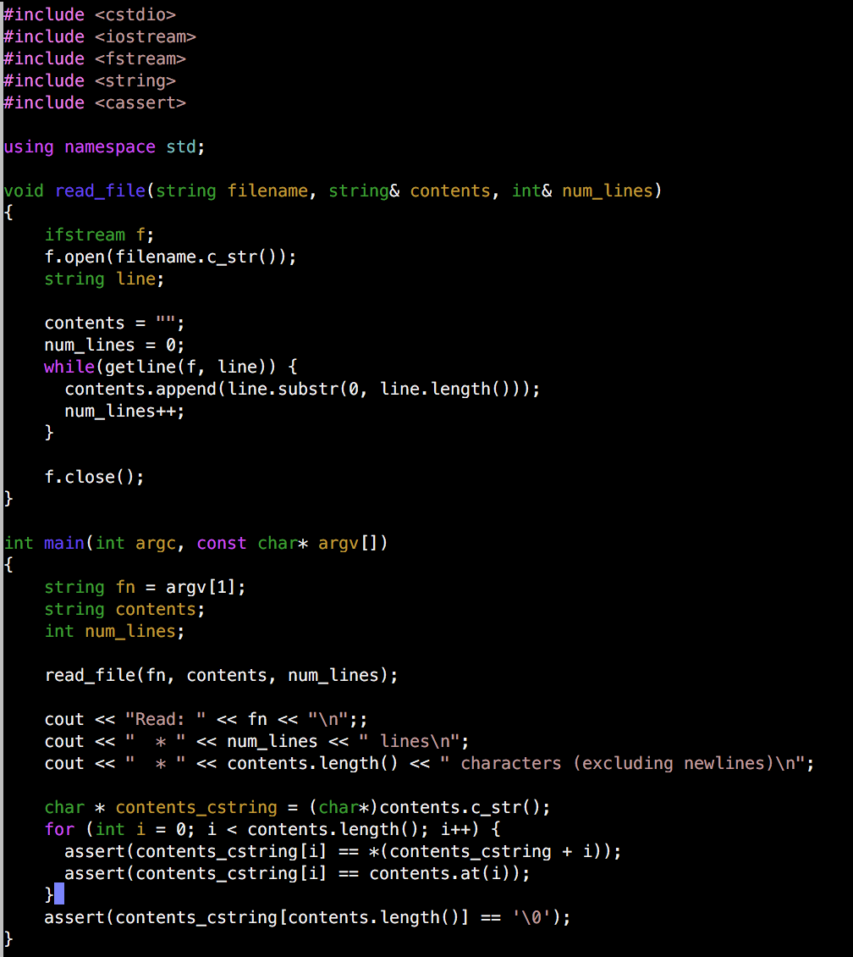
Example of reading in a file in C++
(and a few other things)

Slide 28
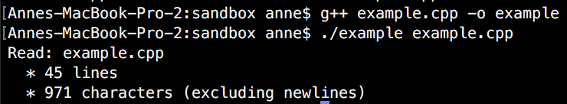
Example of reading in a file in C++
(and a few other things)

Slide 29
Topics for future discussion sections?
Alignment (long-read), and de novo assembly
Scalable and reproducible bioinformatics pipelines (Snakemake)
General programming tips
Specific languages: Python, C++, Unix tools
Additional applications of HMMs (GENSCAN)
Dynamic programming
Machine learning

