Slide 1
Week 2 Discussion Section Genome 540
Mitchell Vollger

Slide 2
Agenda
Q’s about HW1?
Overview of HW2
Other DAG Algorithms
Make and makefiles (prerequisite for learning about Snakemake)

Slide 3
HW2: Highest Weighted Path for Directed Acyclic Graphs (DAGs)
Write 2 programs
Test your code on our examples and compare your results
Run your code on the submission DAG and genome and submit these results
Due Jan 26, 11:59pm

Slide 4
HW2: Highest Weighted Path for Directed Acyclic Graphs (DAGs)

Slide 5
HW2: Write two programs
Program 1: Find a highest-weight path in a weighted directed acyclic graph
Program 2: Convert a fasta file to written graph format

Slide 6
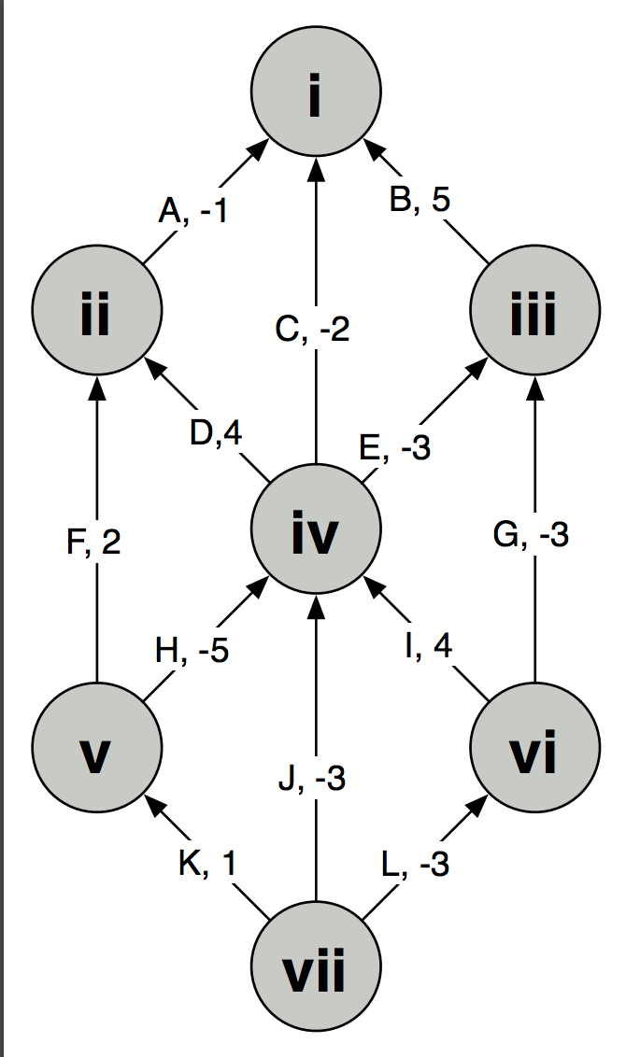
HW2: Program 1
Program 1: Find a highest-weight path in a weighted directed acyclic graph
Convert graph by hand into a list of vertices and edges, which you will input into your program
Write a program to output the
Path Score
2. The label of the beginning vertex on the path
3. the label of the ending vertex on the path
4. (in order) the labels for all the edges that occur on this path.
Test Example:

Slide 7
HW2: Program 1
Program 1: Find a highest-weight path in a weighted directed acyclic graph
Convert graph by hand into a list of vertices and edges, which you will input into your program
Write a program to output the
Path Score
2. The label of the beginning vertex on the path
3. the label of the ending vertex on the path
4. (in order) the labels for all the edges that occur on this path.
Run this program “unconstrained” and with the start and end contraints of “vii” and “i” respectively
Test Example:

Slide 8
HW2: Program 1
Program 1: Find a highest-weight path in a weighted directed acyclic graph
Convert graph by hand into a list of vertices and edges, which you will input into your program
Write a program to output the
Path Score
2. The label of the beginning vertex on the path
3. the label of the ending vertex on the path
4. (in order) the labels for all the edges that occur on this path.
Run this program “unconstrained” and with the start and end contraints of “vii” and “i” respectively
Test Example:
Example Input:
V vii START
V vi
V v
…
E A ii i -1
E B iii i 5

Slide 9
HW2: Program 1
Program 1: Find a highest-weight path in a weighted directed acyclic graph
Convert graph by hand into a list of vertices and edges, which you will input into your program
Write a program to output the
Path Score
2. The label of the beginning vertex on the path
3. the label of the ending vertex on the path
4. (in order) the labels for all the edges that occur on this path.
Run this program “unconstrained” and with the start and end constraints of “vii” and “i” respectively
Example output:
Test Example:
Part 1
Score: 8.0
Begin: vi
End: ii
Path: ID
Part 2
Score: 4.0 Begin: vii
End: i
Path: LIDA

Slide 10
HW2: Program 1
Program 1: Find a highest-weight path in a weighted directed acyclic graph
Convert graph by hand into a list of vertices and edges, which you will input into your program
Write a program to output the
Path Score
2. The label of the beginning vertex on the path
3. the label of the ending vertex on the path
4. (in order) the labels for all the edges that occur on this path.
Run this program “unconstrained” and with the start and end contraints of “i” and “xiii” respectively
Output: Turn this in
For Grading:

Slide 11
Program 1 Algorithm

Slide 12
HW2: Program 2
0
Program 2: Convert FASTA to written graph format
A, -1.49
Read 2 input files:
1) a FASTA file containing a DNA sequence, and
2) a 'scoring scheme' file that indicates a score to be attached to each possible base (A, C, G, T, or other)
Output a written graph to run through program 1
1
C, 0.74
2
G, 0.74
3
T, -1.49
…

Slide 13
HW2: Program 2
0
Program 2: Convert FASTA to written graph format
A, -1.49
Example of written graph output:
V 0
V 1
V 2
…
E G 0 1 0.74
E T 1 2 -1.49
E G 2 3 0.74
1
C, 0.74
2
G, 0.74
3
Run this output through program 1
T, -1.49
…

Slide 14
HW2: Program 2
0
Program 2: Find a highest-weight path in a linked list
A, -1.49
Test example: Mycoplasma gallisepticum
Part 3
>gi|400273702|gb|CP003508.1| Mycoplasma gallisepticum NC96_1596-4-2P, complete genome
*=986257
A=337443
C=156212
T=336693
G=155909
N=0
Score: 11.069998
Begin: 344420
End: 344444
Path: GGCGGCGGCCCCTGGCGATGGCCG
Description: This sequence lies within the HFMG96NCA_2038 gene (encodes a hypothetical protein).
1
C, 0.74
2
G, 0.74
3
T, -1.49
…

Slide 15
HW2: Program 2
Refer to online hw for more thorough details
0
Program 2: Find a highest-weight path in a linked list
A, -1.49
Test example: Mycoplasma gallisepticum
Part 3
>gi|400273702|gb|CP003508.1| Mycoplasma gallisepticum NC96_1596-4-2P, complete genome
*=986257
A=337443
C=156212
T=336693
G=155909
N=0
Score: 11.069998
Begin: 344420
End: 344444
Path: GGCGGCGGCCCCTGGCGATGGCCG
Description: This sequence lies within the HFMG96NCA_2038 gene (encodes a hypothetical protein).
1
C, 0.74
2
G, 0.74
3
T, -1.49
…

Slide 16
Any Questions on HW2?

Slide 17
Other DAG Algorithms
Minimum-weight path on a DAG
Similar to the homework
Looking for the minimum instead of the maximum
If there are no negative weights, then the shortest path is technically weight 0 (single node)
Otherwise, update vertex weights in depth order as normal

Slide 18
What if graph has cycles?
More difficult (can’t order nodes by depth)
Bellman-Ford algorithm (for given start vertex)
Choose source node and set distance to 0
Set distance to all other nodes to infinity
For each edge (u,v), if v’s distance can be reduced by taking that edge, update v’s distance
Cycle through all edges in this way |V|-1 times
Repeat for all vertices as source node
(can also check for negative-weight cycle with one extra iteration)
Tutorial and dynamic programming implementation here.

Slide 19
What if graph has cycles? (no negative edges)
Dijkstra’s algorithm (for given start vertex)
Choose source node and set distance to 0
Set distance to all other nodes to infinity
Set source node to current
Make distance offers to all unvisited neighbors, which are accepted if they’re less than the previous best offer
Mark current as visited (it will never be updated again)
Select unvisited neighbor with smallest distance, set it to current, and repeat
(When destination node has been marked visited, stop)

Slide 21
Make and Makefile
Syntax within “Makefile”:
Target file: prerequisite file(s); command to make target
Execution of make:
make target_file # builds the target file
Or:
make # builds all targets specified by the phony target all

Slide 22
Example Makefile
all: nlines.txt
nlines.txt: input.txt; wc -l input.txt > nlines.txt

Slide 23
Example Makefile
all: nlines.txt
nlines.txt: input.txt; wc -l input.txt > nlines.txt
input.txt: ; {commands to generate input.txt}

Slide 24
Makefile for WDAG HW
all: results/WDAG.txt
results/WDAG.txt: bin/WDAG; bin/WDAG {program inputs}
bin/WDAG: src/WDAG.cpp; g++ -o bin/WDAG src/WDAG.cpp

Slide 25
Snakemake
The Snakemake workflow management system is a tool to create reproducible and scalable data analyses.
Workflows are described via a human readable, Python based language.
They can be seamlessly scaled to server, cluster, grid and cloud environments, without the need to modify the workflow definition.
Finally, Snakemake workflows can entail a description of required software, which will be automatically deployed to any execution environment.
https://snakemake.readthedocs.io/en/stable/

Slide 26
Intro slides for Snakemake
https://slides.com/johanneskoester/snakemake-short#/

Slide 30
More C++ Tips

Slide 31
C++: heap vs. stack memory
Stack
Objects created inside a function stored here by default
Automatically deleted once the function runs to completion
Fixed size – stack overflow if you run out of space
Much faster to allocate
Local data, parameter passing, etc.
Heap
Must use the “new” operator when creating objects to store them here
Must be manually deleted
More memory can be added to the heap as needed
Use heap memory for large objects, or if you don’t know how much space you need
Slower to allocate
Global/shared data, large objects
For more info, see Stack Overflow thread here.

Slide 32
C++: arrays & vectors
Arrays
Built-in language construct for a contiguous, indexable sequence of elements
Fixed size, determined upon declaration
More efficient
For arrays of objects, the object class must have a default constructor
Vectors
Template class implemented as a dynamic array
Grows and shrinks dynamically, and memory is managed automatically
Less efficient
Objects do not require a default constructor
For more info, see Stack Overflow threads here and here, as well as this tutorial.
Notes:
For those uncomfortable with pointers, vectors offer a level of abstraction; they can be passed to other functions/referred to by value, so you don’t strictly need to use pointers to interact with them, unlike arrays. However, do note that passing by value means you are copying the contents of the vector to pass them on to the function, so be careful where you use this.

Slide 33
C++: sorting & comparators
std::sort() – standard C++ sorting function (docs)
Usage: std::sort(first, last) [default sorting] std::sort(first, last, comp) [custom sorting]
`first` and `last` are random-access iterators indicating the range of elements to be sorted, [first, last)
`comp` is a comparator object that describes how items should be compared for sorting
E.g. a comparator for two Suffix objects might look like struct compSuffix { bool operator() (const Suffix& a, const Suffix& b) { return <true when a comes before b> } }
For more info on custom comparators, see the Stack Overflow thread here.

Slide 34
C++: iterators
Iterator: something that allows you to
Iterate over a sequence
Represent a sequence or subsequence
Access elements of a sequence
Introductory tutorial here, and C++ documentation on random-access iterators here
Iterator functions include `begin()` (returns beginning position of container) and `end()` (returns end position of container)
Pointers are a type of iterator
For more info on pointers, see tutorial here, GameDev post here, and Stack Overflow thread here.

Slide 35
See you next week!
Reminder: HW1 due THIS Sunday, 11:59pm

