Slide 1
Week 5
Genome 540: Discussion
Mitchell Vollger
02/06/2020

Slide 2
Agenda
HW4 questions
HW5: Multiple sequence alignment
BLAST

Slide 3
Past and current HWs
Past HW
  All grades have been emailed out. Let me know if you didn’t get yours (even if it was a late submission).
HW4 (D-segment part 2):
  Any questions?
  Because the template was made with only 1,000,000bp the equivalence may be off:
    N_seq(S2)/N_seg(S1) ≈ exp(-(S2-S1))
Notes:
diff can ignore blank spaces
-b

Slide 4
HW 5: find multiple alignment for three sequences
Create an edit graph for 3 sequences using the BLOSUM62 score matrix
Run HW2 WDAG program on the edit graph to find the highest scoring path (local alignment)
Report in the specified format:
  Maximum path score for the multiple alignment
  List of all edge weights (alphabetically sorted)
  List of all edge counts (alphabetically sorted)
  Highest scoring alignment

Slide 5
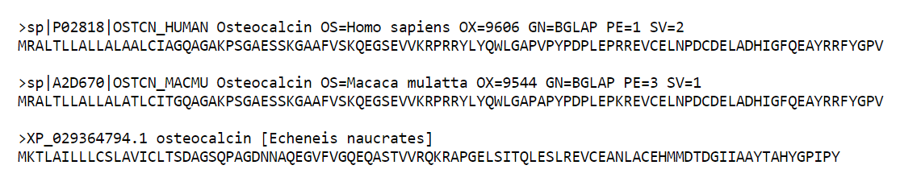
Inputs: Multiple Sequence Alignment (MSA)

Slide 6
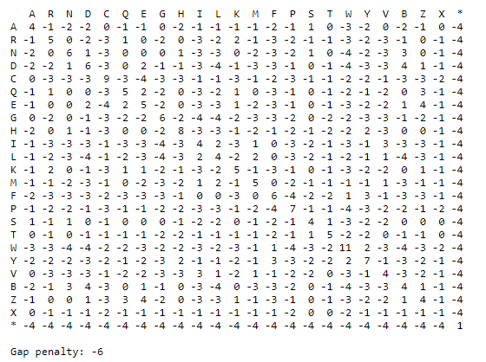
Inputs: Multiple Sequence Alignment (MSA)

Slide 7
HW4: Multiple sequence alignment
B
C
A
A = M C D R ...
B = M S D E ...
C = M V D R ...

Slide 8
HW4: Multiple sequence alignment
B
C
A
0 1 2 3 4
A = •M•C•D•R•...
B = •M•S•D•E•...
C = •M•V•D•R•...

Slide 9
HW4: Multiple sequence alignment
B
C
A
(1,2,1)
(2,2,1)
0 1 2 3 4
A = •M•C•D•R•...
B = •M•S•D•E•...
C = •M•V•D•R•...
(1,1,1)
(2,1,1)
(1,2,2)
(2,2,2)
(1,1,2)
(2,1,2)

Slide 10
HW4: Multiple sequence alignment
B
C
A
(1,2,1)
(2,2,1)
. 0 1 2 3 4
A = •M•C•D•R•...
B = •M•S•D•E•...
C = •M•V•D•R•...
(1,1,1)
(2,1,1)
CSV
(1,2,2)
(2,2,2)
(1,1,2)
(2,1,2)

Slide 11
HW4: Multiple sequence alignment
B
C
A
(1,2,1)
(2,2,1)
. 0 1 2 3 4
A = •M•C•D•R•...
B = •M•S•D•E•...
C = •M•V•D•R•...
weight(CSV) = score(CS) + score(CV) + score(SV)
(1,1,1)
(2,1,1)
CSV
(1,2,2)
(2,2,2)
(1,1,2)
(2,1,2)

Slide 12
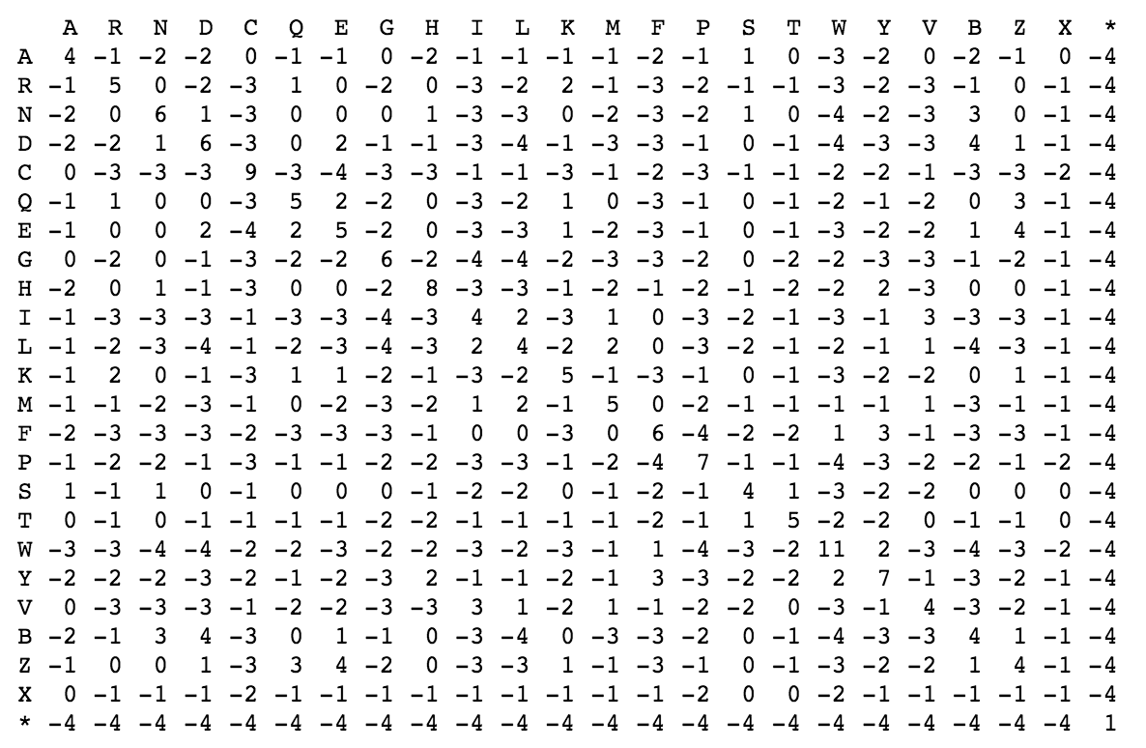
HW4: Multiple sequence alignment
B
C
A
(1,2,1)
(2,2,1)
. 0 1 2 3 4
A = •M•C•D•R•...
B = •M•S•D•E•...
C = •M•V•D•R•...
weight(CSV) = score(CS) + score(CV) + score(SV)
(1,1,1)
(2,1,1)
CSV
(1,2,2)
(2,2,2)
(1,1,2)
(2,1,2)

Slide 13
HW4: Multiple sequence alignment
B
C
A
(1,2,1)
(2,2,1)
. 0 1 2 3 4
A = •M•C•D•R•...
B = •M•S•D•E•...
C = •M•V•D•R•...
weight(CSV) = score(CS) + score(CV) + score(SV)
CS–
(1,1,1)
(2,1,1)
CSV
(1,2,2)
(2,2,2)
(1,1,2)
(2,1,2)

Slide 14
HW4: Multiple sequence alignment
B
C
A
(1,2,1)
(2,2,1)
. 0 1 2 3 4
A = •M•C•D•R•...
B = •M•S•D•E•...
C = •M•V•D•R•...
weight(CSV) = score(CS) + score(CV) + score(SV)
weight(CS-) = score(CS) + score(C–) + score(S–)
CS–
(1,1,1)
(2,1,1)
CSV
(1,2,2)
(2,2,2)
(1,1,2)
(2,1,2)

Slide 15
HW4: Multiple sequence alignment
B
C
A
(1,2,1)
(2,2,1)
. 0 1 2 3 4
A = •M•C•D•R•...
B = •M•S•D•E•...
C = •M•V•D•R•...
weight(CSV) = score(CS) + score(CV) + score(SV)
weight(CS-) = score(CS) + gap_penalty + gap_penalty
CS–
(1,1,1)
(2,1,1)
CSV
(1,2,2)
(2,2,2)
(1,1,2)
(2,1,2)

Slide 16
HW4: Multiple sequence alignment
B
C
A
(1,2,1)
(2,2,1)
. 0 1 2 3 4
A = •M•C•D•R•...
B = •M•S•D•E•...
C = •M•V•D•R•...
weight(CSV) = score(CS) + score(CV) + score(SV)
weight(CS-) = score(CS) + gap_penalty + gap_penalty
–S–
CS–
(1,1,1)
(2,1,1)
C––
CSV
––V
–SV
(1,2,2)
(2,2,2)
C–V
(1,1,2)
(2,1,2)

Slide 17
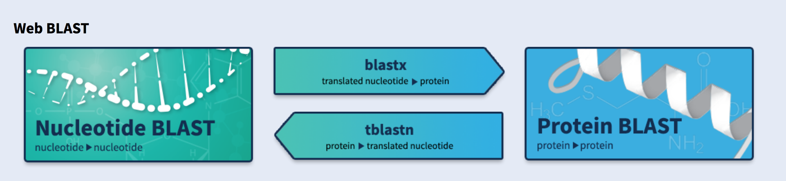
https://blast.ncbi.nlm.nih.gov/Blast.cgi

Slide 18
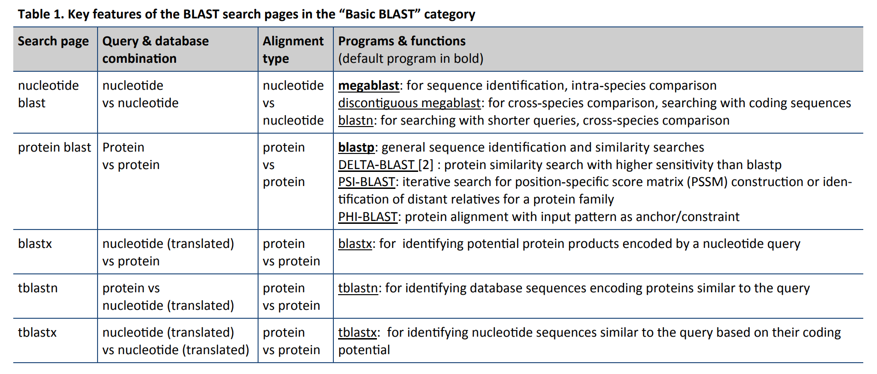

Slide 19
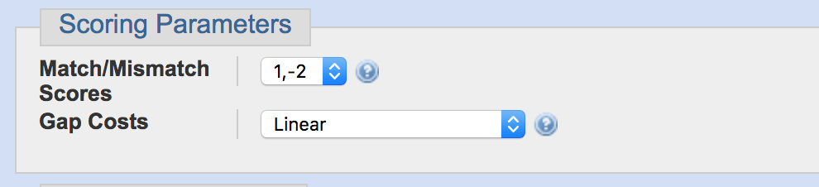
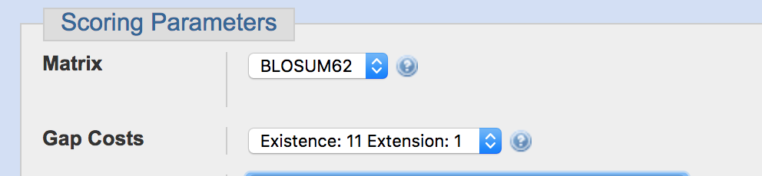
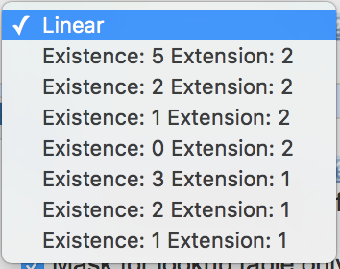
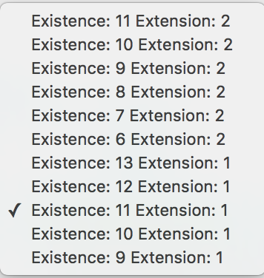
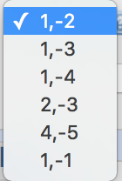
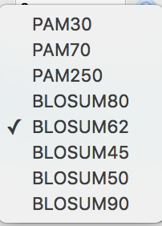

Slide 20
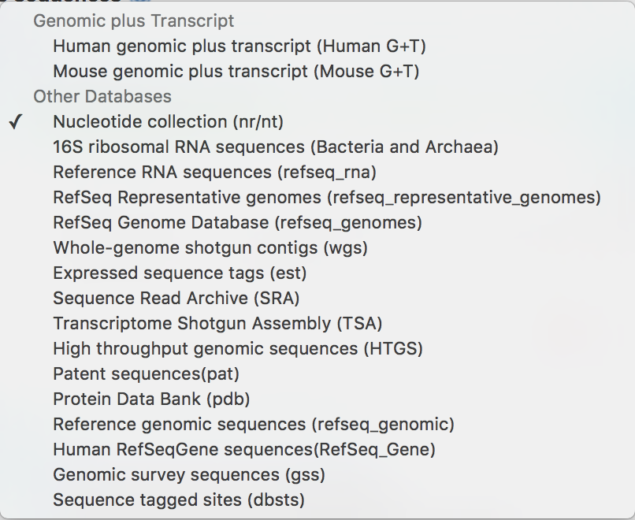
What can I search against?
Nucleotide databases

Slide 21
What can I search against?
Nucleotide databases

Slide 22
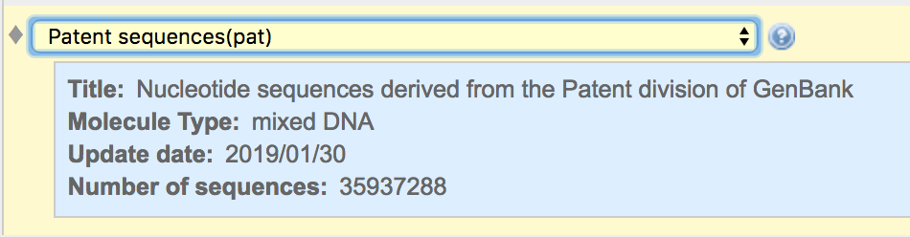
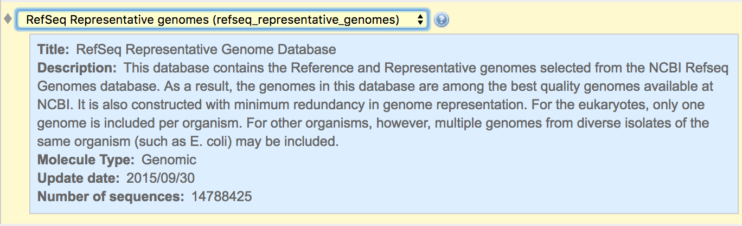
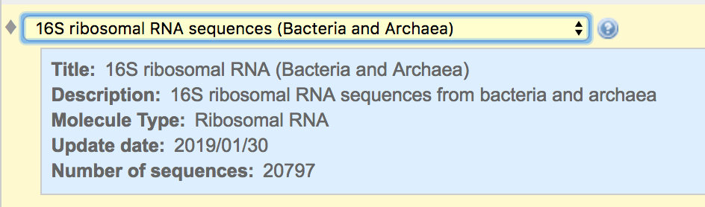
What can I search against?
Nucleotide databases

Slide 23
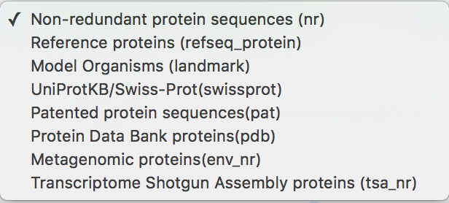
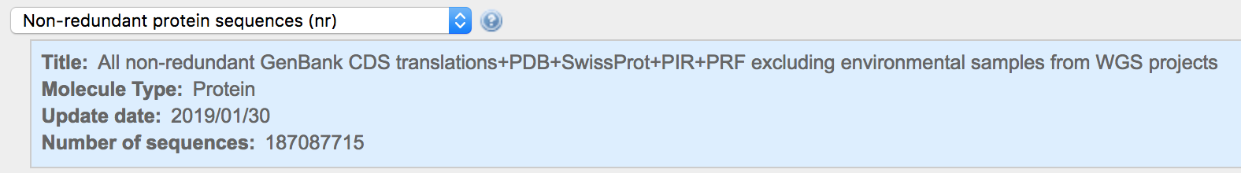
What can I search against?
Protein databases

Slide 24
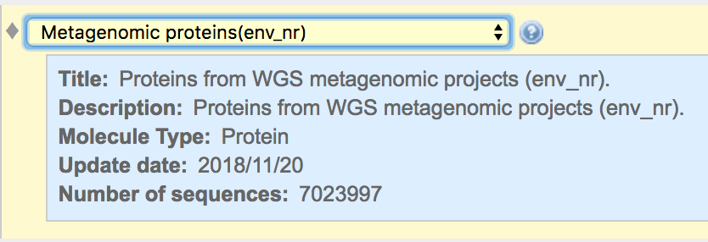
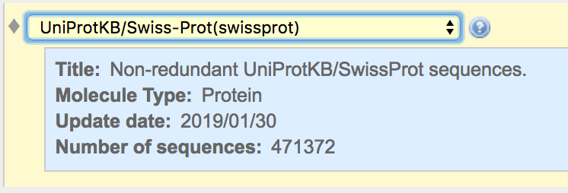
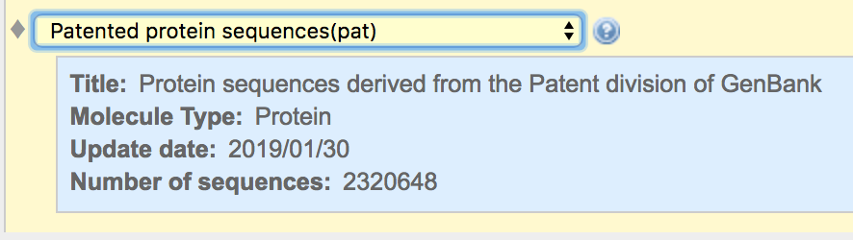
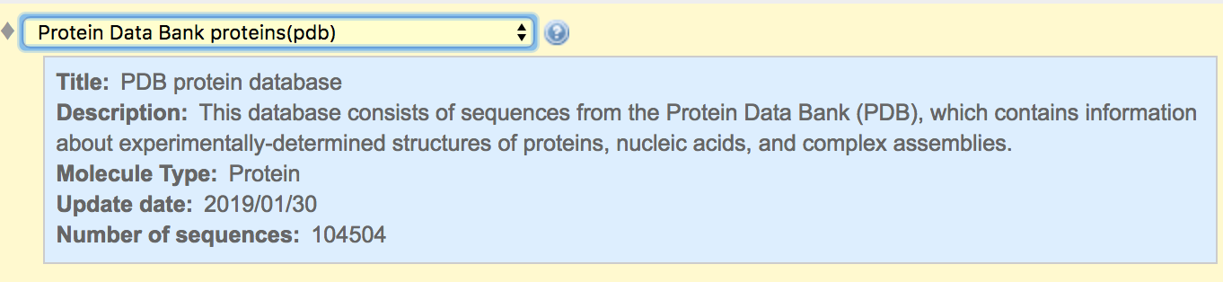
What can I search against?
Protein databases

Slide 25
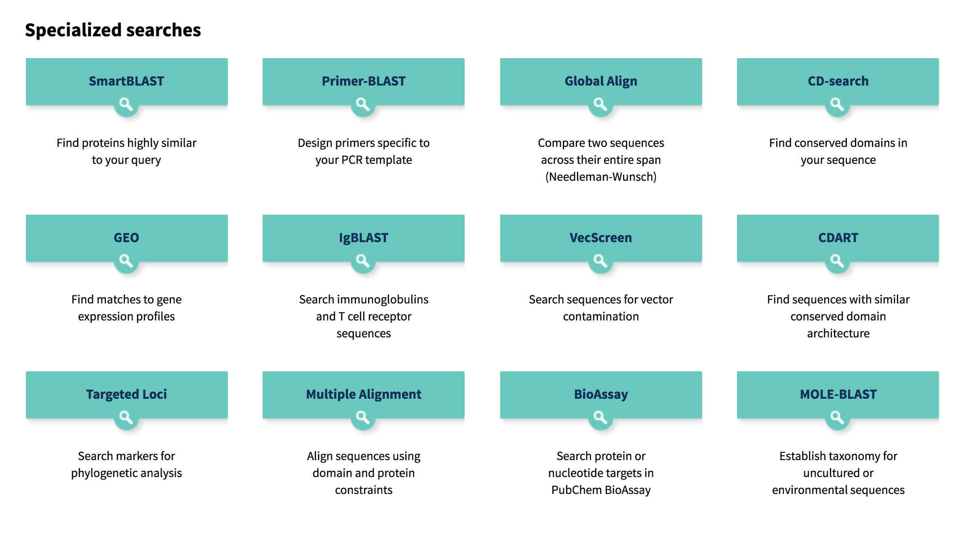
What can I search against?

Slide 26
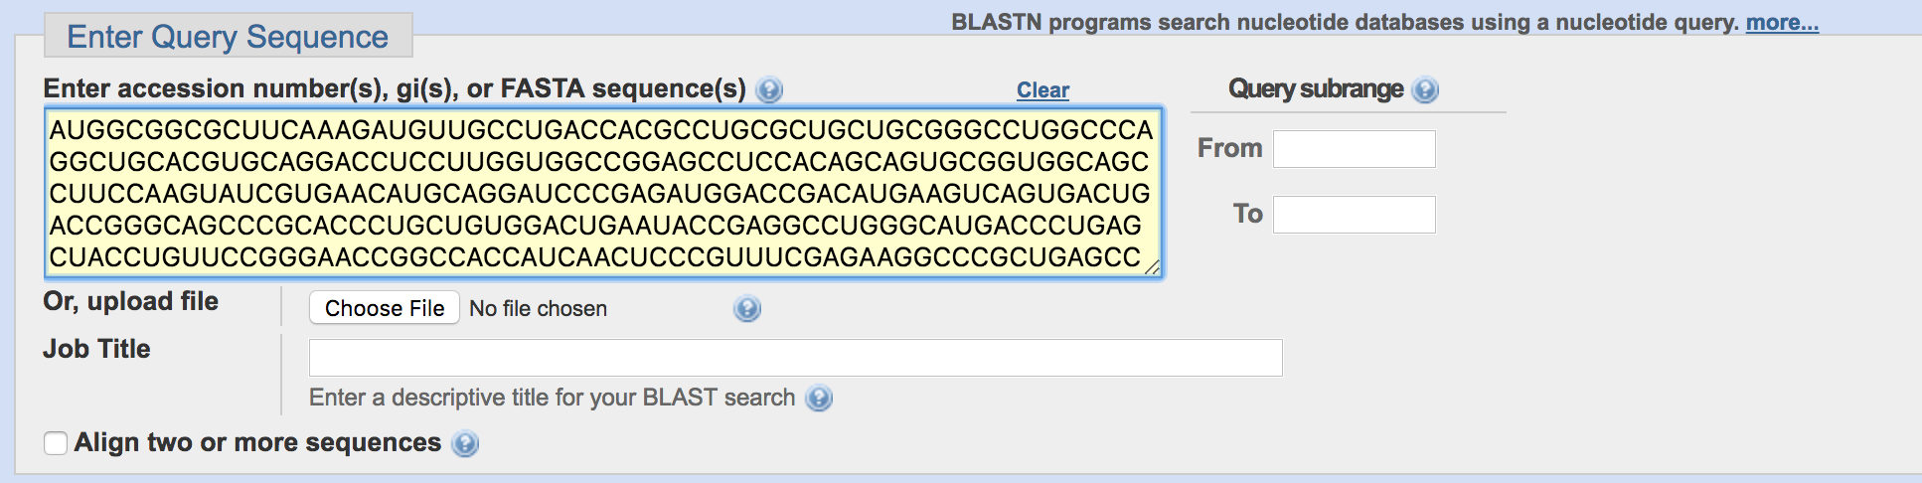
Using BLAST: Input
Seq Length: 755

Slide 27
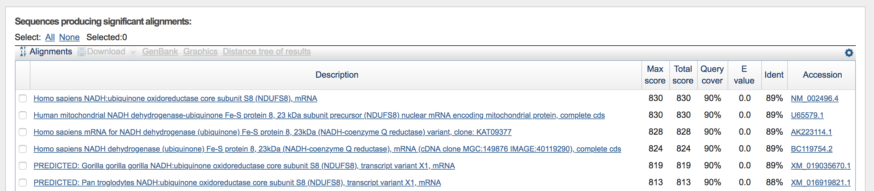
Using BLAST: Output

Slide 28
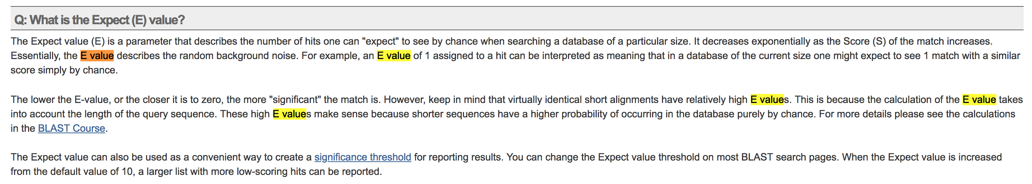
Using BLAST: Output

Slide 29
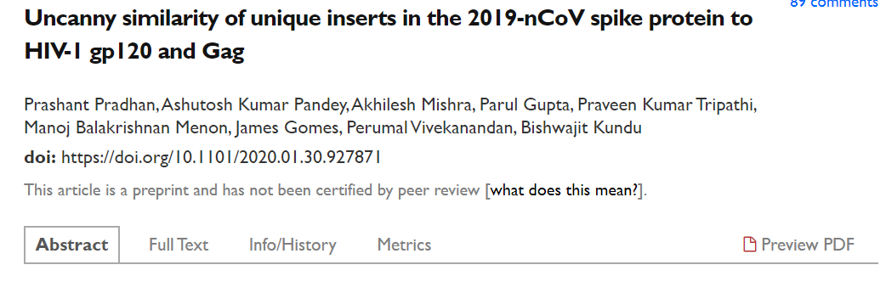
We found 4 insertions in the spike glycoprotein (S) which are unique to the 2019-nCoV and are not present in other coronaviruses. Importantly, amino acid residues in all the 4 inserts have identity or similarity to those in the HIV-1 gp120 or HIV-1 Gag.

Slide 30
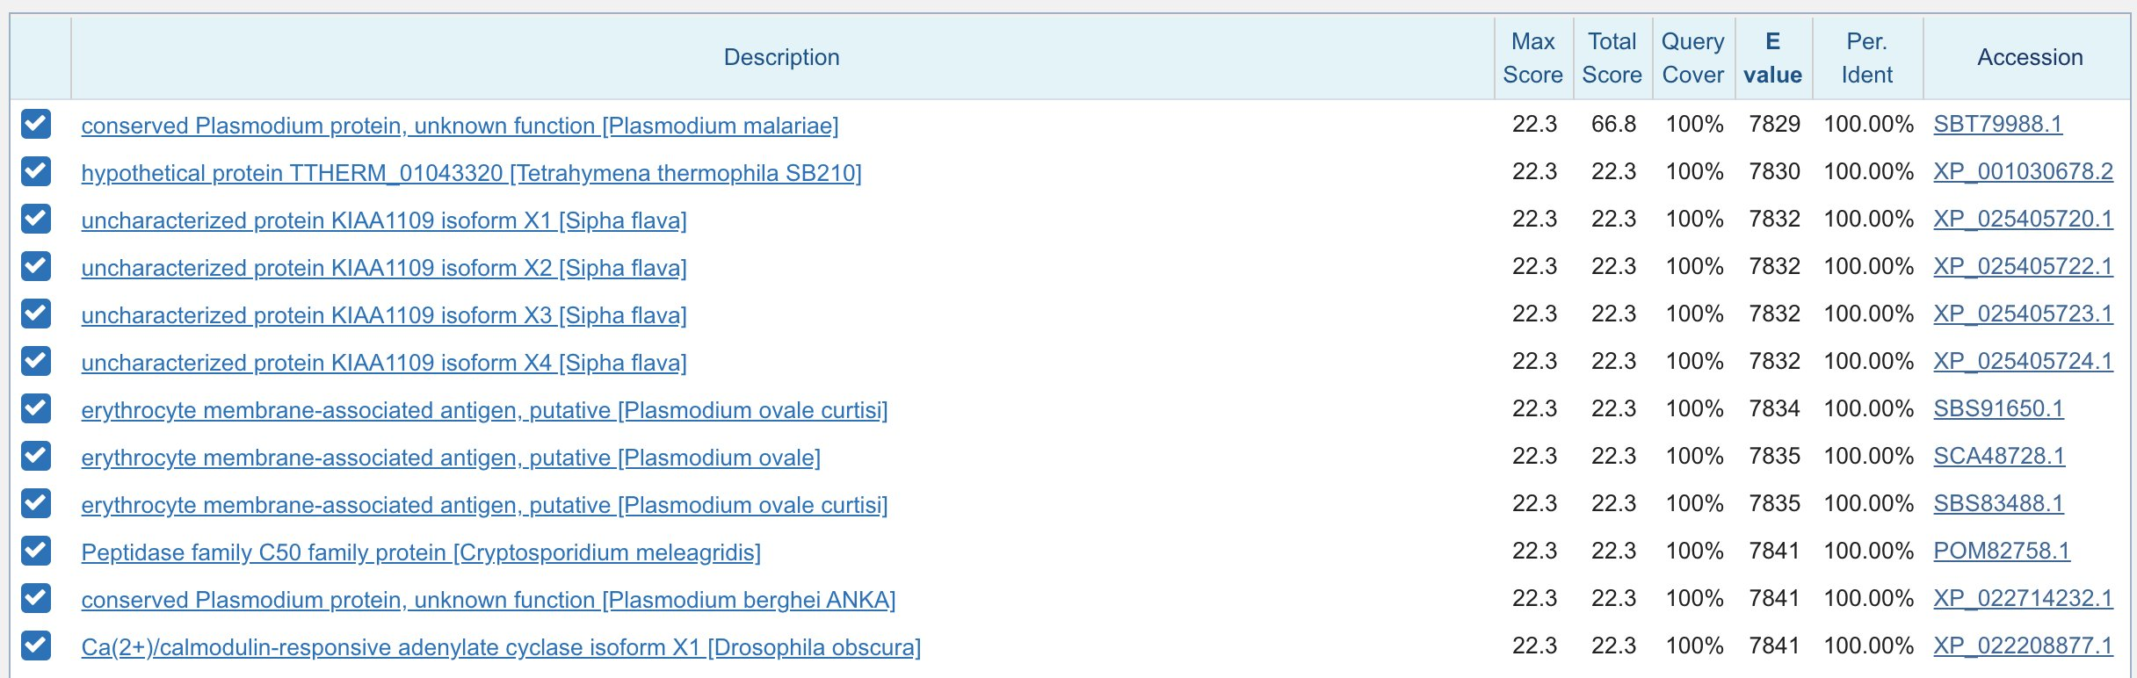
https://twitter.com/trvrb/status/1223337991168380928
https://nextstrain.org/

