Slide 1
Discussion Section
Week 7
Mitchell Vollger

Slide 2
Agenda
HW7
  HMMs: General Concept
    Build general intuition for how it works
    Understanding it in a genomic context
  Viterbi Training
  GENESCAN
  Q&A

Slide 3
Homework 7
Given: (These will be updated)
  DNA sequence (~3.3 million bases, Lactobacillus plantarum)
  Initiation probabilities
  Transition probabilities
  Emission probabilities
Goal:
  1) Construct HMM
  2) Find the Viterbi path
  3) Use the Viterbi path to update
  transition and emission probabilities
Repeat 9 times
(10 iterations total)

Slide 4
HMMs: General Concept
Initial States:
Hidden States:
Can we predict what the weather was based on observing a person’s behavior?
Observations:

Slide 5
HMMs: General Concept
Day 1: Walk
Day 2: Walk
Day 3: Walk
Day 4: Walk
Day 5: Walk
Day 6: Walk
Day 7: Walk
Day 8: Walk
Observation List:

Slide 6
HMMs: General Concept
Day 1: Walk
Day 2: Walk
Day 3: Walk
Day 4: Walk
Day 5: Walk
Day 6: Walk
Day 7: Walk
Day 8: Walk
Observation List:
Sunny
start
Rainy

Slide 7
HMMs: General Concept
Day 1: Walk
Day 2: Walk
Day 3: Walk
Day 4: Walk
Day 5: Walk
Day 6: Walk
Day 7: Walk
Day 8: Walk
Observation List:
Sunny
All possible paths
start
Rainy

Slide 8
HMMs: General Concept
Day 1: Walk
Day 2: Walk
Day 3: Walk
Day 4: Walk
Day 5: Walk
Day 6: Walk
Day 7: Walk
Day 8: Walk
Observation List:
Highest Weight Path
(i.e. most probable path)
Sunny
start
Rainy

Slide 9
HMMs: General Concept
What is the most probable path now?
Day 1: Clean
Day 2: Clean
Day 3: Clean
Day 4: Clean
Day 5: Clean
Day 6: Clean
Day 7: Clean
Day 8: Clean
Observation List:
Sunny
start
Rainy

Slide 10
HMMs: General Concept
What is the most probable path now?
Day 1: Clean
Day 2: Clean
Day 3: Clean
Day 4: Clean
Day 5: Clean
Day 6: Clean
Day 7: Clean
Day 8: Clean
Observation List:
Sunny
start
Rainy

Slide 11
HMMs: General Concept
What is the most probable path now?
Day 1: Clean
Day 2: Clean
Day 3: Clean
Day 4: Clean
Day 5: Walk
Day 6: Walk
Day 7: Walk
Day 8: Walk
Observation List:
Sunny
start
Rainy

Slide 12
HMMs: General Concept
What about more complicated observations?
Day 1: Shop
Day 2: Walk
Day 3: Clean
Day 4: Walk
Day 5: Shop
Day 6: Walk
Day 7: Clean
Day 8: Shop
Observation List:
Sunny
start
Rainy

Slide 13
HMMs: General Concept
What about more complicated observations?
We now need an algorithm to crunch the probability of all possible paths.
Day 1: Shop
Day 2: Walk
Day 3: Clean
Day 4: Walk
Day 5: Shop
Day 6: Walk
Day 7: Clean
Day 8: Shop
Observation List:
Sunny
start
Rainy

Slide 14
Applying this Concept To Genomics/HW7
start
0.996
0.004
A+T Rich
0.001
G+C Rich
0.999
0.99
0.01
A
C
G
T
A = 0.291
C = 0.209
G = 0.209
T = 0.291
A = 0.169
G = 0.331
G = 0.331
T = 0.169

Slide 15
Finding the most likely series of hidden states (Viterbi Path)
Step 1: given an observed sequence, determine the most probable series of states
  This depends on the specified probabilities:
    Initiation
    Transition
    Emission
  Process nodes in a sliding window
Observation: Sequence
A
T
T
C
A
G
C
A
AT-rich
start
GC-rich

Slide 16
Finding the most likely series of hidden states (Viterbi Path)
Step 1: given an observed sequence, determine the most probable series of states
  This depends on the specified probabilities:
    Initiation
    Transition
    Emission
  Process nodes in a sliding window
Initial Prob * Prob Emitting (A)
(2 calculations)
Observation: Sequence
A
T
T
C
A
G
C
A
AT-rich
start
GC-rich

Slide 17
Finding the most likely series of hidden states (Viterbi Path)
Step 1: given an observed sequence, determine the most probable series of states
  This depends on the specified probabilities:
    Initiation
    Transition
    Emission
  Process nodes in a sliding window
Previous Prob * Transition Prob * Prob Emitting (T)
(4 calculations)
Observation: Sequence
A
T
T
C
A
G
C
A
AT-rich
start
GC-rich

Slide 18
Finding the most likely series of hidden states (Viterbi Path)
Step 1: given an observed sequence, determine the most probable series of states
  This depends on the specified probabilities:
    Initiation
    Transition
    Emission
  Process nodes in a sliding window
Previous Prob * Transition Prob * Prob Emitting (A)
(4 calculations)
Observation: Sequence
A
T
T
C
A
G
C
A
AT-rich
start
GC-rich

Slide 19
Viterbi training
Step 2: update probabilities based on the current most probable path
  Updating the transition probabilities
    Calculate how often transitions happen between all pairs of states in the path
    Set the new transition probabilities to those frequencies for the next cycle of Viterbi training
  Updating the emission probabilities
    Calculate how often A/T or G/C are emitted in each state on the path
    Set the new emission probabilities to those frequencies for the next cycle of Viterbi training
Sequence
A
T
T
C
A
G
C
A
AT-rich
GC-rich

Slide 20
Viterbi training
Step 3: repeat steps 9 times (10 times total)
Sequence
A
T
T
C
A
G
C
A
AT-rich
GC-rich

Slide 21
HW7 tips
Calculate first few steps by hand and make sure your program matches (exactly!)
Create other small test cases
Avoid underflow
  Take the logarithm
  Then add instead of multiply
  See Mann and Rabiner (pg 273) for more details [links on website]
    Need to deal with log(0)

Slide 22
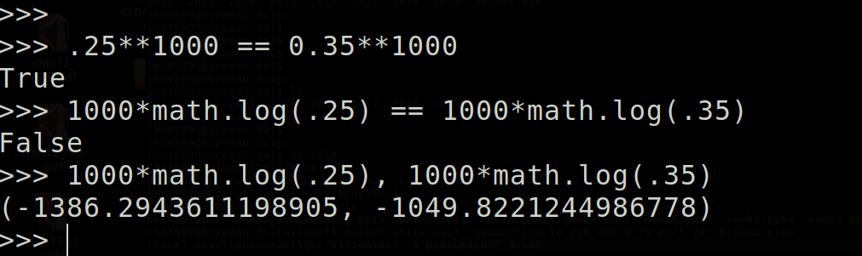

Slide 23
Gene detection: GENSCAN
Probabilistic model of gene structure
Identifies
  Transcription and splice sites
    Based on signal motifs
    Position weight matrix (extended)
  Exon/intron/intergenic regions
    Based on composition
    Hidden Markov Model

Slide 24
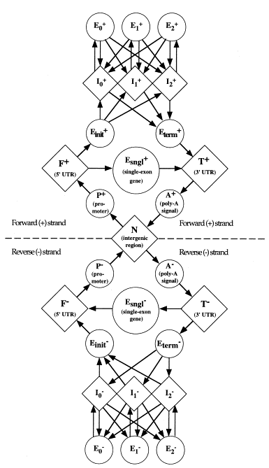
GENESCAN
HMM
Architecture

Slide 25
GENESCAN
HMM
Architecture

Slide 26
Questions?

