Slide 1
Genome 540
Discussion Section Week 1
Jan 7, 2021
Dani Faivre

Slide 2
Agenda
Introductions
HW1 context/advice/questions
C++/general programming tips
Input on future topics

Slide 3
Introductions
Who am I?
  4th year Genome Sciences student
  MacCoss Lab
  Mass Spec Proteomics
    Protein misfolding/aggregation
    Feature detection & alignment
    Reproducible data analysis pipelines
  Python/R/Snakemake/C++
Who are you?
  Department
  Programming experience

Slide 5
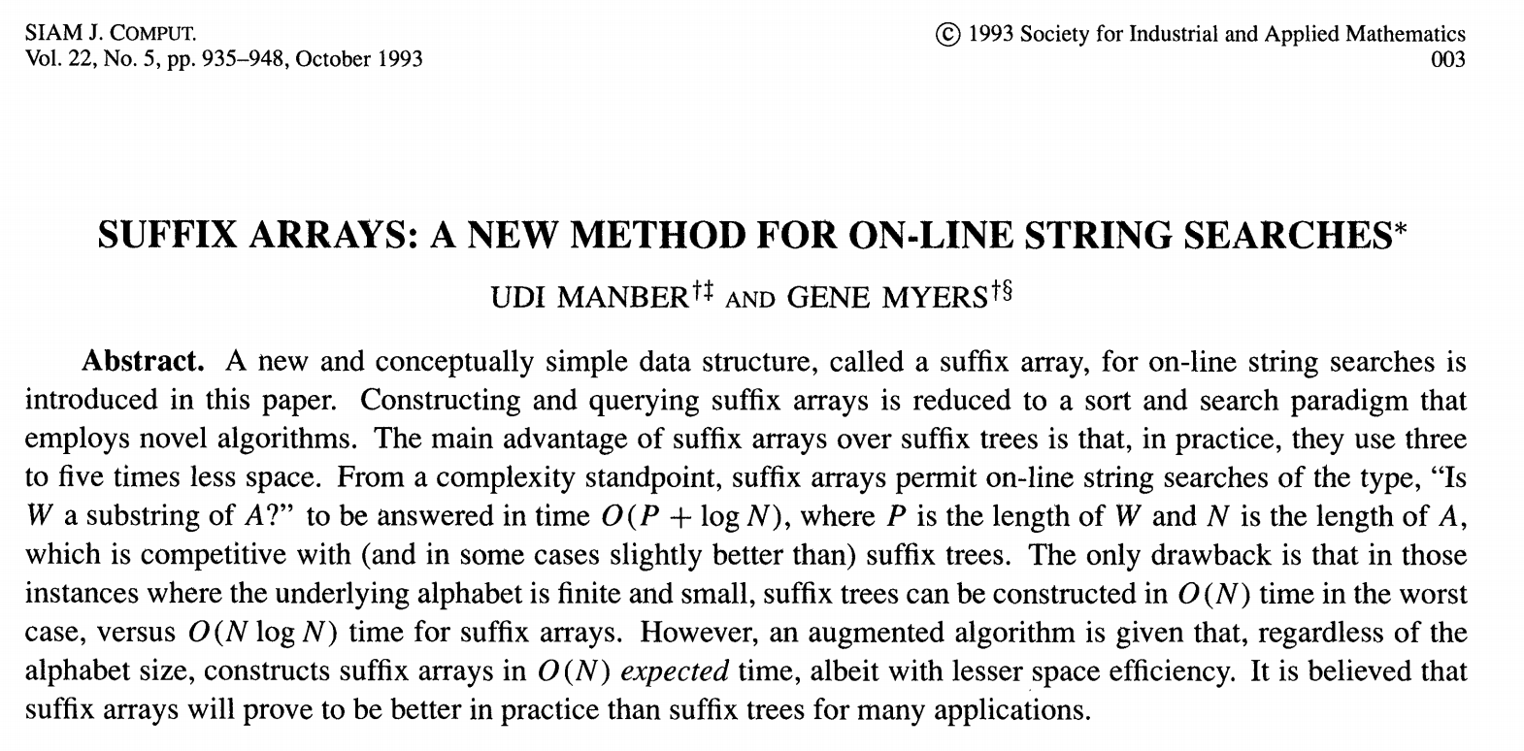

Slide 6
Yahoo!, Amazon, Google, YouTube, NIH
Notes:
Manber – PhD in Computer Science at UW in 1982
1998 - Chief Scientist at Yahoo!
2002 - Joined Amazon, became Chief Algorithms Officer and a vice president
2006 - hired by Google as a vice president of engineering
2014 - vice president of engineering at YouTube
2015 – NIH
2017 – UCSF
2018 – Anthem
2020 – Weekly Medical News (https://weeklymedicalnews.com/)

Slide 7
Yahoo!, Amazon, Google, YouTube, NIH
One of the creators of BLAST (1990),
Shotgun sequence assembly

Slide 8
Suffix trees
Applications:
  Finding longest-repeated substring
  Finding all repetitions in a string
  Computing substring statistics
  Approximate string matching
  Compression
  Genetic sequence analysis
  https://www.youtube.com/watch?v=hLsrPsFHPcQ&t=1s
Notes:
containing all the suffixes of the given text as their keys and positions in the text as their values
Suffix tree for the text BANANA. Each substring is terminated with special character $.
The six paths from the root to the leaves (shown as boxes) correspond to the six suffixes A$, NA$, ANA$, NANA$, ANANA$ and BANANA$. The numbers in the leaves give the start position of the corresponding suffix. Suffix links, drawn dashed, are used during construction.
The suffix tree for the string {S} of length {n} is defined as a tree such that:^{[1]}
The tree has exactly n leaves numbered from {1} to {n}.
Except for the root, every internal node has at least two children.
Each edge is labelled with a non-empty substring of {S}.
No two edges starting out of a node can have string-labels beginning with the same character.
The string obtained by concatenating all the string-labels found on the path from the root to leaf {i} spells out suffix {S[i..n]}, for {i} from {1} to {n}.
Since such a tree does not exist for all strings, {S} is padded with a terminal symbol not seen in the string (usually denoted $). This ensures that no suffix is a prefix of another, and that there will be {n} leaf nodes, one for each of the {n} suffixes of {S}. Since all internal non-root nodes are branching, there can be at most n − 1 such nodes, and n + (n − 1) + 1 = 2n nodes in total (n leaves, n − 1 internal non-root nodes, 1 root).

Slide 9
Suffix arrays
Substantially more space-efficient
Search times comparable
Greater upfront build time
“A primary motivation for this paper was to be able to efficiently answer on-line string queries for very long genetic sequences (on the order of one million or more symbols long). In practice, it is the space overhead of the query data structure that limits the largest text that may be handled.”
Fancier implementations than yours take advantage of the fact that you’re not sorting arbitrary strings, and that suffix trees can be built more quickly

Slide 10
Homework 1
Program a suffix array
Test it on the files provided and compare results to the test output
Run your program on the Bordetella bronchiseptica and the Advenella kashmirensis genome
Use the annotation files to find the gene associated with the longest common subsequences between the two species
Submit your program output and your code

Slide 11
HW1 tips
Start with pseudocode/python
Get comfortable with pointers
Think about how to store inputs
Think about how to store results
Output to template directly

Slide 12
Programming style
The more readable your code is
  The more I’ll be able to help you if something’s wrong
  The more useful it will be to you later (especially if you TA this class…)
Tips for readability
  Intuitive variable/function names
  Comments
    Outlining general structure of program/key points of implemented algorithm
    Clarifying any tricky/unintuitive lines of code
  Simplicity over performance optimization (until it becomes necessary)
Please make an effort to match the template!

Slide 13
Programming tips: testing
Create small, easily-verified test cases
Edge cases
Print intermediate output (cerr)
Write incrementally, test as you go
  Assertion statements
Check against expectations
Notes:
cerr is an object of the stderr stream
cout is an object of the stdout stream
both streams refer to console output by default
Redirecting (piping) one of them (e.g. program.exe >out.txt) would not affect the other
stdout ought to be used for actual program output, whereas all information and error messages should be printed to stderr
Then, if the user redirects output to a file, information messages are still printed on the screen and not to the output file
C++:
http://www.cplusplus.com/reference/cassert/assert/
Python (https://www.programiz.com/python-programming/assert-statement):
assert len(marks) != 0 // output would be AssertionError if marks=[]
assert len(marks) != 0, “List is empty.” // output would be “List is empty.” if marks=[]

Slide 14
Programming tips: efficiency
Remove unnecessary stuff from loops
Avoid slow comparison routines when sorting
Profiling tools
  line_profiler (python)
  gprof, valgrind (C/C++) [valgrind also identifies memory leaks]
  dprofpp (Perl) [Does anyone use Perl anymore??]
Notes:
Profiling is a form of dynamic program analysis that measures the space (memory) or time complexity of a program, the usage of particular instructions, or the frequency and duration of function calls. Profiling can help program optimization.

Slide 15
Pointers in C++
Pointers are memory addresses, which point to variables
There are two operators essential for handling pointers and memory addresses in C/C++: `*` and `&`
Unfortunately, both operators can be used in two ways which often leads to confusion.

Slide 16
* as a suffix to a type is a “pointer”
char * p; // p is a memory location that stores a “char”

Slide 17
& as a unary prefix is the address-of operator and obtains the memory address of a variable
char x = ‘h’;
char * p = &x;
Notes:
unary - consisting of or involving a single component or element
char* p = &x would be the same as:
char x;
char * p;
p = &x;

Slide 18
* as a unary prefix means content of that memory location
char y = ‘a’;
char* p = &y; // p points to the memory location of y
char x = *p ; // *p is the object that p points to (i.e. ‘a’)
Notes:
dereference operator:
*p = ‘h’ // variable pointed to by p equal to ‘h’ (i.e., y = ‘h’)

Slide 19
& as a suffix to a type means “pass by reference”
// pass by reference
void my_func(int &a){
a = 5;
}
int main(int argc, char* argv[] ){
int a = 0;
my_func(a);
cout << a << endl;
}
Notes:
void does not return a value
argv and argc are how command line arguments are passed to main() in C and C++
argc will be the number of strings pointed to by argv. This will (in practice) be 1 plus the number of arguments, as virtually all implementations will prepend the name of the program to the array
The variables are named argc (argument count) and argv (argument vector) by convention, but they can be given any valid identifier: int main(int num_args, char** arg_strings) is equally valid
They can also be omitted entirely, yielding int main(), if you do not intend to process command line arguments

Slide 20
Arrays point to blocks of memory
Arrays are just pointers to continuous blocks of memory
Array indices are just pointer arithmetic and dereferencing combined
  a[12] is the same as *(a + 12)
  &a[3] is the same as a + 3
Large arrays should be dynamically allocated (on the heap)
  Make sure you delete them
char word[6]; // an array of 6 characters called word
word[0] = ‘a’;
word[0]
word[1]
word[2]
‘h’
‘i’
‘\0’
const char *word = “hi”;
0x80
0x88
0x90
word
word+1
word+2
int n = some_large_number;
double * d = new double[n];
Notes:
https://www.cplusplus.com/doc/tutorial/dynamic/
delete[] d;

Slide 21
Dynamic arrays in C++ (Vectors)
#include <iostream>
#include <fstream>
#include <sstream>
#include <vector> // must have this in order to use vector
#include <algorithm>
using namespace std;
int main(int argc, char* argv[] ){
vector<string> vec; // make an empty vector that will be made up of strings
vec.push_back("ZABC"); // adds “ZABC” to the vector, can be accesses with strings[0]
vec.push_back("DEF"); // adds ”DEF”
for(auto x : vec){
cout << x << endl;
}
vec.clear(); // empty the vec of all elements
// documentation http://www.cplusplus.com/reference/vector/vector/
}

Slide 22
Custom data types in C++ (Structs)
struct complex{
int real;
int img;
};
int main(int argc, char* argv[] ){
complex a = { 10 , 1} ;
cout << “Real: ” << a.real << “ Img: ” << a.img << endl;
complex * p = &a;
cout << “Real: ” << p->real << “ Img: ” << p->img << endl;
}
Notes:
The Dot(.) operator is used to access members of a structure or union.
The Arrow(->) operator exists to access the members of the structure or the unions using pointers.

Slide 23
Sorting in C++ with sort
#include <iostream>
#include <fstream>
#include <sstream>
#include <vector>
#include <algorithm> // must have this in order to use sort
using namespace std;
bool my_cmp(const string & a, const string & b ){
return( a < b );
}
int main(int argc, char* argv[] ){
vector<string> vec;
vec.push_back("ZABC");
vec.push_back("DEF");
sort(vec.begin(), vec.end(), my_cmp );
for(auto x : vec){
cout << x << endl;
}
}

Slide 24
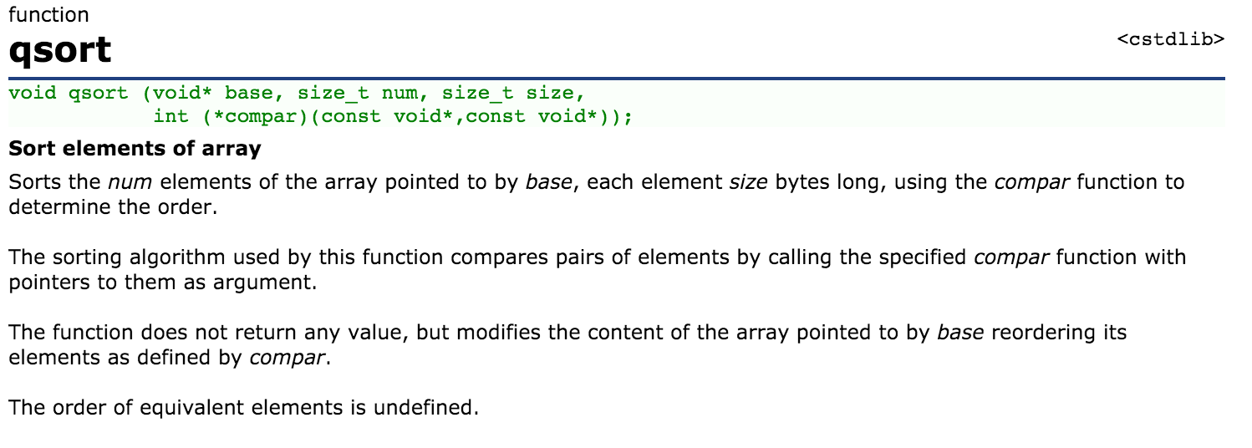
Other sorting options in C++
Notes:
experimentally sort() was faster than qsort()

Slide 25
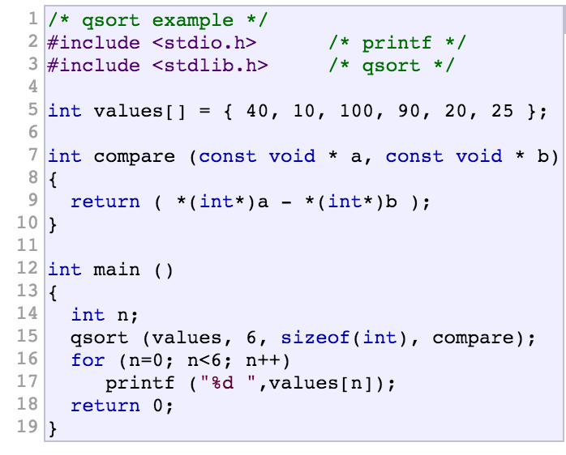
Other sorting options in C++
http://www.cplusplus.com/reference/
Notes:
experimentally sort() was faster than qsort()

Slide 26
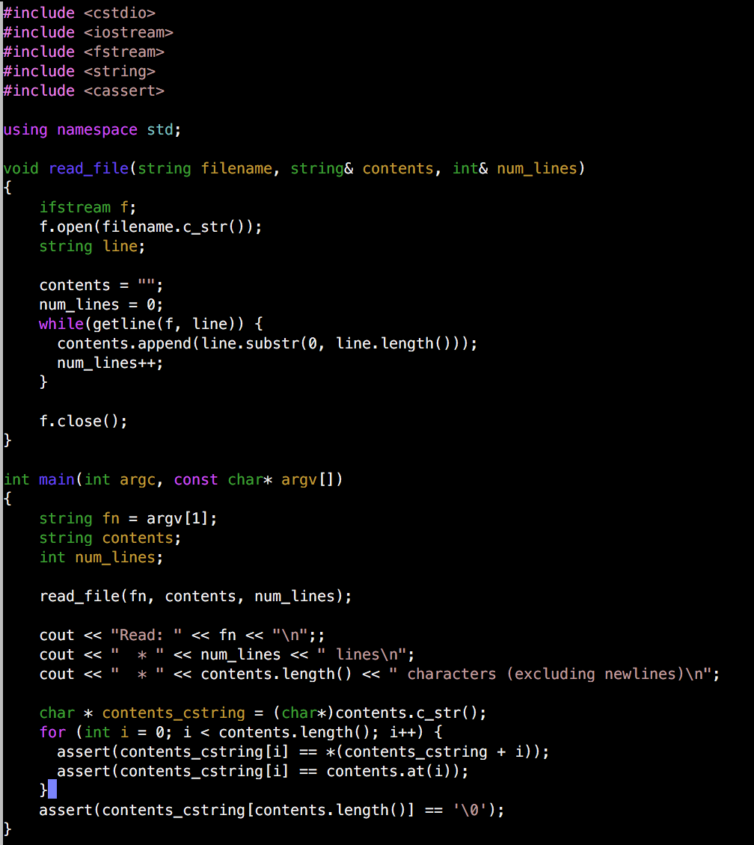
Example of reading in a file in C++
(and a few other things)
Notes:
ifstream: Stream class to read from files
c_str returns a const char* that points to a null-terminated string (needed for open())
https://www.geeksforgeeks.org/getline-string-c/
https://www.geeksforgeeks.org/stdstringappend-in-c/
https://www.geeksforgeeks.org/substring-in-cpp/
substr(position, length)
https://www.geeksforgeeks.org/5-different-methods-find-length-string-c/
(char*)contents.c_str() https://www.geeksforgeeks.org/type-conversion-in-c/
https://www.geeksforgeeks.org/string-at-in-cpp/

Slide 27
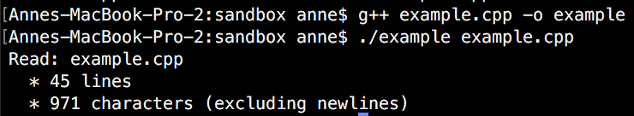
Example of reading in a file in C++
(and a few other things)

Slide 28



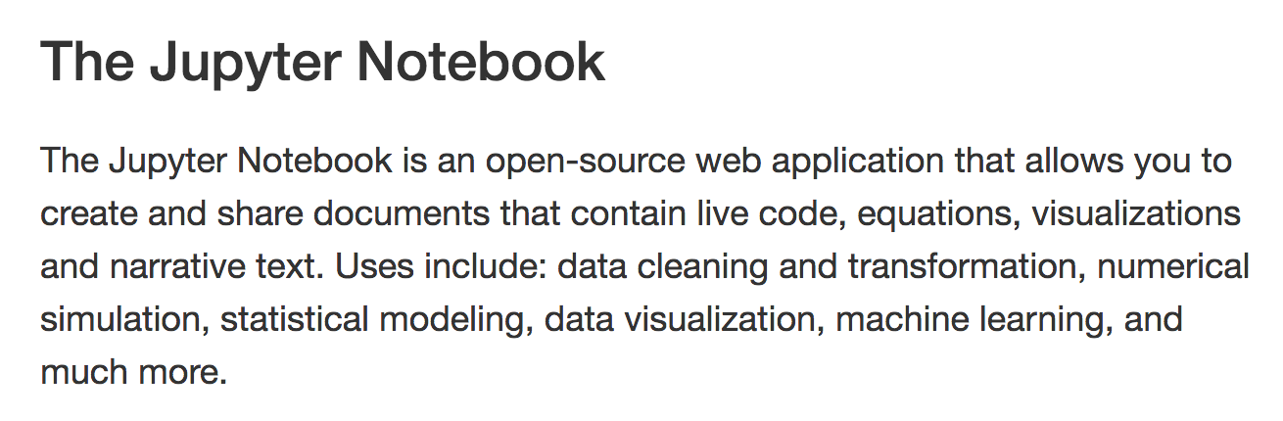
Other Coding Environments
Python

Slide 29
Topics for future discussion sections?
Scalable and reproducible bioinformatics pipelines (Snakemake)
General programming tips
Specific languages: Python, C++, Unix tools
Additional applications of HMMs
Dynamic programming
Machine learning
Version Control/Github
Jupyter Notebooks/Reproducibility

