Slide 1
Week 3 Discussion Section
Dani Faivre
1/21/2021

Slide 2
Discussion Section 3
Follow-up from last discussion
HW2 questions
HW3: modeling translation start sites (TSSs)

Slide 3
Follow-Up

Slide 4
What is the size of the stack?
On Windows, the typical maximum size for a stack is 1MB
On Linux, the typical maximum size is 8MB

Slide 5
Arrays & Pointers
How new works
Locates and reserves storage for the object or objects to be allocated. When this stage is complete, the correct amount of storage is allocated, but it is not yet an object.
Initializes the object(s). Once initialization is complete, enough information is present for the allocated storage to be an object.
Returns a pointer to the object(s) of a pointer type derived from new-type-name or type-name. The program uses this pointer to access the newly allocated object.
https://docs.microsoft.com/en-us/cpp/cpp/new-operator-cpp?view=msvc-160
Notes:
https://docs.microsoft.com/en-us/cpp/cpp/new-operator-cpp?view=msvc-160

Slide 6
Arrays & Pointers
Pointer p that points to the 0th element of the array
Can also declare a pointer that can point to whole array instead of only one element of the array
Useful when talking about multidimensional arrays
// Pointer to an integer
int *p;
// Pointer to an array of 5 integers
int (*ptr)[5];
int arr[5];
// Points to 0th element of the arr.
p = arr;
// Points to the whole array arr.
ptr = &arr;
}
https://www.geeksforgeeks.org/pointer-array-array-pointer/
Notes:
https://www.geeksforgeeks.org/pointer-array-array-pointer/

Slide 7
HW2 Questions?

Slide 8
Comment on rounding
Could be due to rounding earlier in code.
Use ‘double’ instead of ‘float’
Python’s “float” has “double” precision
Use the ‘long’ keyword for extra variable storage (e.g. long double)
Notes:
double has 2x more precision than float.
float is a 32 bit IEEE 754 single precision Floating Point Number1 bit for the sign, (8 bits for the exponent, and 23* for the value), i.e. float has 7 decimal digits of precision.
double is a 64 bit IEEE 754 double precision Floating Point Number (1 bit for the sign, 11 bits for the exponent, and 52* bits for the value), i.e. double has 15 decimal digits of precision.
Float values have between 6 and 9 digits of precision, with most float values having at least 7 significant digits. Double values have between 15 and 18 digits of precision, with most double values having at least 16 significant digits. Long double has a minimum precision of 15, 18, or 33 significant digits depending on how many bytes it occupies.

Slide 9
HW3: create a motif model for TSSs
Due 11:59pm on Sunday, Jan. 31
Assignment:
Parse a Genbank file (gbff format) with sequence info and annotated CDS locations
Write your own code to parse the file! Do not use a third-party Genbank file parser.
Using the CDS information, compute a site weight matrix for a 21bp motif centered at the translation start site
Using the weight matrix, compute scores for annotated CDS translation start sites and for non-annotated positions

Slide 10
Genbank flat file format (.gbff)
Feature list
Each locus has entries for gene, mRNA, and CDS
CDS features are coding sequences (these are the entries we care about)
‘complement’ indicates the reverse complement
ORIGIN
Located after the feature list, at the end of the file
Contains the genome sequence

Slide 11
Genbank flat file format (.gbff)
FEATURES Location/Qualifiers
source 1..2895605
/organism="Plasmodium falciparum 3D7"
/mol_type="genomic DNA"
/isolate="3D7"
/db_xref="taxon:36329"
/chromosome="13"
gene 21467..28890
/gene="VAR"
/locus_tag="MAL13P1.1"
/db_xref="GeneID:813647"
mRNA join(<21467..26641,27577..>28890)
/gene="VAR"
/locus_tag="MAL13P1.1"
/transcript_id="XM_001349702.1"
/db_xref="GI:124512763"
/db_xref="GeneID:813647"
CDS join(21467..26641,27577..28890)
/gene="VAR"
/locus_tag="MAL13P1.1"
/codon_start=1
/product="erythrocyte membrane protein 1, PfEMP1"
/protein_id="XP_001349738.1"
/db_xref="GI:124512764"
/db_xref="GOA:Q8IEV1"
/db_xref="InterPro:IPR008602"
/db_xref="UniProtKB/TrEMBL:Q8IEV1"
/db_xref="GeneID:813647"
/translation="MGPPGITGTQGETAKHMFDRIGKQVYETVKNEAENYISELEGKL SQATLLGERVSSLKTCQLVEDYRSKANGDVKRYPCANRSPVRFSDESRSQCTYNRIKD…"
.
.
.
ORIGIN
1 taaaccctga accctaaacc ctaaaccctg aaccctaaac cctaaaccct aaacctaaac
61 ctaaaccctg aaccctaaac cctgaaccct gaaccctaaa ccctaaaccc tgaaccctaa…
Notes:
Feature list
Each locus has entries for gene, mRNA, and CDS
CDS features are coding sequences (these are the entries we care about)
‘complement’ indicates the reverse complement
ORIGIN
Located after the feature list, at the end of the file
Contains the genome sequence

Slide 12
Some more CDS examples
CDS 96094..97215
/locus_tag="PTSG_00022"
/codon_start=1
/product="hypothetical protein"
/protein_id="EGD72006.1"
/db_xref="GI:326426436"
/translation="MVVAAGSGGASRPTNAPSCPLCPGGSVGGAVLMVVPLLVCIALL
AGCLSVSSLWRRNKRQRHAPQYASTCASGRAKPNKRAAPRVQPDLRLPHQQQQPQHPQ...“
CDS join(10183..10943,11138..11246,11408..11525,11697..11815,
12006..12056,12284..12445,12661..12792,12989..13135,
13293..13400,13597..13661,13848..13957,14104..14208,
14364..14440,14606..14773,14909..15013)
/locus_tag="PTSG_00005"
/codon_start=1
/product="hypothetical protein"
/protein_id="EGD71989.1"
/db_xref="GI:326426419"
/translation="MMMMMMMMRPCCSLPSTWWLVVVVLAAACCAATPTAAAVPAAAP
AEAADPSVVNVGQFVVSLDEDGVLSAVRNPAQMPNPHLAWHSTGEILEVAASKMYLHG...“
CDS complement(join(15291..15934,16108..16234,16358..16394,
16582..16790,17086..17196,17376..17456,17810..17877,
18020..18060,18199..18256,18556..18598,18767..19187,
19334..19410,19552..19631,19795..19917,20098..20183,
20449..20577,20789..20904,21261..21449,21667..21787,
21936..22108,22453..22549,22808..22934,23895..23970,
24140..24246,24389..27209))
/locus_tag="PTSG_11525"
/codon_start=1
/product="hypothetical protein"
/protein_id="EGD71990.1"
/db_xref="GI:326426420"
/translation="MWRSWRHGEVGSGVAGGENGKDAQQASSNSHGSHGSHGSNHPNG
NHGGSSDNVGSSHDERSSSDREQERGQVQRRKRRHARMHEKHASNHAASSVARPSRLT...“
Notes:
Feature list
Each locus has entries for gene, mRNA, and CDS
CDS features are coding sequences (these are the entries we care about)
‘complement’ indicates the reverse complement
ORIGIN
Located after the feature list, at the end of the file
Contains the genome sequence

Slide 13
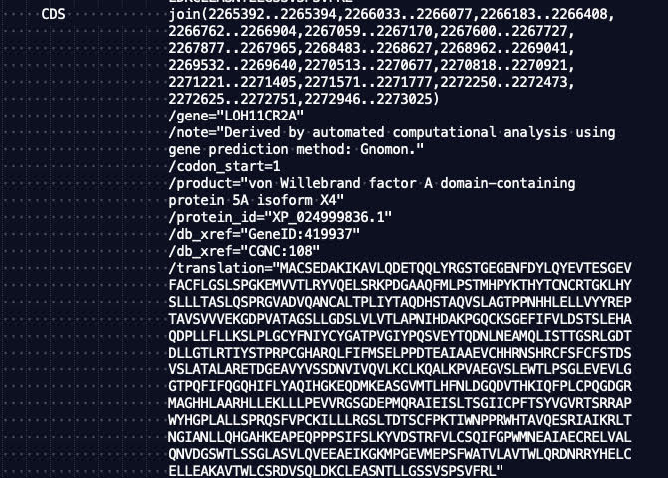
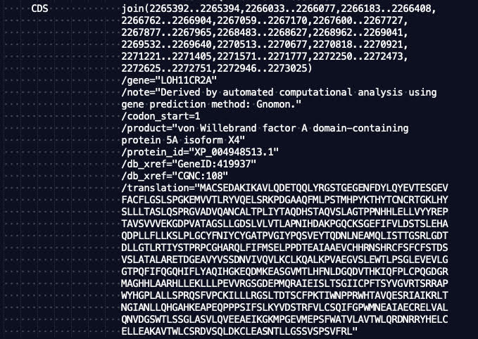
Handling ‘Duplicate’ Entries

Slide 14
Handling ‘Duplicate’ Entries
The specific sequences were annotated by the RefSeq genome annotation pipeline (more info here), which is supposed to generate non-redundant annotations.
Consider each CDS entry listed in the file one time, regardless of whether there are other CDS entries that are similar/identical/overlapping.

Slide 15
Computing a TSS site weight matrix
-10
0
+10
+10
0
-10
5’
3’
3’
5’
Step 0: Compute background nucleotide frequencies (genome + reverse complement).
Step 1: Count matrix – record the number of times each nucleotide shows up at each motif position (-10 to +10).
Step 2: Frequency matrix – proportion of times each nucleotide shows up at each motif position (-10 to +10).
Step 3: Weight matrix
${weight= log}_{2}\left(\frac{nt frequency at motif position}{nt background frequency}\right)$
If a nt has frequency zero, assign a weight of -99.0 (2⁻⁹⁹ = 1.6x10⁻³⁰ ≈ 0)

Slide 16
Computing site scores
-10
0
+10
+10
0
-10
5’
3’
3’
5’
Score for a position = sum of the weights for each nucleotide in the 21bp motif centered at that position
Scores for a position are strand-specific (different for forward vs. reverse)
Compute scores for all possible positions (both strands)

Slide 17
Noncontiguous CDSs
Positions downstream of the translation start site could be noncontiguous
join(1000…1008, 1200…1500)
How would you construct the TSS motif?

Slide 18
Noncontiguous CDSs
Positions downstream of the translation start site could be noncontiguous
join(1000…1008, 1200…1500)
How would you construct the TSS motif?
Note in the gbff that ranges are one indexed and inclusive on both ends.
-10 -9 -8 -7 -6 -5 -4 -3 -2 -1 0 1 2 3 4 5 6 7 8 9 10
990 991 992 993 994 995 996 997 998 999 1000 1001 1002 1003 1004 1005 1006 1007 1008 1200 1201

Slide 19
Reporting score histograms
Score Histogram All:
-5 101880
-4 76413
-3 54704
-2 38081
-1 27202
0 21440
1 18671
2 18825
3 19072
4 18675
5 17308
6 14429
7 10595
8 6915
9 3886
10 1850
11 699
12 225
13 46
14 4
lt-50 6132782
Two histograms:
All genomic positions
Positions that are annotated CDS TSSs
Group scores into bins of size 1 (round down to nearest integer)
Format – two columns:
Score bin
Number of sites with that score
Print all bins with at least one count
Put all scores less than -50 into one bin

Slide 20
Position list
List of non-CDS positions with a motif score >= 10
Format – three columns:
1-indexed genome position (on forward strand)
Strand indicator (0 for forward, 1 for reverse)
Score (to four decimal places)
Position List:
1899 0 10.1167
2274 0 10.1923
2502 0 10.1098
4646 0 10.5886
5252 0 10.5534
6127 0 11.0669
7250 1 10.0453
11016 1 10.1616 ...

Slide 21
HW6 output summary
Nucleotide histogram
Background nt frequencies (based on both strands)
Count matrix (-10 to +10 nucleotides)
Frequency matrix (-10 to +10 nucleotides)
Weight matrix (-10 to +10 nucleotides)
Maximum score
Score histogram for annotated CDS TSSs
Score histogram for all positions
List of non-CDS positions with score >=10

Slide 22
HW6 Tips
Looking only for ‘CDS’ features
Only consider positions where location is certain (no < or >)
Positions downstream of the translation start site could be noncontiguous
join(1000…1008, 1200…1500)
Also watch out for multi-line joins (c.f. examples 2 & 3 in slide 8)
Precision matters! (use doubles over floats)
Make sure outputs make sense (frequencies sum to 1, etc. )

