Slide 1
Week 4 Discussion Section
Genome 540
Dani Faivre

Slide 2
Agenda
Q’s about HW3?
Overview of HW4
Other DAG Algorithms

Slide 3
HW4: Highest Weighted Path for Directed Acyclic Graphs (DAGs)
Write 2 programs
Test your code on our examples and compare your results
Run your code on the submission DAG and genome and submit these results
Due Feb. 7, 11:59pm

Slide 4
HW4: Highest Weighted Path for Directed Acyclic Graphs (DAGs)

Slide 5
HW4: Write two programs
Program 1: Find a highest-weight path in a weighted directed acyclic graph
Program 2: Convert a fasta file to written graph format

Slide 6
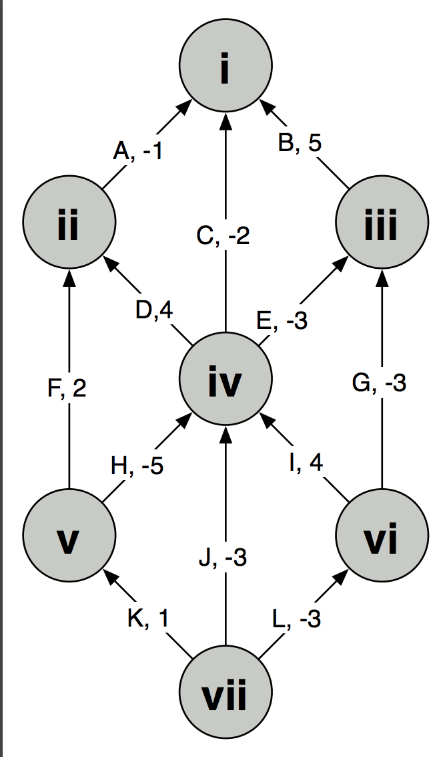
HW4: Program 1
Program 1: Find a highest-weight path in a weighted directed acyclic graph
Convert graph by hand into a list of vertices and edges, which you will input into your program
Write a program to output the
    1. Path Score
    2. The label of the beginning vertex on the path
    3. the label of the ending vertex on the path
    4. (in order) the labels for all the edges that occur on this path.
Test Example:

Slide 7
HW4: Program 1
Program 1: Find a highest-weight path in a weighted directed acyclic graph
Convert graph by hand into a list of vertices and edges, which you will input into your program
Write a program to output the
    1. Path Score
    2. The label of the beginning vertex on the path
    3. the label of the ending vertex on the path
    4. (in order) the labels for all the edges that occur on this path.
Run this program “unconstrained” and with the start and end constraints of “vii” and “i” respectively
Test Example:

Slide 8
HW4: Program 1
Program 1: Find a highest-weight path in a weighted directed acyclic graph
Convert graph by hand into a list of vertices and edges, which you will input into your program
Write a program to output the
    1. Path Score
    2. The label of the beginning vertex on the path
    3. the label of the ending vertex on the path
    4. (in order) the labels for all the edges that occur on this path.
Run this program “unconstrained” and with the start and end constraints of “vii” and “i” respectively
Test Example:
Example Input:
V vii START
V vi
V v
…
E A ii i -1
E B iii i 5

Slide 9
HW4: Program 1
Program 1: Find a highest-weight path in a weighted directed acyclic graph
Convert graph by hand into a list of vertices and edges, which you will input into your program
Write a program to output the
    1. Path Score
    2. The label of the beginning vertex on the path
    3. the label of the ending vertex on the path
    4. (in order) the labels for all the edges that occur on this path.
Run this program “unconstrained” and with the start and end constraints of “vii” and “i” respectively
Example output:
Test Example:
Part 1
Score: 8.0
Begin: vi
End: ii
Path: ID
Part 2
Score: 4.0 Begin: vii
End: i
Path: LIDA

Slide 10
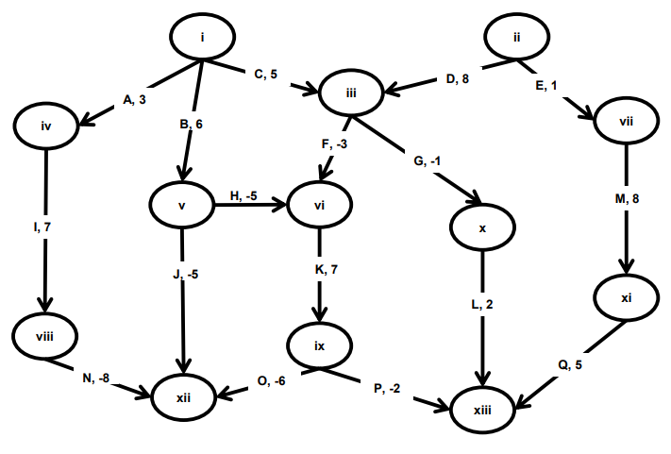
HW4: Program 1
Program 1: Find a highest-weight path in a weighted directed acyclic graph
Convert graph by hand into a list of vertices and edges, which you will input into your program
Write a program to output the
    1. Path Score
    2. The label of the beginning vertex on the path
    3. the label of the ending vertex on the path
    4. (in order) the labels for all the edges that occur on this path.
Run this program “unconstrained” and with the start and end constraints of “i” and “xiii” respectively
Output: Turn this in
For Grading:

Slide 11
Program 1 Algorithm

Slide 12
HW4: Program 2
0
Program 2: Convert FASTA to written graph format
A, -1.49
Read 2 input files:
  1) a FASTA file containing a DNA sequence, and
  2) a 'scoring scheme' file that indicates a score to be attached to each possible base (A, C, G, T, or other)
Output a written graph to run through program 1
1
C, 0.74
2
G, 0.74
3
T, -1.49
…

Slide 13
HW4: Program 2
0
Program 2: Convert FASTA to written graph format
A, -1.49
Example of written graph output:
V 0
V 1
V 2
…
E A 0 1 -1.49
E C 1 2 0.74
E G 2 3 0.74
1
C, 0.74
2
G, 0.74
3
Run this output through program 1
T, -1.49
…

Slide 14
HW4: Program 2
0
Program 2: Find a highest-weight path in a linked list
A, -1.49
Test example: Mycoplasma gallisepticum
Part 3
>gi|400273702|gb|CP003508.1| Mycoplasma gallisepticum NC96_1596-4-2P, complete genome
*=986257
A=337443
C=156212
T=336693
G=155909
N=0
Score: 11.069998
Begin: 344420
End: 344444
Path: GGCGGCGGCCCCTGGCGATGGCCG
Description: This sequence lies within the HFMG96NCA_2038 gene (encodes a hypothetical protein).
1
C, 0.74
2
G, 0.74
3
T, -1.49
…

Slide 15
HW4: Program 2
Refer to online hw for more thorough details
0
Program 2: Find a highest-weight path in a linked list
A, -1.49
Test example: Mycoplasma gallisepticum
Part 3
>gi|400273702|gb|CP003508.1| Mycoplasma gallisepticum NC96_1596-4-2P, complete genome
*=986257
A=337443
C=156212
T=336693
G=155909
N=0
Score: 11.069998
Begin: 344420
End: 344444
Path: GGCGGCGGCCCCTGGCGATGGCCG
Description: This sequence lies within the HFMG96NCA_2038 gene (encodes a hypothetical protein).
1
C, 0.74
2
G, 0.74
3
T, -1.49
…

Slide 16
Any Questions on HW4?

Slide 17
Other DAG Algorithms
Minimum-weight path on a DAG
Similar to the homework
  Looking for the minimum instead of the maximum
  If there are no negative weights, then the shortest path is technically weight 0 (single node)
  Otherwise, update vertex weights in depth order as normal

Slide 18
What if graph has cycles?
More difficult (can’t order nodes by depth)
Bellman-Ford algorithm (for given start vertex)
  Choose source node and set distance to 0
  Set distance to all other nodes to infinity
  For each edge (u,v), if v’s distance can be reduced by taking that edge, update v’s distance
  Cycle through all edges in this way |V|-1 times
  Repeat for all vertices as source node
  (can also check for negative-weight cycle with one extra iteration)
Tutorial and dynamic programming implementation here.
Notes:
https://www.geeksforgeeks.org/dynamic-programming-set-23-bellman-ford-algorithm/

Slide 19
Notes:
https://www.geeksforgeeks.org/dynamic-programming-set-23-bellman-ford-algorithm/

Slide 20
Say edges are processed in the following order: (B, E), (D, B), (B, D), (A, B), (A, C), (D, C), (B, C), (E, D)
Notes:
https://www.geeksforgeeks.org/dynamic-programming-set-23-bellman-ford-algorithm/
The first iteration guarantees to give all shortest paths which are at most 1 edge long.

Slide 21
Say edges are processed in the following order: (B, E), (D, B), (B, D), (A, B), (A, C), (D, C), (B, C), (E, D)
Notes:
https://www.geeksforgeeks.org/dynamic-programming-set-23-bellman-ford-algorithm/
The second iteration guarantees to give all shortest paths which are at most 2 edges long. The algorithm processes all edges 2 more times. The distances are minimized after the second iteration, so third and fourth iterations don’t update the distances.

Slide 22
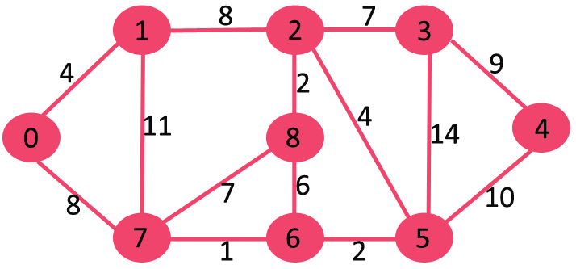
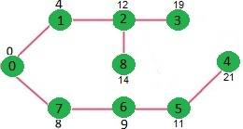
What if graph has cycles? (no negative edges)
Dijkstra’s algorithm (for given start vertex)
  Choose source node and set distance to 0
  Set distance to all other nodes to infinity
  Set source node to current
  Make distance offers to all unvisited neighbors, which are accepted if they’re less than the previous best offer
  Mark current as visited (it will never be updated again)
  Select unvisited neighbor with smallest distance, set it to current, and repeat
  (When destination node has been marked visited, stop)
Notes:
https://brilliant.org/wiki/dijkstras-short-path-finder/
Or: https://www.geeksforgeeks.org/dijkstras-shortest-path-algorithm-greedy-algo-7/
SPT (shortest path tree)

Slide 23
0
Notes:
https://brilliant.org/wiki/dijkstras-short-path-finder/
Or: https://www.geeksforgeeks.org/dijkstras-shortest-path-algorithm-greedy-algo-7/
SPT (shortest path tree)

Slide 24
4
0
8
Notes:
https://brilliant.org/wiki/dijkstras-short-path-finder/
Or: https://www.geeksforgeeks.org/dijkstras-shortest-path-algorithm-greedy-algo-7/
SPT (shortest path tree)
update distance values of its adjacent vertices
Pick the vertex with minimum distance value and not already visited

Slide 25
4
12
0
8
Notes:
https://brilliant.org/wiki/dijkstras-short-path-finder/
Or: https://www.geeksforgeeks.org/dijkstras-shortest-path-algorithm-greedy-algo-7/
SPT (shortest path tree)
update distance values of its adjacent vertices
Pick the vertex with minimum distance value and not already visited

Slide 26
4
12
15
0
8
9
Notes:
https://brilliant.org/wiki/dijkstras-short-path-finder/
Or: https://www.geeksforgeeks.org/dijkstras-shortest-path-algorithm-greedy-algo-7/
SPT (shortest path tree)
update distance values of its adjacent vertices
Pick the vertex with minimum distance value and not already visited

Slide 27
4
12
15
0
8
9
11
Notes:
https://brilliant.org/wiki/dijkstras-short-path-finder/
Or: https://www.geeksforgeeks.org/dijkstras-shortest-path-algorithm-greedy-algo-7/
SPT (shortest path tree)
update distance values of its adjacent vertices
Pick the vertex with minimum distance value and not already visited

Slide 28
4
12
25
15
21
0
8
9
11
Notes:
https://brilliant.org/wiki/dijkstras-short-path-finder/
Or: https://www.geeksforgeeks.org/dijkstras-shortest-path-algorithm-greedy-algo-7/
SPT (shortest path tree)
update distance values of its adjacent vertices
Pick the vertex with minimum distance value and not already visited

Slide 29
4
12
25
19
15
14
21
0
8
9
11
Notes:
https://brilliant.org/wiki/dijkstras-short-path-finder/
Or: https://www.geeksforgeeks.org/dijkstras-shortest-path-algorithm-greedy-algo-7/
SPT (shortest path tree)
update distance values of its adjacent vertices
Pick the vertex with minimum distance value and not already visited

Slide 30
4
12
25
19
15
14
21
0
8
9
11
Notes:
https://brilliant.org/wiki/dijkstras-short-path-finder/
Or: https://www.geeksforgeeks.org/dijkstras-shortest-path-algorithm-greedy-algo-7/
SPT (shortest path tree)
update distance values of its adjacent vertices
Pick the vertex with minimum distance value and not already visited

Slide 31
4
12
25
19
15
14
21
0
8
9
11
Notes:
https://brilliant.org/wiki/dijkstras-short-path-finder/
Or: https://www.geeksforgeeks.org/dijkstras-shortest-path-algorithm-greedy-algo-7/
SPT (shortest path tree)
update distance values of its adjacent vertices
Pick the vertex with minimum distance value and not already visited

Slide 32
4
12
25
19
15
14
21
0
8
9
11
Notes:
https://brilliant.org/wiki/dijkstras-short-path-finder/
Or: https://www.geeksforgeeks.org/dijkstras-shortest-path-algorithm-greedy-algo-7/
SPT (shortest path tree)
update distance values of its adjacent vertices
Pick the vertex with minimum distance value and not already visited

Slide 33
4
12
25
19
15
14
21
0
8
9
11
Notes:
https://brilliant.org/wiki/dijkstras-short-path-finder/
Or: https://www.geeksforgeeks.org/dijkstras-shortest-path-algorithm-greedy-algo-7/
SPT (shortest path tree)
update distance values of its adjacent vertices
Pick the vertex with minimum distance value and not already visited

Slide 34
See you next week!
Reminder: HW3 due THIS Sunday, 11:59pm

