Slide 1
Discussion Section
Week 6
Dani Faivre
February 11, 2021

Slide 2
Agenda
HW5 Questions?
HW6 Introduction
More C++ Tips

Slide 3
HW6: D-segments Revisited
Same input data as for HW5 (file of read-start counts for chromosome 16)
Same scoring scheme for the read-start bins (0, 1, 2, and >=3)
Different values for S and D cutoffs

Slide 4
HW6: D-segments Revisited
Assignment:
  Create randomized data set with the same average read-start distribution as the original data (provided in prompt)
  N = number of sites in original sequence
  counts[r] = number of sites with r read starts in original sequence
  for each site 1..N
  x = random number between 0 and 1 (uniform distribution)
  if x < counts[0] / N
  randomized_counts[site] = 0
  else if x < (counts[0] + counts[1]) / N
  randomized_counts[site] = 1
  else if x < (counts[0] + counts[1] + counts[2]) / N
  randomized_counts[site] = 2
  else
  randomized_counts[site] = 3

Slide 5
HW6: D-segments Revisited
Assignment:
  Create randomized data set with the same average read-start distribution as the original data (provided in prompt)
  Run maximal D-segment algorithm (from HW5) on a randomization of the read start sequence
    Scoring scheme same as HW5 for the read-start bins
    D = -10
    S = {10, 11, 12…28, 29, 30}

Slide 6
HW6: D-segments Revisited
Assignment:
  Create randomized data set with the same average read-start distribution as the original data (provided in prompt)
  Run maximal D-segment algorithm (from HW5) on a randomization of the read start sequence
    Scoring scheme same as HW5 for the read-start bins
    D = -10
    S = {10, 11, 12…28, 29, 30}
  Run maximal D-segment algorithm on the original data, using the same parameters

Slide 7
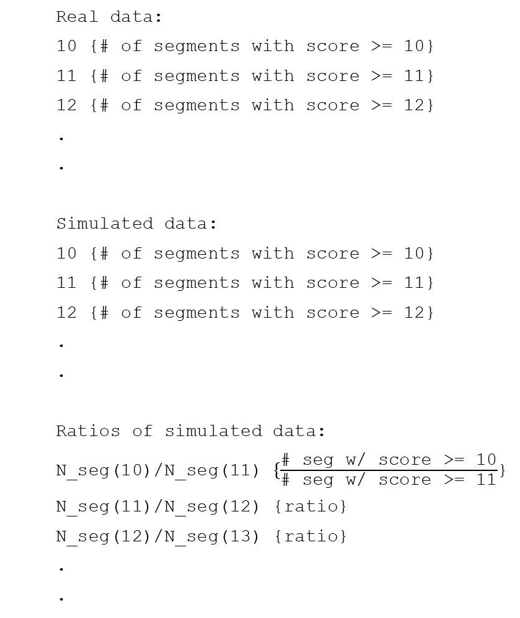
HW6: D-segments Revisited
  Real data:
  10 {# of segments with score >= 10}
  11 {# of segments with score >= 11}
  12 {# of segments with score >= 12}
  .
  .
  Simulated data:
  10 {# of segments with score >= 10}
  11 {# of segments with score >= 11}
  12 {# of segments with score >= 12}
  .
  .
  Ratios of simulated data:
  N_seg(10)/N_seg(11) $\{\frac{\text{\# }\text{seg} \text{w}\text{/ }\text{score}\text{ >= 10}}{\text{\# }\text{seg} \text{w}\text{/} \text{score}\text{ >= 11}}$}
  N_seg(11)/N_seg(12) {ratio}
  N_seg(12)/N_seg(13) {ratio}
  .
  .
Output:
  Two lists of pairs, one for the original ‘real’ data and another for the simulated data. Each row should contain:
    S-value
    Number of D-segments found
  A list of ratios based on the simulated data:
    Label each row N_seg(S_{i})/N_seg(S_{i+1})
    Ratio of #D-seg(S_{i})/#D-seg(S_{i+1}) rounded to 2 dec.
    If there is a 0 in the denominator of your ratio, print -1
  Brief written answers to the questions posed in the assignment text

Slide 8
  We care about
  {# of segments with score >= S}
  Simulated data:
  10 0
  11 0
  12 0
  13 0
  14 0
  15 0
D
cumulative score
S
0
sequence position

Slide 9
  We care about
  {# of segments with score >= S}
  Simulated data:
  10 0
  11 0
  12 0
  13 0
  14 0
  15 0
  Simulated data:
  10 1
  11 1
  12 1
  13 1
  14 1
  15 1
D
cumulative score
S
0
15
sequence position

Slide 10
  We care about
  {# of segments with score >= S}
  Simulated data:
  10 2
  11 2
  12 2
  13 1
  14 1
  15 1
  Simulated data:
  10 1
  11 1
  12 1
  13 1
  14 1
  15 1
D
cumulative score
S
0
15
12
sequence position

Slide 11
HW6: Questions?

Slide 12
Preprocessors
programs that process our source code before compilation
preprocessor directives begin with a ‘#’ (hash) symbol
4 main types of preprocessor directives:
  Macros
  File Inclusion
  Conditional Compilation
  Other directives
#include <iostream>
// macro definition
#define LIMIT 5
int main()
{
for (int i = 0; i < LIMIT; i++) {
std::cout << i << "\n";
}
return 0;
}
Notes:
https://www.geeksforgeeks.org/cc-preprocessors/

Slide 13
Macros
piece of code in a program which is given some name
When the name is encountered by the compiler, the compiler replaces the name with the actual piece of code
‘#define’ directive is used to define a macro
  ‘LIMIT’ in the macro definition is called a macro template
  ‘5’ is a macro expansion
#include <iostream>
// macro definition
#define LIMIT 5
int main()
{
for (int i = 0; i < LIMIT; i++) {
std::cout << i << "\n";
}
return 0;
}
Notes:
https://www.geeksforgeeks.org/cc-preprocessors/
https://www.geeksforgeeks.org/interesting-facts-preprocessors-c/
See more examples in Colab notebook

Slide 14
File Inclusion
tells the compiler to include a file in the source code program
Header File or Standard files
  contains definition of pre-defined functions
  Syntax: #include< file_name >
  ‘<’ and ‘>’ instruct the preprocessor to look in the standard folder where all header files are held
User defined files
  good practice to divide larger programs into smaller files
  Syntax: #include"filename"
  Double quotes instruct the preprocessor to look in the current folder (current directory)
Notes:
https://www.geeksforgeeks.org/cc-preprocessors/

Slide 15
Conditional Compilation
helps to compile a specific portion of the program or to skip compilation of some specific part of the program based on some conditions
#ifdef macro_name
statement1;
statement2;
statement3;
.
.
.
statementN;
#endif
Notes:
https://www.geeksforgeeks.org/cc-preprocessors/

Slide 16
Other directives
#undef Directive
  Used to undefine an existing macro
#pragma Directive
  Used to turn on or off some features (compiler-specific)
#pragma warn Directive
  Used to hide the warning messages that are displayed during compilation
Notes:
https://www.geeksforgeeks.org/cc-preprocessors/
https://www.geeksforgeeks.org/interesting-facts-preprocessors-c/
See more examples in Colab notebook

