Slide 1
Week 7 Genome 540: Discussion
Dani Faivre
02/16/2021

Slide 2
Agenda
HW6 questions
HW7: Multiple sequence alignment
BLAST

Slide 3
Past and current HWs
Past HW
All grades (up through HW5) have been emailed out. Let me know if you didn’t get yours (even if it was a late submission).
HW6 (D-segment part 2):
Any questions?
Notes:
diff can ignore blank spaces
-b

Slide 4
HW 7: find multiple alignment for three sequences
Create an edit graph for 3 sequences using the BLOSUM62 score matrix
Run HW4 WDAG program on the edit graph to find the highest scoring path (local alignment)
Report in the specified format:
Maximum path score for the multiple alignment
List of all edge weights (alphabetically sorted)
List of all edge counts (alphabetically sorted)
Highest scoring alignment

Slide 5
Inputs: Multiple Sequence Alignment (MSA)

Slide 6
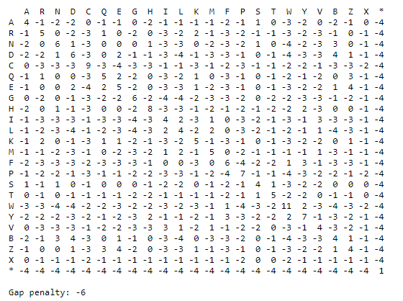
Inputs: Multiple Sequence Alignment (MSA)
Notes:
* is where a DNA sequence has been translated, and there’s a stop codon

Slide 7
HW7: Multiple sequence alignment
B
C
A
A = M C D R ...
B = M S D E ...
C = M V D R ...

Slide 8
HW7: Multiple sequence alignment
B
C
A
0 1 2 3 4
A = •M•C•D•R•...
B = •M•S•D•E•...
C = •M•V•D•R•...

Slide 9
HW7: Multiple sequence alignment
B
C
A
(1,2,1)
(2,2,1)
0 1 2 3 4
A = •M•C•D•R•...
B = •M•S•D•E•...
C = •M•V•D•R•...
(1,1,1)
(2,1,1)
(1,2,2)
(2,2,2)
(1,1,2)
(2,1,2)

Slide 10
HW7: Multiple sequence alignment
B
C
A
(1,2,1)
(2,2,1)
. 0 1 2 3 4
A = •M•C•D•R•...
B = •M•S•D•E•...
C = •M•V•D•R•...
(1,1,1)
(2,1,1)
CSV
(1,2,2)
(2,2,2)
(1,1,2)
(2,1,2)

Slide 11
HW7: Multiple sequence alignment
B
C
A
(1,2,1)
(2,2,1)
. 0 1 2 3 4
A = •M•C•D•R•...
B = •M•S•D•E•...
C = •M•V•D•R•...
weight(CSV) = score(CS) + score(CV) + score(SV)
(1,1,1)
(2,1,1)
CSV
(1,2,2)
(2,2,2)
(1,1,2)
(2,1,2)

Slide 12
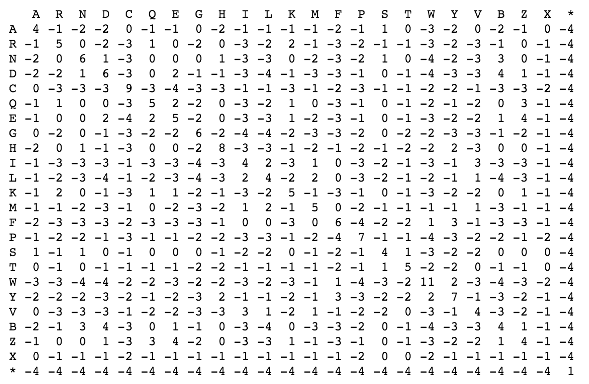
HW7: Multiple sequence alignment
B
C
A
(1,2,1)
(2,2,1)
. 0 1 2 3 4
A = •M•C•D•R•...
B = •M•S•D•E•...
C = •M•V•D•R•...
weight(CSV) = score(CS) + score(CV) + score(SV)
(1,1,1)
(2,1,1)
CSV
(1,2,2)
(2,2,2)
(1,1,2)
(2,1,2)

Slide 13
HW7: Multiple sequence alignment
B
C
A
(1,2,1)
(2,2,1)
. 0 1 2 3 4
A = •M•C•D•R•...
B = •M•S•D•E•...
C = •M•V•D•R•...
weight(CSV) = score(CS) + score(CV) + score(SV)
CS–
(1,1,1)
(2,1,1)
CSV
(1,2,2)
(2,2,2)
(1,1,2)
(2,1,2)

Slide 14
HW7: Multiple sequence alignment
B
C
A
(1,2,1)
(2,2,1)
. 0 1 2 3 4
A = •M•C•D•R•...
B = •M•S•D•E•...
C = •M•V•D•R•...
weight(CSV) = score(CS) + score(CV) + score(SV)
weight(CS-) = score(CS) + score(C–) + score(S–)
CS–
(1,1,1)
(2,1,1)
CSV
(1,2,2)
(2,2,2)
(1,1,2)
(2,1,2)

Slide 15
HW7: Multiple sequence alignment
B
C
A
(1,2,1)
(2,2,1)
. 0 1 2 3 4
A = •M•C•D•R•...
B = •M•S•D•E•...
C = •M•V•D•R•...
weight(CSV) = score(CS) + score(CV) + score(SV)
weight(CS-) = score(CS) + gap_penalty + gap_penalty
CS–
(1,1,1)
(2,1,1)
CSV
(1,2,2)
(2,2,2)
(1,1,2)
(2,1,2)

Slide 16
HW7: Multiple sequence alignment
B
C
A
(1,2,1)
(2,2,1)
. 0 1 2 3 4
A = •M•C•D•R•...
B = •M•S•D•E•...
C = •M•V•D•R•...
weight(CSV) = score(CS) + score(CV) + score(SV)
weight(CS-) = score(CS) + gap_penalty + gap_penalty
–S–
CS–
(1,1,1)
(2,1,1)
C––
CSV
––V
–SV
(1,2,2)
(2,2,2)
C–V
(1,1,2)
(2,1,2)

Slide 17
https://blast.ncbi.nlm.nih.gov/Blast.cgi
Notes:
Basic Local Alignment Search Tool (BLAST)

Slide 18
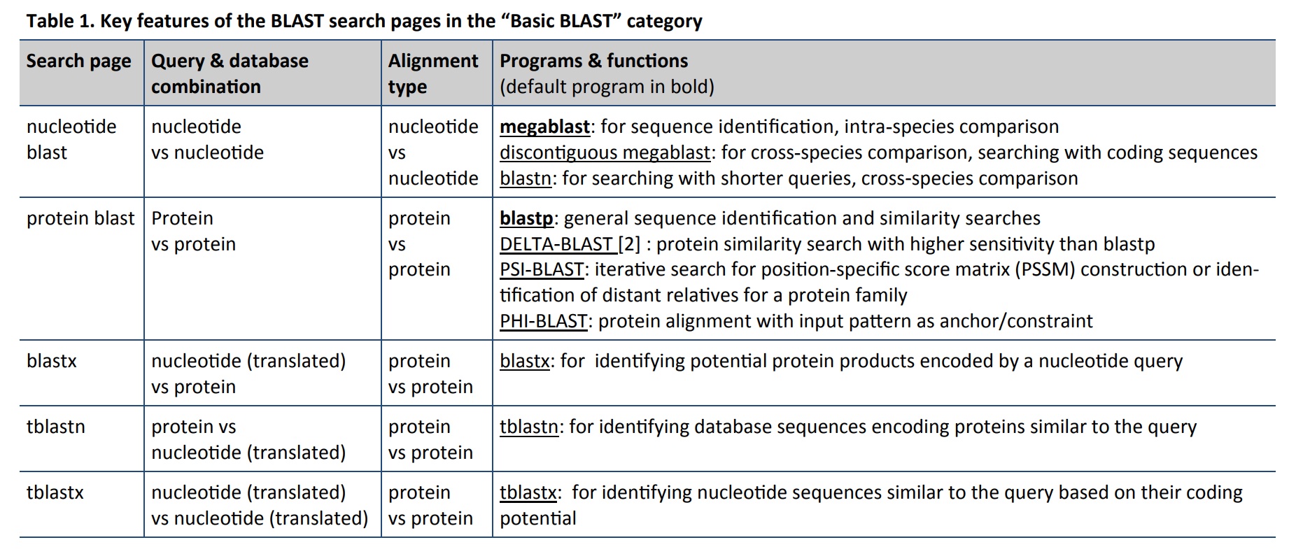

Slide 19
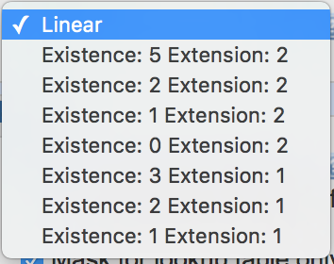
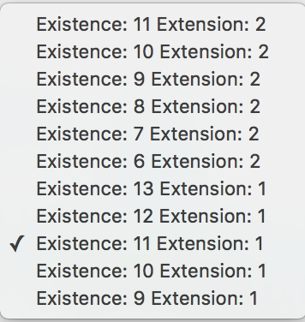
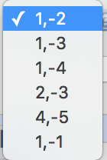
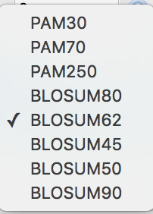

Slide 20
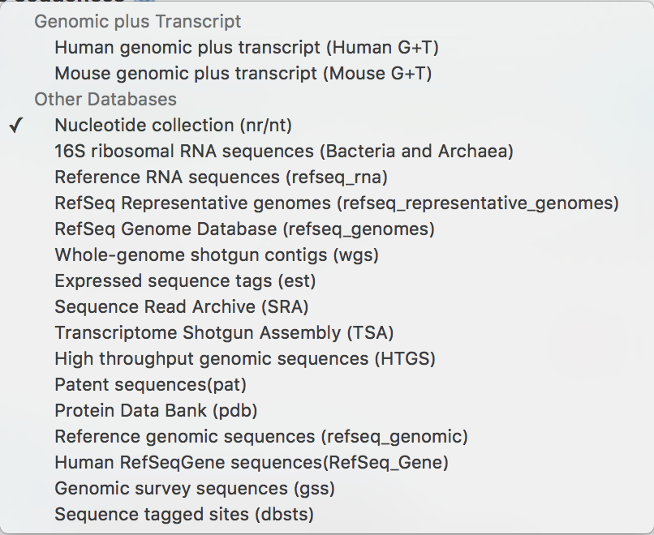
What can I search against?
Nucleotide databases

Slide 21
What can I search against?
Nucleotide databases

Slide 22
What can I search against?
Nucleotide databases

Slide 23
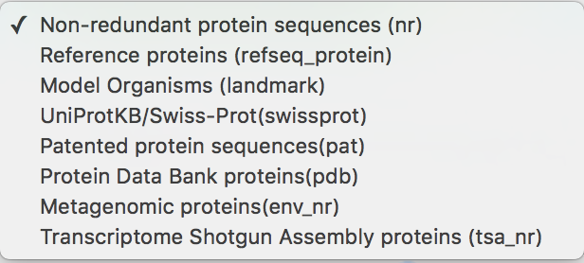
What can I search against?
Protein databases

Slide 24
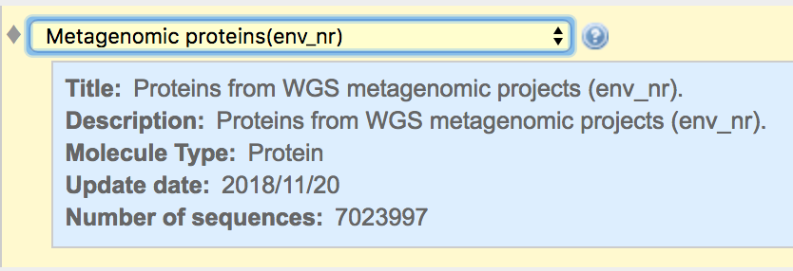
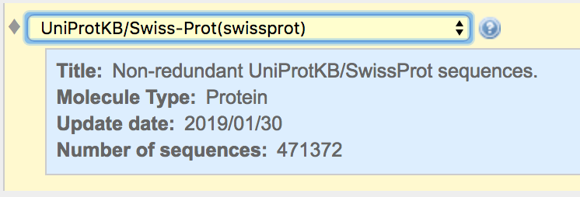
What can I search against?
Protein databases

Slide 25
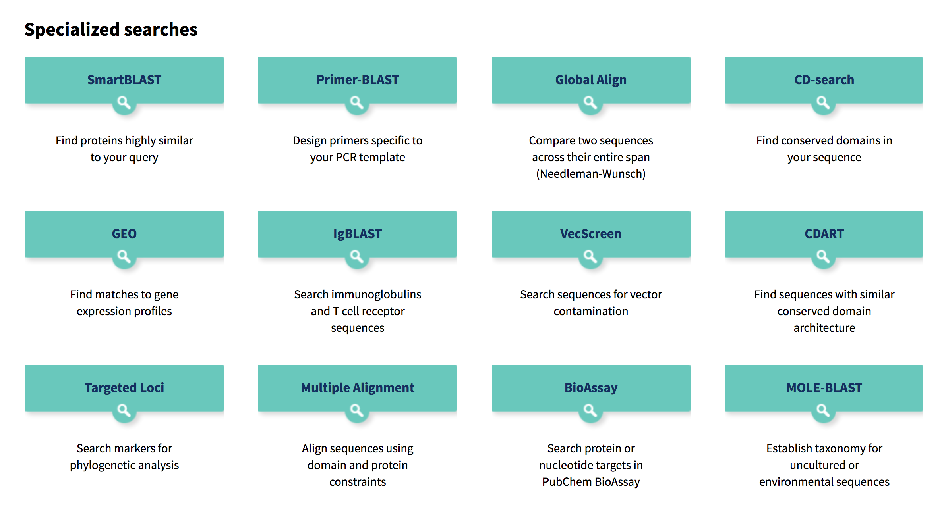
What can I search against?

Slide 26
Using BLAST: Input
Seq Length: 755

Slide 27
Using BLAST: Output

Slide 28
Using BLAST: Output

Slide 29
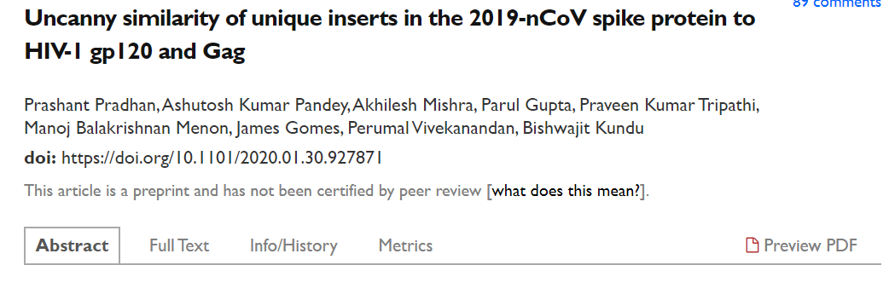
Withdrawn
We found 4 insertions in the spike glycoprotein (S) which are unique to the 2019-nCoV and are not present in other coronaviruses. Importantly, amino acid residues in all the 4 inserts have identity or similarity to those in the HIV-1 gp120 or HIV-1 Gag.
Notes:
Throwback – Feb. 6, 2020 Discussion Section
The sequence differences are not unique to COVID-19. Closely related [bat] coronaviruses have these chunks as well. They are small motifs used by nature over and over again. – Bedford
https://www.bioworld.com/articles/433087-article-headline

Slide 30
https://twitter.com/trvrb/status/1223337991168380928
https://nextstrain.org/

Slide 31
Templates in C++
#include<iostream>
using namespace std;
//write template
template <typename T>
T myMax(T x, T y)
{
return(x > y)? x: y;
}
int main()
{
cout << myMax<int>(3,7) << endl;
cout << myMax<double>(5.0, 3.0) << endl;
cout << myMax<char>('g','e') << endl;
return 0;
}
pass data type as a parameter so we don’t need to write the same code for different data types
Uses keywords ‘template’ and ‘typename’
‘typename’ could be replaced by ‘class’
Expanded at compiler time like macros, but does type checking before template expansion
Notes:
https://www.geeksforgeeks.org/templates-cpp/

