Slide 1
Discussion Section Week 8
Dani Faivre
Feb 25, 2021

Slide 2
Agenda
HW7 questions?
HMMs: general concept
General intuition for how it works
Understanding it in a genomic context
Baum-Welch (forward-backward) algorithm
HW8

Slide 3
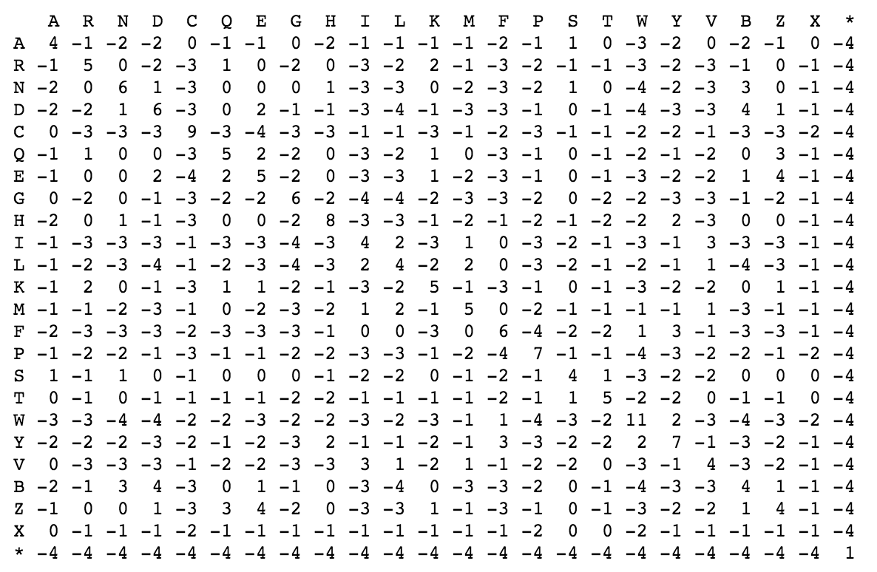
HW7: Multiple sequence alignment
B
C
A
(1,2,1)
(2,2,1)
. 0 1 2 3 4
A = •M•C•D•R•...
B = •M•S•D•E•...
C = •M•V•D•R•...
weight(CSV) = score(CS) + score(CV) + score(SV)
weight(CS-) = score(CS) + gap_penalty + gap_penalty
–S–
CS–
(1,1,1)
(2,1,1)
C––
CSV
––V
–SV
(1,2,2)
(2,2,2)
C–V
(1,1,2)
(2,1,2)

Slide 4
B
0,3,0
1,3,0
2,3,0
3,3,0
C
A
0,2,0
1,2,0
2,2,0
3,2,0
0,1,0
3,3,1
1,1,0
2,1,0
3,1,0
3,2,1
0,0,0
1,0,0
2,0,0
3,0,0
3,3,2
3,1,1
3,2,2
0,0,1
1,0,1
2,0,1
3,0,1
3,3,3
3,1,2
0 1 2 3 4
A = •M•C•D•
B = •M•S•D•
C = •M•V•D•R•
3,2,3
0,0,2
1,0,2
2,0,2
3,0,2
3,3,4
3,1,3
3,2,4
0,0,3
1,0,3
2,0,3
3,0,3
3,1,4
0,0,4
1,0,4
2,0,4
3,0,4

Slide 5
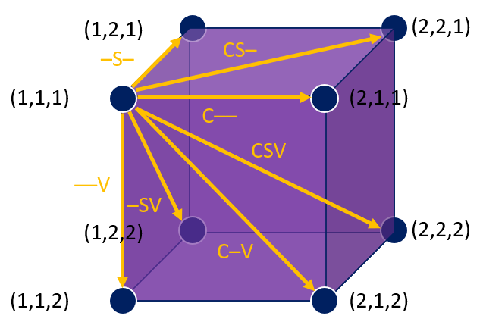
B
0,3,0
1,3,0
2,3,0
3,3,0
C
A
0,2,0
1,2,0
2,2,0
3,2,0
0,1,0
3,3,1
1,1,0
2,1,0
3,1,0
3,2,1
0,0,0
1,0,0
2,0,0
3,0,0
3,3,2
3,1,1
3,2,2
0,0,1
1,0,1
2,0,1
3,0,1
3,3,3
3,1,2
0 1 2 3 4
A = •M•C•D•
B = •M•S•D•
C = •M•V•D•R•
3,2,3
0,0,2
1,0,2
2,0,2
3,0,2
3,3,4
3,1,3
3,2,4
0,0,3
1,0,3
2,0,3
3,0,3
3,1,4
0,0,4
1,0,4
2,0,4
3,0,4

Slide 6
B
0,3,0
1,3,0
2,3,0
3,3,0
C
A
0,2,0
1,2,0
2,2,0
3,2,0
0,1,0
3,3,1
1,1,0
2,1,0
3,1,0
3,2,1
3,3,2
0,1,1
1,1,1
2,1,1
3,1,1
3,2,2
3,3,3
0,1,2
1,1,2
2,1,2
3,1,2
0 1 2 3 4
A = •M•C•D•
B = •M•S•D•
C = •M•V•D•R•
3,2,3
3,3,4
0,1,3
1,1,3
2,1,3
3,1,3
3,2,4
0,1,4
1,1,4
2,1,4
3,1,4

Slide 7
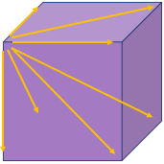
B
0,3,0
1,3,0
2,3,0
3,3,0
C
A
0,2,0
1,2,0
2,2,0
3,2,0
0,1,0
3,3,1
1,1,0
2,1,0
3,1,0
3,2,1
3,3,2
0,1,1
1,1,1
2,1,1
3,1,1
3,2,2
3,3,3
0,1,2
1,1,2
2,1,2
3,1,2
0 1 2 3 4
A = •M•C•D•
B = •M•S•D•
C = •M•V•D•R•
3,2,3
3,3,4
0,1,3
1,1,3
2,1,3
3,1,3
3,2,4
0,1,4
1,1,4
2,1,4
3,1,4

Slide 8
B
0,3,0
1,3,0
2,3,0
3,3,0
C
A
0,2,0
1,2,0
2,2,0
3,2,0
0,1,0
3,3,1
1,1,0
2,1,0
3,1,0
3,2,1
3,3,2
0,1,1
1,1,1
2,1,1
3,1,1
3,2,2
3,3,3
0,1,2
1,1,2
2,1,2
3,1,2
0 1 2 3 4
A = •M•C•D•
B = •M•S•D•
C = •M•V•D•R•
3,2,3
3,3,4
0,1,3
1,1,3
2,1,3
3,1,3
3,2,4
0,1,4
1,1,4
2,1,4
3,1,4
# E ?

Slide 9
B
0,3,0
1,3,0
2,3,0
3,3,0
C
A
0,2,0
1,2,0
2,2,0
3,2,0
0,1,0
3,3,1
1,1,0
2,1,0
3,1,0
3,2,1
3,3,2
0,1,1
1,1,1
2,1,1
3,1,1
3,2,2
3,3,3
0,1,2
1,1,2
2,1,2
3,1,2
0 1 2 3 4
A = •M•C•D•
B = •M•S•D•
C = •M•V•D•R•
3,2,3
3,3,4
0,1,3
1,1,3
2,1,3
3,1,3
3,2,4
0,1,4
1,1,4
2,1,4
3,1,4
# E ?

Slide 10
B
0,3,0
1,3,0
2,3,0
3,3,0
C
A
-S-
0,2,0
1,2,0
2,2,0
3,2,0
M--
3,3,1
0,1,0
1,1,0
2,1,0
3,1,0
--M
3,2,1
M--
3,3,2
0,1,1
1,1,1
2,1,1
3,1,1
3,2,2
M--
3,3,3
0,1,2
1,1,2
2,1,2
3,1,2
0 1 2 3 4
A = •M•C•D•
B = •M•S•D•
C = •M•V•D•R•
3,2,3
M--
3,3,4
0,1,3
1,1,3
2,1,3
3,1,3
3,2,4
M--
0,1,4
1,1,4
2,1,4
3,1,4

Slide 11
HMMs: General Concept
Initial States:
Hidden States:
Can we predict what the weather was based on observing a person’s behavior?
Observations:

Slide 12
HMMs: General Concept
Day 1: Walk
Day 2: Walk
Day 3: Walk
Day 4: Walk
Day 5: Walk
Day 6: Walk
Day 7: Walk
Day 8: Walk
Observation List:

Slide 13
HMMs: General Concept
Day 1: Walk
Day 2: Walk
Day 3: Walk
Day 4: Walk
Day 5: Walk
Day 6: Walk
Day 7: Walk
Day 8: Walk
Observation List:
Sunny
start
Rainy

Slide 14
HMMs: General Concept
Day 1: Walk
Day 2: Walk
Day 3: Walk
Day 4: Walk
Day 5: Walk
Day 6: Walk
Day 7: Walk
Day 8: Walk
Observation List:
Sunny
All possible paths
start
Rainy

Slide 15
HMMs: General Concept
Day 1: Walk
Day 2: Walk
Day 3: Walk
Day 4: Walk
Day 5: Walk
Day 6: Walk
Day 7: Walk
Day 8: Walk
Observation List:
Highest Weight Path
(i.e. most probable path)
Sunny
start
Rainy

Slide 16
HMMs: General Concept
What is the most probable path now?
Day 1: Clean
Day 2: Clean
Day 3: Clean
Day 4: Clean
Day 5: Clean
Day 6: Clean
Day 7: Clean
Day 8: Clean
Observation List:
Sunny
start
Rainy

Slide 17
HMMs: General Concept
What is the most probable path now?
Day 1: Clean
Day 2: Clean
Day 3: Clean
Day 4: Clean
Day 5: Clean
Day 6: Clean
Day 7: Clean
Day 8: Clean
Observation List:
Sunny
start
Rainy

Slide 18
HMMs: General Concept
What is the most probable path now?
Day 1: Clean
Day 2: Clean
Day 3: Clean
Day 4: Clean
Day 5: Walk
Day 6: Walk
Day 7: Walk
Day 8: Walk
Observation List:
Sunny
start
Rainy

Slide 19
HMMs: General Concept
What about more complicated observations?
Day 1: Shop
Day 2: Walk
Day 3: Clean
Day 4: Walk
Day 5: Shop
Day 6: Walk
Day 7: Clean
Day 8: Shop
Observation List:
Sunny
start
Rainy

Slide 20
HMMs: General Concept
What about more complicated observations?
We now need an algorithm to crunch the probability of all possible paths.
Day 1: Shop
Day 2: Walk
Day 3: Clean
Day 4: Walk
Day 5: Shop
Day 6: Walk
Day 7: Clean
Day 8: Shop
Observation List:
Sunny
start
Rainy

Slide 21
Applying this Concept To Genomics/HW
start
0.996
0.004
A+T Rich
0.001
G+C Rich
0.999
0.99
0.01
A
C
G
T
A = 0.291
C = 0.209
G = 0.209
T = 0.291
A = 0.169
C = 0.331
G = 0.331
T = 0.169

Slide 22
Baum-Welch Algorithm
Baum–Welch is an expectation-maximization algorithm that uses the forward–backward algorithm.
1. Use the forward algorithm to calculate the forward probabilities for the HMM.
2. Use the backward algorithm to calculate the backward probabilities for the HMM.
3. Re-estimate transition, emission, and initial probabilities by calculating the expected number of each edge type
4. Calculate the new log likelihood of the model (the likelihood of our observations given our re-tuned model)
5. Repeat until the change in log likelihood is smaller than a given threshold or when a maximum number of iterations is passed.

Slide 23
Forward-backward algorithm
A
G
C

Slide 24
Forward-backward algorithm
A
G
C
For each node:
Forward: store the sum of probabilities of paths ending at position i state k
Backward: store the sum of probabilities of paths starting at position i state k

Slide 25
Forward-backward algorithm
A
G
C
For each node:
Forward: store the sum of probabilities of paths ending at position i state k
Backward: store the sum of probabilities of paths starting at position i state k

Slide 26
Mathematical Terminology
Some terminology for the following slides:
α_{k}(i): The forward probability of being in state k at position i
β_{k}(i): The backward probability of being in state k at position i
e_{k}(S_{i}): The emission probability of the character at position i in state k
a_{kl}: The transition probability from state k to state l
$π$_{k}: The initiation probability to state k
N = Number of states/number of incoming edges to a node

Slide 27
Forward Algorithm
α_{k}(1) = $π$_{k *} e_{k}(S_{i})
α_{k}(i+1) = e_{k}(S_{i+1}) * $\sum_{j=1}^{N}{\text{α}\text{j}\left(i\right) a_{jk}}$
Build a dynamic programming table for these calculations
(or store these calculations in node/vertex objects; or in a list)
A
G
C
 | A | G | C
State 1 | $$Eq. 1$$ | $$Eq. 2$$ | $$Eq. 2$$
State 2 | $$Eq. 1$$ | $$Eq. 2$$ | $$Eq. 2$$
Notes:
Look up how to do the addition in this statement. Will it create an underflow issue.

Slide 28
Backward Algorithm
Build a dynamic programming table for these calculations
(or store these calculations in node/vertex objects; or in a list)
A
G
C
 | A | G | C
State 1 | $$Eq. 2$$ | $$Eq. 2$$ | $$Eq. 1$$
State 2 | $$Eq. 2$$ | $$Eq. 2$$ | $$Eq. 1$$

Slide 29
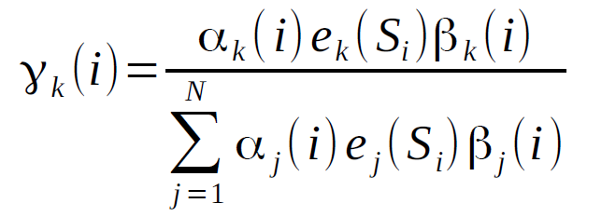
An alternative way to think about updating
A
G
C
Consider the probabilities at each node:
Figure out the probability of being in state k at position i

Slide 30
An alternative way to think about updating
A
G
C
Consider the probabilities at each edge:
Figure out the probability of going from state k to state l from position i to position i+1
Note: The emission probability e_{k}(S_{i}) has been factored out of the forward probability below. If you already calculated it in to the forward probability, you don’t have to do it twice.

Slide 31
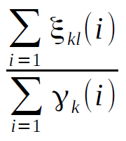
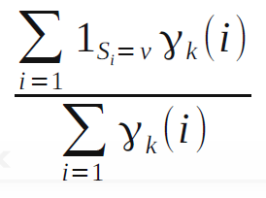
An alternative way to think about updating
The initial probabilities for each state k can be updated to
The transition probability from state k to state l can be updated to
The emission probability for symbol v from state k can be updated to
Remember to ignore the last position

Slide 32
Notes for debugging
Try calculating some simple forward and backward probabilities by hand to check your algorithm
Make sure the sum of the numerators for a single state or transition from a given state equals the associated denominator
The likelihood at each iteration should increase; if it decreases, then you have a bug
Have a print statement in your program to keep track of iterations as your program is running. The assignment will provide an estimate on the number of iterations to converge.

Slide 33
Underflow
This happens when numbers are too small to be stored in a variable
Solutions:
Scale weights to be close to 1 (affects all paths by same constant factor – which can be multiplied back later)
Use log weights, so can add instead of multiplying
Ex: Instead of 0.0001 * 0.0002, you can do:
log(0.0001) + log(0.0002)
What about when you need to sum probabilities in logspace? See this blogpost for a solution or Tobias Mann
https://gasstationwithoutpumps.wordpress.com/2014/05/06/sum-of-probabilities-in-log-prob-space/

Slide 34
HW8: detecting G+C-rich regions (Baum-Welch)
Due 11:59pm Sunday, March 7
Assignment: use Baum-Welch algorithm to identify G+C-rich regions in a genome sequence
Input: FASTA
Run Baum-Welch until the increase in sequence log-likelihood is less than 0.1
Output:
Name and first line of the FASTA file
Number of iterations until convergence
Final sequence log-likelihood
Final probabilities (initial, transition, emission)
Scientific notation, four significant digits (see template)

Slide 35
HW8 tips
Calculate first few steps by hand and make sure your program matches (exactly!)
Create other small test cases
Avoid underflow
Take the logarithm
Then add instead of multiply
See Mann and Rabiner (pg 273) for more details [links on website]
Need to deal with log(0)

